Slide 1
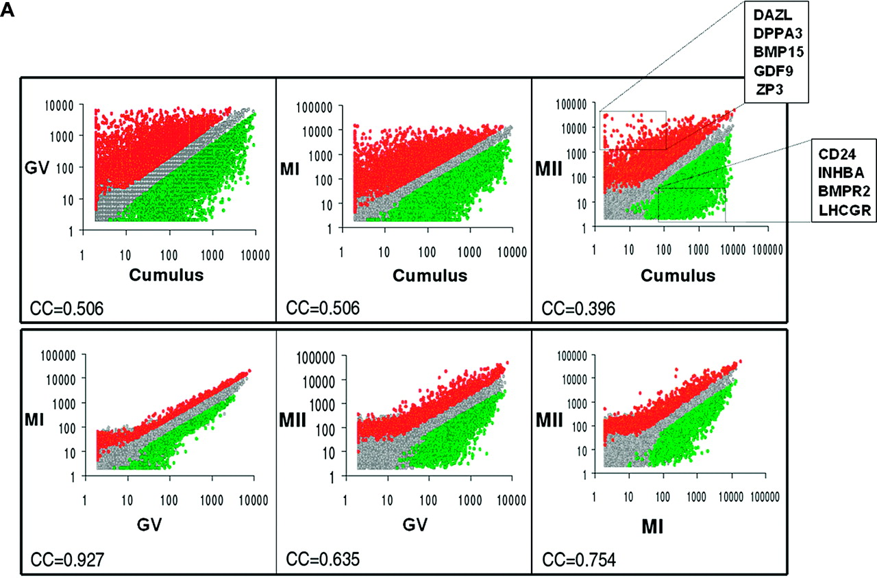
Figure 1. Global gene-expression variation. (A) Scatter plots. Each sample was plotted against all other samples to ...
Notes:
Figure 1. Global gene-expression variation. (A) Scatter plots. Each sample was plotted against all other samples to visualize the expression variation. Only the 26 662 probes with at least one sample with a ‘present’ detection call were included. All signal values were floored to 2. Red circles, probes overexpressed in the sample specified on the left side; green circles, probes overexpressed in the sample specified at the bottom of each plot; grey circles, probes whose expression does not vary significantly between the two samples. For each couple of sample, the Pearson’s correlation coefficient was computed (r), based on the signal of probes with at least one sample with a ‘present’ detection call. GV, germinal vesicle; MI, metaphase I; MII, metaphase II. (B) Hierarchical clustering. The expression signatures of oocytes and cumulus cells were visualized by hierarchical clustering on the 15 000 probesets with the highest variation coefficient. The colours indicate the relative expression levels of each gene, with red indicating an expression above median, green indicating expression under median and black representing median expression. Cluster (a) was a group of genes overexpressed in oocyte (GV–MI–MII), including genes such as DAZL, GDF9, BMP15, ZP1,2,3,4. Cluster (b) was group of genes overexpressed in cumulus cells, including genes such as CD24, Activin A, PAPPA, TNTSF11, LHCGR and INHA.
Unless provided in the caption above, the following copyright applies to the content of this slide: © The Author 2006. Published by Oxford University Press on behalf of the European Society of Human Reproduction and Embryology. All rights reserved. For Permissions, please email: journals.permissions@oxfordjournals.org The online version of this article has been published under an open access model. Users are entitled to use, reproduce, disseminate, or display the open access version of this article for non-commercial purposes provided that: the original authorship is properly and fully attributed; the Journal and Oxford University Press are attributed as the original place of publication with the correct citation details given; if an article is subsequently reproduced or disseminated not in its entirety but only in part or as a derivative work this must be clearly indicated. For commercial re-use, please contact journals.permissions@oxfordjournals.org

Slide 2
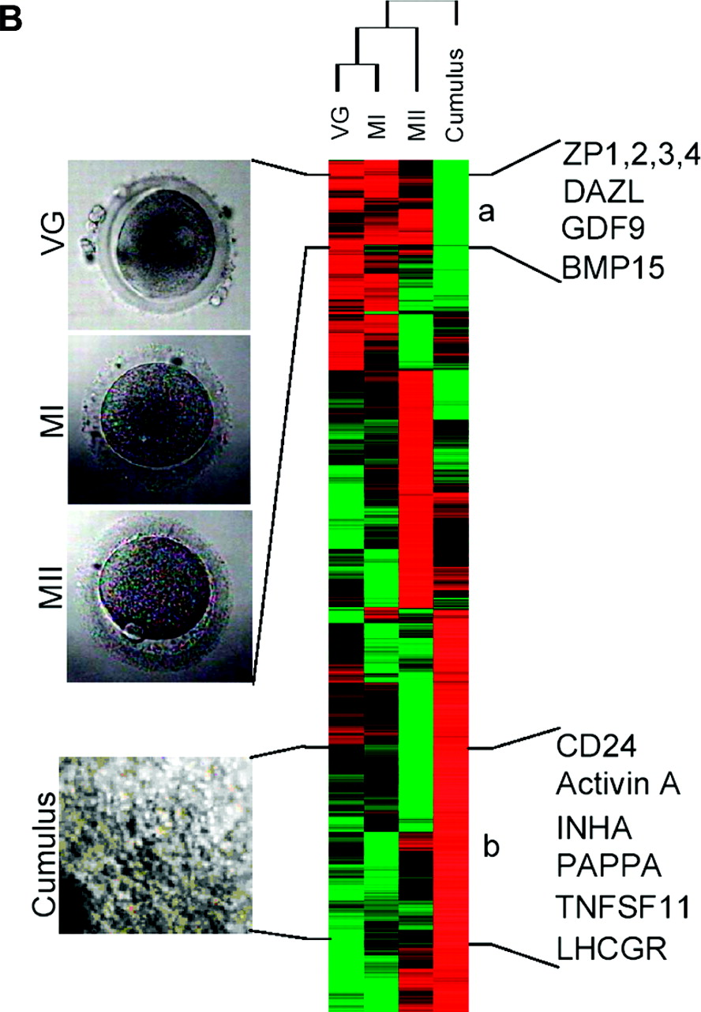
Figure 1. Global gene-expression variation. (A) Scatter plots. Each sample was plotted against all other samples to ...
Notes:
Figure 1. Global gene-expression variation. (A) Scatter plots. Each sample was plotted against all other samples to visualize the expression variation. Only the 26 662 probes with at least one sample with a ‘present’ detection call were included. All signal values were floored to 2. Red circles, probes overexpressed in the sample specified on the left side; green circles, probes overexpressed in the sample specified at the bottom of each plot; grey circles, probes whose expression does not vary significantly between the two samples. For each couple of sample, the Pearson’s correlation coefficient was computed (r), based on the signal of probes with at least one sample with a ‘present’ detection call. GV, germinal vesicle; MI, metaphase I; MII, metaphase II. (B) Hierarchical clustering. The expression signatures of oocytes and cumulus cells were visualized by hierarchical clustering on the 15 000 probesets with the highest variation coefficient. The colours indicate the relative expression levels of each gene, with red indicating an expression above median, green indicating expression under median and black representing median expression. Cluster (a) was a group of genes overexpressed in oocyte (GV–MI–MII), including genes such as DAZL, GDF9, BMP15, ZP1,2,3,4. Cluster (b) was group of genes overexpressed in cumulus cells, including genes such as CD24, Activin A, PAPPA, TNTSF11, LHCGR and INHA.
Unless provided in the caption above, the following copyright applies to the content of this slide: © The Author 2006. Published by Oxford University Press on behalf of the European Society of Human Reproduction and Embryology. All rights reserved. For Permissions, please email: journals.permissions@oxfordjournals.org The online version of this article has been published under an open access model. Users are entitled to use, reproduce, disseminate, or display the open access version of this article for non-commercial purposes provided that: the original authorship is properly and fully attributed; the Journal and Oxford University Press are attributed as the original place of publication with the correct citation details given; if an article is subsequently reproduced or disseminated not in its entirety but only in part or as a derivative work this must be clearly indicated. For commercial re-use, please contact journals.permissions@oxfordjournals.org

Slide 3
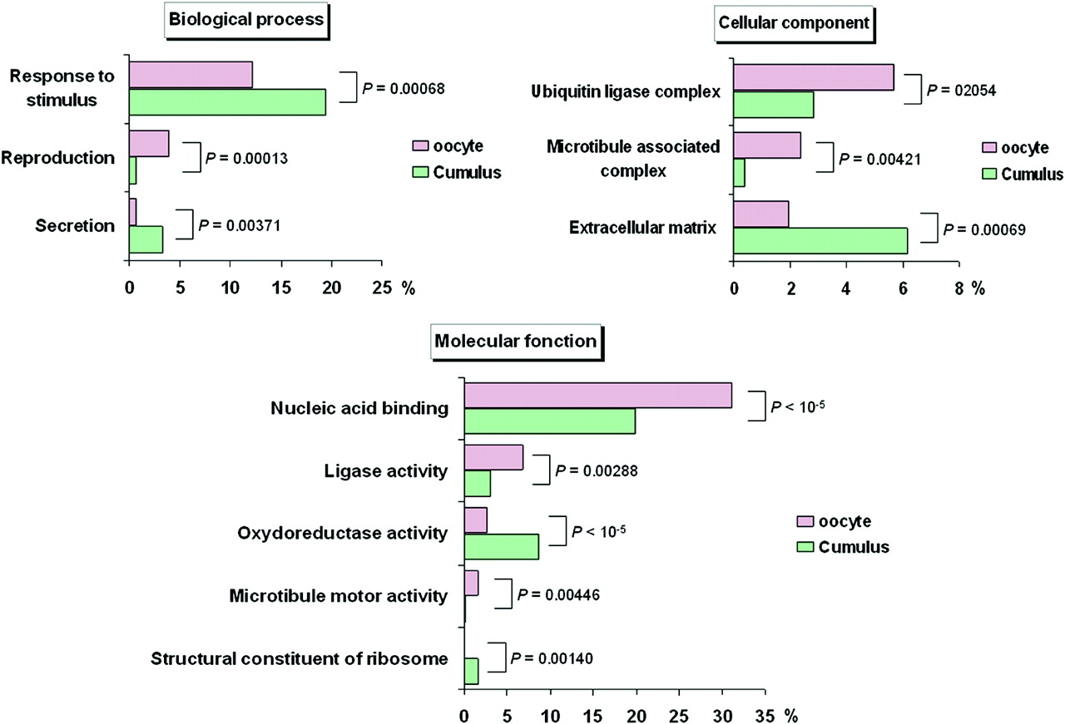
Figure 2. Differential gene ontology (GO) annotations between oocytes and cumulus cells. We compared the frequency of ...
Notes:
Figure 2. Differential gene ontology (GO) annotations between oocytes and cumulus cells. We compared the frequency of level-three GO annotations of genes overexpressed in oocytes to those of genes overexpressed in cumulus cells. The statistical analysis was made using the Fatigo website (http://www.fatigo.org/) using Unigene cluster ID. Histograms show the percentage of genes with the specified GO annotation in the group of genes overexpressed in oocytes (purple) or in cumulus (green).
Unless provided in the caption above, the following copyright applies to the content of this slide: © The Author 2006. Published by Oxford University Press on behalf of the European Society of Human Reproduction and Embryology. All rights reserved. For Permissions, please email: journals.permissions@oxfordjournals.org The online version of this article has been published under an open access model. Users are entitled to use, reproduce, disseminate, or display the open access version of this article for non-commercial purposes provided that: the original authorship is properly and fully attributed; the Journal and Oxford University Press are attributed as the original place of publication with the correct citation details given; if an article is subsequently reproduced or disseminated not in its entirety but only in part or as a derivative work this must be clearly indicated. For commercial re-use, please contact journals.permissions@oxfordjournals.org

Slide 4
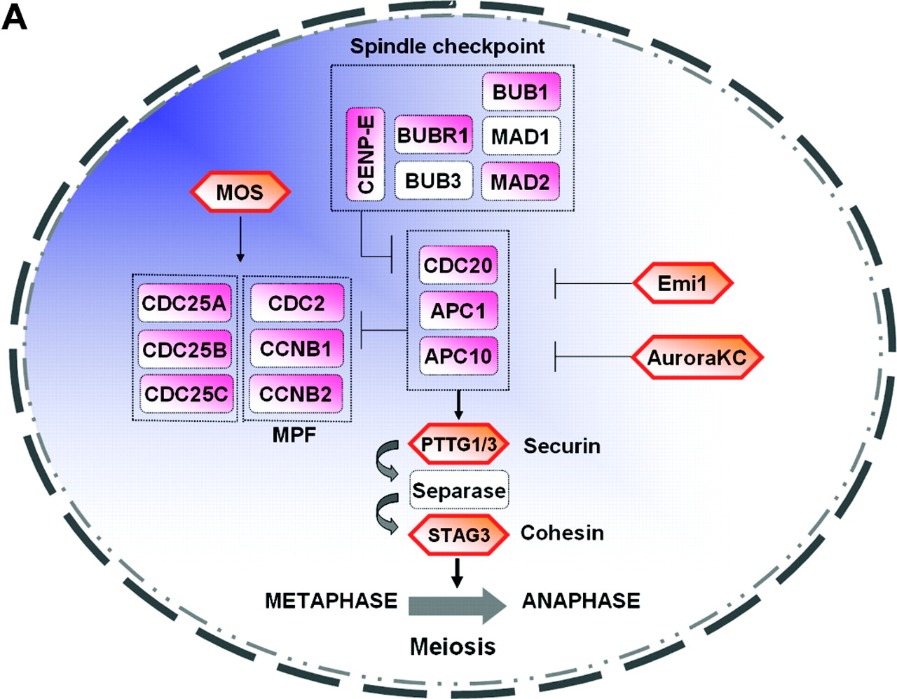
Figure 3. Schematic representation of selected genes involved in meiosis and cumulus–oocyte complex (A) Meiosis. Actors ...
Notes:
Figure 3. Schematic representation of selected genes involved in meiosis and cumulus–oocyte complex (A) Meiosis. Actors of meiosis in oocytes: components of the maturation-promoting factor (MPF), components of the spindle checkpoint, components of the anaphase-promoting complex (APC/C), the downstream targets such as the securin PTTG3 and regulators. Genes in pink are up-regulated in oocytes. Genes that are specific to meiosis are highlighted by an orange hexagon. Genes in white did not display a significant modification in gene expression between oocytes and somatic cells (cumulus cells). See Table I for full name and references. (B) Cumulus–oocyte complex. Genes overexpressed in oocytes (pink) or overexpressed in cumulus (green) that are involved in the cumulus–oocyte complex interactions. Oocyte genes included members of the TGF-β superfamily such as growth differentiation factor 9 (GDF9), fibroblast growth factor 9 and 15 (FGF9, 15), bone morphogenetic protein 6 and 15 (BMP6, 15). Conversely, in cumulus cells, the genes overexpressed included hormonal receptors such as luteinizing hormone/choriogonadotrophin receptor (LHCGR), progesterone receptor membrane component 1 and 2 (PGRMC1, 2), interleukin IL1beta, chemokines (IL8) and CD24 antigen, inhibin alpha (INHA), activin A (INHBA). Genes in red are up-regulated in the oocytes compared with cumulus cells. Genes in green are up-regulated in the cumulus cells compared with oocytes. Genes shown in blue are expressed in oocytes and cumulus cells such as gap junction protein alpha (GJA1). See Table II for complete list of full names and references.
Unless provided in the caption above, the following copyright applies to the content of this slide: © The Author 2006. Published by Oxford University Press on behalf of the European Society of Human Reproduction and Embryology. All rights reserved. For Permissions, please email: journals.permissions@oxfordjournals.org The online version of this article has been published under an open access model. Users are entitled to use, reproduce, disseminate, or display the open access version of this article for non-commercial purposes provided that: the original authorship is properly and fully attributed; the Journal and Oxford University Press are attributed as the original place of publication with the correct citation details given; if an article is subsequently reproduced or disseminated not in its entirety but only in part or as a derivative work this must be clearly indicated. For commercial re-use, please contact journals.permissions@oxfordjournals.org

Slide 5
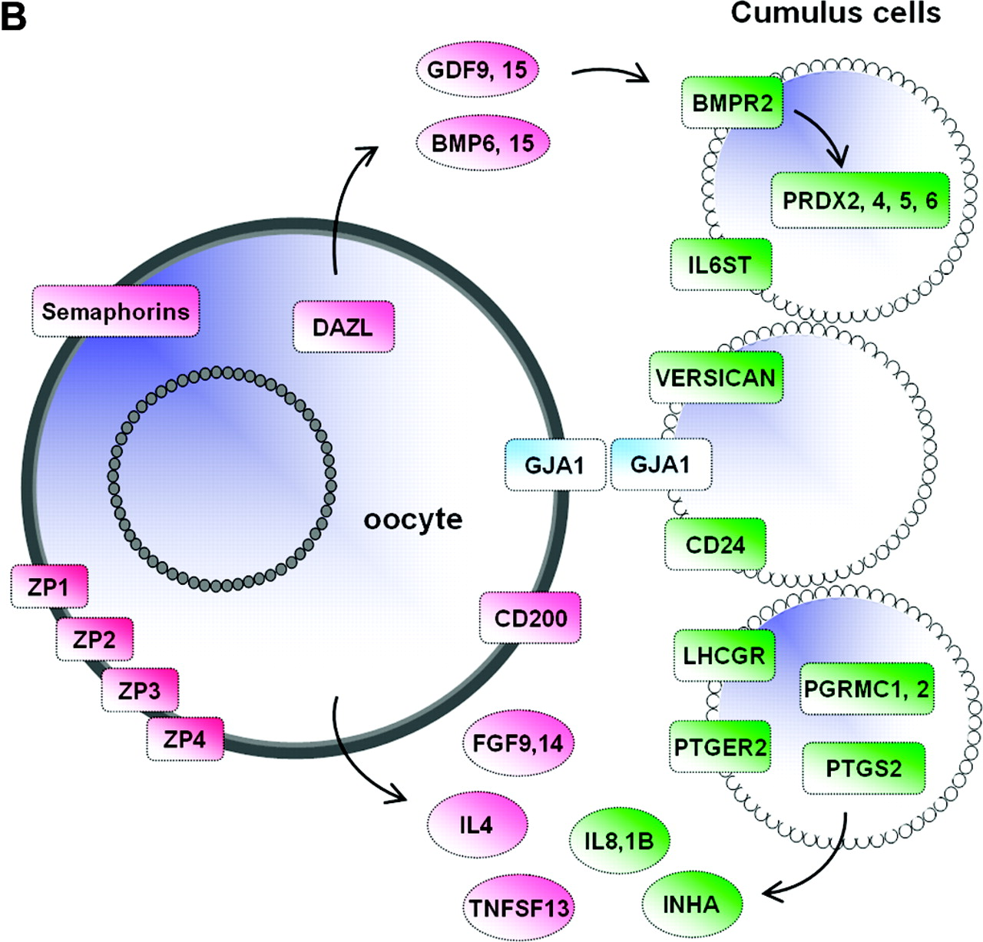
Figure 3. Schematic representation of selected genes involved in meiosis and cumulus–oocyte complex (A) Meiosis. Actors ...
Notes:
Figure 3. Schematic representation of selected genes involved in meiosis and cumulus–oocyte complex (A) Meiosis. Actors of meiosis in oocytes: components of the maturation-promoting factor (MPF), components of the spindle checkpoint, components of the anaphase-promoting complex (APC/C), the downstream targets such as the securin PTTG3 and regulators. Genes in pink are up-regulated in oocytes. Genes that are specific to meiosis are highlighted by an orange hexagon. Genes in white did not display a significant modification in gene expression between oocytes and somatic cells (cumulus cells). See Table I for full name and references. (B) Cumulus–oocyte complex. Genes overexpressed in oocytes (pink) or overexpressed in cumulus (green) that are involved in the cumulus–oocyte complex interactions. Oocyte genes included members of the TGF-β superfamily such as growth differentiation factor 9 (GDF9), fibroblast growth factor 9 and 15 (FGF9, 15), bone morphogenetic protein 6 and 15 (BMP6, 15). Conversely, in cumulus cells, the genes overexpressed included hormonal receptors such as luteinizing hormone/choriogonadotrophin receptor (LHCGR), progesterone receptor membrane component 1 and 2 (PGRMC1, 2), interleukin IL1beta, chemokines (IL8) and CD24 antigen, inhibin alpha (INHA), activin A (INHBA). Genes in red are up-regulated in the oocytes compared with cumulus cells. Genes in green are up-regulated in the cumulus cells compared with oocytes. Genes shown in blue are expressed in oocytes and cumulus cells such as gap junction protein alpha (GJA1). See Table II for complete list of full names and references.
Unless provided in the caption above, the following copyright applies to the content of this slide: © The Author 2006. Published by Oxford University Press on behalf of the European Society of Human Reproduction and Embryology. All rights reserved. For Permissions, please email: journals.permissions@oxfordjournals.org The online version of this article has been published under an open access model. Users are entitled to use, reproduce, disseminate, or display the open access version of this article for non-commercial purposes provided that: the original authorship is properly and fully attributed; the Journal and Oxford University Press are attributed as the original place of publication with the correct citation details given; if an article is subsequently reproduced or disseminated not in its entirety but only in part or as a derivative work this must be clearly indicated. For commercial re-use, please contact journals.permissions@oxfordjournals.org

Slide 6
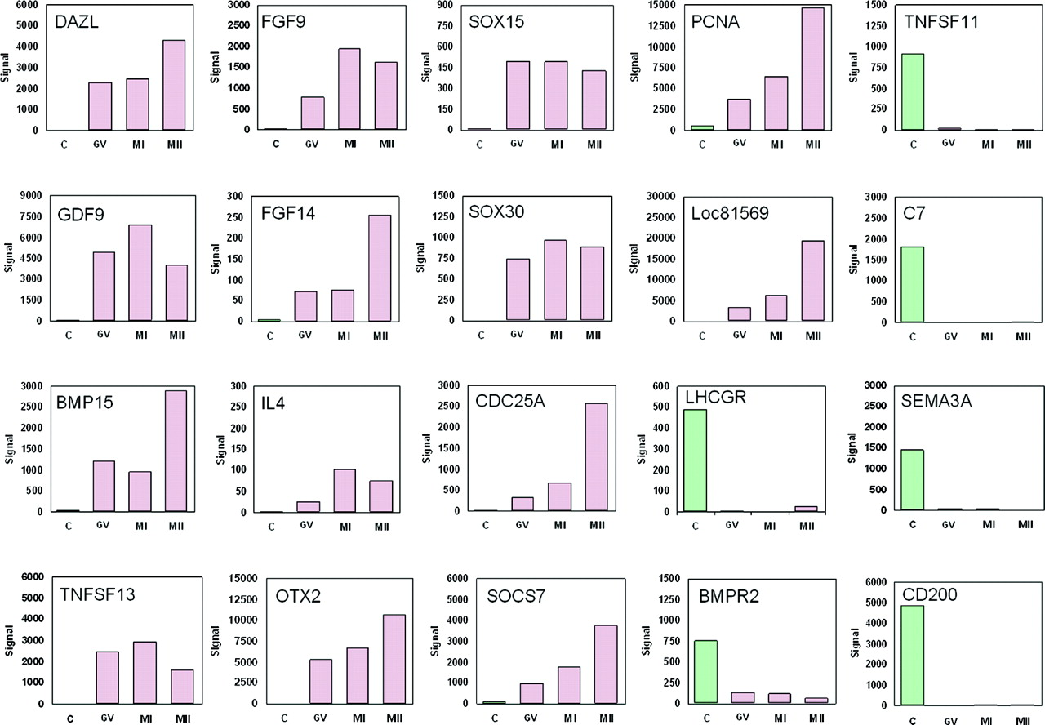
Figure 4. Expression histograms of selected genes in oocytes and cumulus cells. Histograms show signal values of 20 ...
Notes:
Figure 4. Expression histograms of selected genes in oocytes and cumulus cells. Histograms show signal values of 20 genes that are differentially expressed between oocyte (purple) and cumulus cells (green). Gene expression is measured by pan-genomic HG-U133 Plus 2.0 Affymetrix oligonucleotides microarrays, and the signal intensity for each gene is shown on the y-axis as arbitrary units determined by the GCOS 1.2 software (Affymetrix). GV, germinal vesicle; MI, metaphase I; MII, metaphase II; C, cumulus.
Unless provided in the caption above, the following copyright applies to the content of this slide: © The Author 2006. Published by Oxford University Press on behalf of the European Society of Human Reproduction and Embryology. All rights reserved. For Permissions, please email: journals.permissions@oxfordjournals.org The online version of this article has been published under an open access model. Users are entitled to use, reproduce, disseminate, or display the open access version of this article for non-commercial purposes provided that: the original authorship is properly and fully attributed; the Journal and Oxford University Press are attributed as the original place of publication with the correct citation details given; if an article is subsequently reproduced or disseminated not in its entirety but only in part or as a derivative work this must be clearly indicated. For commercial re-use, please contact journals.permissions@oxfordjournals.org

