Slide 1
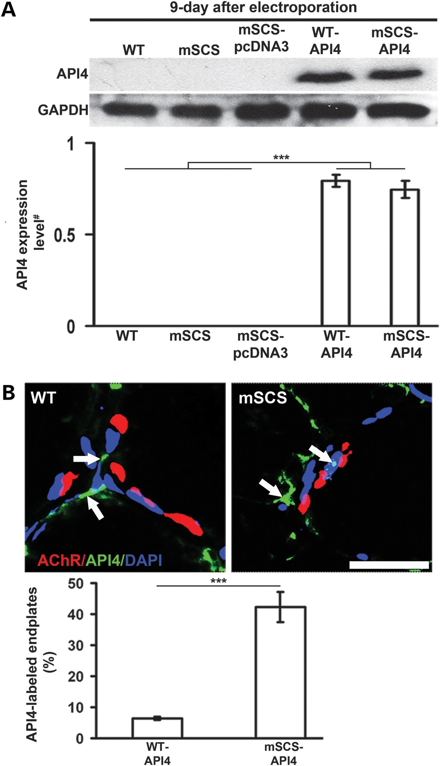
Figure 1. Expression of recombinant API4 in TA muscle by electroporation. (A) Upper: 9-days after electroporation of ...
Notes:
Figure 1. Expression of recombinant API4 in TA muscle by electroporation. (A) Upper: 9-days after electroporation of API4 plasmid in WT and mSCS TA muscle there was strong expression of API4 protein in TA western blots. No API4 protein was detected in WT, mSCS and mSCS with electroporation of pcDNA3 as control (mSCS-pcDNA3). Lower: relative protein levels of API4 (# = normalized to GAPDH) in API4-electroporated WT (WT-API4) and mSCS (mSCS-API4) TA muscle (0.79 ± 0.03 and 0.74 ± 0.05, respectively) were significantly greater than the undetectable levels in untransfected muscle. n = 3; ***P < 0.001, Student's t-test. (B) Upper: API4, immunostained with antibody to API4 (green) was not co-localized with AChRs labeled with TxR-αBT (red) but predominantly surrounded subsynaptic DAPI-labeled nuclei (blue) in API4-electroporated WT TA muscle (WT-API4). However, API4 labeling was much more prominent in subsynaptic nuclei in API4-transfected mSCS muscle (mSCS-API4) than WT muscle. Lower: 42.2 ± 4.9% of endplates labeled for API4 in mSCS-API4 mice, while compared with 6.3 ± 0.5% in WT-API4 mice. Scale bar = 15 µm; n = 7; ***P< 0.001, Student's t-test.
Unless provided in the caption above, the following copyright applies to the content of this slide: © The Author 2013. Published by Oxford University Press. All rights reserved. For Permissions, please email: journals.permissions@oup.com

Slide 2
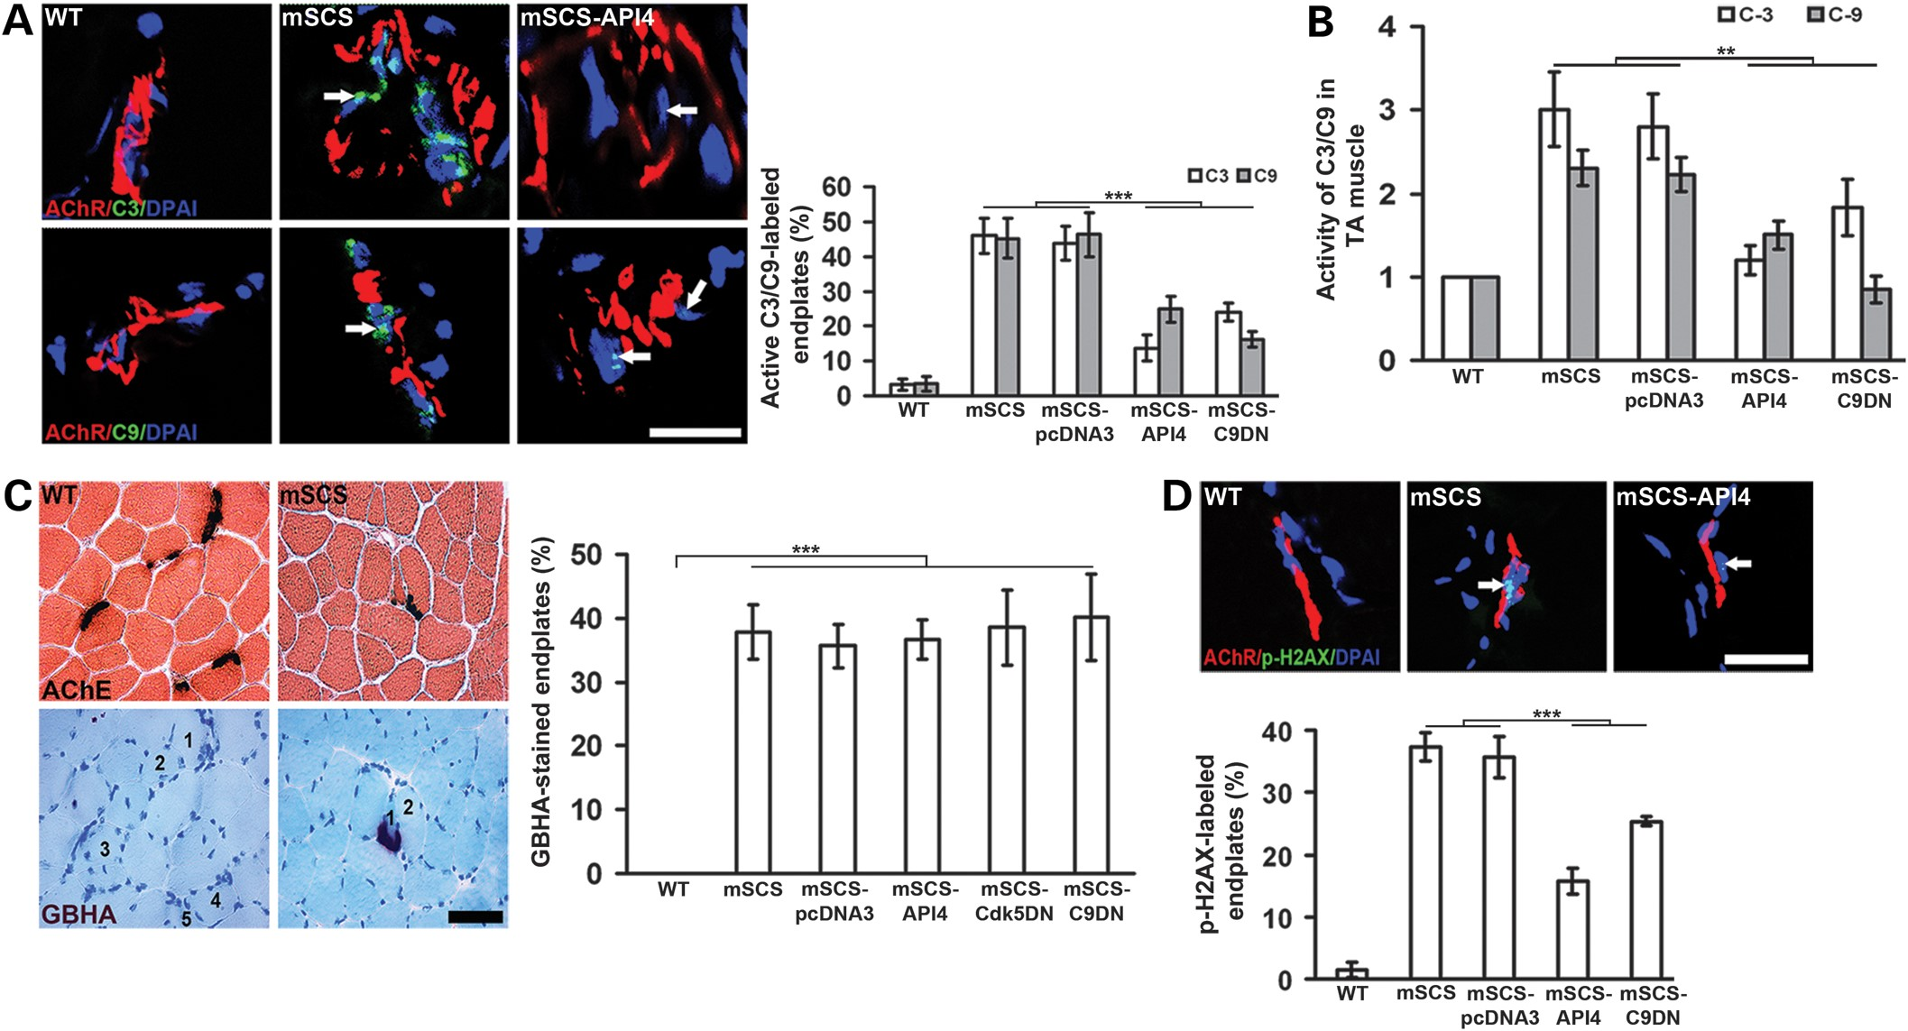
Figure 2. Inhibition of caspase-3/9 activity in TA muscle reduces DNA damage in subsynaptic nuclei in mSCS. (A) Left: ...
Notes:
Figure 2. Inhibition of caspase-3/9 activity in TA muscle reduces DNA damage in subsynaptic nuclei in mSCS. (A) Left: intense labeling of untreated NMJs (red) in mSCS muscle with antibody to C3 (green, arrows) and C9 (green, arrows) was decreased or completely eliminated in mSCS muscle expressing API4. Right: in mSCS-API4 muscle, 13.7 ± 3.8% of endplates were labeled with anti-C3 and 24.9 ± 3.8% with anti-C9, compared with 45.9 ± 5.0% for C3 and 45.2 ± 5.7% for C9 in pcDNA3-treated mSCS. In mSCS muscle transfected with C9DN (SCS-C9DN), 24.1 ± 2.6% of endplates were labeled with C3 and 16.1 ± 2.3% with C9, compared with 43.9 ± 4.9% for C3 and 46.3 ± 6.4% for C9 in mSCS-pcDNA3. Scale bar = 15 µm; n = 5; ***P < 0.001, Student's t-test. (B) Relative protease activity of caspase-3 (C3) and caspase-9 (C9) (# = normalized to WT) in WT, mSCS and treated mSCS. In mSCS-API4, C3 was 1.20 ± 0.2 of WT and C9 was 1.5 ± 0.2 of WT, compared with 3.0 ± 0.5 for C3 and 2.3 ± 0.2 for C9 in mSCS. Caspase-3 and -9 activities in mSCS-C9DN were reduced to 1.8 ± 0.3 and 0.8 ± 0.2, respectively, compared with 2.8 ± 0.4 for C3 and 2.2 ± 0.2 for C9 in mSCS-pcDNA3. n = 5; **P < 0.01, Mann–Whitney U-test. (C) Left: serial TA muscle sections labeled for cholinesterase (dark brown) to localize endplates and GBHA (red) to localize Ca2+ overloading in WT and mSCS muscle. The numbers on GBHA-labeled fibers correspond to fibers with cholinesterase-stained endplates in adjacent section. Ca2+-overloaded endplates were found in mSCS muscle but not in WT. Right: quantitation of Ca2+-overloaded endplates showed that no GBHA-stained endplates were found in WT compared with 37.8 ± 4.3% GBHA-stained endplates in mSCS muscle, 36.7 ± 3.1% in API4-expressing mSCS muscle (SCS-API4), 40.2 ± 6.7% in C9DN-expressing mSCS muscle (SCS-C9DN), 38.5 ± 5.8% in Cdk5DN SCS-Cdk5DN) and 35.7 ± 3.4% in SCS control (SCS-pcDNA3). n = 5; P > 0.95. (D) Upper: API4 prevents subsynaptic DNA damage in mSCS muscle. Phospho-γH2AX-labeled (p-H2AX, green) nuclei (DAPI, blue) were co-localized with NMJ (red) in mSCS muscle, but significantly diminished in subsynaptic nuclei in mSCS-API4. Lower: 15.8 ± 2.0% of endplates were labeled with p-H2AX in mSCS-API4 compared with 37.3 ± 2.2% in mSCS and 35.6 ± 3.3% in mSCS control (SCS-pcDNA3). 25.7 ± 0.7% of endplates in mSCS-C9DN were labeled with p-H2AX. Only 1.42 ± 1.23% of WT endplates were labeled with p-H2AX. Scale bar = 15 µm; n = 5; ***P < 0.001, Student's t-test.
Unless provided in the caption above, the following copyright applies to the content of this slide: © The Author 2013. Published by Oxford University Press. All rights reserved. For Permissions, please email: journals.permissions@oup.com

Slide 3
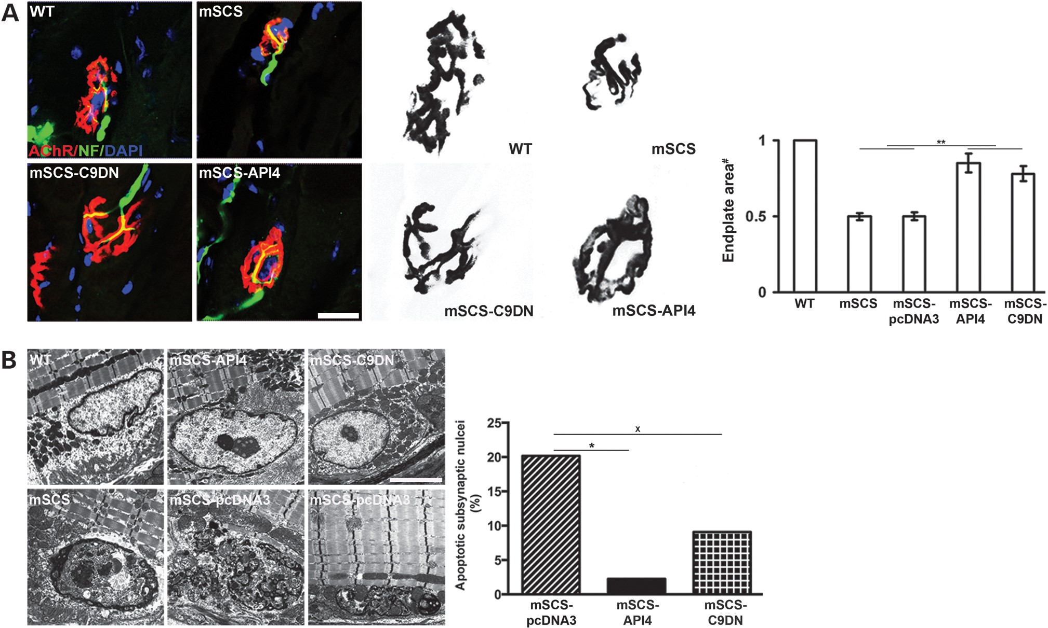
Figure. 3 Inhibition of caspase-3 and -9 activities increases AChR density and improves ultrastructural changes of NMJ ...
Notes:
Figure. 3 Inhibition of caspase-3 and -9 activities increases AChR density and improves ultrastructural changes of NMJ in mSCS. (A) Left: neuromuscular junctions of WT, mSCS and mSCS treated with API4, or C9DN immunolabeled with neurofilament-specific antibody (green) and TxR-αBT (red) in WT, mSCS and treated mSCS muscle. Scale bar = 25 µm; n = 5. Scale bar = 25 µm; n = 5. Middle: images from A showing only AChR labeling with TxR-αBT for AChR density area measurements. Right: upper: AChR density in WT, mSCS and treated mSCS (# = normalize to WT). Electroporation of AIP4 and C9DN to mSCS muscle increased AChR density to 0.78 ± 0.05 and 0.85 ± 0.06 of WT, respectively, whereas 0.49 ± 0.02 in mSCS and 0.51 ± 0.03 in mSCS control (SCS-pcDNA3; **P < 0.01, Mann–Whitney U-test). Lower: endplate area (μm2) in WT, mSCS and treated mSCS. Endplate area was 598.36 ± 74.13 in WT, 460.09 ± 48.95 in SCS-API4 and 429.11.36 ± 79.22 in mSCS-C9DN, compared with 259.55 ± 46.11 in mSCS and 263.16 ± 61.23 in mSCS control (SCS-pcDNA3). n = 5; ***P < 0.001, Student's t-test. Number of end plates = 50/sample. (B) Ultrastructure of NMJs from WT, untreated control mSCS and treated mSCS muscle. NMJs of mSCS muscles exhibited ultrastructural changes as previously described (left). Degenerative changes in postsynaptic nuclei were improved in the treated mSCS muscles. The number of degenerative nuclei with apoptosis-like changes was quantified (right). 20.18% (23 of 114) of junctional nuclei in mSCS muscles showed degenerative changes (left, bottom row). WT muscle with normal subsynaptic nucleus is shown for comparison. API4-treated mSCS muscle showed improvement in ultrastructural abnormalities with a significant decrease in the number of degenerative nuclei to 2.27% (1 of 44). A similar trend was seen in the C9DN-treated mSCS animals with 9.09% degenerative nuclei (3 of 33). This trend did not reach statistical significance. The size bars correspond to 2 µm. The P-values for the comparison between control mSCS muscles and API4-treated mSCS muscles or between control muscles and C9DN-treated mSCS muscles, respectively, were calculated by χ2 testing. *P < 0.005; xP < 0.14.
Unless provided in the caption above, the following copyright applies to the content of this slide: © The Author 2013. Published by Oxford University Press. All rights reserved. For Permissions, please email: journals.permissions@oup.com

Slide 4
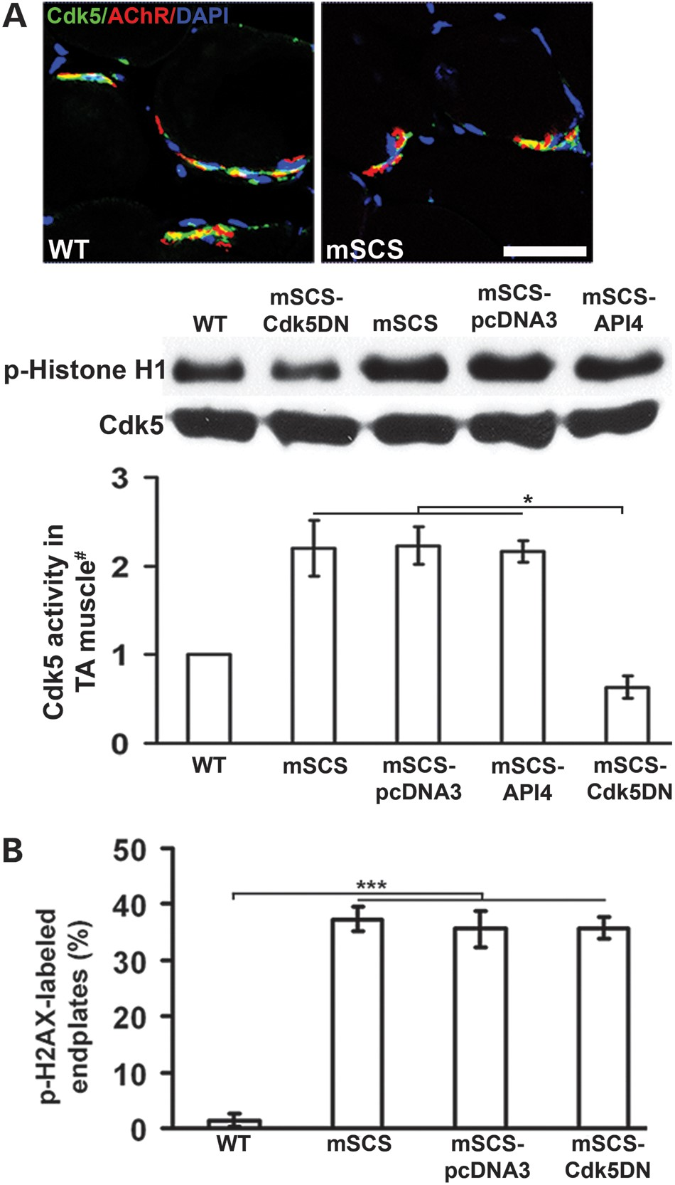
Figure 4. Reduction of Cdk5 activity does not improve subsynaptic DNA damage in mSCS muscle. (A) Upper: immunostaining ...
Notes:
Figure 4. Reduction of Cdk5 activity does not improve subsynaptic DNA damage in mSCS muscle. (A) Upper: immunostaining of Cdk5 (green) co-localized with NMJ (red) in WT and mSCS. No morphological changes were identified between WT, mSCS and treated mSCS TA muscle. Middle: Cdk5 activity is increased in mSCS muscle compared with WT. Electroporation of Cdk5DN plasmid reduced Cdk5-dependent phosphorylated Histone H1 level in mSCS muscle, whereas API4 expression had no effect on Cdk5 activity. Lower: quantification of Cdk5 activity in WT, mSCS and treated mSCS TA muscle expressed as the ratio of phosphorylated histone H1 level to Cdk5 protein expression level (# = normalized to WT). In mSCS-Cdk5DN, Cdk5 activity was 0.63 ± 0.13 of WT, compared with 2.2 ± 0.3 in SCS, 2.2 ± 0.1 in mSCS-API4 and 2.2 ± 0.2 in mSCS-pcDNA3. n = 3; *P 0.98. p-H2AX-labeled endplates in WT was 1.42 ± 1.23%. n = 5; ***P < 0.001, Student's t-test.
Unless provided in the caption above, the following copyright applies to the content of this slide: © The Author 2013. Published by Oxford University Press. All rights reserved. For Permissions, please email: journals.permissions@oup.com

Slide 5
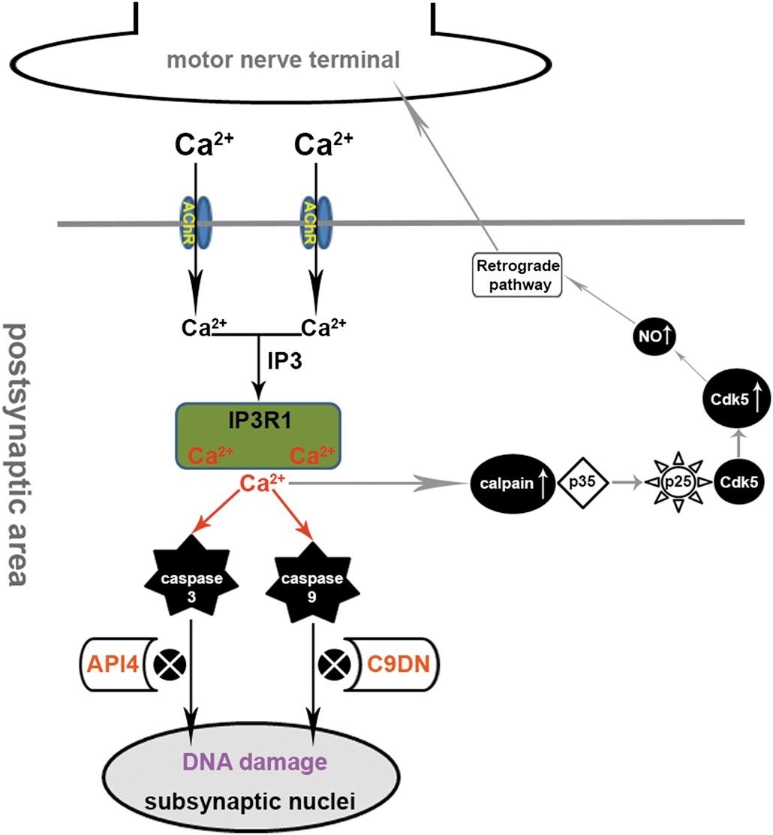
Figure 5. Diagram of molecular mechanism of SCS disease. Prolonged openings of mutant AChRs in SCS allow entry of ...
Notes:
Figure 5. Diagram of molecular mechanism of SCS disease. Prolonged openings of mutant AChRs in SCS allow entry of excess Ca2+, which combines with IP3 (inositol 1,4,5-triphosphate) to activate IP3R1 (type I inositol 1,4,5-triphosphate receptor) causing further Ca2+ release from internal stores (10). Excessive sarcoplasmic Ca2+ activates caspase-3 and -9 as well as calpain at postsynaptic area. Activated caspase-3 and -9 enter into subsynaptic nuclei leading to DNA damage. Inhibition of caspase-3 with API4 reduces subsynaptic DNA damage and ultrastructural evidence of subsynaptic nuclear degeneration. Similarly, inhibition of caspase-9 activity using dominant-negative caspase-9 (C9DN) reduces subsynaptic DNA damage and subsynaptic nuclear degeneration. As we previously showed, activated calpain at the postsynaptic area in SCS has a predominantly presynaptic action, through activation of Cdk5 by cleavage of p35, Cdk5 co-activator and increased NO production via nNOS (neural nitric oxide synthase) pathway (9,41). Here, our studies demonstrate that neither activated calpain nor increased Cdk5 activity are not involved in subsynaptic DNA damage.
Unless provided in the caption above, the following copyright applies to the content of this slide: © The Author 2013. Published by Oxford University Press. All rights reserved. For Permissions, please email: journals.permissions@oup.com

