Slide 1
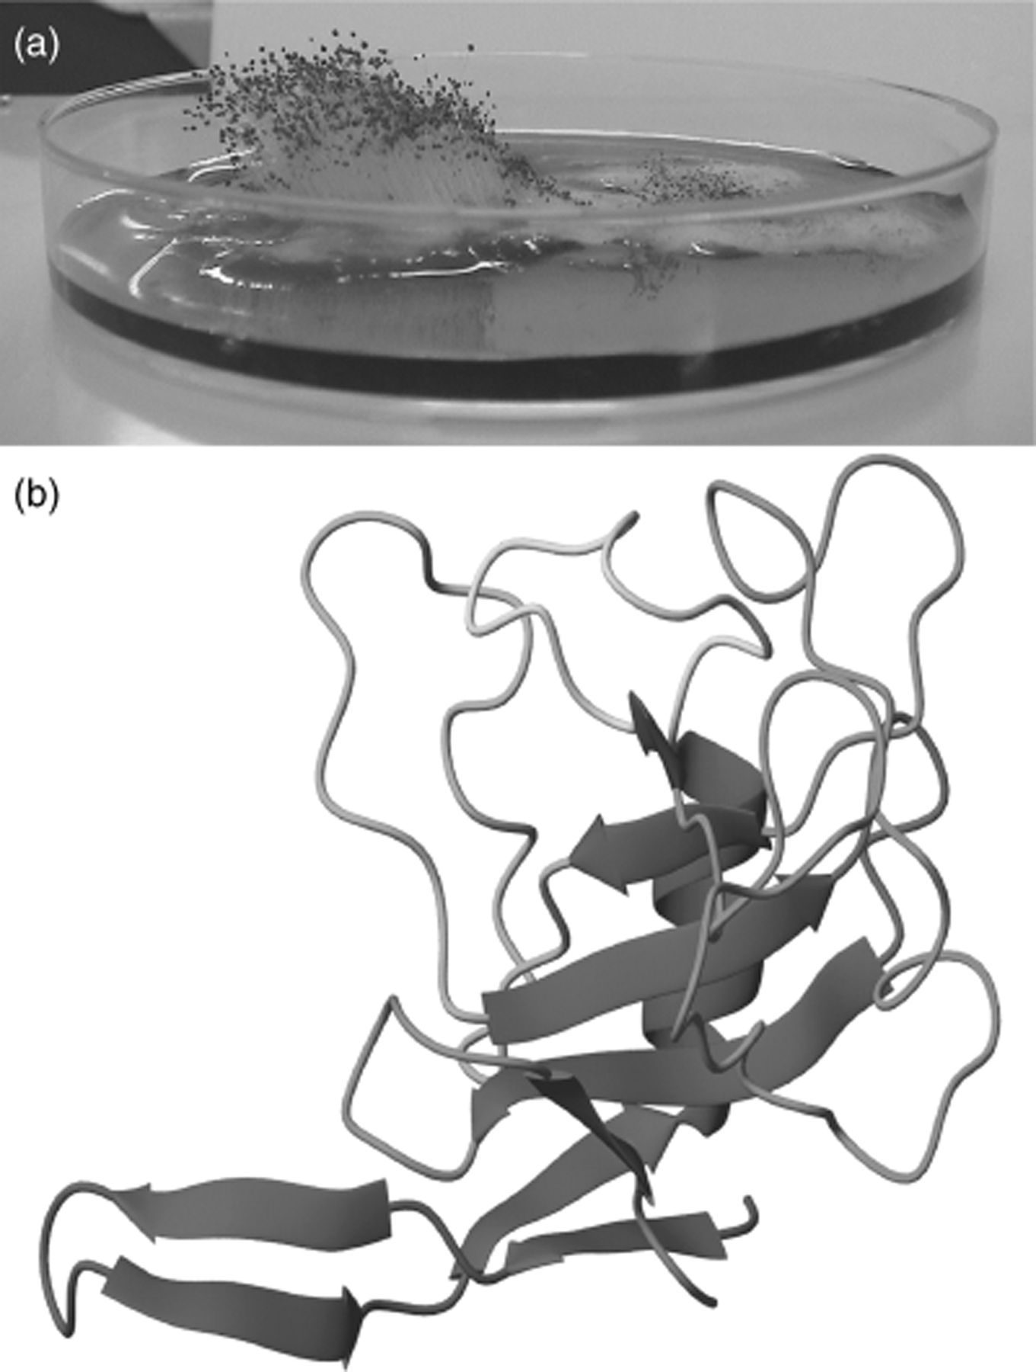
Figure 1 (a) Photograph of a culture of Aspergillus giganteus MDH 18894. (b) Three-dimensional structure of α-sarcin ...
Notes:
Figure 1 (a) Photograph of a culture of Aspergillus giganteus MDH 18894. (b) Three-dimensional structure of α-sarcin (PDB ID 1DE3): The diagram was generated with the molmol program ( Koradi et al. , 1996 ).
Unless provided in the caption above, the following copyright applies to the content of this slide: © 2006 Federation of European Microbiological Societies.

Slide 2
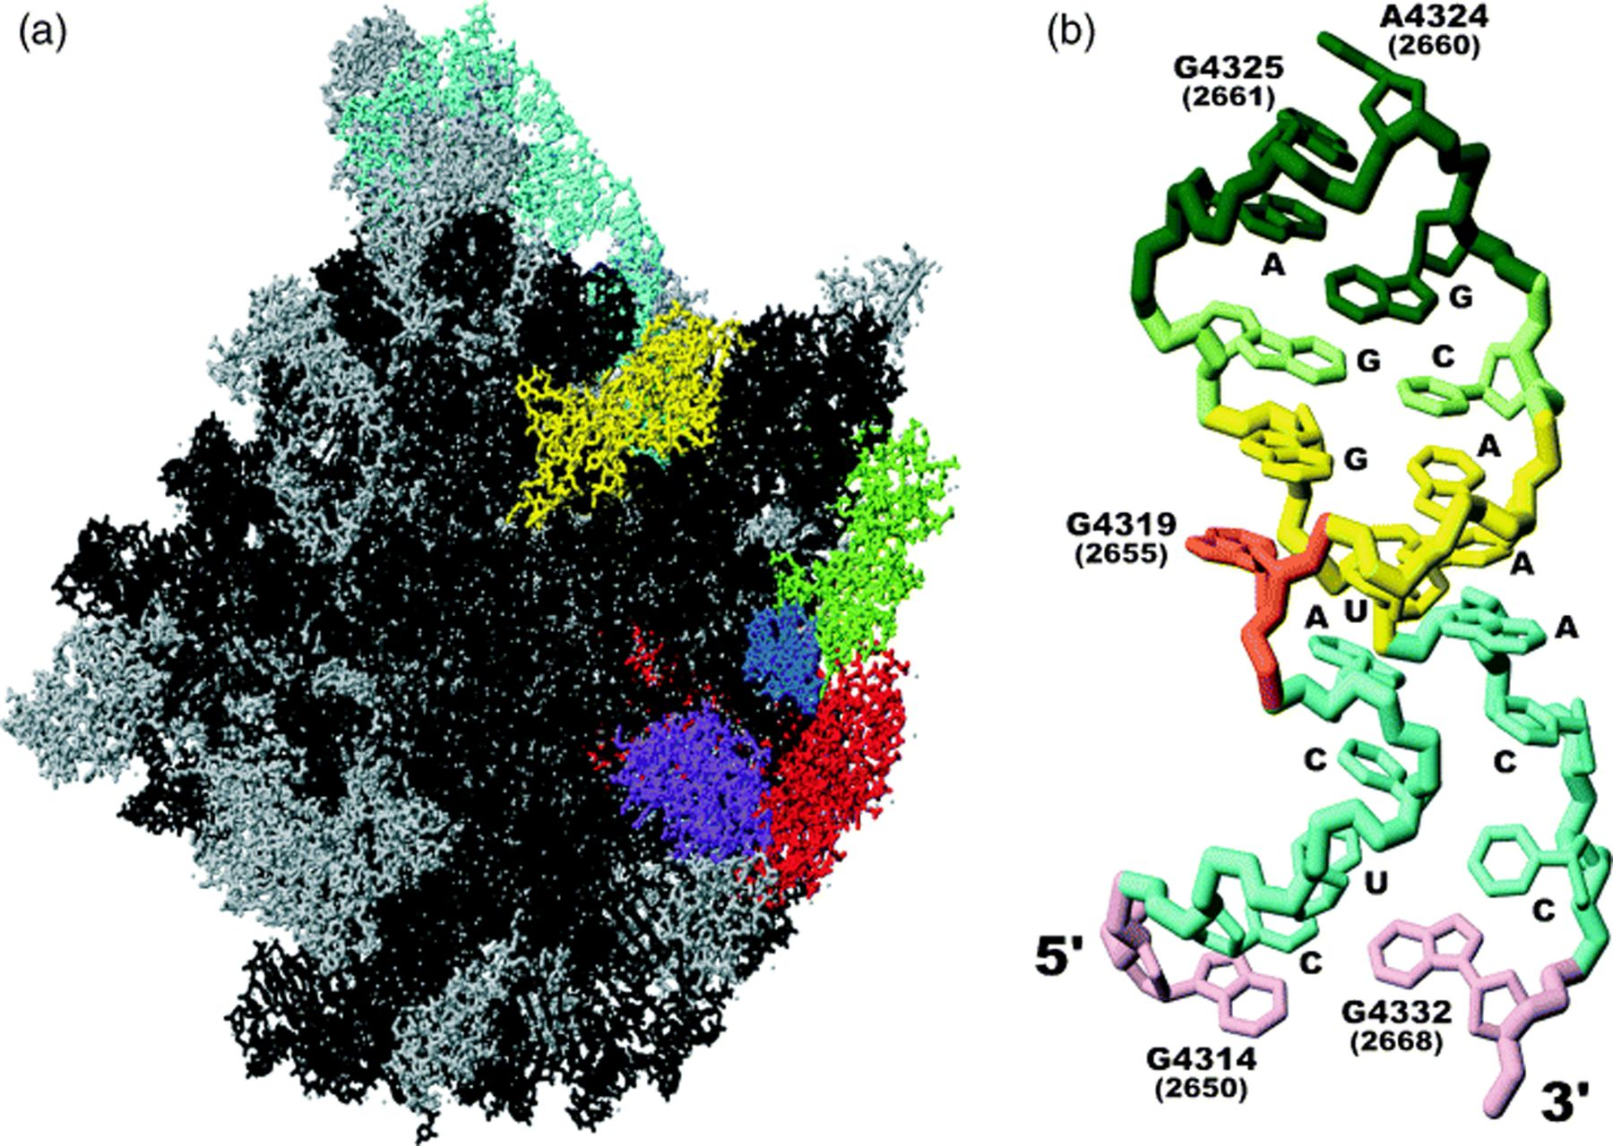
Figure 2 (a) Diagram showing the structure of the Halobacterium marismortui ribosome large subunit (PDB ID 1JJ2): ...
Notes:
Figure 2 (a) Diagram showing the structure of the Halobacterium marismortui ribosome large subunit (PDB ID 1JJ2): black, 23S RNA gene; cyan, 5S RNA gene; blue, SRL; red, ribosomal protein L3; green, ribosomal protein L6; yellow, ribosomal protein 10e; purple, ribosomal protein L14; gray, other ribosomal proteins. (b) Diagram showing the structure of the SRL ( Correll et al. , 1998 ). Numbers correspond to rat or Escherichia coli (in brackets) nucleotide positions within the 28S (23S) rRNA gene. The bond cleaved by ribotoxins is that on the 3′-side of G4325 (2661) (dark green). Ricin depurinates A4324 (2660) (dark green). The bulged G is G4319 (2655) (orange). The Watson–Crick region of the hairpin (violet), the flexible region (cyan), the G-bulged cross-strand stack (yellow) and the tetraloop (green) are colored. The diagrams were generated with the molmol program ( Koradi et al. , 1996 ).
Unless provided in the caption above, the following copyright applies to the content of this slide: © 2006 Federation of European Microbiological Societies.

Slide 3
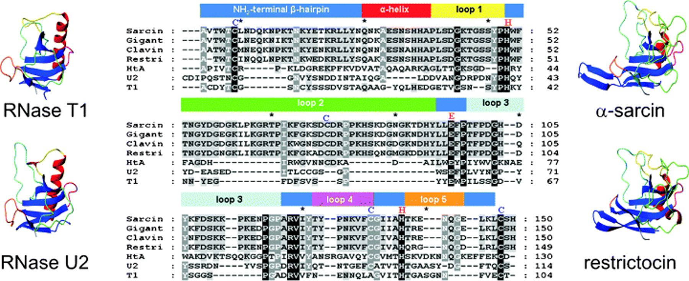
Figure 3 (a) Sequence alignment of several different ribotoxins (α-sarcin, gigantin, clavin, restrictocin, and HtA) ...
Notes:
Figure 3 (a) Sequence alignment of several different ribotoxins (α-sarcin, gigantin, clavin, restrictocin, and HtA) and RNases T1 and U2. Cysteine residues of ribotoxins (blue) and the three proved, or presumed, catalytic residues of all the proteins (in red) are indicated. Diagrams showing the three-dimensional structures of α-sarcin, restrictocin and RNases T1 and U2 are also shown. Color codes are as in Fig. 1 . Three-dimensional structures of proteins were fitted to the atomic coordinates of the active site residues (α-sarcin: 48, 50, 96, 121, 137, 145; restrictocin: 47, 49, 95, 120, 136, 144; RNase T1: 38, 40, 66, 77, 92, 100; RNase U2: 39, 41, 62, 85, 101, 110) and common disulfide bridges of the four proteins (α-sarcin, 6–148; restrictocin, 5–147; RNase T1, 6–103; RNase U2, 9–113) (root mean square deviation of the fitting, 1.877). The diagrams and fittings were generated with the molmol program ( Koradi et al. , 1996 ).
Unless provided in the caption above, the following copyright applies to the content of this slide: © 2006 Federation of European Microbiological Societies.

Slide 4
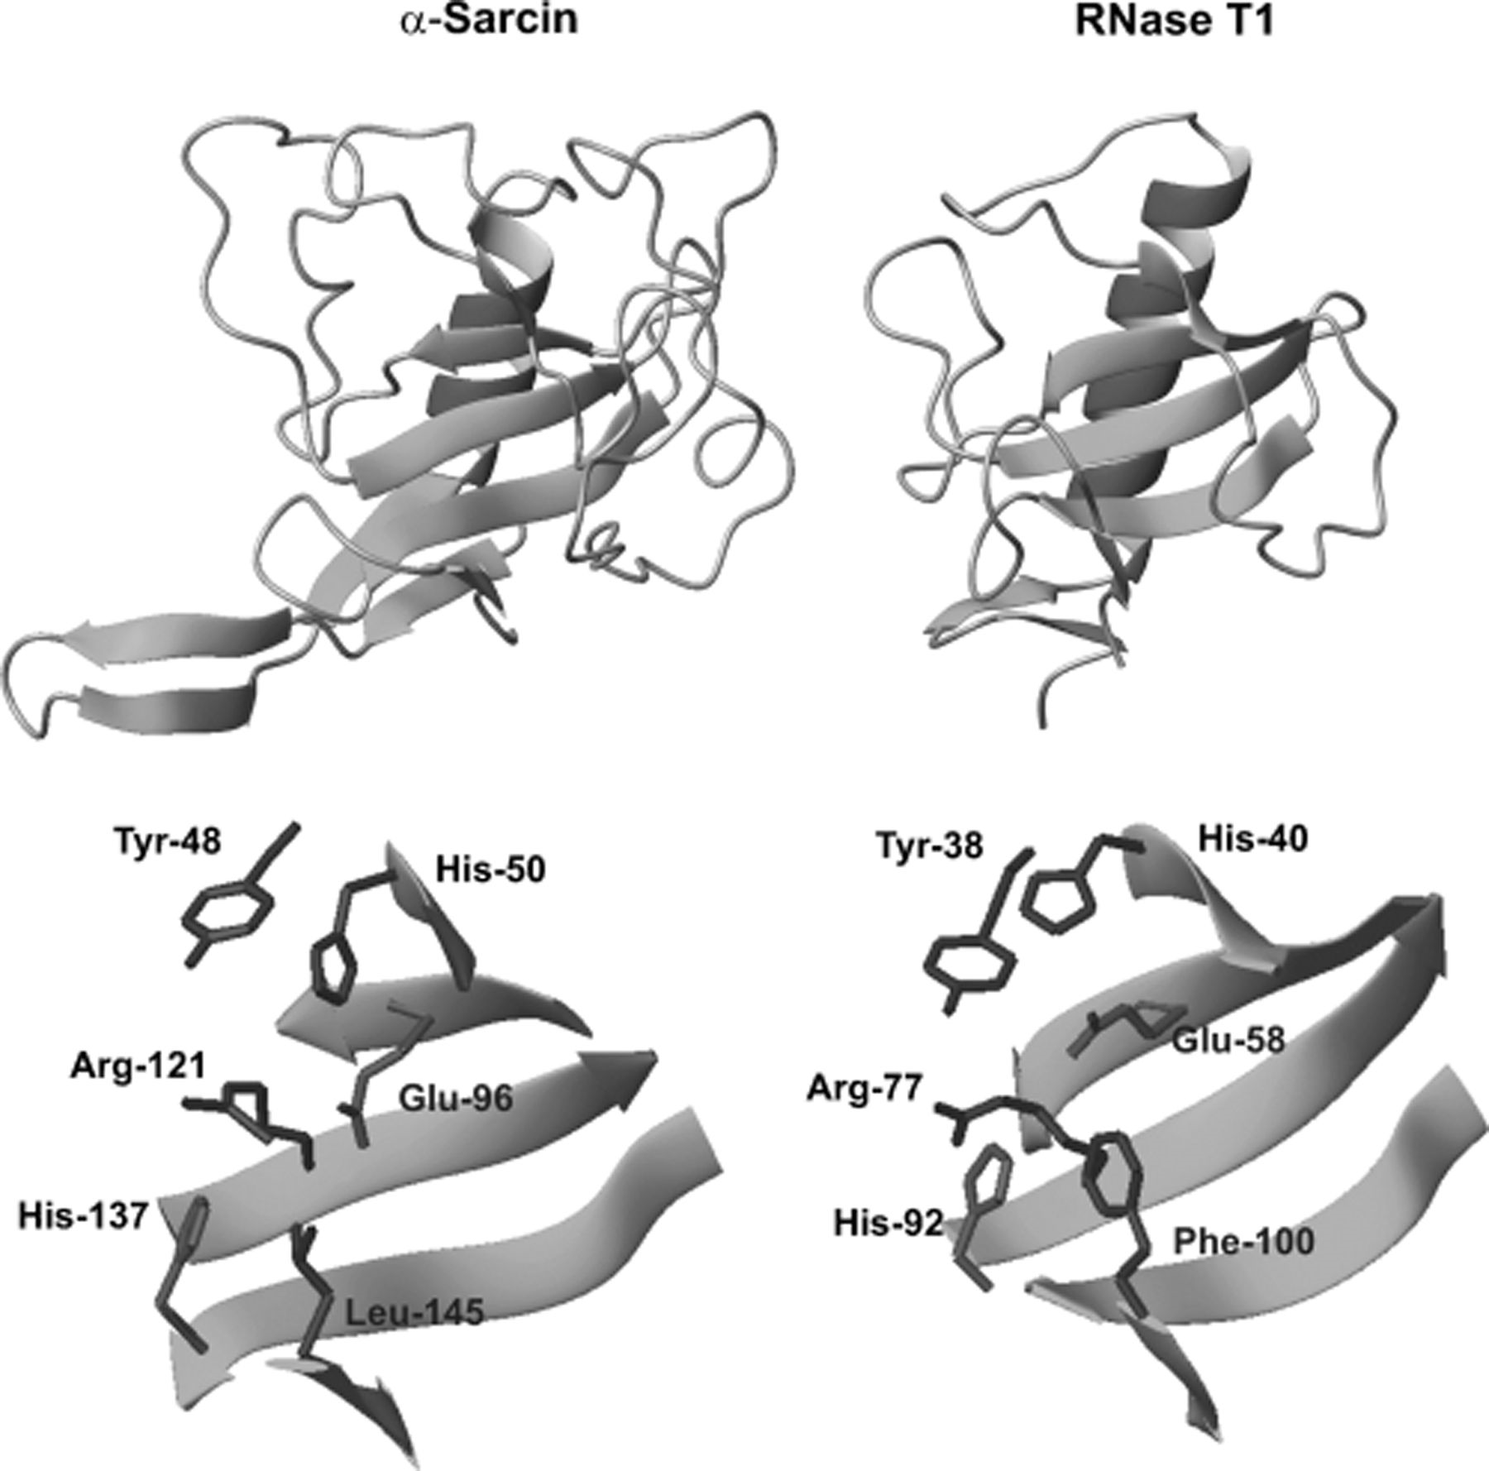
Figure 4 Representation of the geometric arrangement of the side chain residues found in the active sites of α-sarcin ...
Notes:
Figure 4 Representation of the geometric arrangement of the side chain residues found in the active sites of α-sarcin and RNase T1. Only the side chains of the catalytic residues directly involved in the mechanism of general acid–base cleavage are shown. The three-dimensional structures of both proteins are also shown. The diagrams were generated with the molmol program ( Koradi et al. , 1996 ).
Unless provided in the caption above, the following copyright applies to the content of this slide: © 2006 Federation of European Microbiological Societies.

Slide 5
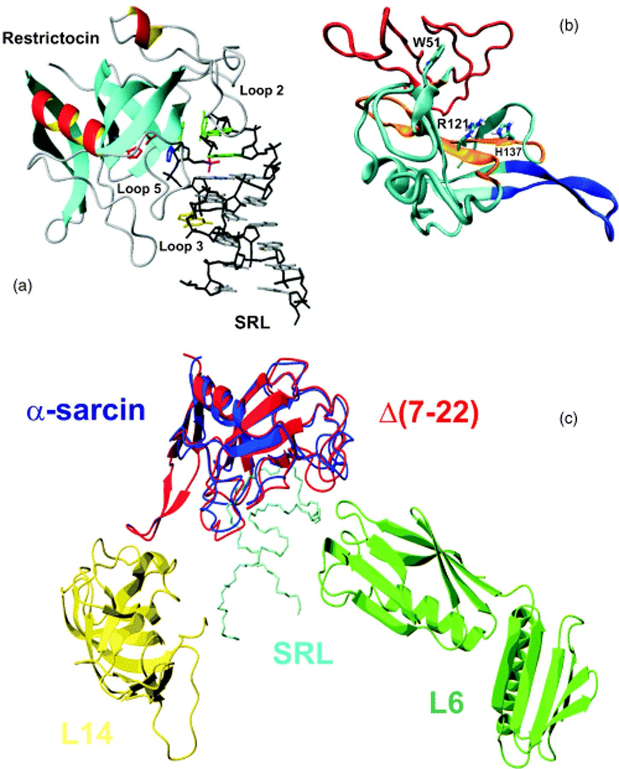
Figure 5 (a) Diagram showing the crystalline structure of an SRL analog–restrictocin complex ( Yang et al. , 2001 ) ...
Notes:
Figure 5 (a) Diagram showing the crystalline structure of an SRL analog–restrictocin complex ( Yang et al. , 2001 ) (PDB accession number 1JBS ). The analog structure is distorted in comparison to the wild-type SRL, and this explains the absence of cleavage, which allowed crystallization of the complex. The side chains of His49 (blue), Glu95 (red), and His136 (red) are also shown. The RNA backbone is shown is black, with the bases in gray, except for the bulged G in yellow, the tetraloop in green, and the phosphate group of the bond susceptible to cleavage in magenta. The loops equivalent to α-sarcin's loops 2, 3 and 5 are also indicated. (b) Diagram showing the α-sarcin regions presumably involved in the establishment of interactions with phospholipid bilayers: purple, residues 7–22; orange, residues 116–139 and 51; red, residues 53–93 (loop 2). The side chains of Trp51, Arg121 and His137 are also shown. (c) Minimized docking model showing the interaction of wild-type (PDB ID 1DE3) and Δ(7–22) α-sarcin (PDB ID 1R4Y) with the SRL (PDB ID 430D) and the Halobacterium marismortui ribosomal proteins L6 and L14 ( García-Mayoral et al. , 2005a , b ). Diagrams were generated with molmol (a, c) ( Koradi et al. , 1996 ) and vmd (b) ( Humphrey et al. , 1996 ) programs.
Unless provided in the caption above, the following copyright applies to the content of this slide: © 2006 Federation of European Microbiological Societies.

Slide 6
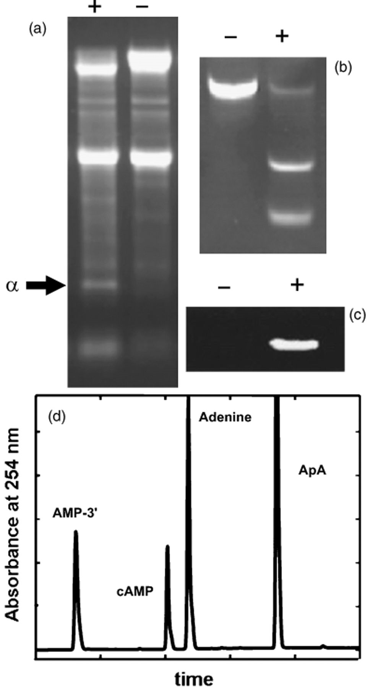
Figure 6 Examples of the different enzymatic assays used to study ribotoxin ribonucleolytic activity. The presence (+) ...
Notes:
Figure 6 Examples of the different enzymatic assays used to study ribotoxin ribonucleolytic activity. The presence (+) or absence (−) of α-sarcin in the assay is indicated. (a) Specific cleavage of rabbit ribosomes. The α-fragment is indicated by an arrow. (b) Specific cleavage of a 35-mer SRL-like oligonucleotide. (c) Zymogram against poly(A). (d) HPLC resolution of the products produced after incubation of α-sarcin with ApA.
Unless provided in the caption above, the following copyright applies to the content of this slide: © 2006 Federation of European Microbiological Societies.

Slide 7
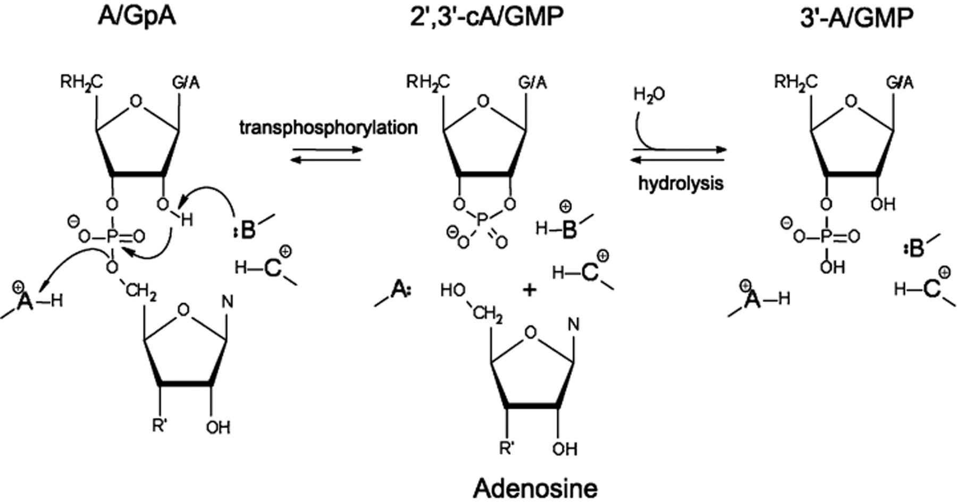
Figure 7 Proposed mechanism for the catalytic mechanism of cyclizing RNases against a dinucleotide substrate (ApA or ...
Notes:
Figure 7 Proposed mechanism for the catalytic mechanism of cyclizing RNases against a dinucleotide substrate (ApA or GpA). A transphosphorylation process (in which the corresponding 2′,3′ cyclic mononucleotide and adenosine are produced) is followed by hydrolysis of the cyclic nucleotide to produce the corresponding 3′-mononucleotide. (A), (B) and (C) are His92, Glu58 and His40 in RNase T1 ( Steyaert, 1997 ), and His137, Glu96 and His50 in α-sarcin ( Lacadena et al. , 1999 ), respectively.
Unless provided in the caption above, the following copyright applies to the content of this slide: © 2006 Federation of European Microbiological Societies.

