Slide 1
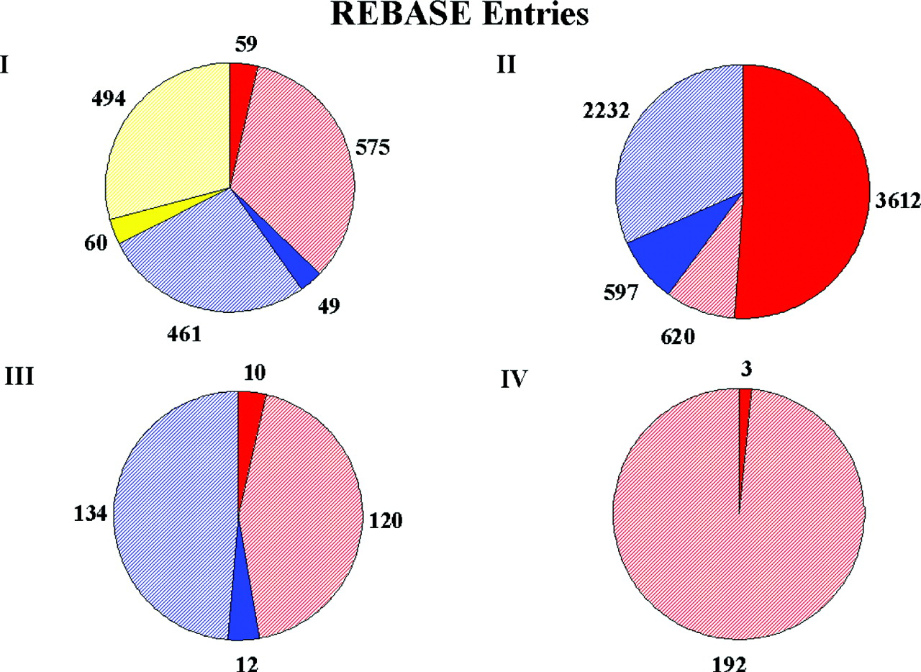
Figure 1. The circles depict the four major types of restriction enzymes and show the occurrence of their components in ...
Notes:
Figure 1. The circles depict the four major types of restriction enzymes and show the occurrence of their components in REBASE. The Type I enzymes have three genes encoding a methyltransferase subunit, a restriction subunit and a specificity subunit. The Type II enzymes have two separate genes, one encoding a restriction enzyme and one encoding a methyltransferase. The Type III enzymes also have two genes, one encoding a methyltransferase, which can operate alone or form part of a complex with a restriction subunit. The Type IV enzymes act alone and restrict DNA that is methylated. The solid colors indicate REBASE entries that have been experimentally verified and the shaded colors indicate genes predicted computationally. R genes are in red, M genes in blue and specificity genes in yellow. The numbers refer to the contents of REBASE on September 15, 2004.
Unless provided in the caption above, the following copyright applies to the content of this slide: © 2005, the authors Nucleic Acids Research, Vol. 33, Database issue © Oxford University Press 2005; all rights reserved

