Slide 1
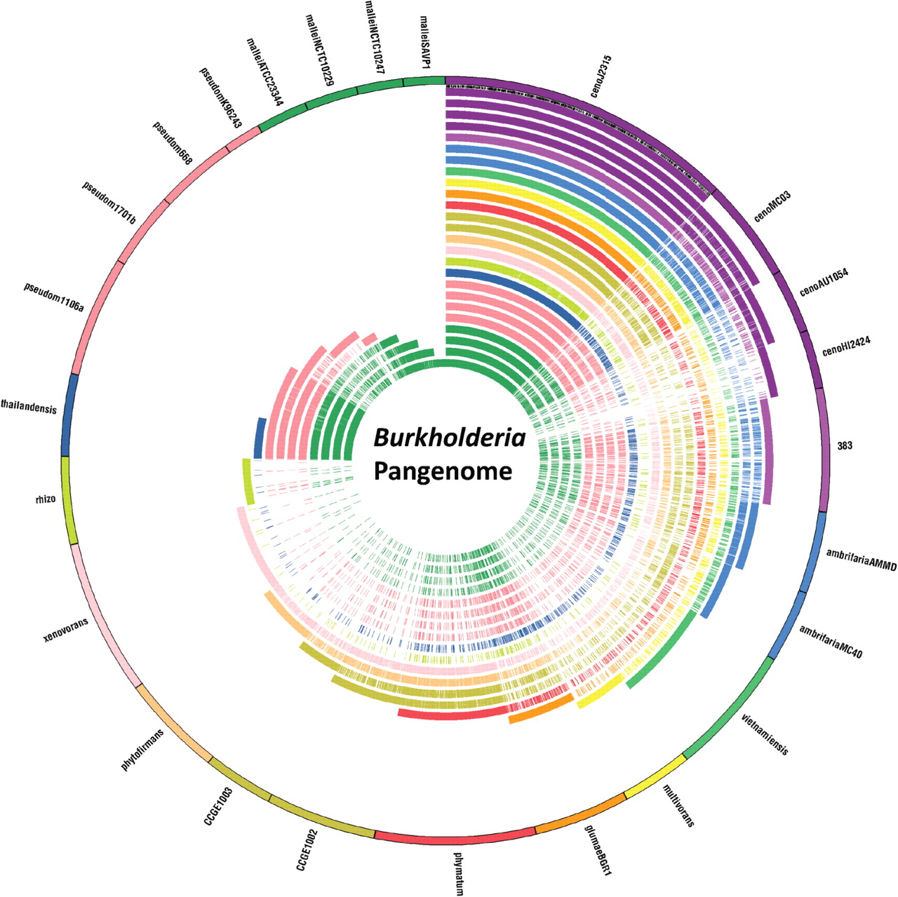
Figure 1: Example pangenome from the Burkholderia genus. Comparative gene content of 25 genomes of Burkholderia. ...
Notes:
Figure 1: Example pangenome from the Burkholderia genus. Comparative gene content of 25 genomes of Burkholderia. Beginning clockwise from the top of the circle, the outermost circle represents the 56 777 gene family Burkholderia pangenome, all genes (constant wedge width per gene) originating from the genome whose name is indicated outside the circle. Only the unique genes, absent (i.e. no orthologs) from any of the preceding genomes, are displayed (outer circle) such that each wedge indicates a new gene (protein) family. For all 25 inner circles, all genes are shown that match any gene family represented in the outer circles. The first genome is that of B. cenocepacia J2315 and proceeds inward to Burkholderia rhizoxinica. This order is the same clockwise as it is for outermost to innermost circles, and they are also colored/shaded accordingly. Genomes of different strains of the same species are colored/shaded the same, and genes are ordered with respect to position in the chromosomes and in the chromosome order. The small black lines between the outer circle and the J2315 ring are the core genes shared among all genomes.
Unless provided in the caption above, the following copyright applies to the content of this slide: © The Author 2011. Published by Oxford University Press. All rights reserved. For permissions, please email: journals.permissions@oup.com

Slide 2
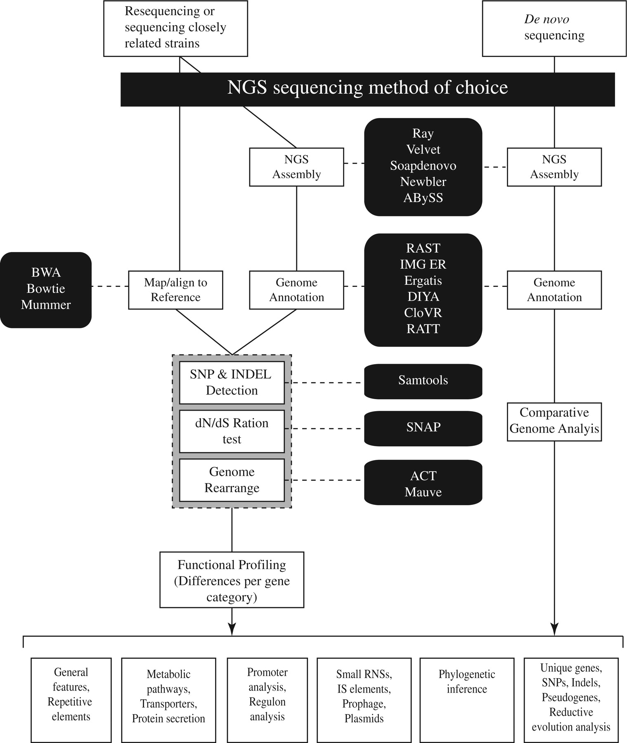
Figure 2: Diagram of possible NGS data processing workflows. When sequencing the genome of a phylogenetically distinct ...
Notes:
Figure 2: Diagram of possible NGS data processing workflows. When sequencing the genome of a phylogenetically distinct organism, one first assembles the data, followed by annotation and then comparative analysis with other genome(s) based on ortholog analysis. When a reference genome is available, more options are available for comparative analysis and often more detailed analyses are possible, including SNP discovery. Some of the tools commonly used for analysis steps are listed and can be found in.
Unless provided in the caption above, the following copyright applies to the content of this slide: © The Author 2011. Published by Oxford University Press. All rights reserved. For permissions, please email: journals.permissions@oup.com

