Slide 1
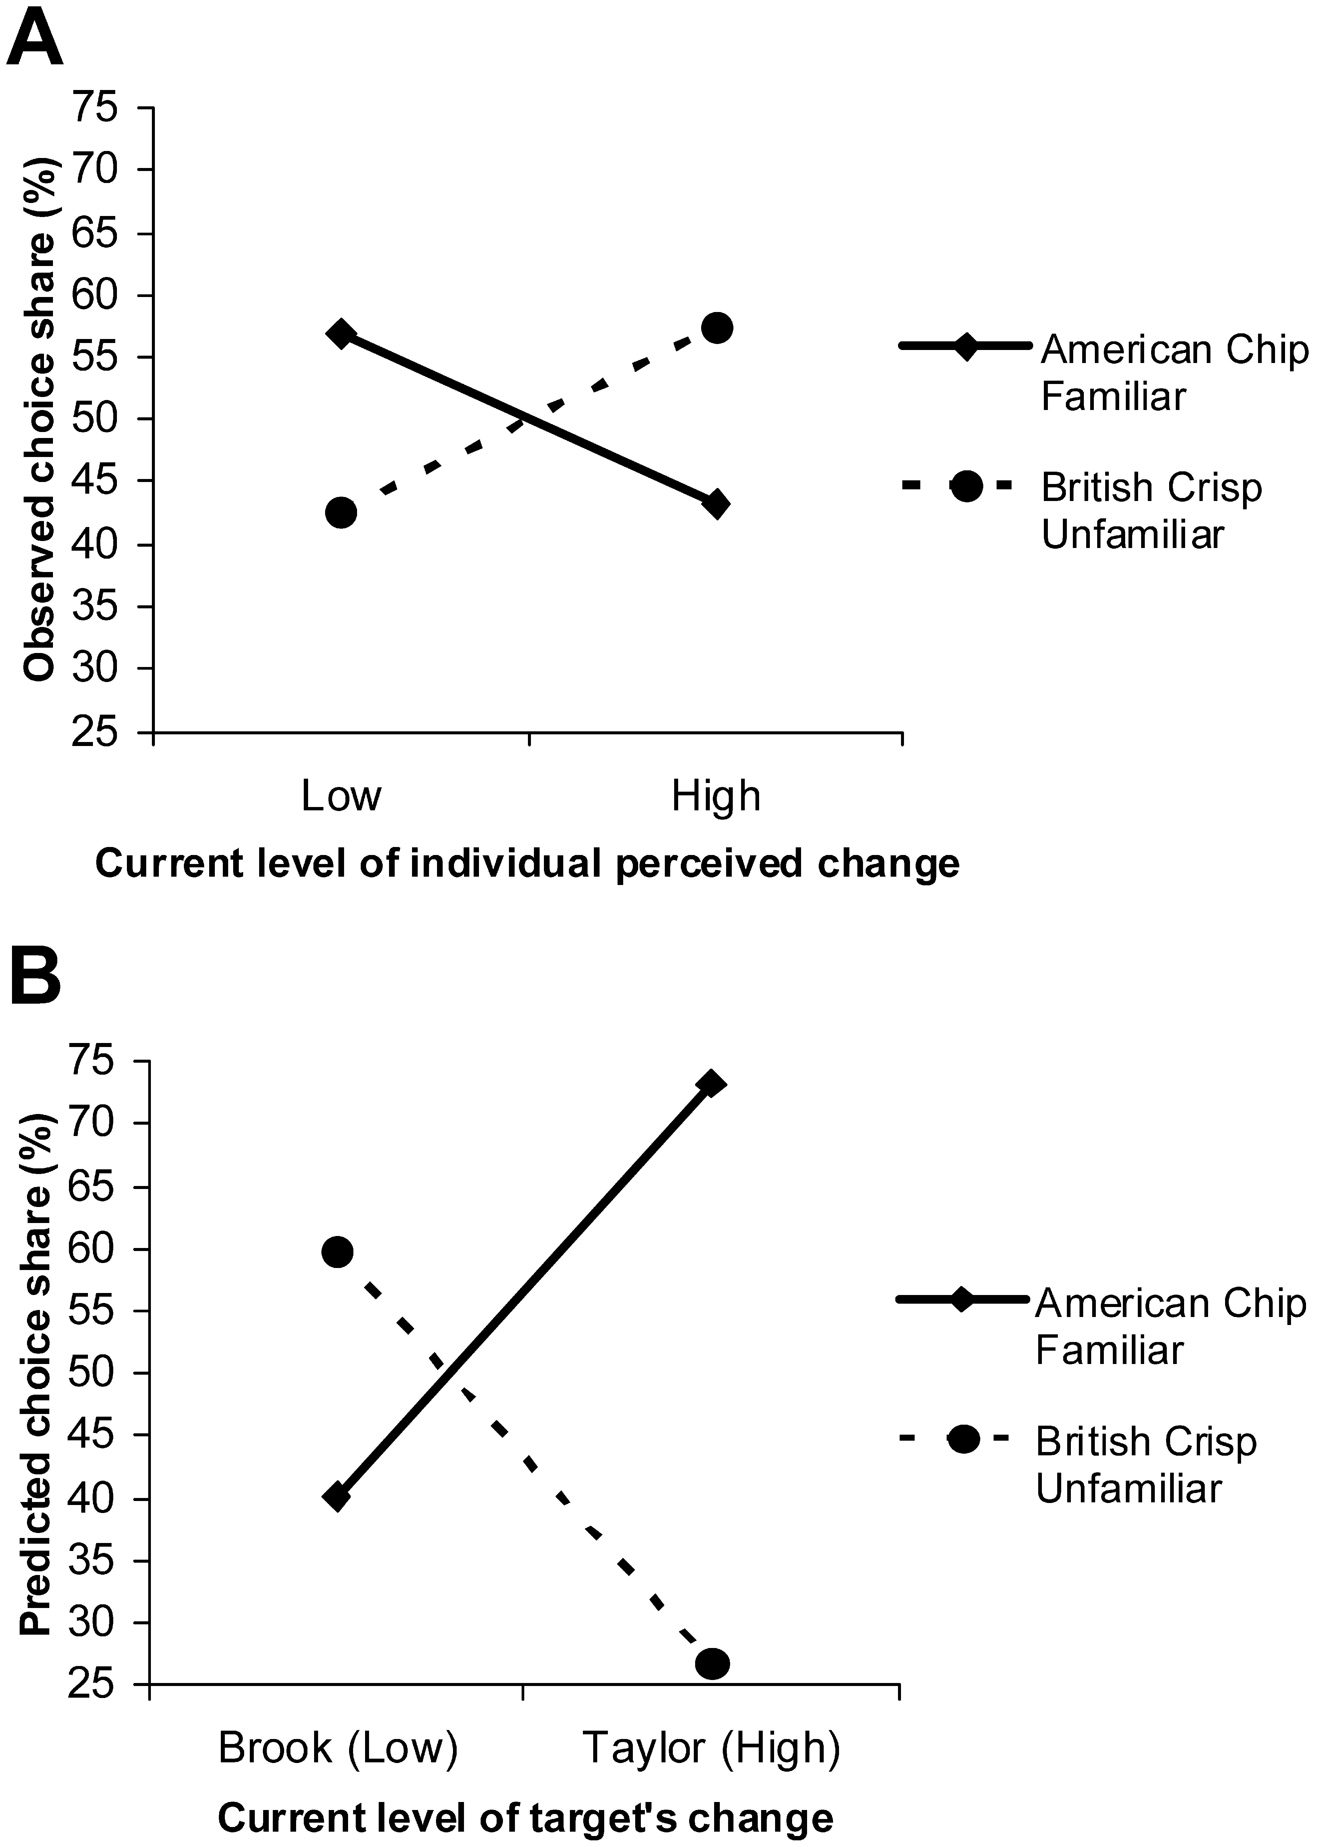
Figure 1 Observed and Predicted Choice of Familiar “Comfort” Options Note.—A, Observed choice (study 1). B, Predicted ...
Notes:
Figure 1 Observed and Predicted Choice of Familiar “Comfort” Options Note.—A, Observed choice (study 1). B, Predicted choice (study 2).
Unless provided in the caption above, the following copyright applies to the content of this slide: © 2009 by JOURNAL OF CONSUMER RESEARCH, Inc.

Slide 2
Table 1 Cognitive Responses for Participants’ Predicted Choice (Study 2)
Notes:
Table 1 Cognitive Responses for Participants’ Predicted Choice (Study 2)
Unless provided in the caption above, the following copyright applies to the content of this slide: © 2009 by JOURNAL OF CONSUMER RESEARCH, Inc.

Slide 3
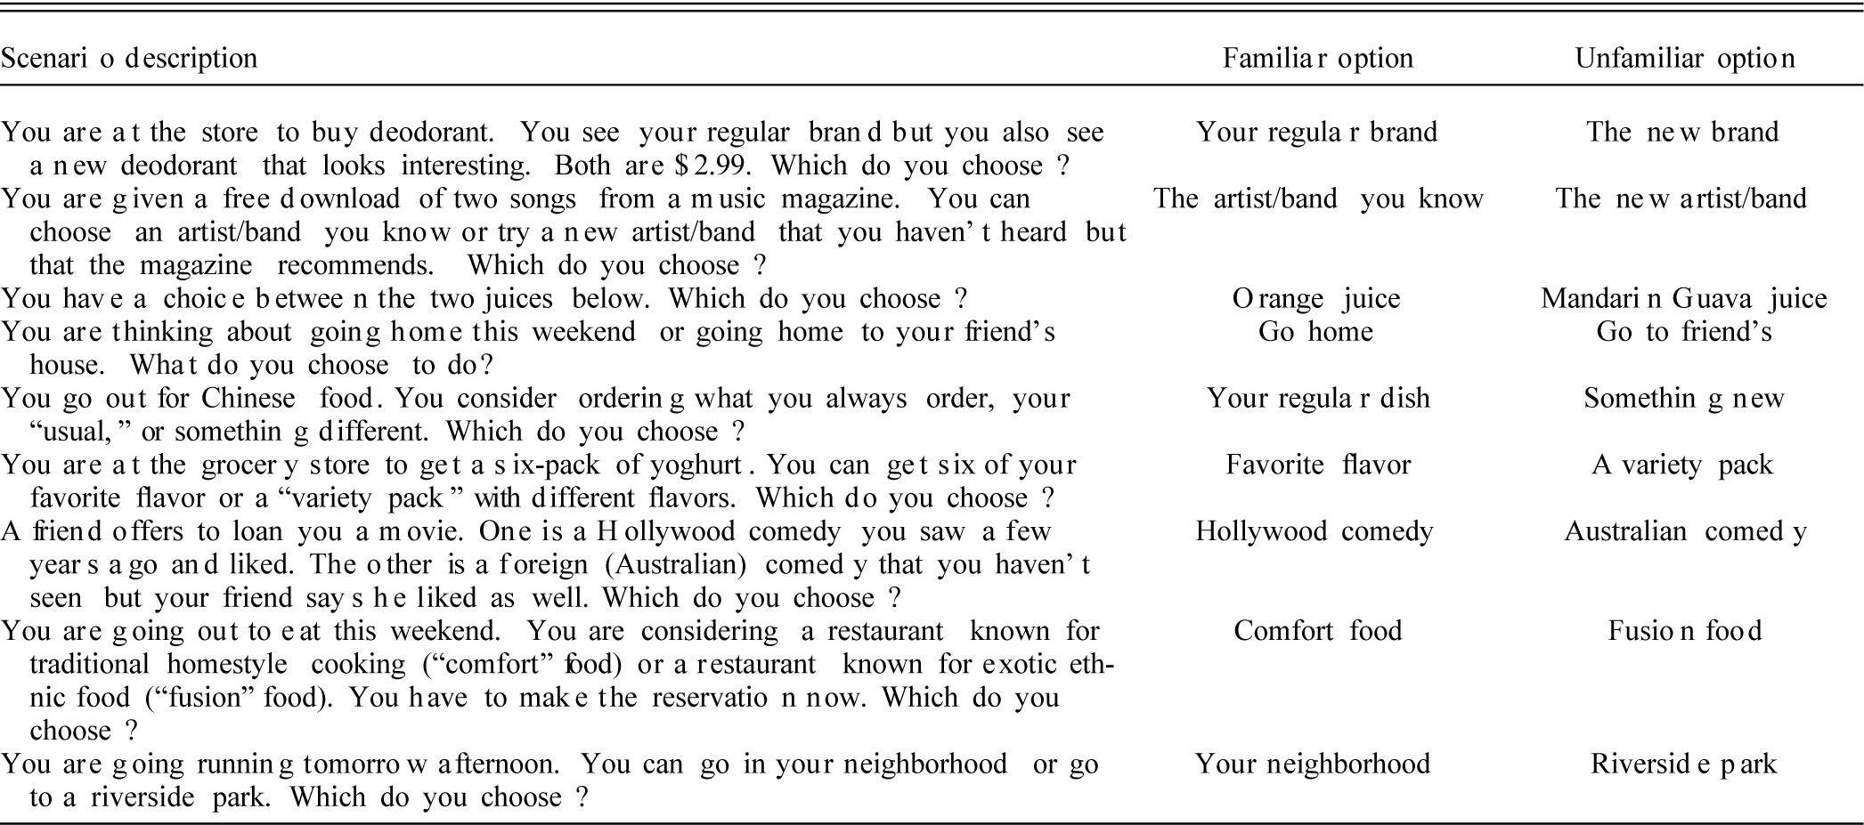
Table 2 Food and Nonfood Choice Scenarios (Study 3)
Notes:
Table 2 Food and Nonfood Choice Scenarios (Study 3)
Unless provided in the caption above, the following copyright applies to the content of this slide: © 2009 by JOURNAL OF CONSUMER RESEARCH, Inc.

Slide 4
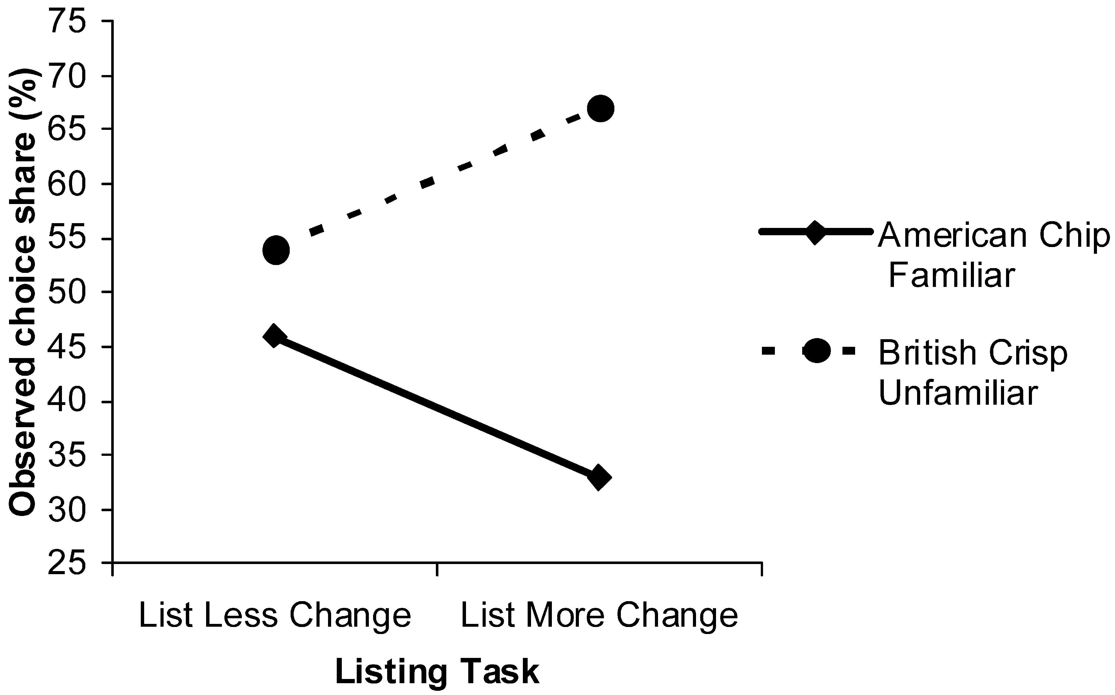
Figure 2 Manipulation of Perceived Life Change and Comfort Food Fallacy Effect (Study 5)
Notes:
Figure 2 Manipulation of Perceived Life Change and Comfort Food Fallacy Effect (Study 5)
Unless provided in the caption above, the following copyright applies to the content of this slide: © 2009 by JOURNAL OF CONSUMER RESEARCH, Inc.

