Slide 1
Fig. 1. Claisen rearrangement of chorismate (1) to prephenate (2).
Notes:
Fig. 1. Claisen rearrangement of chorismate (1) to prephenate (2).
Unless provided in the caption above, the following copyright applies to the content of this slide: © The Author 2005. Published by Oxford University Press. All rights reserved. For Permissions, please e-mail: journals.permissions@oupjournals.org

Slide 2
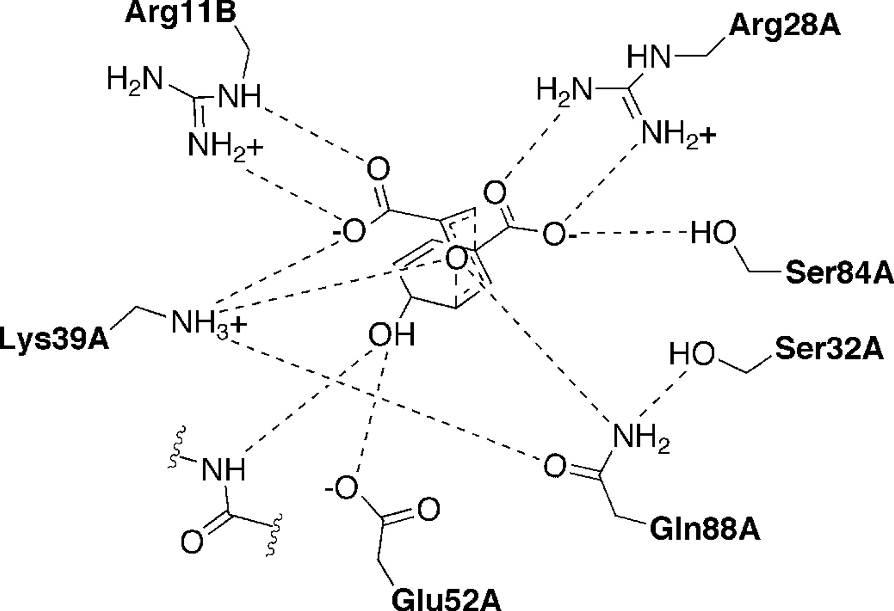
Fig. 2. Predicted hydrogen bonding in the Ala32Ser chorismate mutase variant. Interactions in the wild-type crystal ...
Notes:
Fig. 2. Predicted hydrogen bonding in the Ala32Ser chorismate mutase variant. Interactions in the wild-type crystal structure are the same except for position 32A.
Unless provided in the caption above, the following copyright applies to the content of this slide: © The Author 2005. Published by Oxford University Press. All rights reserved. For Permissions, please e-mail: journals.permissions@oupjournals.org

