Slide 1
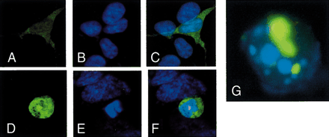
Figure 1. Expression of huntingtin exon 1 (httEx1) fused to EGFP with a polyglutamine expansion forms visible ...
Notes:
Figure 1. Expression of huntingtin exon 1 (httEx1) fused to EGFP with a polyglutamine expansion forms visible aggregates (A) Diffuse fluorescence of httEx1 with 23 glutamines (green) in SK-N-SH cell. (B) Normal nucleus (DAPI staining, blue). (C) Overlay of (A) and (B). (D) Appearance of poly(Q) aggregate induced by httEx1 with 103 glutamines in SK-N-SH cell. (E) Pyknotic/fragmented nucleus, DAPI staining, (blue) (F) Overlay of (D) and (E). The magnification in (D–F) is slightly larger than in (A–C). Note that the intensity of the fluorescence signal in (D) (EGFP–httEx1–Q103 expression) cannot be compared with the fluorescence signal in (A) (EGFP–httEx1–Q23), since different filter settings needed to be chosen owing to the much higher signal of the aggregate (see text). Cells were transfected, fixed after 48 hours with paraformaldehyde (4%) and analysed using confocal microscopy. We observed similar results in COS-7 cells (not shown). (G) Fragmented nucleus (blue) of a COS-7 cell expressing EGFP–httEx1–Q74 with aggregates (green). (H) Western blot analysis of vectors expressing huntingtin exon 1 with 23, 53, 74 or 103 glutamines fused to EGFP. Expression of EGFP as a non-fusion protein is shown. COS-7 cells were either not transfected or transfected with equal amounts of total DNA (2 µg) comprising EGFP fused to httEx1 and empty vector in a 1 : 3 molar ratio in order to mimic typical conditions used in cotransfection experiments described in Materials and Methods. 48 hours after transfection, whole-cell lysates were run on a SDS–PAGE gel and the same blot was probed with anti-EGFP and anti-actin antibodies (loading control).
Unless provided in the caption above, the following copyright applies to the content of this slide:

Slide 2
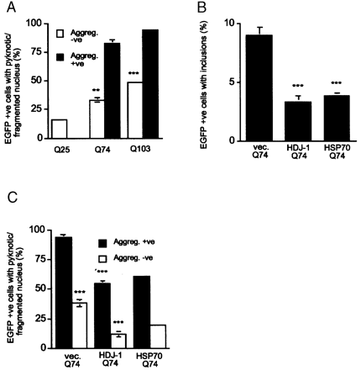
Figure 2. Expression of huntingtin exon 1 (httEx1) with poly(Q) expansions is toxic in the presence and ...
Notes:
Figure 2. Expression of huntingtin exon 1 (httEx1) with poly(Q) expansions is toxic in the presence and absence of aggregates within SK-N-SH cells. (A) Percentages of SK-N-SH cells transfected with httEx1–Q25, –Q74 or –Q103, showing nuclear abnormalities. Cells with (aggreg.+ve) or without (aggreg.−ve) aggregates were analysed. (B) HDJ-1 and HSP70 coexpression with httQ74 suppress poly(Q) aggregation in SK-N-SH cells (vec., empty vector). (C) Suppression of poly(Q)-mediated cell death by HDJ-1 and HSP70 coexpression in SK-N-SH cells with/without aggregates. For experiments in (A–C), cells were transfected and were fixed after 48 hours, and their nuclei were stained with DAPI. Data from one representative triplicate experiment with standard errors are shown. Statistics from two or three triplicate experiments (see experimental procedures): **, P<0.001; ***, P<0.0001. (D) Western blot analysis of HSP27, HDJ-1, HSP70 and E1B19K overexpression after 48 hours in COS-7 cells. Cells were untransfected or were transfected with empty vector control or the vector expressing the HSP or E1B19K. Note that exogenous HSP70 is tagged (6×His & Xpress epitope) and hence runs slightly higher on the gel.
Unless provided in the caption above, the following copyright applies to the content of this slide:

Slide 3
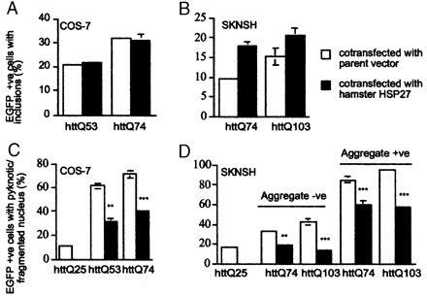
Figure 3. HSP27 does not inhibit huntingtin (httEx1) aggregation, but suppresses its toxicity in the presence ...
Notes:
Figure 3. HSP27 does not inhibit huntingtin (httEx1) aggregation, but suppresses its toxicity in the presence and absence of aggregates. (A, B) No suppression of aggregate formation by hamster HSP27 in COS-7 cells (A) and SK-N-SH cells (B). (C, D) Suppression of httEx1-mediated cell death by HSP27 in COS-7 cells (C) and SK-N-SH cells (D) with/without aggregates. For experiments in (A–D), cells were transfected and were fixed after 48 hours, and their nuclei were stained with DAPI. Data from one representative triplicate experiment with standard errors are shown. Statistics from two or three triplicate experiments (see experimental procedures): **, P<0.001; ***, P<0.0001.
Unless provided in the caption above, the following copyright applies to the content of this slide:

Slide 4
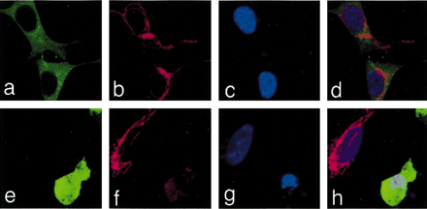
Figure 4. Poly(Q)-mediated cell death is associated with cytochrome c (cyt c) release from mitochondria. (A) ...
Notes:
Figure 4. Poly(Q)-mediated cell death is associated with cytochrome c (cyt c) release from mitochondria. (A) SK-N-SH cells (green) expressing httEx1–Q25. (B) cyt c staining is localized to mitochondria (red). (C) Normal nuclei (blue). (D) Overlay of (A–C). (E) SK-N-SH cell expressing httEx1–Q103 (green). (F) Owing to cyt c release from mitochondria of the transfected cell, the staining normally localised to mitochondria is lost and is faintly diffuse throughout the cytoplasm (red). (G) The nucleus is abnormal (condensed, blue). (H) Overlay of (E–G). Note that the magnification for (E–H) is slightly higher and the brightness is enhanced in order to visualize the faint staining of cyt c released from mitochondria. For the experiments in (A–H), cells were transfected and were fixed after 48 hours with paraformaldehyde (4%); immunocytochemistry was performed using a anti-cyt c antibody and analysed using confocal microscopy. We obtained similar results using COS-7 cells. For quantification of cyt c release, see Figure 5.
Unless provided in the caption above, the following copyright applies to the content of this slide:

Slide 5
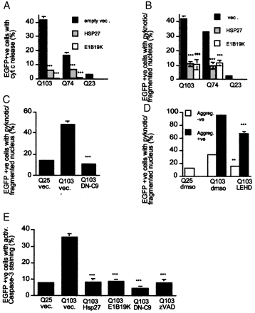
Figure 5. Inhibition of cyt c release reduces poly(Q)-mediated cell death. (A) Percentages of EGFP-positive ...
Notes:
Figure 5. Inhibition of cyt c release reduces poly(Q)-mediated cell death. (A) Percentages of EGFP-positive SK-N-SH cells showing cyt c release when cotransfected with empty vector (vec.), HSP27 or E1B19K; note that HSP27 and E1B19K inhibit cyt c release. (B) Percentages of EGFP-positive SK-N-SH cells showing nuclear abnormalities for the same experiment as in (A). (C) Percentages of EGFP-positive SK-N-SH cells showing nuclear abnormalities when cotransfected with empty vector (vec.) or dominant-negative caspase-9 construct (DN-C9); note the protection against poly(Q)-mediated cell death by DN-C9 coexpression. (D) Poly(Q)-induced cell death is reduced by exposure to the caspase-9-like inhibitor z-LEHD-fmk (100 µm). (E) Caspase-3 activation induced by mutant httEx1 is inhibited by HSP27, E1B19K and dominant negative caspase-9 (DN-C9) coexpression, or exposure to the general caspase inhibitor zVAD-fmk (100 µm). After fixation, immunocytochemistry was performed using an antibody that detects activated caspase-3. The percentage of EGFP-positive cells with positive staining of the active caspase-3 antibody is shown (see Materials and Methods). For experiments in (A–E), cells were transfected and were fixed after 48 hours, and their nuclei were stained with DAPI. Data from one duplicate/triplicate representative experiment with standard errors are shown. Statistics from two or three duplicate/triplicate experiments (see Materials and Methods): **, P<0.001; ***, P<0.0001.
Unless provided in the caption above, the following copyright applies to the content of this slide:

Slide 6
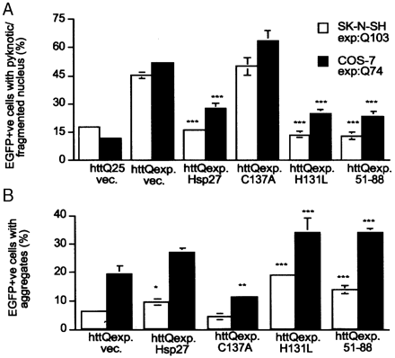
Figure 6. The cyt c binding-deficient HSP27 mutant Δ51–88 protects against poly(Q)-mediated cell death. (A) ...
Notes:
Figure 6. The cyt c binding-deficient HSP27 mutant Δ51–88 protects against poly(Q)-mediated cell death. (A) Percentages of SK-N-SH (open columns) and COS-7 (filled columns) cells with nuclear abnormalities expressing httEx1–Q74 (COS-7) or httEx1–Q103 (SK-N-SH) and cotransfected with either wild-type human HSP27, cyt c binding-deficient mutants (Δ51–88 and C137A), or a mutant that is able to bind to cyt c (H131L). (B) Percentages of EGFP-positive cells containing aggregates for the same experiment as in (A). Cells were transfected and were fixed after 48 hours, and their nuclei were stained with DAPI. Data from one triplicate representative experiment with standard errors are shown. Statistics from two triplicate experiments (see Materials and Methods): *, P<0.05; **, P<0.001; ***, P<0.0001. (C) Western blot analysis showing levels of wild-type and mutant HSP27 overexpression in COS-7 cells 48 hours after transfection (see text). Note that there is background expression of endogenous HSP27 accounting for the 28.4 kDa band in the 51–88 lane. Hsp27, human HSP27 (wild-type); H131L, human HSP27 mutant able to bind to cyt c; C137A, Human HSP27 mutant unable to bind to cyt c; 51–88 (human HSP27 deletion mutant unable to bind to cyt c; S1D, (human HSP27 phosphomimicry mutant of serine 15; S2D, human HSP27 phosphomimicry mutant of serines 15 and 78; S3D, human HSP27 phosphomimicry mutant of serines 15, 78 and 82.
Unless provided in the caption above, the following copyright applies to the content of this slide:

Slide 7
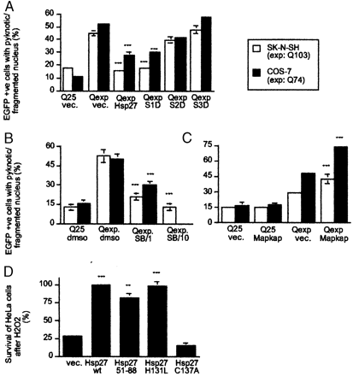
Figure 7. The phosphorylation status of HSP27 determines its protective activity against poly(Q)-mediated ...
Notes:
Figure 7. The phosphorylation status of HSP27 determines its protective activity against poly(Q)-mediated cell death. (A) Percentages of SK-N-SH (open columns) and COS-7 (filled columns) cells with nuclear abnormalities expressing httEx1–Q74 (COS-7) or httEx1–Q103 (SK-N-SH) and cotransfected with phosphorylation mutants of HSP27 where serine 15 (S1D), serines 15 and 78 (S2D) or serines 15, 78 and 82 (S3D) were replaced by aspartate. (B) The p38 MAP kinase inhibitor SB203580 protects against poly(Q)-mediated cell death. Cells transfected with mutant httEx1 were grown for 48 hours (SK-N-SH: open columns; COS-7: filled columns) in the presence/absence of SB203580 (SB/1: 1 µm, SB/10: 10 µm) and the percentages of cells with nuclear abnormalities are shown; 10 µm of SB203580 resulted in non-specific toxicity in COS-7 cells (see results). (C) Coexpression of MAPKAP kinase 2 with mutant httEx1 increases its toxicity. SK-N-SH cells (open columns) and COS-7 cells (filled columns) were cotransfected with either empty vector (vec.) or a MAKAP kinase 2-expressing plasmid. For experiments in (A–C), cells were transfected and were fixed after 48 hours, and their nuclei were stained with DAPI. Data from one triplicate representative experiment with standard errors are shown. Statistics from two or three triplicate experiments (see Materials and Methods). (D) HSP27 mutants that protect against poly(Q)-induced death also protect against oxidative stress induced by hydrogen peroxide (H2O2). HeLa cells were transfected with the respective plasmids and exposed to 400 µm of H2O2 (see Materials and Methods). An unpaired t-test was performed on data from three independent experiments: **, P<0.001; ***, P<0.0001.
Unless provided in the caption above, the following copyright applies to the content of this slide:

Slide 8
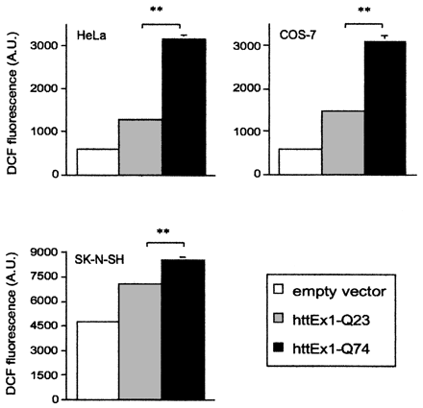
Figure 8. Mutant huntingtin (httEx1) induces increased levels of ROS. Comparison of ROS levels in HeLa, COS-7 ...
Notes:
Figure 8. Mutant huntingtin (httEx1) induces increased levels of ROS. Comparison of ROS levels in HeLa, COS-7 or SK-N-SH cells that were transfected with empty vector, HA-tagged httEx1–Q23 or –Q74. Cells were analysed after 48 hours of transfection, with similar transfection efficiencies and expression levels of transgenes in each treatment and cell type (see Materials and Methods). After exposure of cells to DCFH-DA, which is oxidized to fluorescent DCF by intracellular ROS, fluorescence was estimated in vivo at 4, 10, 20, 30, 40, 50 and 60 minutes and expressed in arbitrary units (A.U.). Data for the 30-minute time point from three independent transfection experiments are shown [means with error bars (SD)]. Note that error bars are not visible when SDs are very small. Identical trends to what is shown at 30 minutes were observed at all other time points (data not shown). **, P<0.001; ***, P<0.0001 (unpaired t-test).
Unless provided in the caption above, the following copyright applies to the content of this slide:

Slide 9
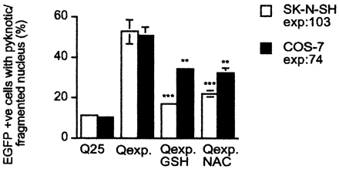
Figure 9.N-Acetyl-l-cysteine (NAC) and glutathione (GSH) protect against poly(Q)-mediated cell death. Cells ...
Notes:
Figure 9.N-Acetyl-l-cysteine (NAC) and glutathione (GSH) protect against poly(Q)-mediated cell death. Cells were grown in the presence/absence of GSH (glutathione ethylester, 5 mm) or NAC (5 mm) after transfection with EGFP–httEx1–Q25/74/103, and cell death was estimated. Data from two independent transfection experiments in triplicate are shown: **, P<0.001; ***, P<0.0001.
Unless provided in the caption above, the following copyright applies to the content of this slide:

Slide 10
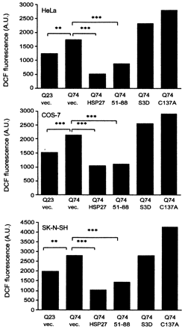
Figure 10. HSP27 reduces increased levels of ROS induced by mutant huntingtin (httEx1). Comparison of ROS ...
Notes:
Figure 10. HSP27 reduces increased levels of ROS induced by mutant huntingtin (httEx1). Comparison of ROS levels in HeLa, COS-7 or SK-N-SH cells that were cotransfected with HA-tagged httQ23/74 and empty vector or HSP27/mutants, Note that both wild-type HSP27 and the cyt c binding-deficient mutant Δ51–88 [which also protects against poly(Q)-induced death] reduce ROS, but no reduction was seen with the triple phosphorylation mimicry mutant S3D (S15,78,82D) or the C137A mutant [these mutants do not protect against poly(Q)-mediated cell death]. After exposure of cells to DCFH-DA, which is oxidized to fluorescent DCF by intracellular ROS, fluorescence was estimated in vivo at 4, 10, 20, 30, 40, 50 and 60 minutes and expressed in arbitrary units (A.U.). Data for the 30-minute time point from three independent transfection experiments are shown [means with error bars (SD)]. Note that error bars are not visible when SDs are very small. Identical trends to what is shown at 30 minutes were observed at all other time points (data not shown). **, P<0.001; ***, P<0.0001 (unpaired t-test).
Unless provided in the caption above, the following copyright applies to the content of this slide:

Slide 11
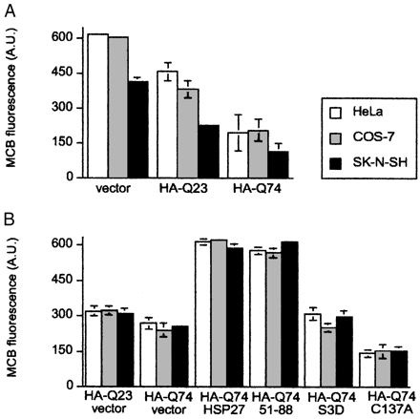
Figure 11. Cells expressing mutant huntingtin (httEx1) have decreased levels of reduced glutathione (GSH), ...
Notes:
Figure 11. Cells expressing mutant huntingtin (httEx1) have decreased levels of reduced glutathione (GSH), which is increased by coexpression of HSP27. (A) Comparison of cellular content of GSH in HeLa, COS-7 and SK-N-SH cells expressing empty vector or HA-tagged httEx1–Q23 or –Q74; there is a significant reduction of GSH levels in Q74 cells versus Q23 cells in all cell types (P<0.05). (B) Comparison of GSH levels in cells coexpressing HA-tagged httQ74 and empty vector or wild-type HSP27 or mutants. Q74 cells expressing empty vector show a reduction in GSH levels compared with Q23 cells (all cell types; P<0.05). Note that coexpression of wild-type HSP27 and the cyt c binding-deficient mutant Δ51–88 increase intracellular GSH levels in Q74 cells compared with empty vector (all cell types; P<0.001), but not the triple phosphorylation mimicry mutant S3D (S15,78,82D) (all cell types; not significant). There are decreased GSH levels in Q74 cells for the C137A mutant compared with empty vector (all cell types; P<0.05). Also note the inverse relation between ROS and GSH levels (Figs 8 and 10). For all experiments, the total GSH cellular content was determined using monochlorobimane (MCB) (see Materials and Methods). Paired t-tests were performed on data from three independent transfection experiments in (A) and (B) [means with error bars (SD) are presented].
Unless provided in the caption above, the following copyright applies to the content of this slide:

