Slide 1
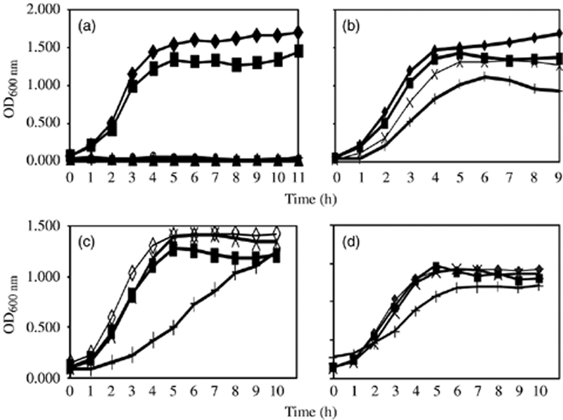
1 The effect of ZnO nanoparticles on the growth of Staphylococcus aureus strain RN6390. Cultures were set up at ...
Notes:
1 The effect of ZnO nanoparticles on the growth of Staphylococcus aureus strain RN6390. Cultures were set up at an initial inoculum of 0.5% dilution from overnight cultures (equivalent to 0.04–0.06 OD) in nutrient broth containing various concentrations from 0 to 5 mM (0–0.04%; ⋄, control 0 mM; ▪, 0.5 mM; ×, 2 mM; +, 5 mM) of ZnO nanoparticles colloidal suspension from two different sources. Cultures were incubated at 37°C with constant shaking at 220 r.p.m under normal ambient laboratory light conditions (a and b) and in the dark (c and d). (a and c) ZnO nanoparticles with average particle diameter c. 8 nm; (b and d) ZnO nanoparticles with average particle diameter c. 50−70 nm.
Unless provided in the caption above, the following copyright applies to the content of this slide: © 2007 Federation of European Microbiological Societies

Slide 2
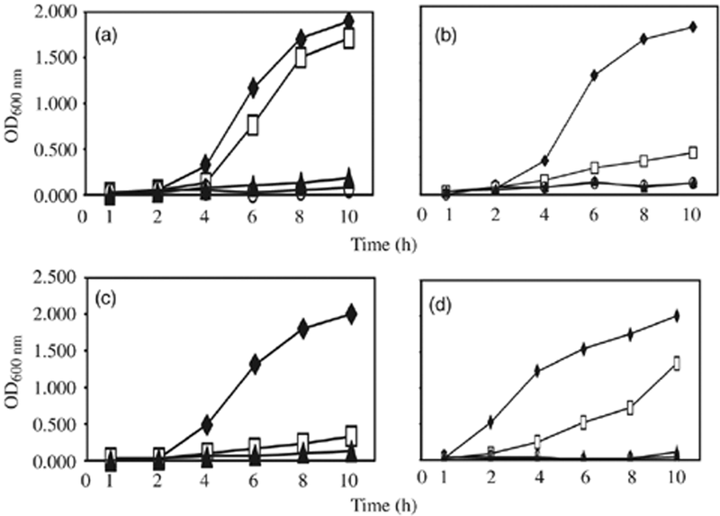
2 Growth curves of various bacterial strains in tryptic soya broth (a, b and c) and LB (d) media in the ...
Notes:
2 Growth curves of various bacterial strains in tryptic soya broth (a, b and c) and LB (d) media in the presence of various concentrations of ZnO nanoparticles with smaller particle diameter. Cultures were set up and grown under the same conditions as described in Fig. 1a, expect that different concentrations were used (♦, control 0 mM; □, 2 mM; ▴, 5 mM; ○, 10 mM). (a) Staphylococcus aureus N315; (b) Staphylococcus epidermidis 1487; (c) Streptococcus pyogenes NZ131 and (d) Bacillus subtilis 168.
Unless provided in the caption above, the following copyright applies to the content of this slide: © 2007 Federation of European Microbiological Societies

