Slide 1
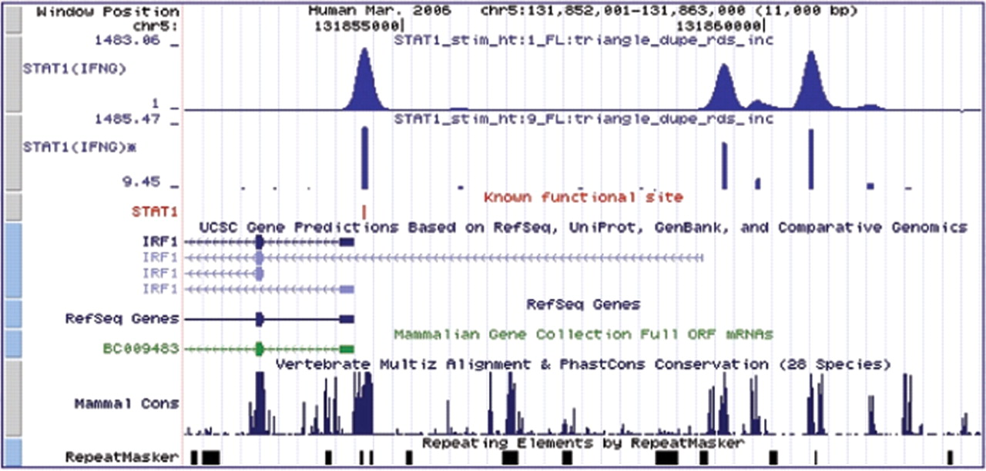
Fig. 1. FindPeaks 3.1 has several functions for refining peak locations, which can be employed to obtain narrow ...
Notes:
Fig. 1. FindPeaks 3.1 has several functions for refining peak locations, which can be employed to obtain narrow boundaries of the peaks, likely to contain the sites of interest. The top line (STAT1(IFNG)) shows the unprocessed peaks obtained from a ChIP-Seq experiment (Robertson et al., 2007). The line below (STAT1(IFNG)*) shows the refined peaks, using several features of the FindPeaks 3.1 application, yielding narrow peaks which corresponds well to the known binding site (red).
Unless provided in the caption above, the following copyright applies to the content of this slide: © 2008 The Author(s)This is an Open Access article distributed under the terms of the Creative Commons Attribution Non-Commercial License (http://creativecommons.org/licenses/by-nc/2.0/uk/) which permits unrestricted non-commercial use, distribution, and reproduction in any medium, provided the original work is properly cited.

