Slide 1
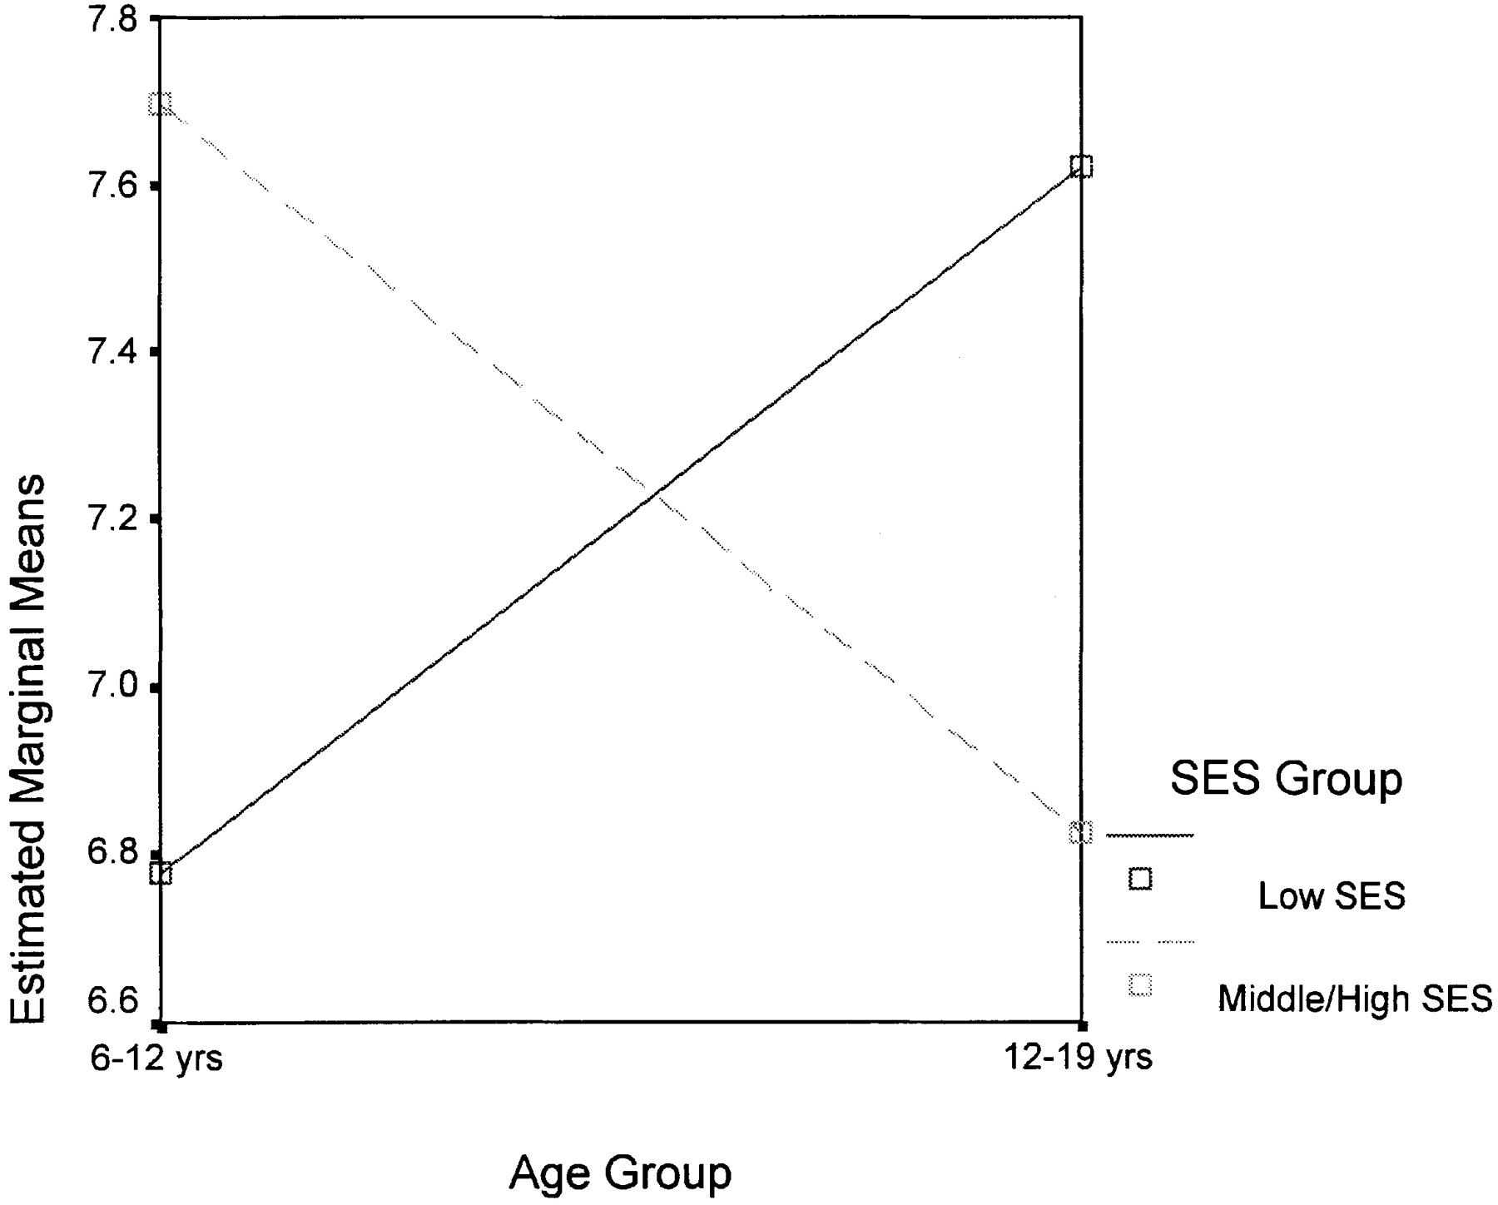
Fig. 2. Physical self-esteem scores of normal weight children and adolescents in different SES groups.
Notes:
Fig. 2. Physical self-esteem scores of normal weight children and adolescents in different SES groups.
Unless provided in the caption above, the following copyright applies to the content of this slide: © Oxford University Press

