Slide 1
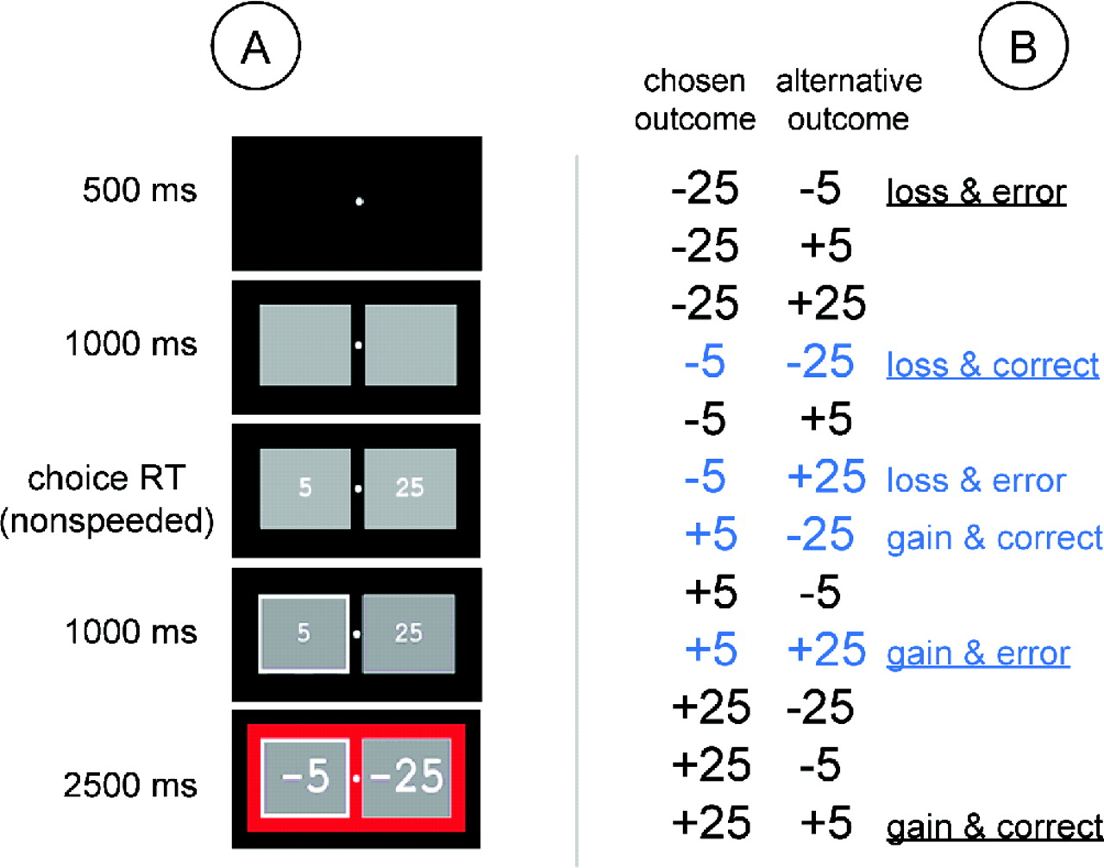
Figure 1. (A) Example of stimulus events in the gambling task. The duration of each stimulus event is ...
Notes:
Figure 1. (A) Example of stimulus events in the gambling task. The duration of each stimulus event is indicated. See text for details. (B) List of possible combinations of chosen outcome and alternative outcome. The blue conditions indicate the four conditions chosen here to analyze the effects of gain versus loss and correct versus error. The underlined conditions indicate the four conditions chosen by Gehring and Willoughby (2002a). ‘Loss’ and ‘gain’ indicate that the chosen outcome yielded a financial penalty or reward, respectively. ‘Error’ indicates that the alternative outcome would have yielded a larger reward or a smaller penalty, relative to the chosen outcome. ‘Correct’ indicates that the alternative outcome would have yielded a smaller reward or a larger penalty, relative to the chosen outcome.
Unless provided in the caption above, the following copyright applies to the content of this slide:

Slide 2
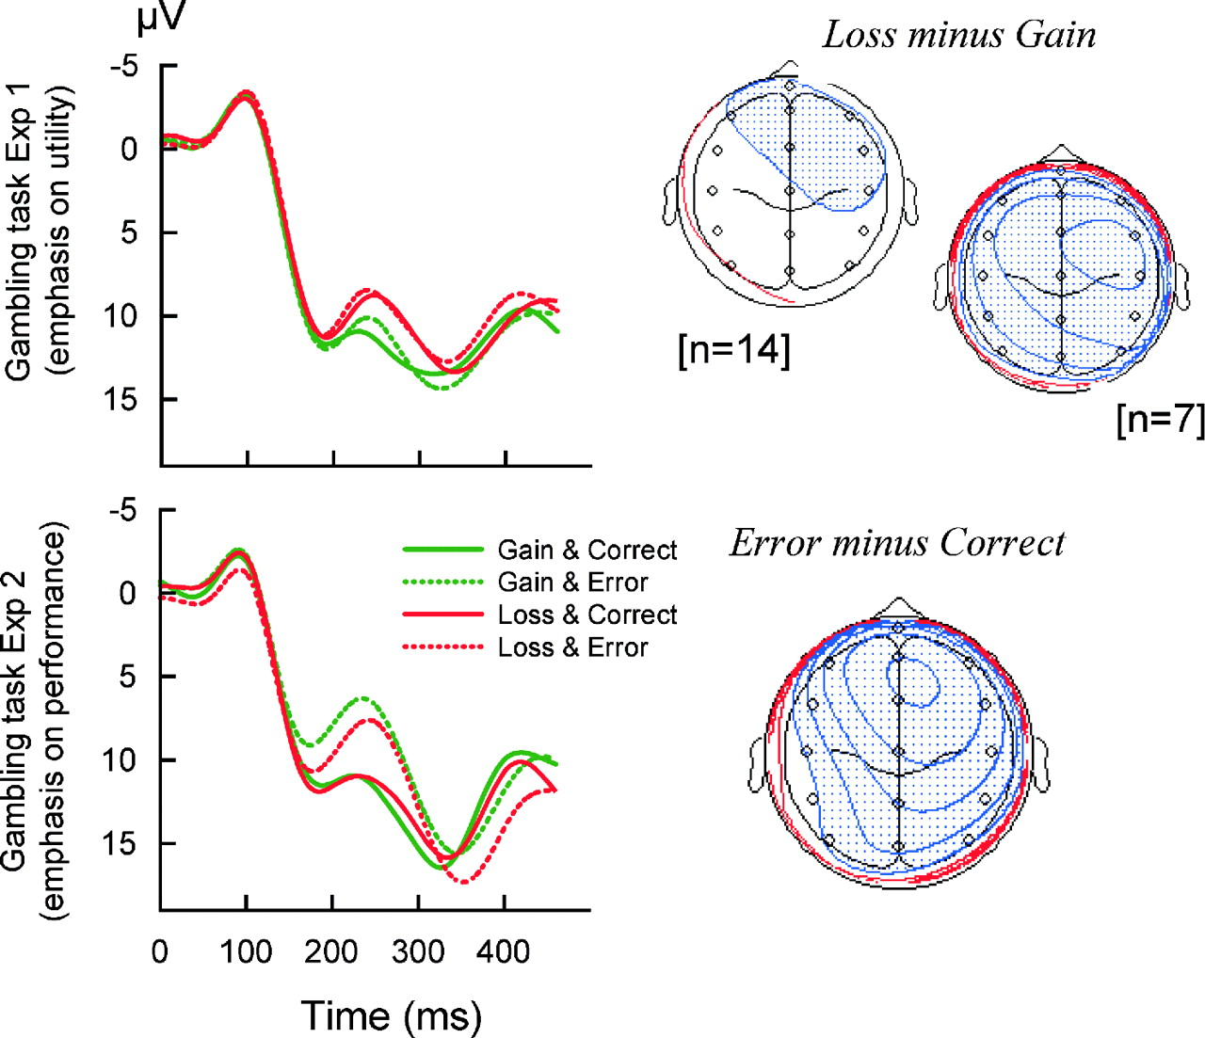
Figure 2. (Left panel) Feedback-locked ERPs at electrode FCz. Data from the gambling task in Experiment 1 ...
Notes:
Figure 2. (Left panel) Feedback-locked ERPs at electrode FCz. Data from the gambling task in Experiment 1 (top) and 2 (bottom) are shown for four of the conditions. (Right panel) Voltage maps representing the scalp topography of the ERN difference waveform at its peak latency. The subtraction underlying each difference waveform is indicated next to each map. Blue regions indicate negative values, red regions indicate positive values. The decrease/increase in voltage represented by each isopotential line is 0.04 µV.
Unless provided in the caption above, the following copyright applies to the content of this slide:

Slide 3
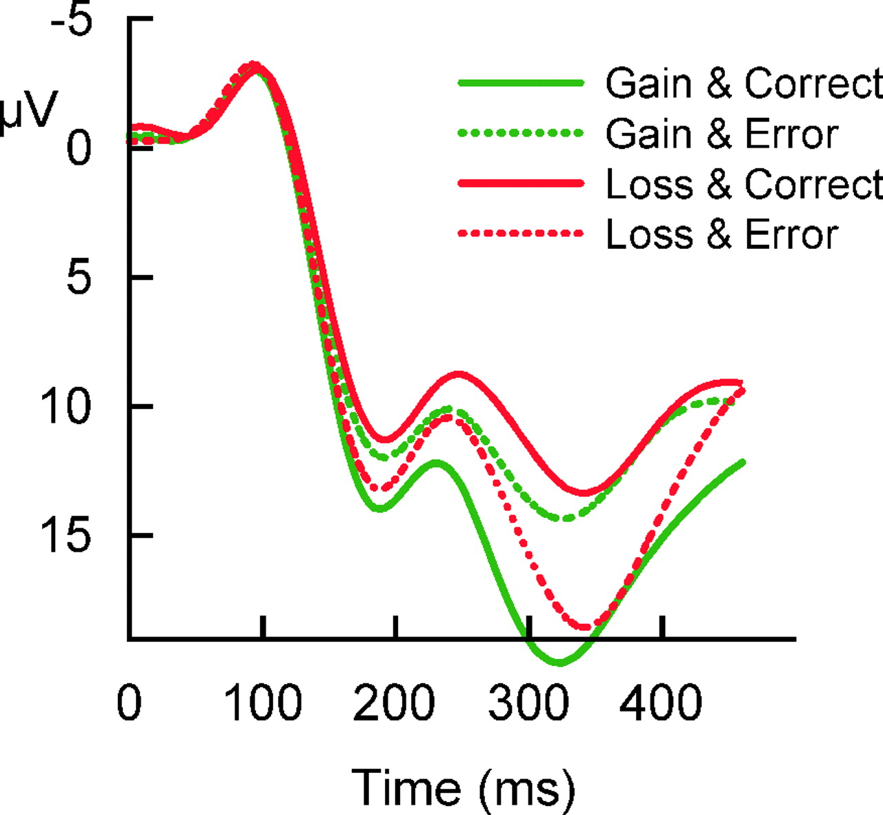
Figure 3. Feedback-locked ERPs at electrode FCz from the gambling task in Experiment 1. Data are shown for ...
Notes:
Figure 3. Feedback-locked ERPs at electrode FCz from the gambling task in Experiment 1. Data are shown for the conditions that were compared by Gehring and Willoughby (2002a). These data also illustrate the effect of differences in absolute reward magnitude on P300 amplitude, and the resulting difficulty of measuring ERN amplitude.
Unless provided in the caption above, the following copyright applies to the content of this slide:

