Slide 1
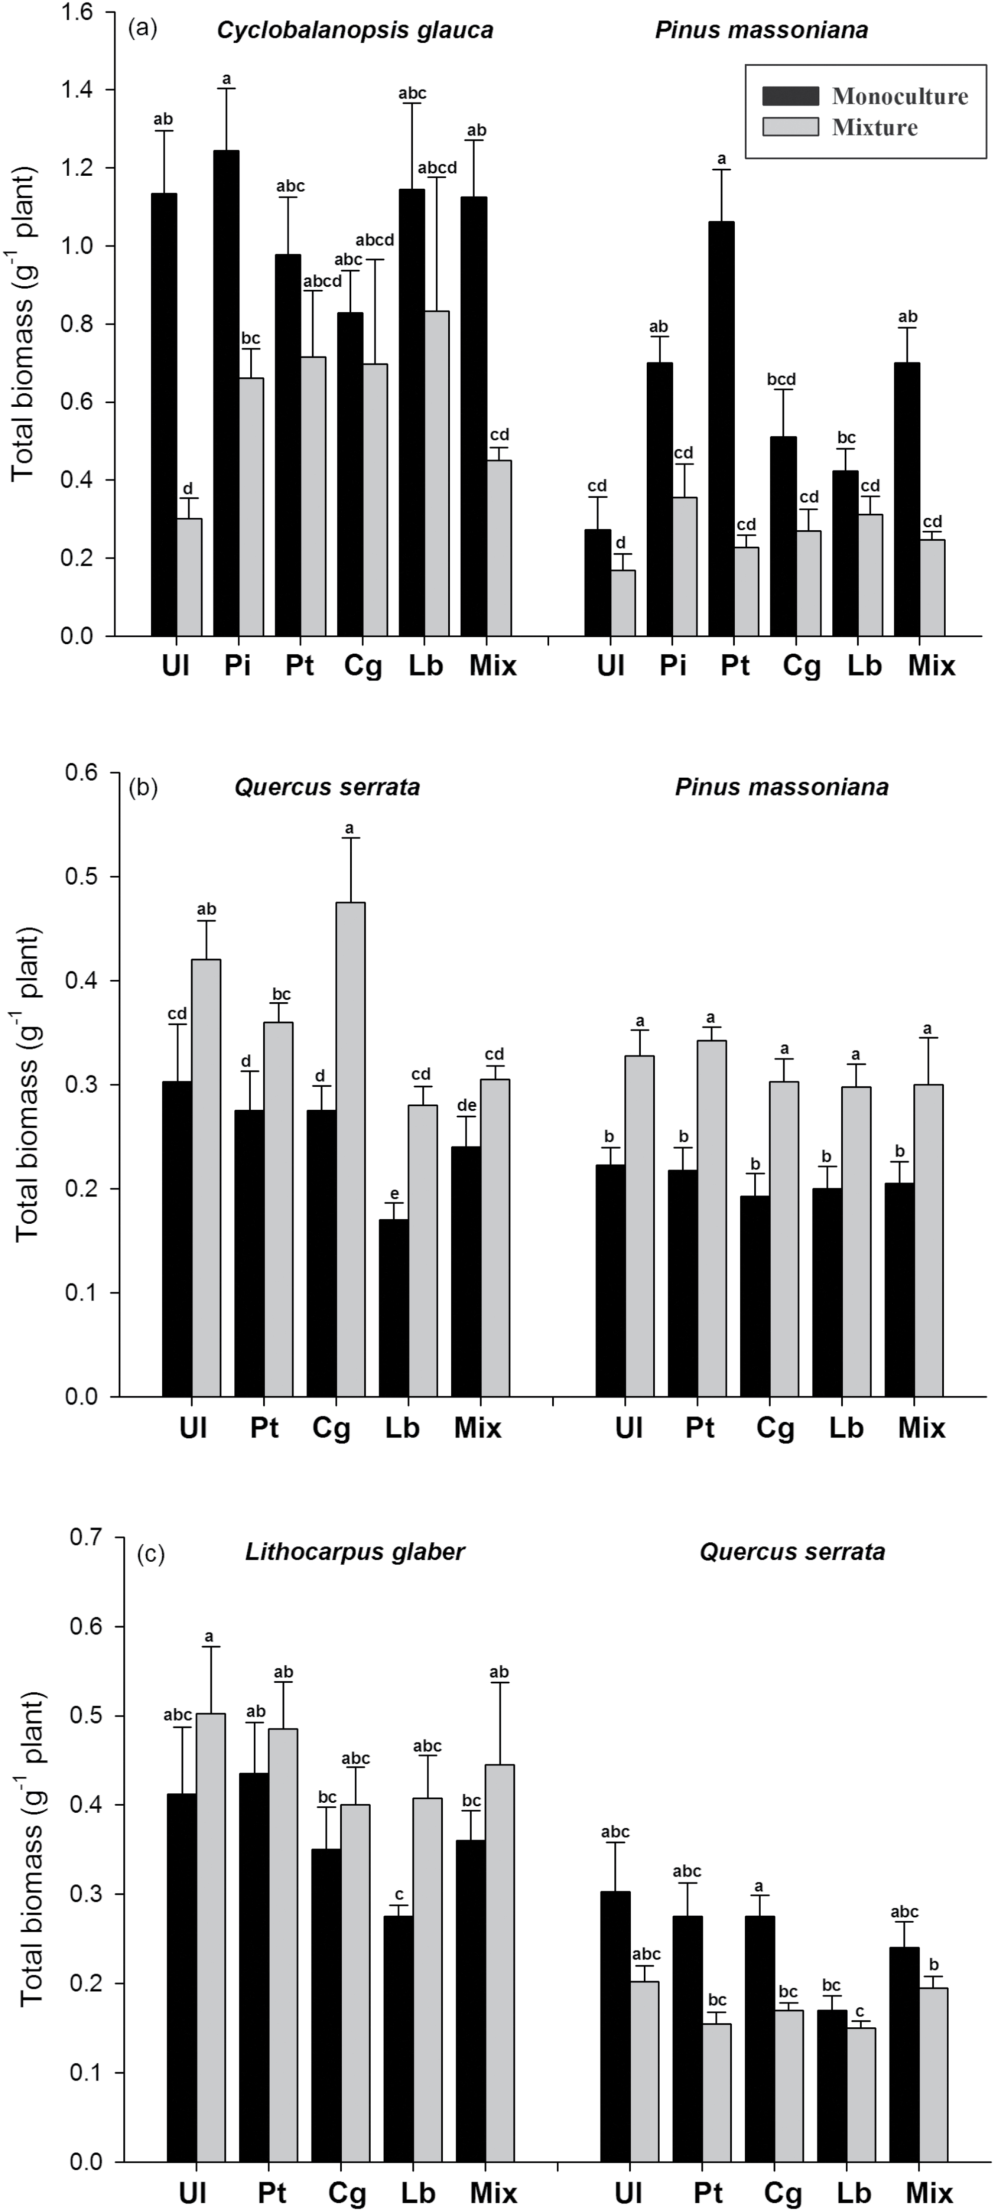
Figure 1: total biomass of plant species in monocultures and mixtures among different treatments in the Cyclobalanopsis ...
Notes:
Figure 1: total biomass of plant species in monocultures and mixtures among different treatments in the Cyclobalanopsis glauca–Pinus massoniana combination (a), Quercus serrata–Pinus massoniana combination (b) and Lithocarpus glaber–Quercus serrata combination (c). UI = uninoculated control, Pi = Paxillus involutus, Pt = Pisolithus tinctorius, Cg = Cenococcum geophilum, Lb = Laccaria bicolor and Mix = mixture of the three (Pis. tinctorius, Ce. geophilum and La. bicolor) or four fungal species. Means (n = 4 ± SE) shared the same letter within a plant species are not significantly different according to Tukey’s HSD or Dunnett’s T3 post hoc test at P < 0.05.
Unless provided in the caption above, the following copyright applies to the content of this slide: © The Author 2016. Published by Oxford University Press on behalf of the Institute of Botany, Chinese Academy of Sciences and the Botanical Society of China. All rights reserved. For permissions, please email: journals.permissions@oup.com

Slide 2
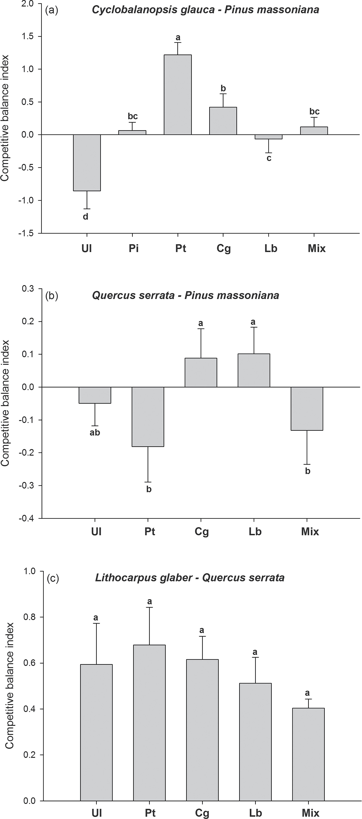
Figure 2: competitive balance index for interspecific competition between Cyclobalanopsis glauca and Pinus massoniana ...
Notes:
Figure 2: competitive balance index for interspecific competition between Cyclobalanopsis glauca and Pinus massoniana (a), between Quercus serrata and Pin. massoniana (b) and between Lithocarpus glaber and Q. serrata (c) among different treatments. UI = uninoculated control, Pi = Paxillus involutus, Pt = Pisolithus tinctorius, Cg = Cenococcum geophilum, Lb = Laccaria bicolor and Mix = mixture of the three (Pis. tinctorius, Ce. geophilum and La. bicolor) or four fungal species. Means (n = 4 ± SE) shared the same letter are not significantly different according to a Tukey’s test at P < 0.05.
Unless provided in the caption above, the following copyright applies to the content of this slide: © The Author 2016. Published by Oxford University Press on behalf of the Institute of Botany, Chinese Academy of Sciences and the Botanical Society of China. All rights reserved. For permissions, please email: journals.permissions@oup.com

