Slide 1
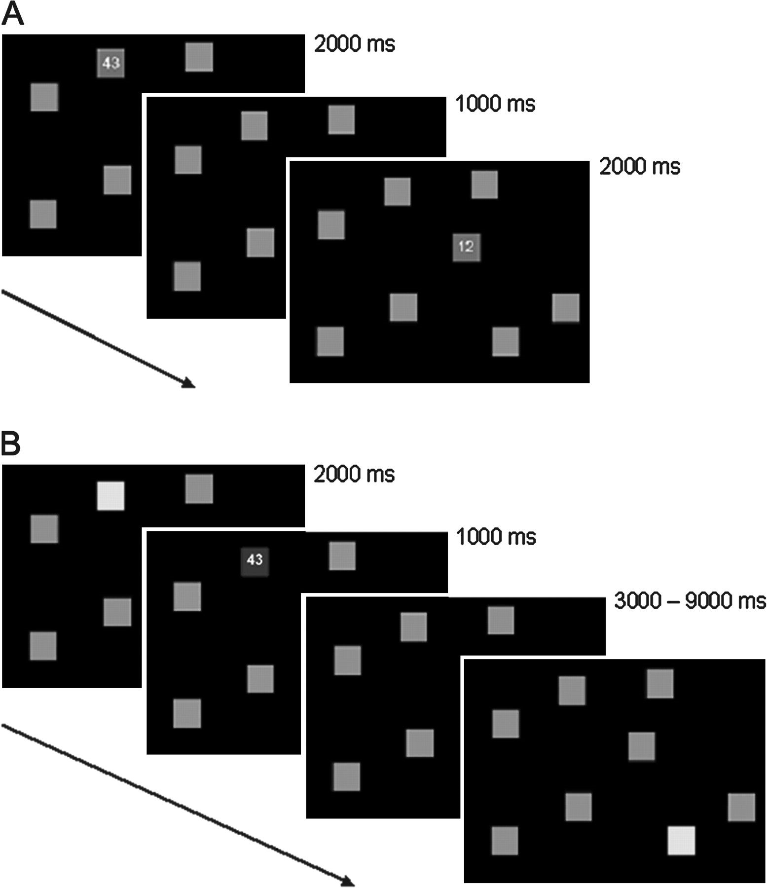
Figure 1. The spatial learning task used in the present study, with 8 location–number pairs. (A) Displays shown during ...
Notes:
Figure 1. The spatial learning task used in the present study, with 8 location–number pairs. (A) Displays shown during the encoding phase. Two-digit numbers appeared, in random order, successively at each of the 8 gray locations. (B) Displays shown during the recall phase. A yellow location represents a cue to which the participant must respond. Feedback consisted of the correct number on a blue location for a correct response, or a red location for an error (not shown here).
Unless provided in the caption above, the following copyright applies to the content of this slide: © The Author 2007. Published by Oxford University Press. All rights reserved. For permissions, please e-mail: journals.permissions@oxfordjournals.org

Slide 2
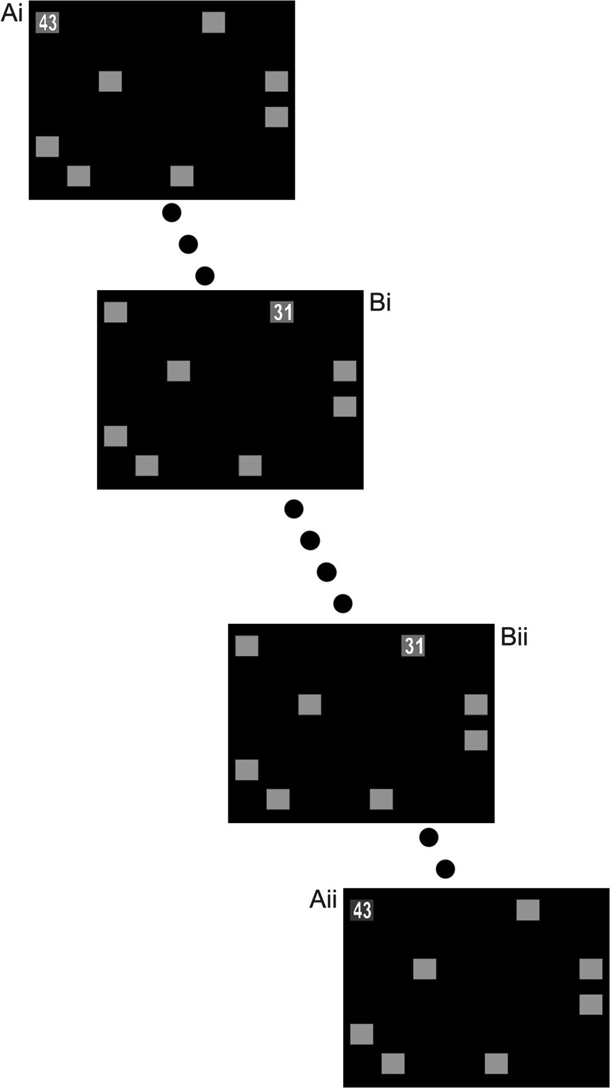
Figure 2. Method used to classify corrected and repeated errors. Feedback for a participant's response involved ...
Notes:
Figure 2. Method used to classify corrected and repeated errors. Feedback for a participant's response involved presentation of the correct number on either a red background, indicating an error, or a blue background, indicating an accurate recall response. Categorization as either a corrected or repeated error was determined by the participant's performance for the same trial during the next round. In example A, the participant correctly responded with the number 43 during the next recall probe of the top-left location (Aii), and so the initial error (Ai) is categorized as a corrected error. In example B, the participant incorrectly responds to the next presentation of the top-right location (Bii), and therefore the initial error (Bi) is categorized as a repeated error. Dots represent the intervening trials.
Unless provided in the caption above, the following copyright applies to the content of this slide: © The Author 2007. Published by Oxford University Press. All rights reserved. For permissions, please e-mail: journals.permissions@oxfordjournals.org

Slide 3
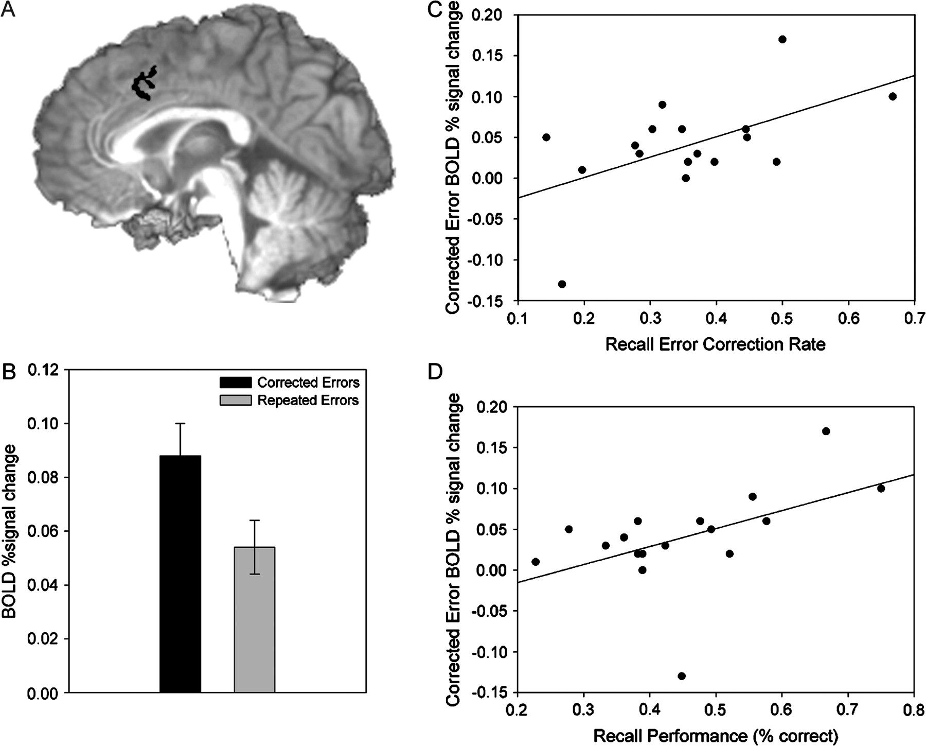
Figure 3. Corrected errors were associated with significantly higher levels of activity in the medial frontal cortex. ...
Notes:
Figure 3. Corrected errors were associated with significantly higher levels of activity in the medial frontal cortex. (A) Axial view of the error-related cingulate cluster (MNI: x = −3; y = 12; and z = 42). (B) Amount of BOLD signal change (relative to baseline) in the error-related pMFC region during corrected and repeated error events. (C) Individual differences in the rate of error correction (accurate performance for a trial that had produced an error in the previous round), correlated positively with the amount of activity in the pMFC during corrected errors (relative to repeated errors). (D) Recall performance, indexed as the percentage of correct responses from all trials, correlated positively with BOLD activity in the pMFC during corrected errors.
Unless provided in the caption above, the following copyright applies to the content of this slide: © The Author 2007. Published by Oxford University Press. All rights reserved. For permissions, please e-mail: journals.permissions@oxfordjournals.org

Slide 4
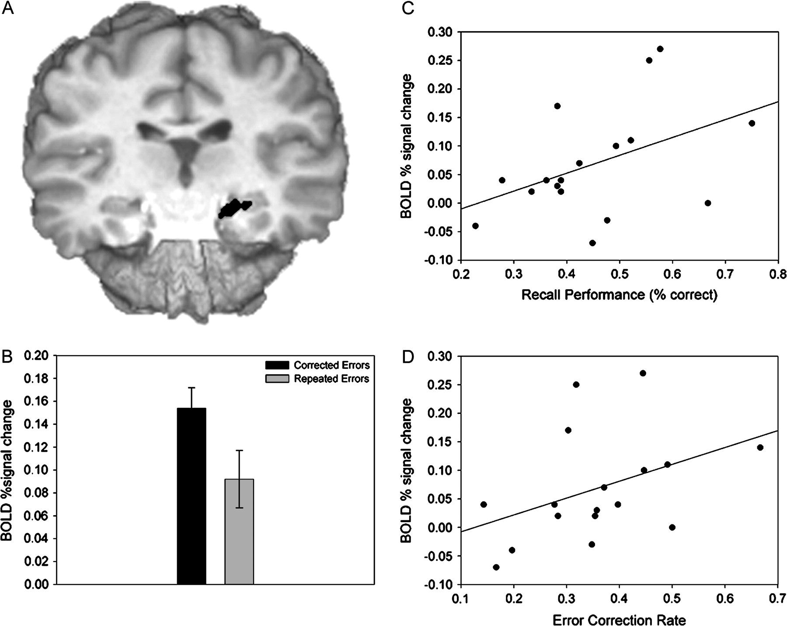
Figure 4. Corrected errors were associated with significantly higher levels of activity in the left hippocampus. (A) ...
Notes:
Figure 4. Corrected errors were associated with significantly higher levels of activity in the left hippocampus. (A) Coronal view of the error-related left hippocampal cluster (MNI: x = −18; y = −20; and z = −15). (B) Amount of BOLD signal change (relative to baseline) in the error-related hippocampal region during corrected and repeated error events. (C) Individual differences in the rate of error correction (accurate performance for a trial that had produced an error in the previous round), correlated positively with the amount of activity in the left hippocampus during corrected errors (relative to repeated errors). (D) Recall performance, indexed as the percentage of correct responses from all trials, positively correlated with BOLD activity in the left hippocampus during corrected errors.
Unless provided in the caption above, the following copyright applies to the content of this slide: © The Author 2007. Published by Oxford University Press. All rights reserved. For permissions, please e-mail: journals.permissions@oxfordjournals.org

