Slide 1
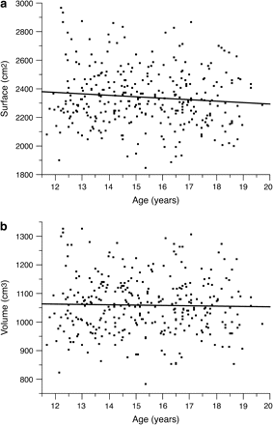
Figure 1. Changes in total hemispheric surface and total hemispheric volume with age. There was no significant ...
Notes:
Figure 1. Changes in total hemispheric surface and total hemispheric volume with age. There was no significant correlation between (a) total surface area (P= 0.10) nor of (b) total hemispheric volume (P= 0.70) with age.
Unless provided in the caption above, the following copyright applies to the content of this slide: © The Author 2008. Published by Oxford University Press. All rights reserved. For permissions, please e-mail: journals.permissions@oxfordjournals.org

Slide 2
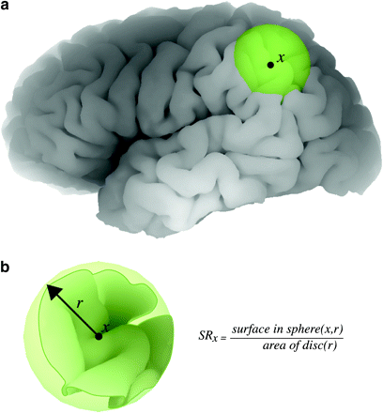
Figure 2. Surface ratio for the local estimation of folding. For every point x in the cortex (a), the local folding is ...
Notes:
Figure 2. Surface ratio for the local estimation of folding. For every point x in the cortex (a), the local folding is estimated through the ratio between the pial surface contained in a small sphere around the point and that of a disc of the same radius r (b). The disc approximates the area of that region if it were not folded. Sphere radius = 20 mm.
Unless provided in the caption above, the following copyright applies to the content of this slide: © The Author 2008. Published by Oxford University Press. All rights reserved. For permissions, please e-mail: journals.permissions@oxfordjournals.org

Slide 3
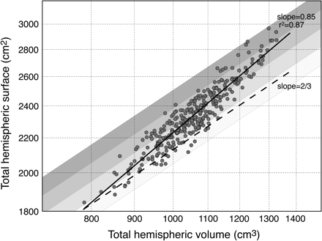
Figure 3. Cortical surface versus hemispheric volume (log–log graph). The slope of the regression line for ...
Notes:
Figure 3. Cortical surface versus hemispheric volume (log–log graph). The slope of the regression line for geometrically similar brains should be of 2/3 (dashed line). The actual slope of 0.85 (solid line) indicates that larger human brains have disproportionately more surface than the smaller. The shaded bands, with slope of 2/3, show brains with similar surface-to-volume ratio. The amount of surface relative to volume increases as we move from the lighter, to the darker bands.
Unless provided in the caption above, the following copyright applies to the content of this slide: © The Author 2008. Published by Oxford University Press. All rights reserved. For permissions, please e-mail: journals.permissions@oxfordjournals.org

Slide 4
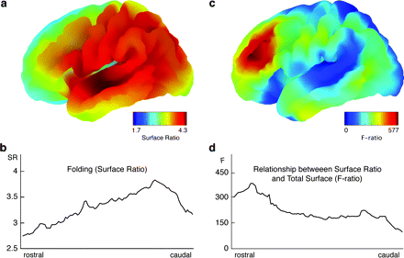
Figure 4. Map of average cortical folding (surface ratio) and significance of the effect of total cortical surface on ...
Notes:
Figure 4. Map of average cortical folding (surface ratio) and significance of the effect of total cortical surface on local folding (F-ratio values). (a) The local folding shows a rostro-caudal gradient, with the least folded regions situated toward the rostral part of the brain, and the more folded regions located toward the caudal part. (b) Rostro-caudal profile of folding estimated through the surface ratio. (c) The degree of folding varied with total cortical surface, the most significant effect, and the strongest correlations, being found in the prefrontal cortex. (d) Rostro-caudal profile of the F-ratio.
Unless provided in the caption above, the following copyright applies to the content of this slide: © The Author 2008. Published by Oxford University Press. All rights reserved. For permissions, please e-mail: journals.permissions@oxfordjournals.org

Slide 5
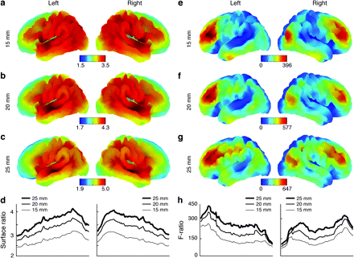
Figure 5. Effect of sphere radius length. The rostro-caudal gradient in the degree of folding, and the prefrontal ...
Notes:
Figure 5. Effect of sphere radius length. The rostro-caudal gradient in the degree of folding, and the prefrontal effect of total cortical surface on folding, are the same for surface ratios computed with a sphere-radius of 15 mm (a, e), 20 mm (b, f), and 25 mm (c, g). (a–c) Average folding map. (e–g) Effect of total cortical surface on folding. (d) Rostro-caudal profile of average folding. (h) Rostro-caudal profile of statistical significance (F-ratio).
Unless provided in the caption above, the following copyright applies to the content of this slide: © The Author 2008. Published by Oxford University Press. All rights reserved. For permissions, please e-mail: journals.permissions@oxfordjournals.org

