Slide 1
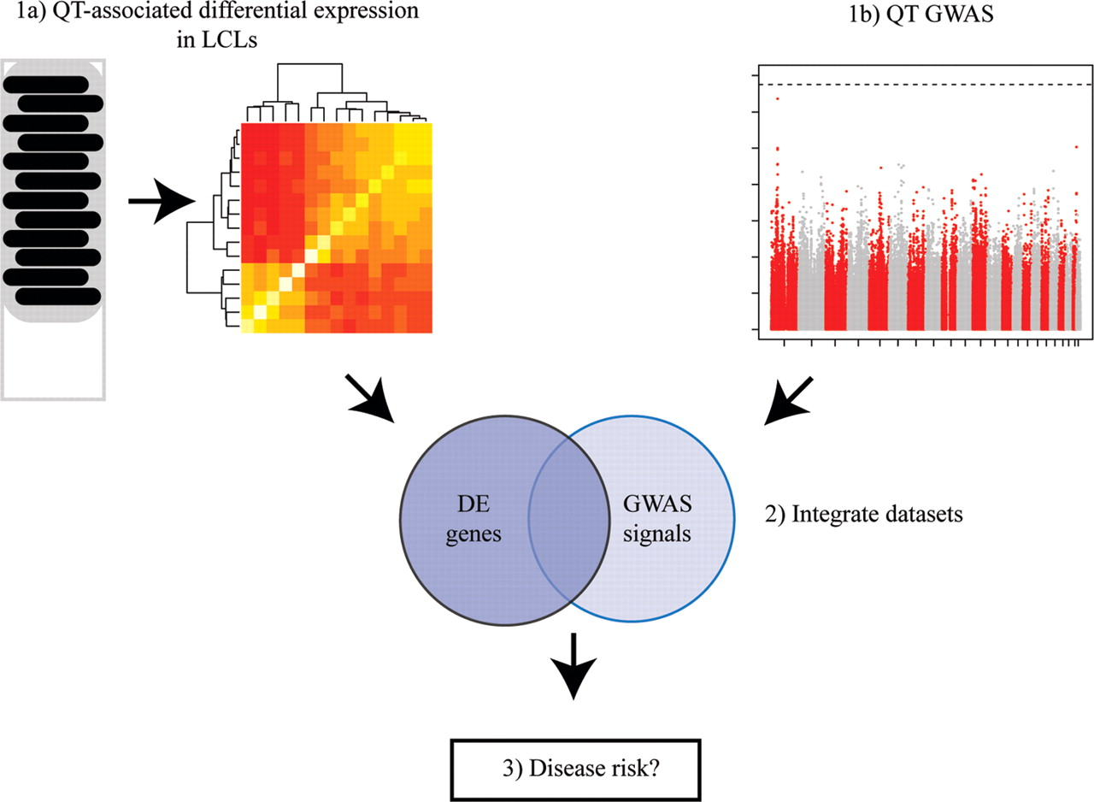
Figure 1. Study design. We performed a gene expression profiling study (1a) to identify differentially expressed genes ...
Notes:
Figure 1. Study design. We performed a gene expression profiling study (1a) to identify differentially expressed genes between individuals with low and high lymphocyte counts, as well as a GWAS (1b) to identify loci associated with lymphocyte counts. We integrated data from the two studies (2) to identify candidate genes that would have been missed by the GWAS alone. Ultimately, we asked whether these candidate genes are also associated with asthma (3).
Unless provided in the caption above, the following copyright applies to the content of this slide: © The Author 2012. Published by Oxford University PressThis is an Open Access article distributed under the terms of the Creative Commons Attribution Non-Commercial License (http://creativecommons.org/licenses/by-nc/2.5), which permits unrestricted non-commercial use, distribution, and reproduction in any medium, provided the original work is properly cited.

Slide 2
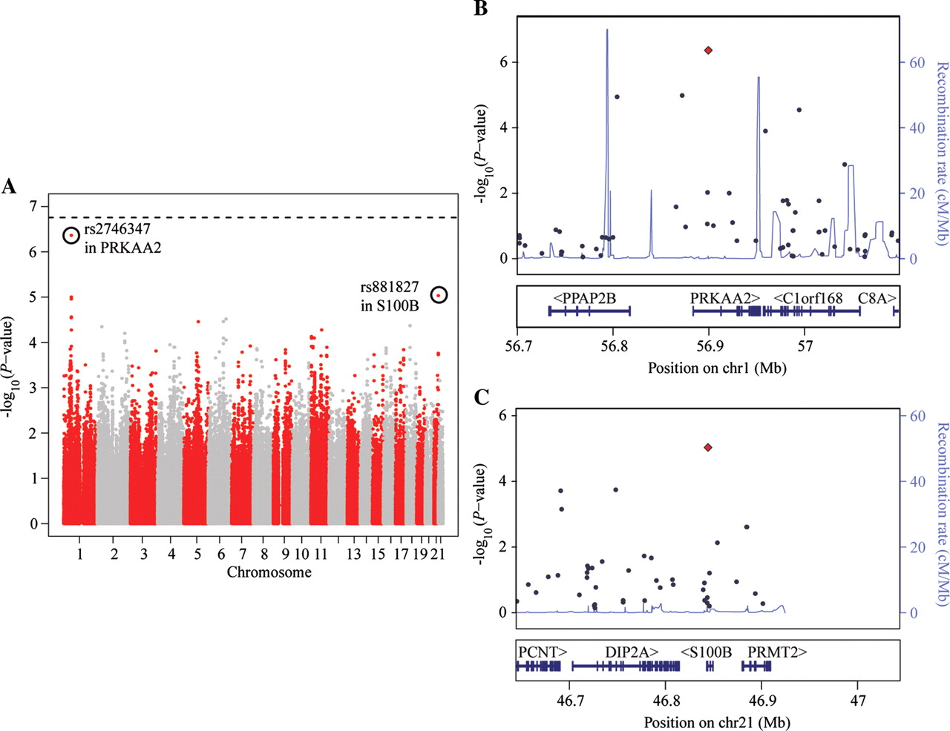
Figure 2. GWAS for lymphocyte count. (A) Manhattan plot displaying the −log₁₀ (P-values) for a GWAS of ...
Notes:
Figure 2. GWAS for lymphocyte count. (A) Manhattan plot displaying the −log10 (P-values) for a GWAS of lymphocyte counts in 462 Hutterites. The top two SNPs are circled. (B) Close-up of the region around the top SNP, rs2746347 (red point), which is located within the first intron of PRKAA2. The estimated recombination rate (based on HapMap data) in the region is also plotted. (C) Close-up of the region around the second most significant SNP, rs881827 (red point), located within an intron of S100B.
Unless provided in the caption above, the following copyright applies to the content of this slide: © The Author 2012. Published by Oxford University PressThis is an Open Access article distributed under the terms of the Creative Commons Attribution Non-Commercial License (http://creativecommons.org/licenses/by-nc/2.5), which permits unrestricted non-commercial use, distribution, and reproduction in any medium, provided the original work is properly cited.

Slide 3
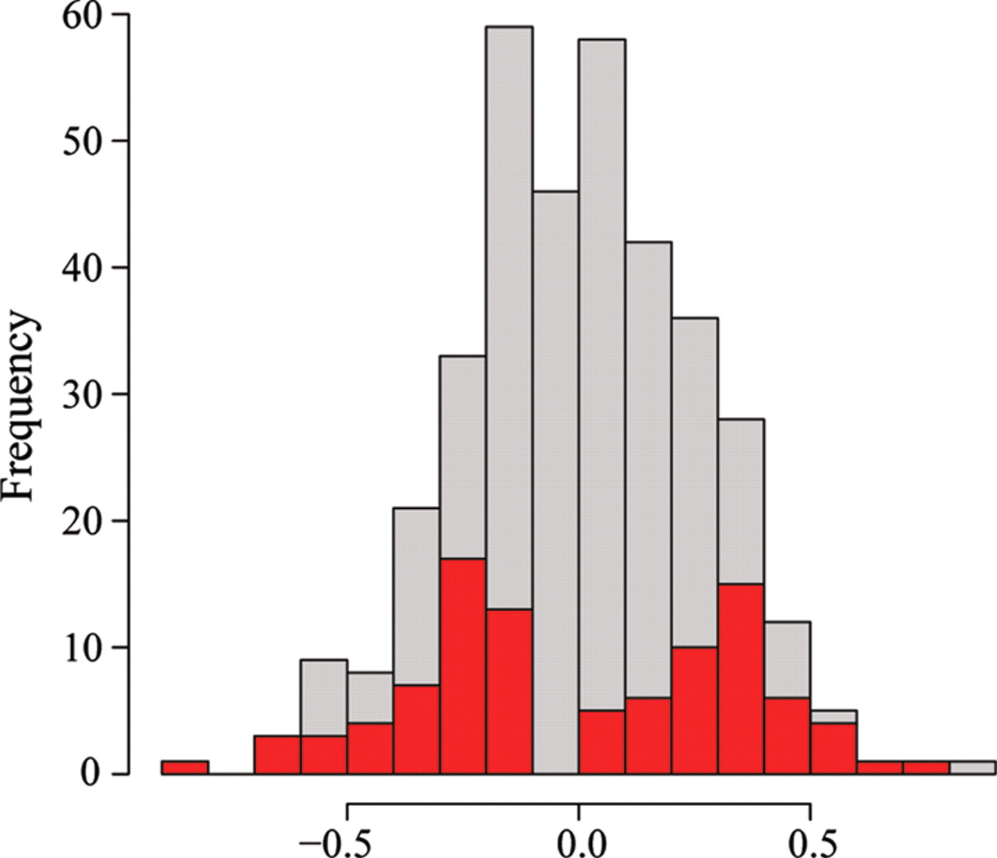
Figure 3. Choice of samples for the gene expression profiling study. A histogram of the distribution of lymphocyte ...
Notes:
Figure 3. Choice of samples for the gene expression profiling study. A histogram of the distribution of lymphocyte counts (x-axis; the transformed residuals after correcting for age) for all available samples (gray bars) and for the 96 individuals chosen for the gene expression profiling study (red bars).
Unless provided in the caption above, the following copyright applies to the content of this slide: © The Author 2012. Published by Oxford University PressThis is an Open Access article distributed under the terms of the Creative Commons Attribution Non-Commercial License (http://creativecommons.org/licenses/by-nc/2.5), which permits unrestricted non-commercial use, distribution, and reproduction in any medium, provided the original work is properly cited.

Slide 4
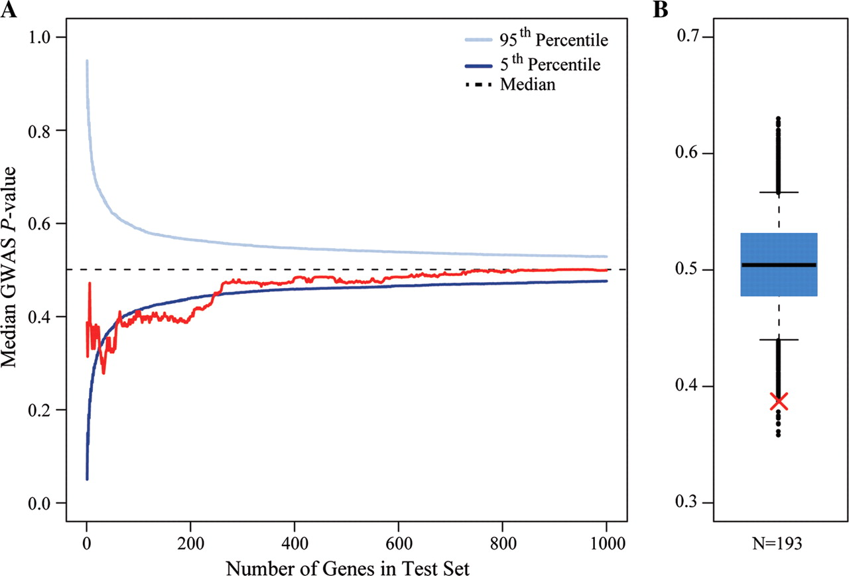
Figure 4. Integrating the GWAS and gene expression profiling studies. (A) The median lymphocyte count GWAS P-value ...
Notes:
Figure 4. Integrating the GWAS and gene expression profiling studies. (A) The median lymphocyte count GWAS P-value (y-axis) for an expanding window of genes is plotted in red. Genes are ordered by the strength of evidence supporting differences in expression level between individuals with low and high lymphocyte counts. The blue curves indicate the confidence interval for median P-values for random sets of genes at each test set size (based on 10 000 permutations). (B) A box plot of the distribution of median lymphocyte count GWAS P-values for random sets of 193 genes (based on 10 000 permutations). The whiskers extend to the 5th and 95th percentile. Black points indicate the observed medians outside this range. The red ‘X’ indicates the median P-value observed for the top 193 differentially expressed genes.
Unless provided in the caption above, the following copyright applies to the content of this slide: © The Author 2012. Published by Oxford University PressThis is an Open Access article distributed under the terms of the Creative Commons Attribution Non-Commercial License (http://creativecommons.org/licenses/by-nc/2.5), which permits unrestricted non-commercial use, distribution, and reproduction in any medium, provided the original work is properly cited.

Slide 5
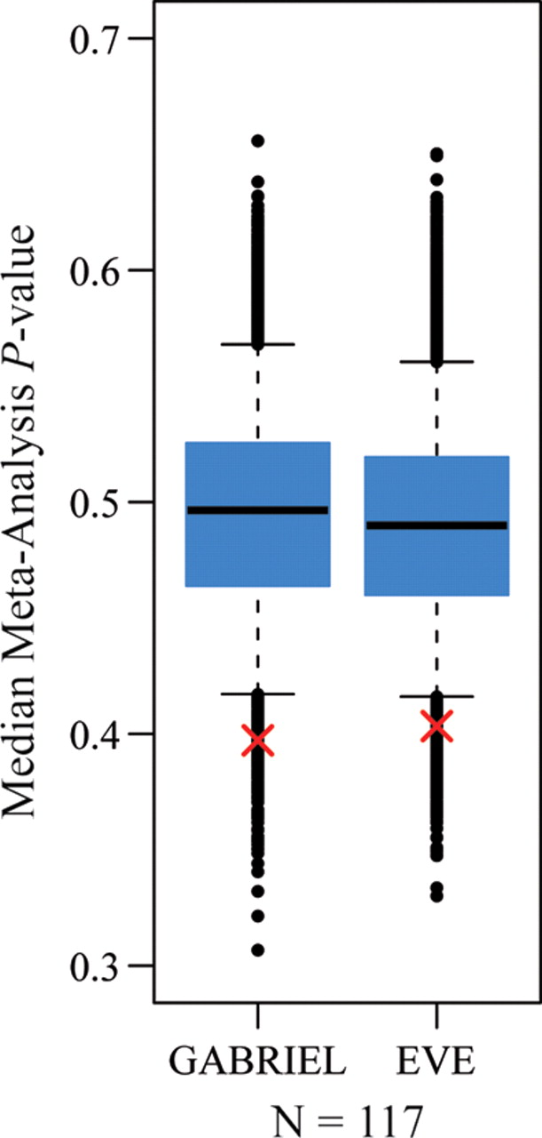
Figure 5. Integrating results with asthma meta-analyses. Box plots of the distribution of median GABRIEL meta-analysis ...
Notes:
Figure 5. Integrating results with asthma meta-analyses. Box plots of the distribution of median GABRIEL meta-analysis P-values and median EVE meta-analysis P-value for random sets of 117 genes (based on 10 000 permutations). The whiskers extend to the 5th and 95th percentiles. Black points indicate the observed medians outside this range. For each box plot, the red ‘X’ indicates the median P-value observed for the 117 genes carried forward based on the analysis of association with lymphocyte counts.
Unless provided in the caption above, the following copyright applies to the content of this slide: © The Author 2012. Published by Oxford University PressThis is an Open Access article distributed under the terms of the Creative Commons Attribution Non-Commercial License (http://creativecommons.org/licenses/by-nc/2.5), which permits unrestricted non-commercial use, distribution, and reproduction in any medium, provided the original work is properly cited.

