Slide 1
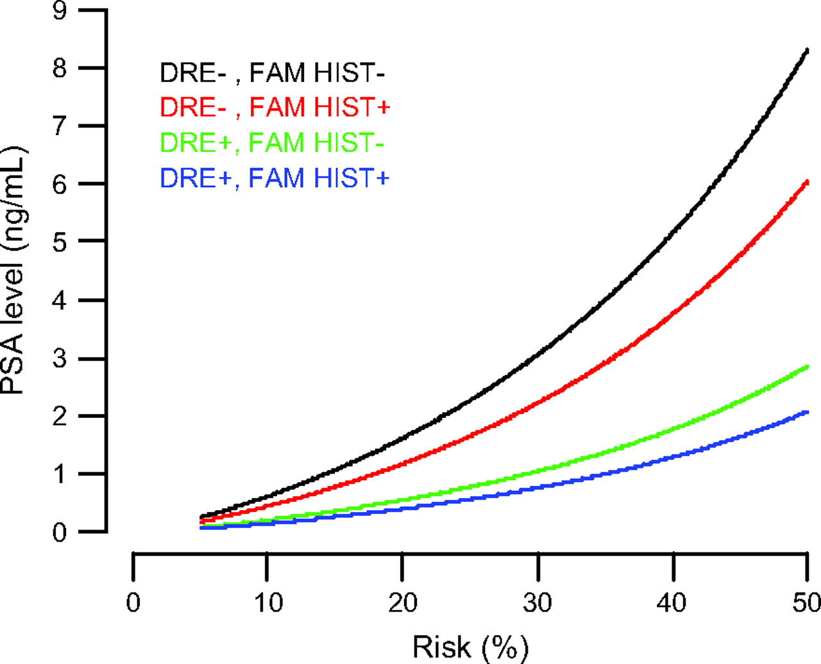
Fig. 3. Prostate-specific antigen (PSA) levels achieving specified risks of prostate cancer ranging from 5% to 50% ...
Notes:
Fig. 3. Prostate-specific antigen (PSA) levels achieving specified risks of prostate cancer ranging from 5% to 50% by digital rectal examination result and family history for men who had no previous prostate biopsy. DRE+ = an abnormal digital rectal examination that is suggestive of prostate cancer; DRE− = a normal digital rectal examination; FAM HIST+ = family history of prostate cancer; FAM HIST− = no family history of prostate cancer.
Unless provided in the caption above, the following copyright applies to the content of this slide: © The Author 2006. Published by Oxford University Press.

Slide 2
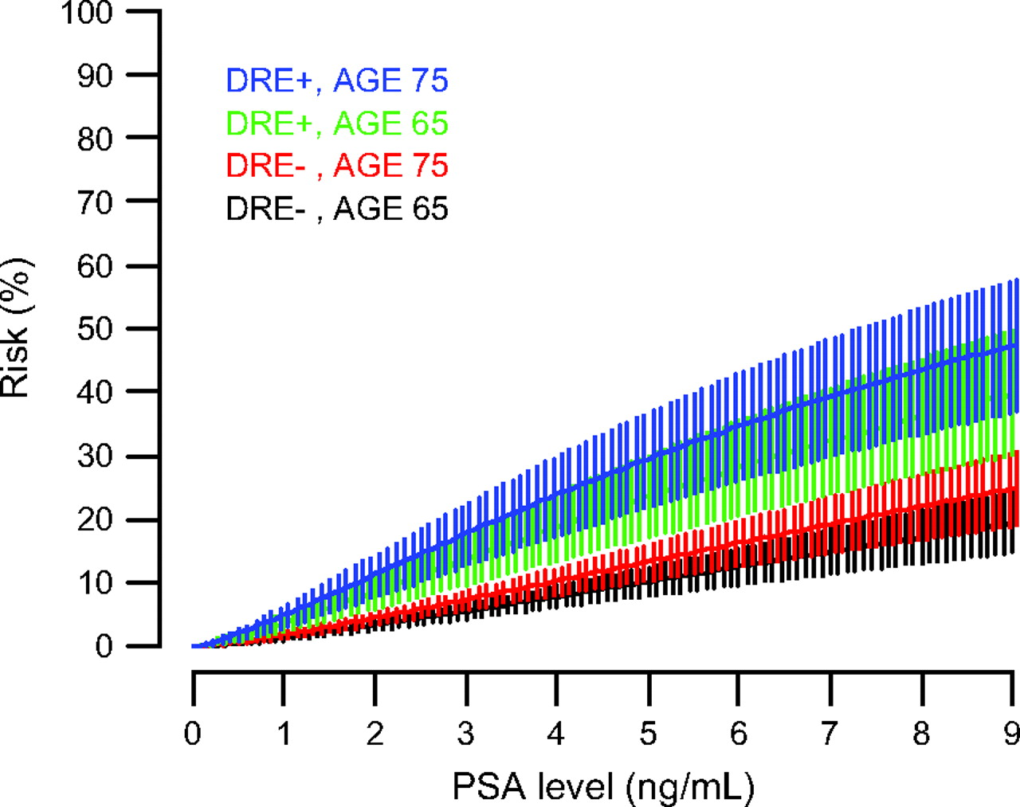
Fig. 2. Risk of high-grade prostate cancer as a function of prostate-specific antigen (PSA) level and digital rectal ...
Notes:
Fig. 2. Risk of high-grade prostate cancer as a function of prostate-specific antigen (PSA) level and digital rectal examination result for white men aged 65 years or 75 years who had no previous prostate biopsy. Vertical lines indicate pointwise 95% confidence intervals for the risk at each PSA level. DRE + = an abnormal digital rectal examination that is suggestive of prostate cancer; DRE − = a normal digital rectal examination.
Unless provided in the caption above, the following copyright applies to the content of this slide: © The Author 2006. Published by Oxford University Press.

Slide 3
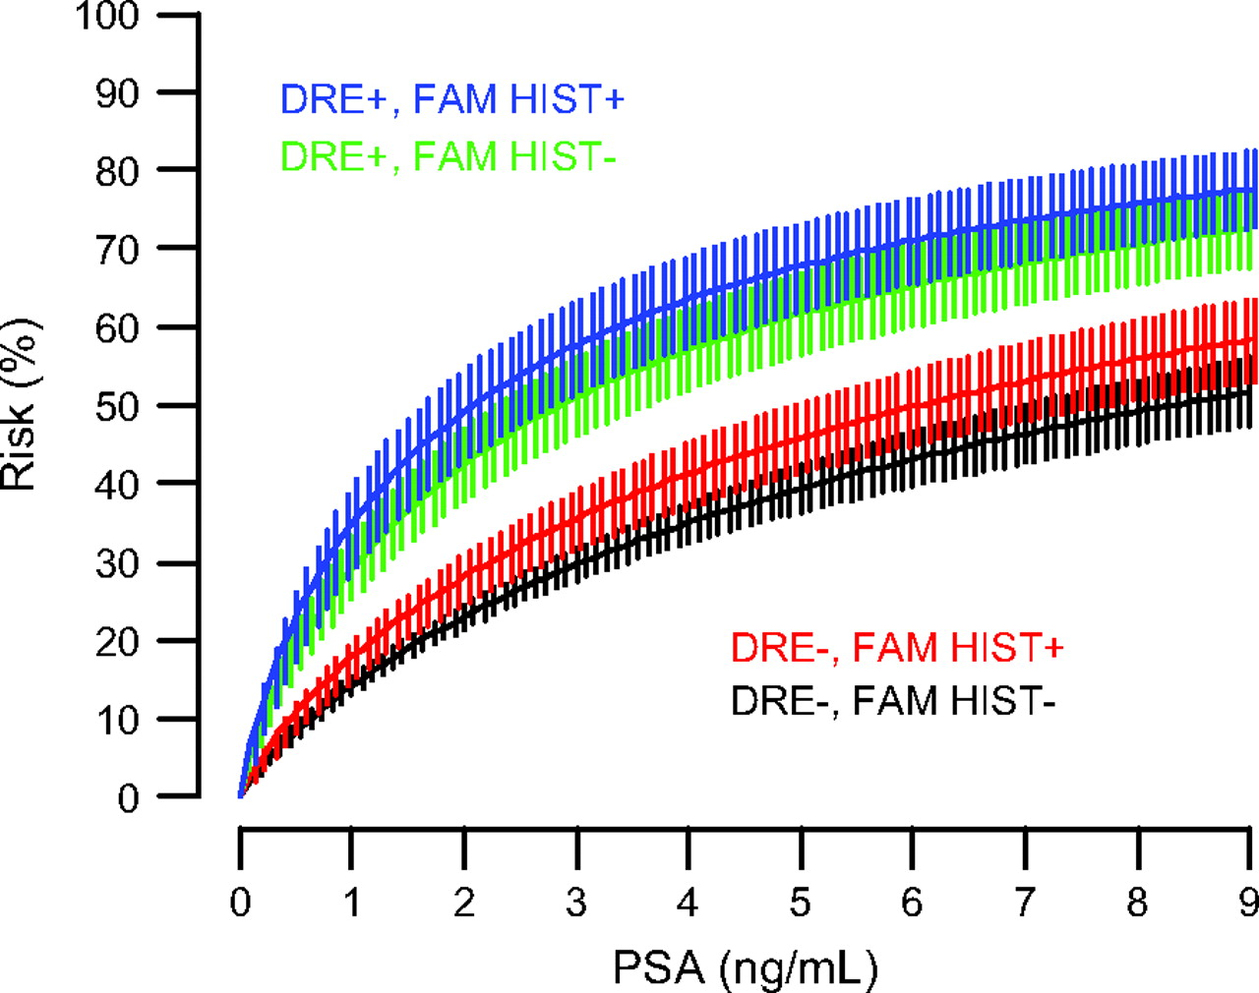
Fig. 1. Risk of prostate cancer as a function of prostate-specific (PSA) antigen level, digital rectal examination ...
Notes:
Fig. 1. Risk of prostate cancer as a function of prostate-specific (PSA) antigen level, digital rectal examination result, and family history of prostate cancer for men who did not have a previous prostate biopsy. Vertical lines indicate pointwise 95% confidence intervals for the risk at each PSA level. DRE+ = an abnormal digital rectal examination that is suggestive of prostate cancer; DRE− = a normal digital rectal examination; FAM HIST+ = family history of prostate cancer; FAM HIST− = no family history of prostate cancer.
Unless provided in the caption above, the following copyright applies to the content of this slide: © The Author 2006. Published by Oxford University Press.

