Slide 1
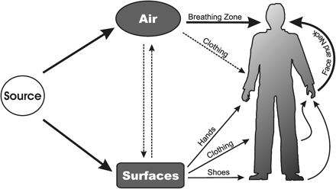
Fig. 1 Beryllium exposure-pathway model.
Notes:
Fig. 1 Beryllium exposure-pathway model.
Unless provided in the caption above, the following copyright applies to the content of this slide: The Author 2006. Published by Oxford University Press on behalf of the British Occupational Hygiene Society

Slide 2
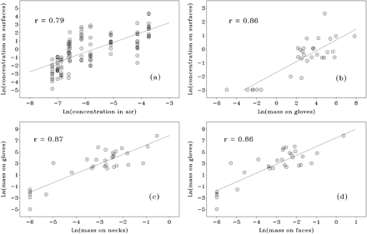
Fig. 2. Comparison plots illustrating the relationships of beryllium levels among (a) surface and air measurements, ...
Notes:
Fig. 2. Comparison plots illustrating the relationships of beryllium levels among (a) surface and air measurements, (b) surface and glove measurements, (c) glove and neck measurements and (d) glove and face measurements.
Unless provided in the caption above, the following copyright applies to the content of this slide: The Author 2006. Published by Oxford University Press on behalf of the British Occupational Hygiene Society

