Slide 1
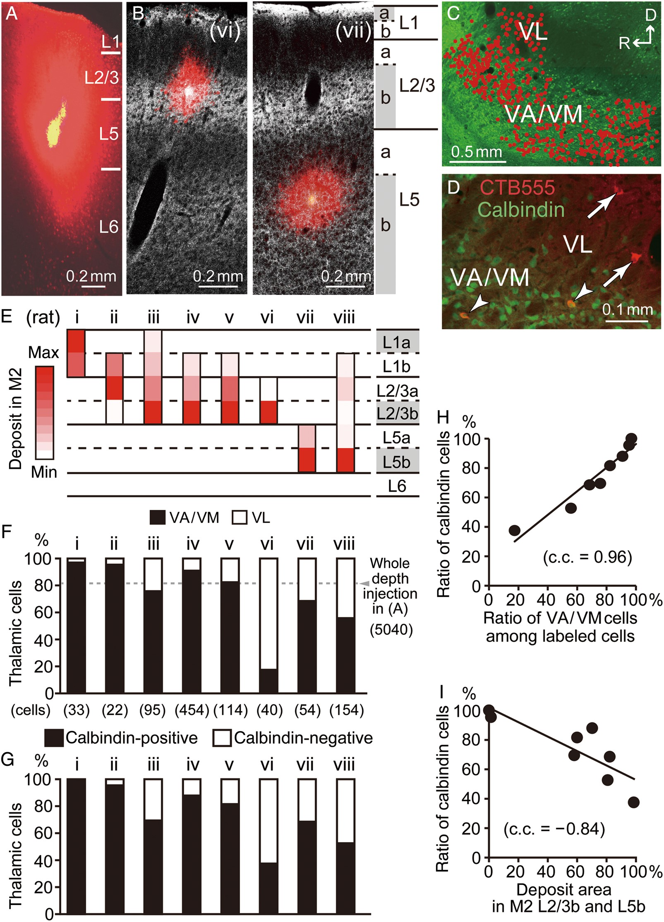
Figure 1. Laminar specificity of calbindin-positive and -negative thalamocortical inputs in the frontal cortex. (A) ...
Notes:
Figure 1. Laminar specificity of calbindin-positive and -negative thalamocortical inputs in the frontal cortex. (A) Massive Alexa Fluor 555-conjugated cholera toxin subunit B (CTB555) injection spanning L1 to upper L6 in secondary motor area (M2). (B) Localized CTB555 deposits in M2 (red; 2 cases shown). Gray scale image shows vesicular glutamate transporter type 2 (VGluT2) immunofluorescence, which presents denser VGluT2-positive puncta in layer (L) 1a, L2/3b, and L5b. Sagittal section, 20-µm thickness. Rat numbers (i–viii) are common in (B and E–G). (C) Retrogradely labeled thalamocortical cells by massive CTB555 injection shown in (A). Each red dot corresponds to a single labeled neuron. Ventral anterior/ventromedial (VA/VM) and ventrolateral (VL) nuclei were identified by additional calbindin immunostaining, showing stronger expression in VA/VM relative to VL. D, dorsal; R, rostral; Sagittal section (1.3 mm from the midline), 50-µm thickness. (D) Retrograde labeling of thalamocortical cells by iontophoretic injections of CTB555 into M2 (case viii in (E)). The VA/VM nuclei contain much more calbindin-positive cells than the VL nucleus. In accordance with calbindin cell distribution, labeled cells in VA/VM were mostly calbindin-positive (arrowheads), whereas those in VL were generally calbindin-negative (arrows). (E) Laminar localization of tracer deposits in M2. Color-coded scale, laminar proportions of the injection area from 0% (white) to the maximum (red) for individual injections. (F) Proportions of VA/VM and VL cells among the labeled thalamocortical cells. Black bar, VA/VM; white bar, VL. (n), total number of counted neurons. “Whole depth” indicates cells labeled by an extensive CTB555 injection, shown in (A). (G) Proportions of calbindin-positive and -negative cells among all labeled thalamocortical cells. Black bar, calbindin-positive; white bar, calbindin-negative. Note that the neuron populations are the same as those shown in (F). (H) Correlation between the ratio of calbindin-positive and VA/VM cells among the labeled cells (P < 0.01). c.c., correlation coefficient. (I) Negative correlations between the ratio of calbindin-positive cells among the labeled cells and the tracer deposit area proportions of L2/3b and L5b in the total deposit area (P < 0.01).
Unless provided in the caption above, the following copyright applies to the content of this slide: © The Author 2015. Published by Oxford University Press. All rights reserved. For Permissions, please e-mail: journals.permissions@oup.com

Slide 2
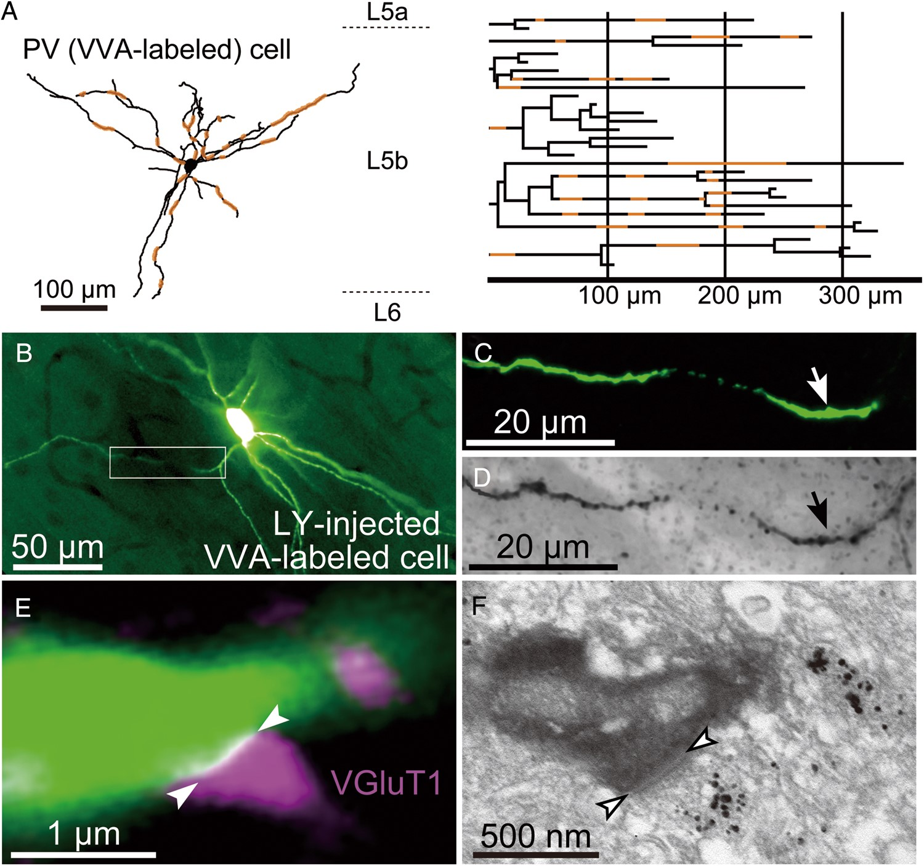
Figure 2. Appositions of VGluT-positive boutons on Vicia villosa agglutinin (VVA)-labeled dendrites. (A) Reconstruction ...
Notes:
Figure 2. Appositions of VGluT-positive boutons on Vicia villosa agglutinin (VVA)-labeled dendrites. (A) Reconstruction (left) and dendrogram (right) of a VVA-labeled putative PV-positive cell in L5b that was intracellularly stained with Lucifer yellow (LY). The orange-colored segments are the dendritic regions used for measurements of VGluT-positive bouton appositions. (B) Fluorescent microscopic image of a VVA-labeled cell visualized by LY injection. (C) LY-labeled dendrite of the VVA cell, which corresponds to the segment enclosed by a square in (B). (D) The same dendritic part as (C) but visualized with a DAB immunoreaction against LY for subsequent EM observation. This section was also immunostained for VGluT1 by silver enhancement. (E) VGluT1-positive bouton apposition (magenta) on a VVA cell dendrite (green) visualized by immunofluorescence and LY injection. This dendritic segment corresponds to those indicated by arrows in (C) and (D). The region between the 2 arrowheads represents a bouton apposition site. (F) Synapse formation at the VGluT1-positive bouton apposition on the VVA cell dendrite, shown in (E). The electron-dense immunoreactions were used for LY (DAB) and VGluT1 (silver enhancement). The region between the 2 arrowheads indicates an asymmetric synapse on the dendrite, which corresponds to that in (E).
Unless provided in the caption above, the following copyright applies to the content of this slide: © The Author 2015. Published by Oxford University Press. All rights reserved. For Permissions, please e-mail: journals.permissions@oup.com

Slide 3
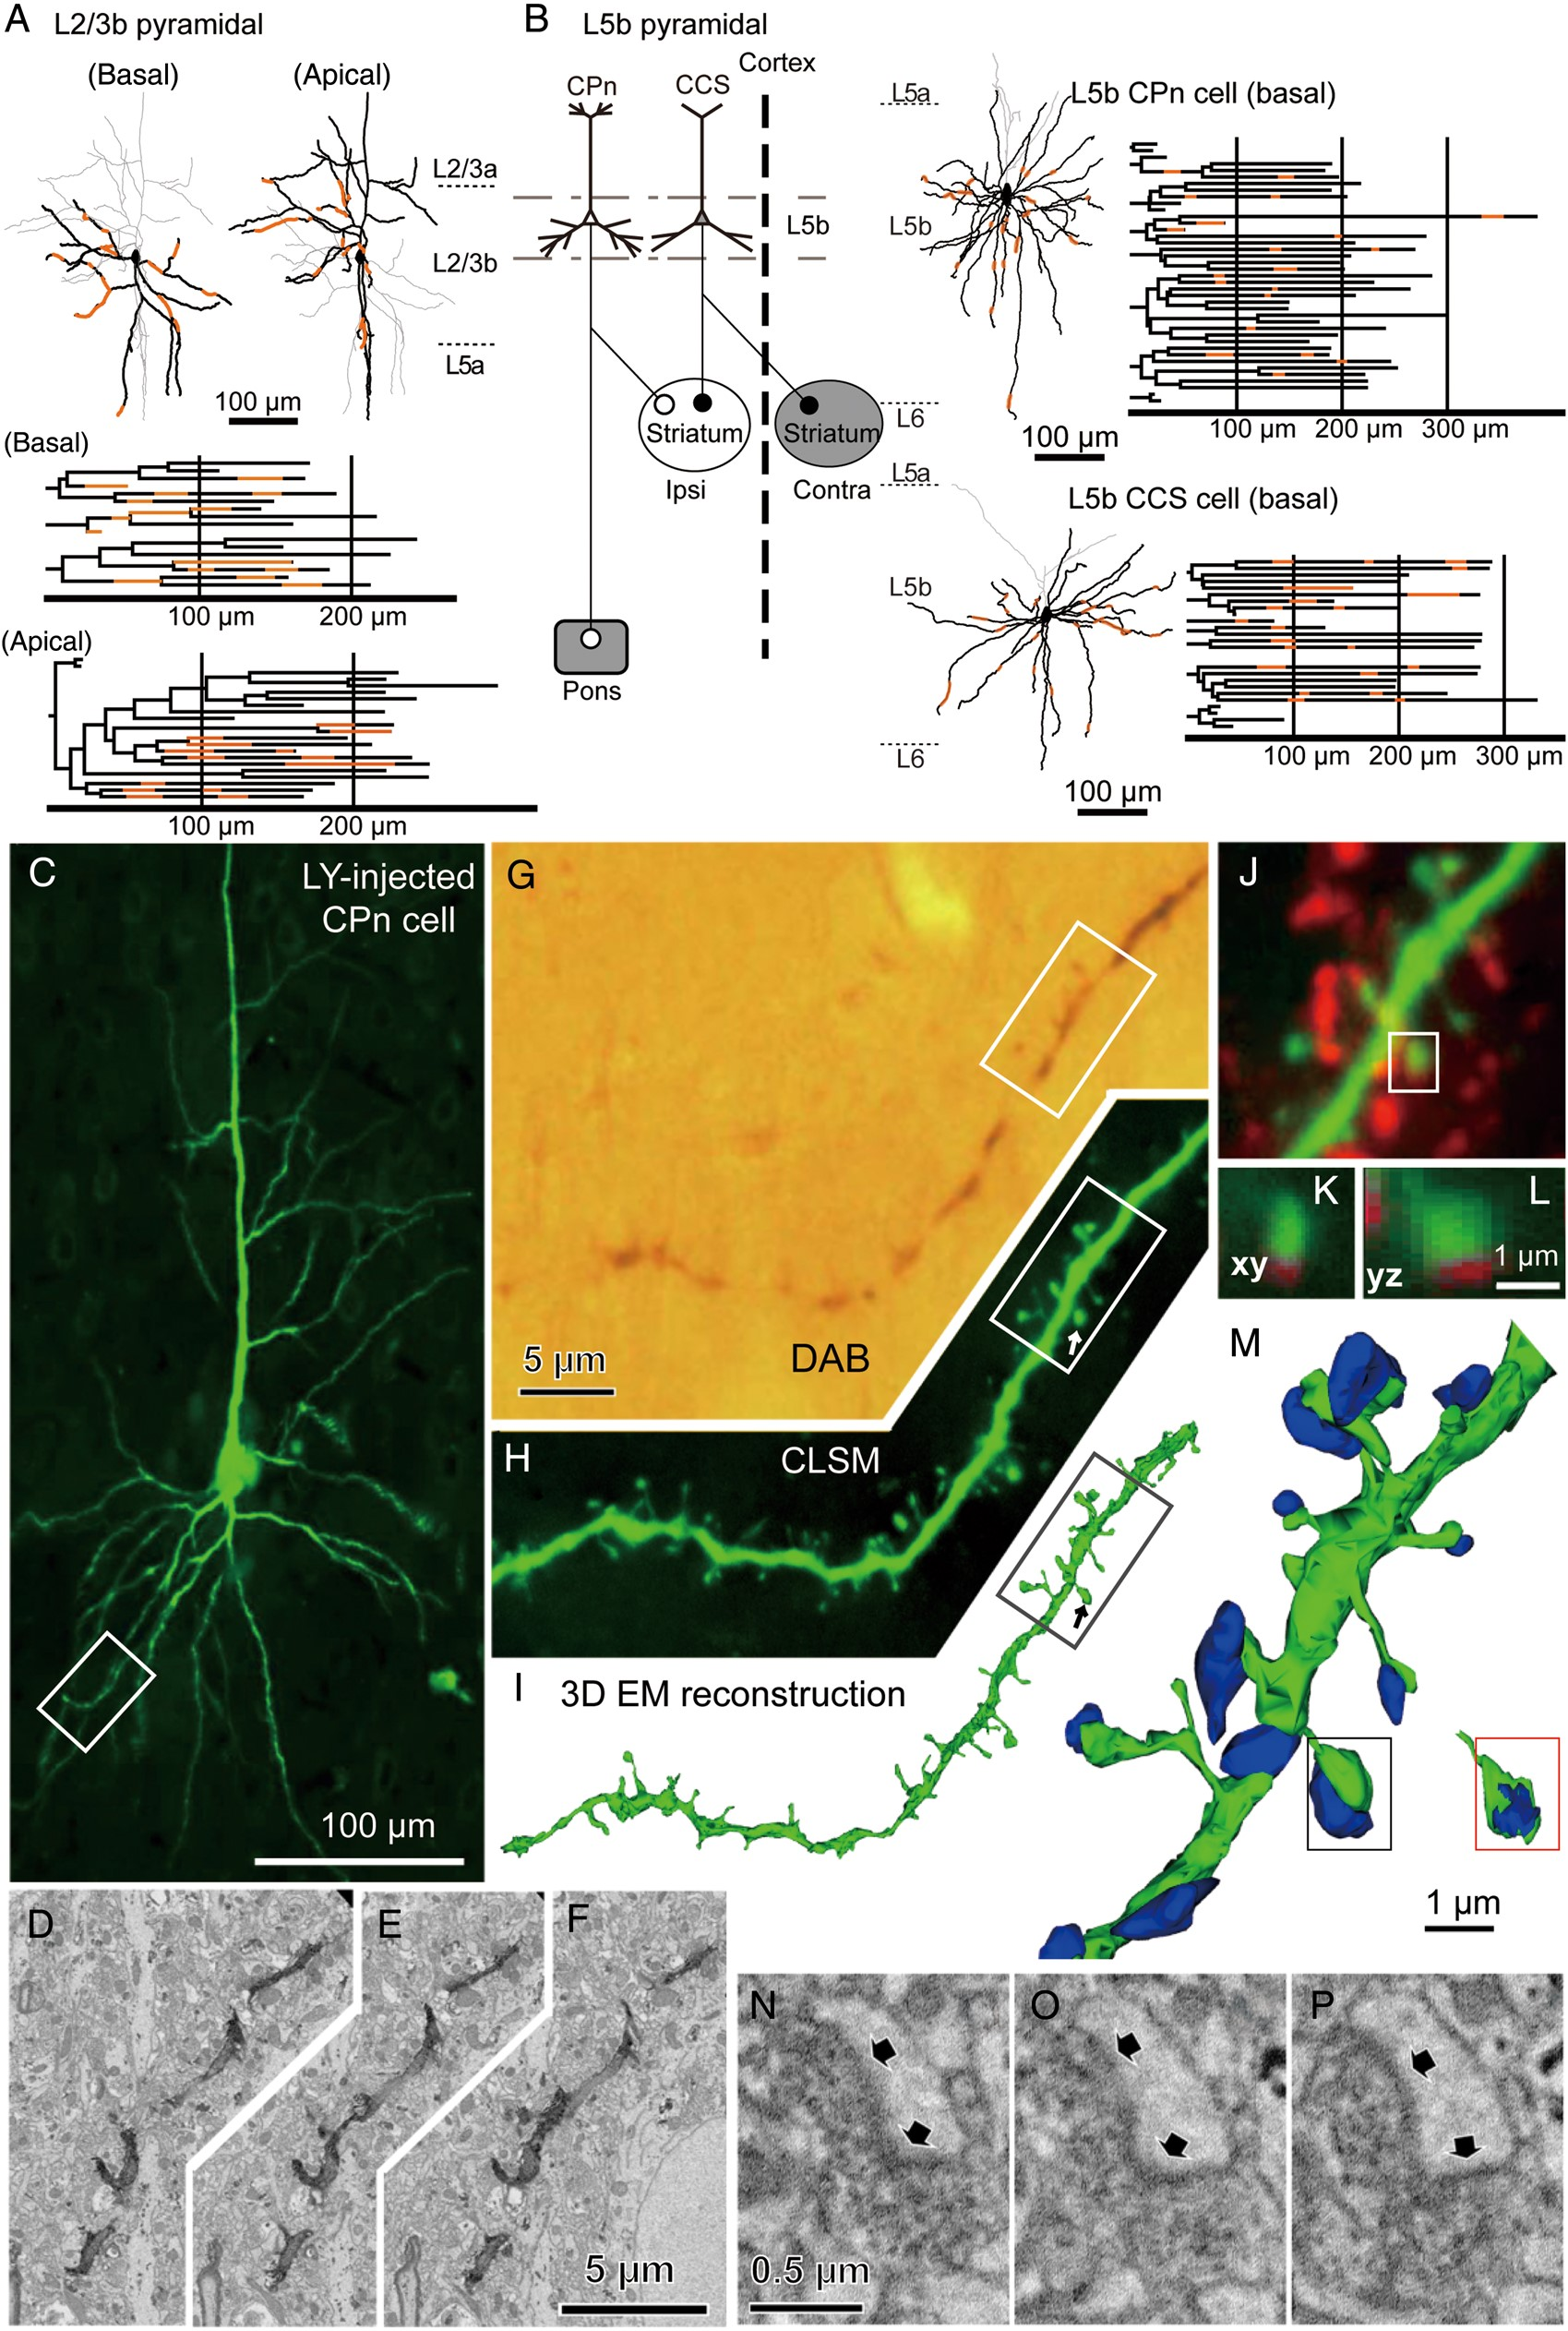
Figure 3. VGluT-positive axonal bouton appositions on spines of L2/3b and L5b pyramidal cells stained with LY. (A) ...
Notes:
Figure 3. VGluT-positive axonal bouton appositions on spines of L2/3b and L5b pyramidal cells stained with LY. (A) Reconstructions of dendritic branches of a L2/3b corticocortical cell. Left, basal (black) and apical (gray); right, apical (black) and basal (gray). The neuron was visualized by intracellular injection of LY into a pyramidal cell labeled retrogradely from ipsilateral primary motor area. The dendrograms are shown below. Most basal dendritic branches were visualized by this labeling, but the apical branches were partially stained including oblique branches. The orange-colored segments were used for analysis. (B) Left: Identification of corticopontine (CPn) and crossed-corticostriatal (CCS) cells by retrograde labeling from the ipsilateral pontine nuclei and contralateral striatum (gray areas), respectively. Right: Reconstructions of the basal dendrites (black) and apical dendrites (gray) of LY-injected CPn (upper) and CCS cells (lower). The dendrograms of the basal dendrites are shown on the right. Orange-colored segments, the dendritic regions that were used for analysis. (C) A confocal laser scanning microscopy (CLSM) image of an LY-injected L5b pyramidal cell, identified as a CPn cell by retrograde labeling from the ipsilateral pontine nuclei. (D–I) Correspondence between morphologies of a dendritic segment imaged with CLSM and EM reconstructions. The segment shown corresponds to the dendrite in the rectangle in (C). (D–F) Diamond-knife serial block-face scanning electron microscope (SBEM) images obtained from the segment shown in (G). Z-step, 60 nm. (G) Bright field image of the segment shown in (H), visualized with DAB reaction. (H) Reconstruction from fluorescence images. (I) 3D reconstructions of the segment from SBEM images. (J) Dual fluorescence image of an LY-filled dendritic segment (green) and VGluT1 immunohistochemistry (red). This corresponds to the dendrite within the rectangle in (H). (K and L) The spine (green) is located just next to a VGluT1-positive axon terminal (red) in the x–y plane (K) as well as the y–z plane (L). This spine is the same one indicated by an arrow in (H) and within the rectangle in (J). (M–P) Confirmation of synapse formation at appositions identified by CLSM, correlating their EM images. From matching between dendritic morphologies of CLSM (H) and EM reconstructions (I), we could specify the spines and apposing boutons without presynaptic electron-dense staining. We confirmed synapse formation between the spine and apposing bouton (compare fluorescence images in (J–L), EM image reconstruction of the postsynaptic dendrite [green] and axon terminals [blue] in (M), and serial EM images of the synaptic junction on the spine (N–P), a region between 2 arrows, corresponding to the spine in the rectangle in (M). The junction area is shown within in the red rectangle, by rotating the spine and removing the presynaptic bouton.
Unless provided in the caption above, the following copyright applies to the content of this slide: © The Author 2015. Published by Oxford University Press. All rights reserved. For Permissions, please e-mail: journals.permissions@oup.com

Slide 4
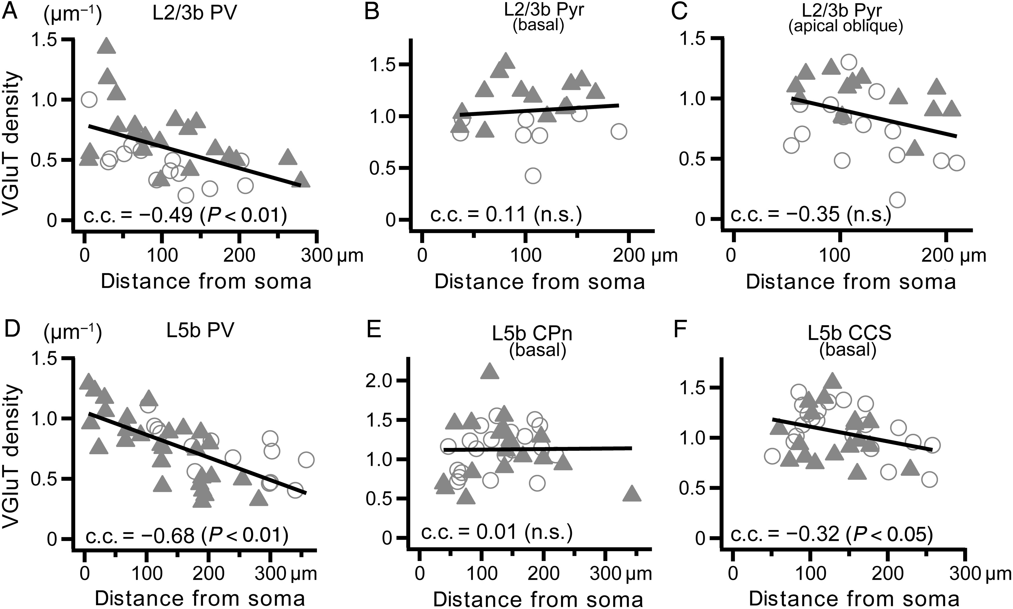
Figure 4. Relationship of the apposition densities of VGluT-labeled boutons with distances from the somata. (A–C) ...
Notes:
Figure 4. Relationship of the apposition densities of VGluT-labeled boutons with distances from the somata. (A–C) Relationship of VGluT-labeled bouton apposition densities on target dendrites in L2/3b with distances from the somata, obtained from 2 cells (open circles and filled triangles, respectively). (A) Dendritic shafts of PV cells; (B) basal dendritic spines of pyramidal cells; (C) apical oblique dendritic spines of pyramidal cells. Note that the densities of PV cells varied significantly depending on distance from the soma (P < 0.01), but those of pyramidal cells did not. n.s., statistically not significant. (D–F) Relationship of VGluT-labeled bouton apposition densities on target dendrite in L5b with distances from somata, obtained from 2 cells (open circles and filled triangles, respectively). (D) Dendritic shafts of PV cells; (E) basal dendritic spines of CPn cells; (F) basal dendritic spines of CCS cells. Note that the densities of PV and CCS cells varied depending on the distances significantly (PV cells, P < 0.01; CCS cells, P < 0.05), but those of CPn cells did not (P = 0.93).
Unless provided in the caption above, the following copyright applies to the content of this slide: © The Author 2015. Published by Oxford University Press. All rights reserved. For Permissions, please e-mail: journals.permissions@oup.com

Slide 5
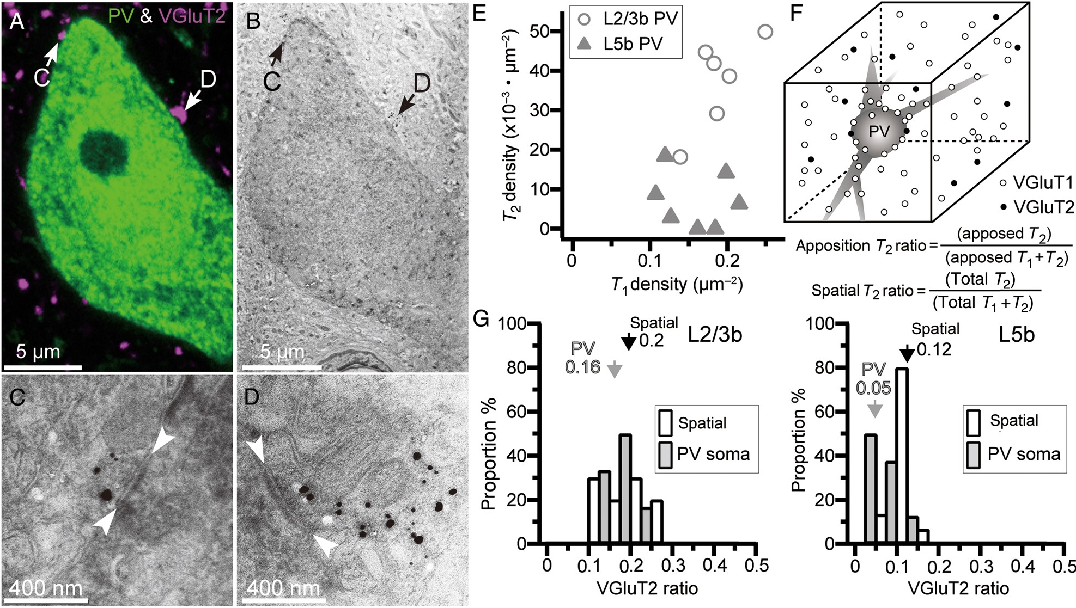
Figure 5. Bouton appositions of VGluT1/T2-positive terminals on PV-labeled somata. (A–D) Appositions and synapse ...
Notes:
Figure 5. Bouton appositions of VGluT1/T2-positive terminals on PV-labeled somata. (A–D) Appositions and synapse formation of immunolabeled boutons on PV-labeled soma identified using CLSM and EM. (A) CLSM image of dual immunohistochemical staining of PV (green) and VGluT2 (magenta) in the frontal cortex. (B) Lower magnification EM image of the identical neuron in (A) visualized by DAB staining and VGluT2-positive boutons visualized by silver enhancement. (C and D) Higher magnification EM images of VGluT2-positive boutons obtained from a section adjacent to that of (B). Both boutons apposing on a PV-labeled soma identified by CLSM made synapses on the target soma (region between the 2 white arrowheads, synaptic junction). (E) Density comparison of VGluT1/T2-labeled boutons apposing on PV-labeled somata between L2/3b and L5b. Open circle, L2/3b; filled triangle, L5b. (F) Spatial T2 ratio: ratio of VGluT2-positive boutons to whole VGluT-positive boutons in the local environment. Apposition T2 ratio: ratio of VGluT2 appositions to total glutamatergic appositions. (G) VGluT2-labeled boutons among all VGluT-labeled boutons (VGluT2 ratio) in L2/3b (left) and L5b (right). White bar, spatial T2 ratio; Gray bar, apposition T2 ratio. Arrows, mean value. The apposition T2 ratios of L2/3b PV somata were similar to the spatial T2 ratio in L2/3b, but those of L5b PV somata were lower than the spatial T2 ratio in L5b (P < 0.01, Mann–Whitney U-test).
Unless provided in the caption above, the following copyright applies to the content of this slide: © The Author 2015. Published by Oxford University Press. All rights reserved. For Permissions, please e-mail: journals.permissions@oup.com

Slide 6
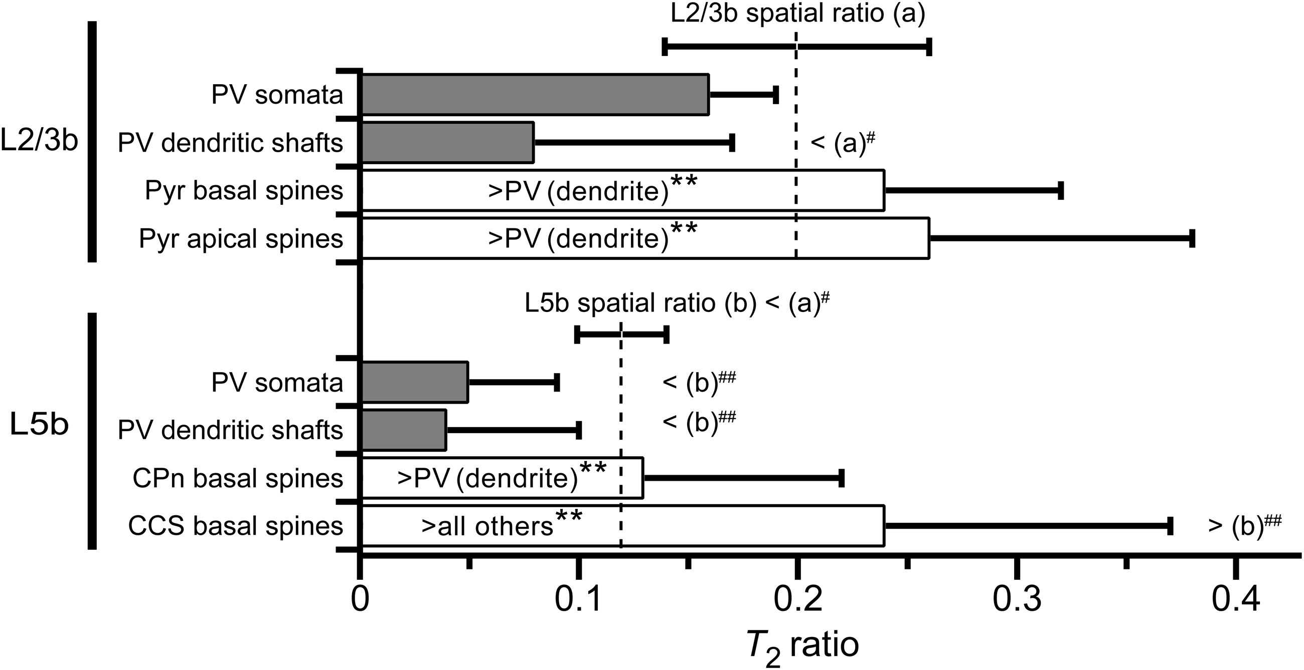
Figure 6. Apposition T₂ ratios in L2/3b and L5b cell subtypes and comparison with the spatial T₂ ...
Notes:
Figure 6. Apposition T2 ratios in L2/3b and L5b cell subtypes and comparison with the spatial T2 ratio. Gray bars, apposition T2 ratios in somata and dendritic shafts of PV cells; white bars, apposition T2 ratios in dendritic spines of pyramidal cells. Horizontal bar, mean + SD. Comparison among the subtypes and domains by Tukey–Kramer test: *P < 0.05 and **P < 0.01. Vertical dashed lines, mean of spatial T2 ratios: VGluT2-labeled boutons among total VGluT-labeled boutons (both VGluT1 and VGluT2) distributed locally; (a) for L2/3b and (b) for L5b. Comparison between the apposition and spatial T2 ratios by Mann–Whitney U-tests: #P < 0.05 and ##P < 0.01.
Unless provided in the caption above, the following copyright applies to the content of this slide: © The Author 2015. Published by Oxford University Press. All rights reserved. For Permissions, please e-mail: journals.permissions@oup.com

Slide 7
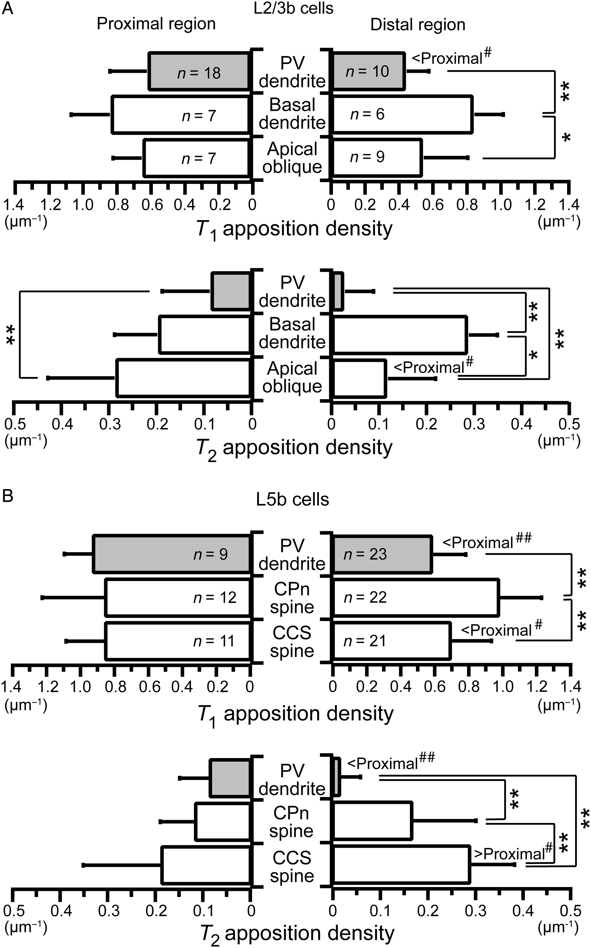
Figure 7. Bouton apposition densities of VGluT1/T2-positive terminals on dendritic regions proximal and distal from the ...
Notes:
Figure 7. Bouton apposition densities of VGluT1/T2-positive terminals on dendritic regions proximal and distal from the soma. (A) T1/T2 apposition densities of L2/3b cells. Gray bars, apposition densities of PV cell dendritic shafts; white bars, apposition densities of pyramidal cell spines. Data, mean + SD. Segments with the dendritic regions nearer than 100 µm (left, proximal region) and further than 125 µm (right, distal region) were used. Upper, T1 apposition density; lower, T2 apposition density. Proximal/distal comparisons by Mann–Whitney U-tests (#P < 0.05 and ##P < 0.01); subtype comparisons by Tukey–Kramer tests (*P < 0.05 and **P < 0.01). (B) T1/T2 apposition densities of L5b cells. Gray bars, apposition densities of PV cell dendritic shafts; white bars, apposition densities of CPn and CCS cell spines. Segments with the dendritic regions nearer than 100 µm (left, proximal region) and further than 125 µm (right, distal region) were used.
Unless provided in the caption above, the following copyright applies to the content of this slide: © The Author 2015. Published by Oxford University Press. All rights reserved. For Permissions, please e-mail: journals.permissions@oup.com

Slide 8
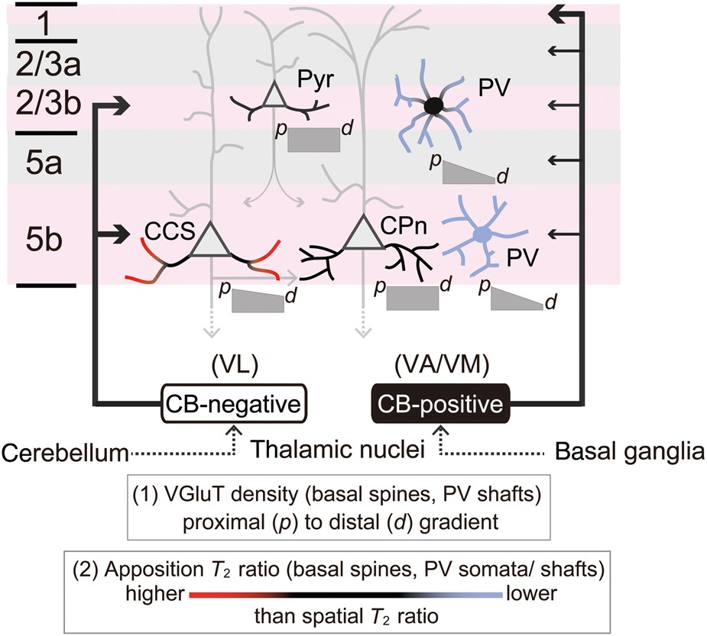
Figure 8. Local excitatory input selectivity depends on presynaptic cell type, as well as on postsynaptic cell subtype ...
Notes:
Figure 8. Local excitatory input selectivity depends on presynaptic cell type, as well as on postsynaptic cell subtype and surface domain. Calbindin-positive thalamocortical fibers innervate L1 and, to a lesser extent, all other layers. On the other hand, calbindin-negative thalamocortical fibers preferentially innervate L2/3b and L5b. In L2/3b, the dendrites of pyramidal cells and somata of PV cells receive thalamic inputs in proportion to their local abundance among all excitatory terminals (represented by black color), while dendrites of PV cells avoid otherwise available thalamic inputs (represented by blue color). In L5b, CCS cell basal dendrites, particularly their distal parts, receive more thalamic inputs than predicted by their local abundance (represented by red color), whereas both somata and dendrites of PV cells repel thalamic inputs. The density of VGluT-positive all excitatory inputs onto PV cell dendritic shafts and CCS cell spines decreases with distance from soma, while excitatory input density on CPn cell spines is independent of distance from soma.
Unless provided in the caption above, the following copyright applies to the content of this slide: © The Author 2015. Published by Oxford University Press. All rights reserved. For Permissions, please e-mail: journals.permissions@oup.com

