Slide 1
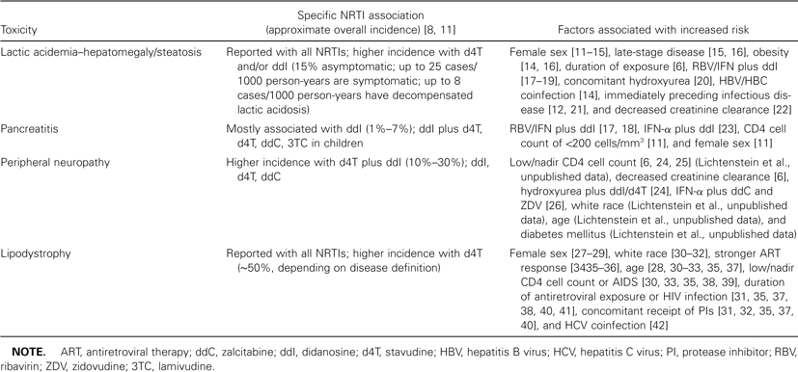
Table 1 Risk factors associated with major nucleotide- and nucleoside-analogue reverse-transcriptase inhibitor (NRTI) ...
Notes:
Table 1 Risk factors associated with major nucleotide- and nucleoside-analogue reverse-transcriptase inhibitor (NRTI) toxicities.
Unless provided in the caption above, the following copyright applies to the content of this slide: © 2004 by the Infectious Diseases Society of America

Slide 2
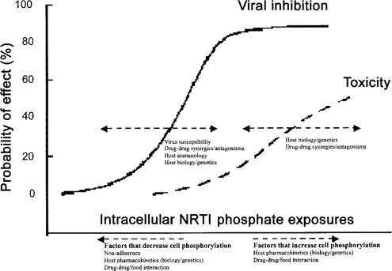
Figure 1 Therapeutic index of nucleotide- and nucleoside-analogue reverse-transcriptase inhibitors (NRTIs). The ...
Notes:
Figure 1 Therapeutic index of nucleotide- and nucleoside-analogue reverse-transcriptase inhibitors (NRTIs). The probabilities (y axis) of drug efficacy (solid-line curve) and toxicity (dashed-line curve) are analyzed with respect to drug exposure (x axis.) A narrow horizontal distance between the curves signifies a narrow therapeutic index. Biological diversity in the patient and in the disease influences the probability of drug effects (dashed horizontal arrows).
Unless provided in the caption above, the following copyright applies to the content of this slide: © 2004 by the Infectious Diseases Society of America

Slide 3
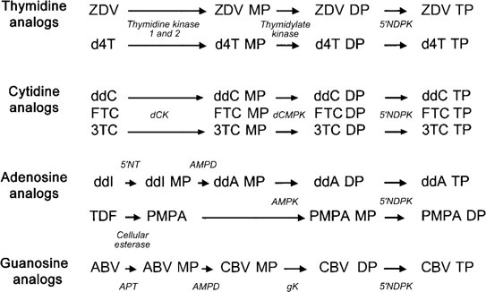
Figure 2 Host-cell-mediated sequential enzymatic phosphorylation steps required for activating the nucleotide- and ...
Notes:
Figure 2 Host-cell-mediated sequential enzymatic phosphorylation steps required for activating the nucleotide- and nucleoside-analogue reverse-transcriptase inhibitors (NRTIs) to the triphosphate moiety. ABV, abacavir; AMPD, adenosine monophosphate deaminase; AMPK, adenosine monophosphate kinase (adenylate kinase); APT, adenosine phosphotransferase; CBV, carbovir; dCK, deoxycytidine kinase; dCMPK, deoxycytidine monophosphate kinase; ddA, 2′,3′-dideoxyadenosine; ddI, didanosine; DP, diphosphate; d4T, stavudine; FTC, emtricitabine; gK, guanylate kinase; MP, monophosphate; PMPA, tenofovir (PMPA DP is a triphosphate analogue); TDF, tenofovir disoproxil fumarate; TP, triphosphate; ZDV, zidovudine; 3TC, lamivudine; 5′NDPK, 5′ nucleoside diphosphate kinase; 5′NT, 5′ nucleotidase.
Unless provided in the caption above, the following copyright applies to the content of this slide: © 2004 by the Infectious Diseases Society of America

Slide 4
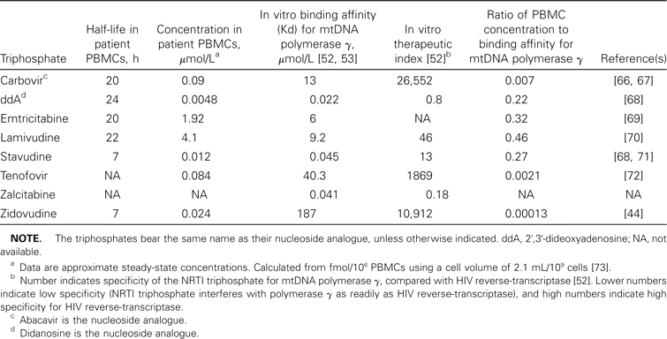
Table 2 Cellular pharmacological data for nucleotide- and nuceloside-analogue reverse-transcriptase inhibitor (NRTI) ...
Notes:
Table 2 Cellular pharmacological data for nucleotide- and nuceloside-analogue reverse-transcriptase inhibitor (NRTI) triphosphates (TPs) in patients and in vitro and the relationship to toxicity.
Unless provided in the caption above, the following copyright applies to the content of this slide: © 2004 by the Infectious Diseases Society of America

Slide 5
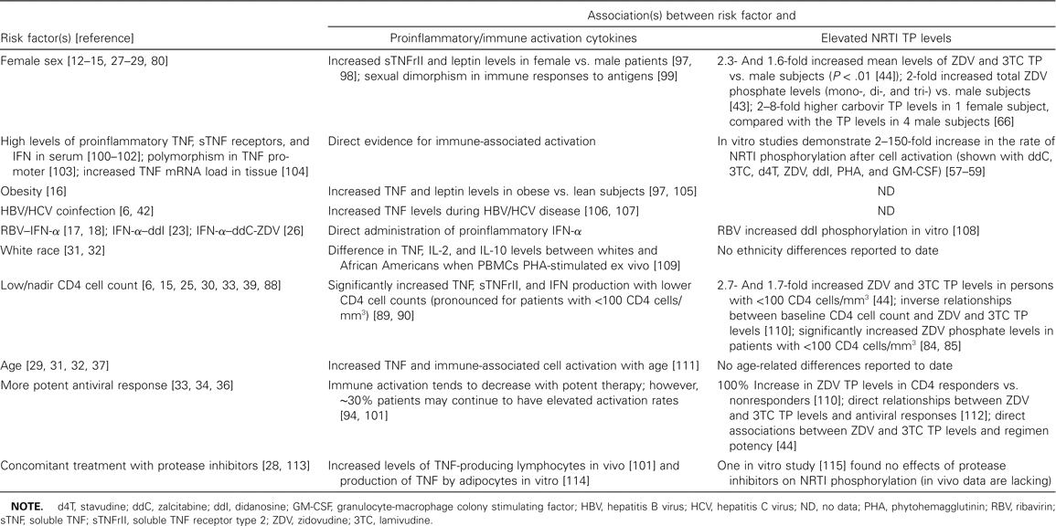
Table 3 Associations between epidemiologically identified risk factors for nucleotide- and nucleoside-analogue ...
Notes:
Table 3 Associations between epidemiologically identified risk factors for nucleotide- and nucleoside-analogue reverse-transcriptase inhibitor (NRTI) toxicity, proinflammation/cellular activation, and elevated NRTI triphosphate (TP) levels.
Unless provided in the caption above, the following copyright applies to the content of this slide: © 2004 by the Infectious Diseases Society of America

