Slide 1
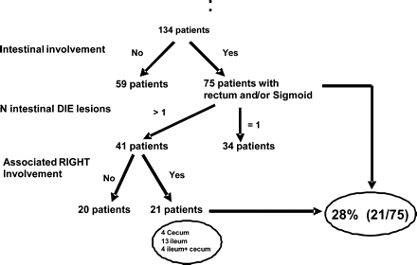
Figure 1 Intestinal endometriosis: the anatomic distribution of lesions in 134 patients with DIE.
Notes:
Figure 1 Intestinal endometriosis: the anatomic distribution of lesions in 134 patients with DIE.
Unless provided in the caption above, the following copyright applies to the content of this slide: © The Author 2008. Published by Oxford University Press on behalf of the European Society of Human Reproduction and Embryology. All rights reserved. For Permissions, please email: journals.permissions@oxfordjournals.org

