Slide 1
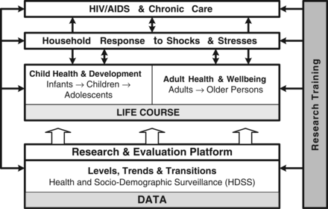
Figure 1 Research themes supported by the Agincourt HDSS, South Africa
Notes:
Figure 1 Research themes supported by the Agincourt HDSS, South Africa
Unless provided in the caption above, the following copyright applies to the content of this slide: Published by Oxford University Press on behalf of the International Epidemiological Association © The Author 2012; all rights reserved.This is an Open Access article distributed under the terms of the Creative Commons Attribution Non-Commercial License (http://creativecommons.org/licenses/by-nc/3.0/), which permits non-commercial re-use, distribution, and reproduction in any medium, provided the original work is properly cited. For commercial re-use, please contact journals.permissions@oup.com

Slide 2
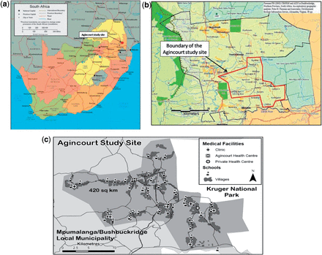
Figure 2 (a) Location of Agincourt HDSS and sub-district within South Africa, near the Mozambique border. (b) Boundary ...
Notes:
Figure 2 (a) Location of Agincourt HDSS and sub-district within South Africa, near the Mozambique border. (b) Boundary of the Agincourt HDSS study site adjacent to the Kruger National Park, South Africa. (c) Agincourt HDSS study site and sub-district indicating positions of villages and health and education facilities
Unless provided in the caption above, the following copyright applies to the content of this slide: Published by Oxford University Press on behalf of the International Epidemiological Association © The Author 2012; all rights reserved.This is an Open Access article distributed under the terms of the Creative Commons Attribution Non-Commercial License (http://creativecommons.org/licenses/by-nc/3.0/), which permits non-commercial re-use, distribution, and reproduction in any medium, provided the original work is properly cited. For commercial re-use, please contact journals.permissions@oup.com

Slide 3
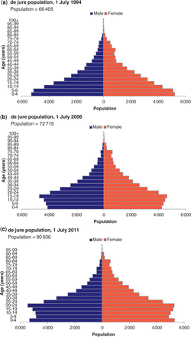
Figure 3 Population pyramids of the Agincourt HDSS population: 1994, 2006 and 2011. (a) de jure population, 1 July ...
Notes:
Figure 3 Population pyramids of the Agincourt HDSS population: 1994, 2006 and 2011. (a) de jure population, 1 July 1994; population = 66 405. (b) de jure population, 1 July 2006; population = 72 715. (c) de jure population, 1 July 2011; population = 90 036
Unless provided in the caption above, the following copyright applies to the content of this slide: Published by Oxford University Press on behalf of the International Epidemiological Association © The Author 2012; all rights reserved.This is an Open Access article distributed under the terms of the Creative Commons Attribution Non-Commercial License (http://creativecommons.org/licenses/by-nc/3.0/), which permits non-commercial re-use, distribution, and reproduction in any medium, provided the original work is properly cited. For commercial re-use, please contact journals.permissions@oup.com

