Slide 1
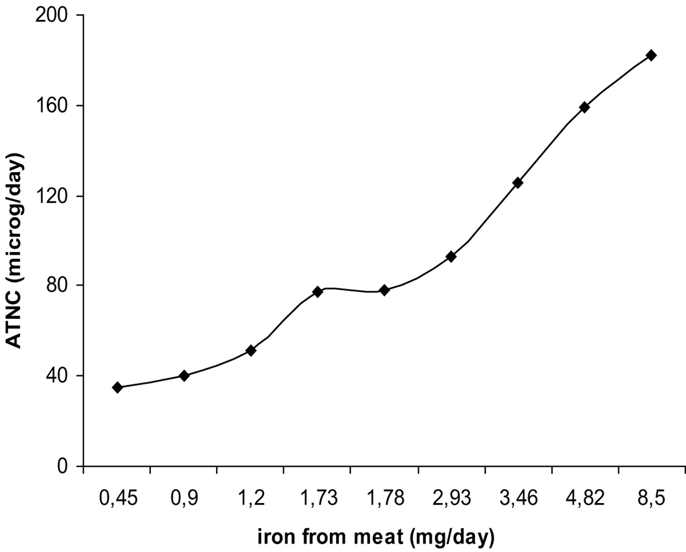
Fig. 1. ENOC formation in relation to dietary iron from meat. Data gathered from feeding studies from Bingham et al ...
Notes:
Fig. 1. ENOC formation in relation to dietary iron from meat. Data gathered from feeding studies from Bingham et al . (4), Cross et al . (5), Hughes et al . (13), Silvester et al . (14). Iron content from UK Food Composition Database (15).
Unless provided in the caption above, the following copyright applies to the content of this slide: © The Author 2006. Published by Oxford University Press. All rights reserved. For Permissions, please email: journals.permissions@oxfordjournals.org

