Slide 1
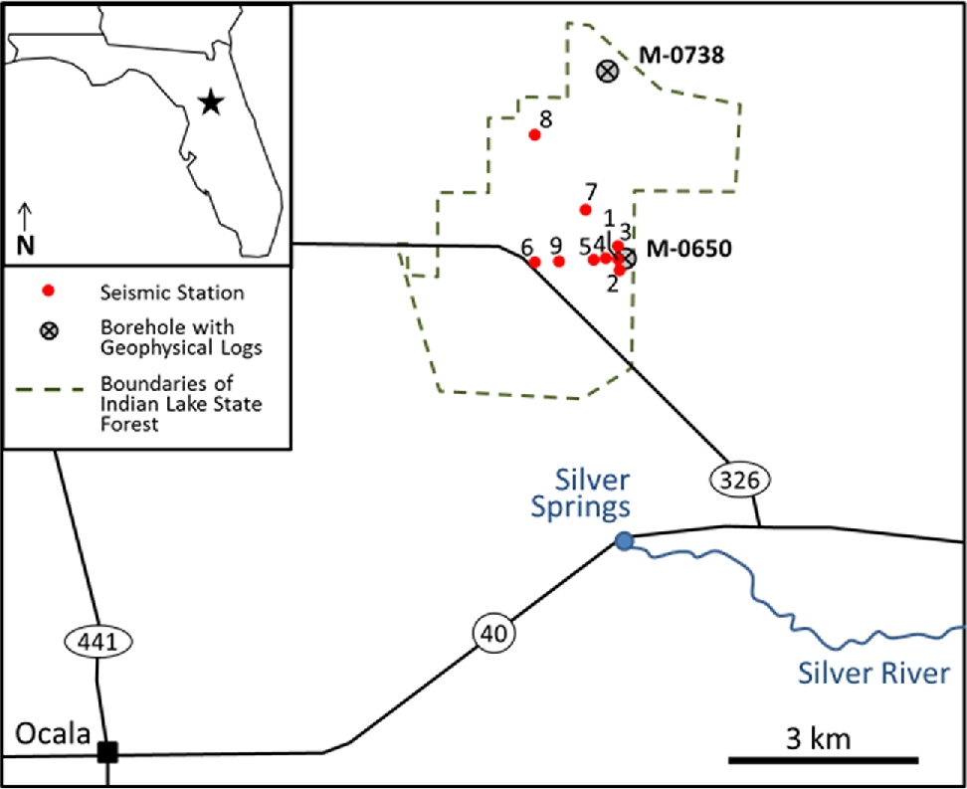
Figure 1. The study region is within Indian Lake State Forest which lies approximately 8 km northeast of Ocala, Florida ...
Notes:
Figure 1. The study region is within Indian Lake State Forest which lies approximately 8 km northeast of Ocala, Florida and ∼2 km north of Silver Springs. The locations of the nine seismic stations within the study site (red circles) along with the two deep boreholes with geophysical logging information (M-0650 and M-0738 – crossed grey circles) are shown.
Unless provided in the caption above, the following copyright applies to the content of this slide: © The Authors 2017. Published by Oxford University Press on behalf of The Royal Astronomical Society.

Slide 2
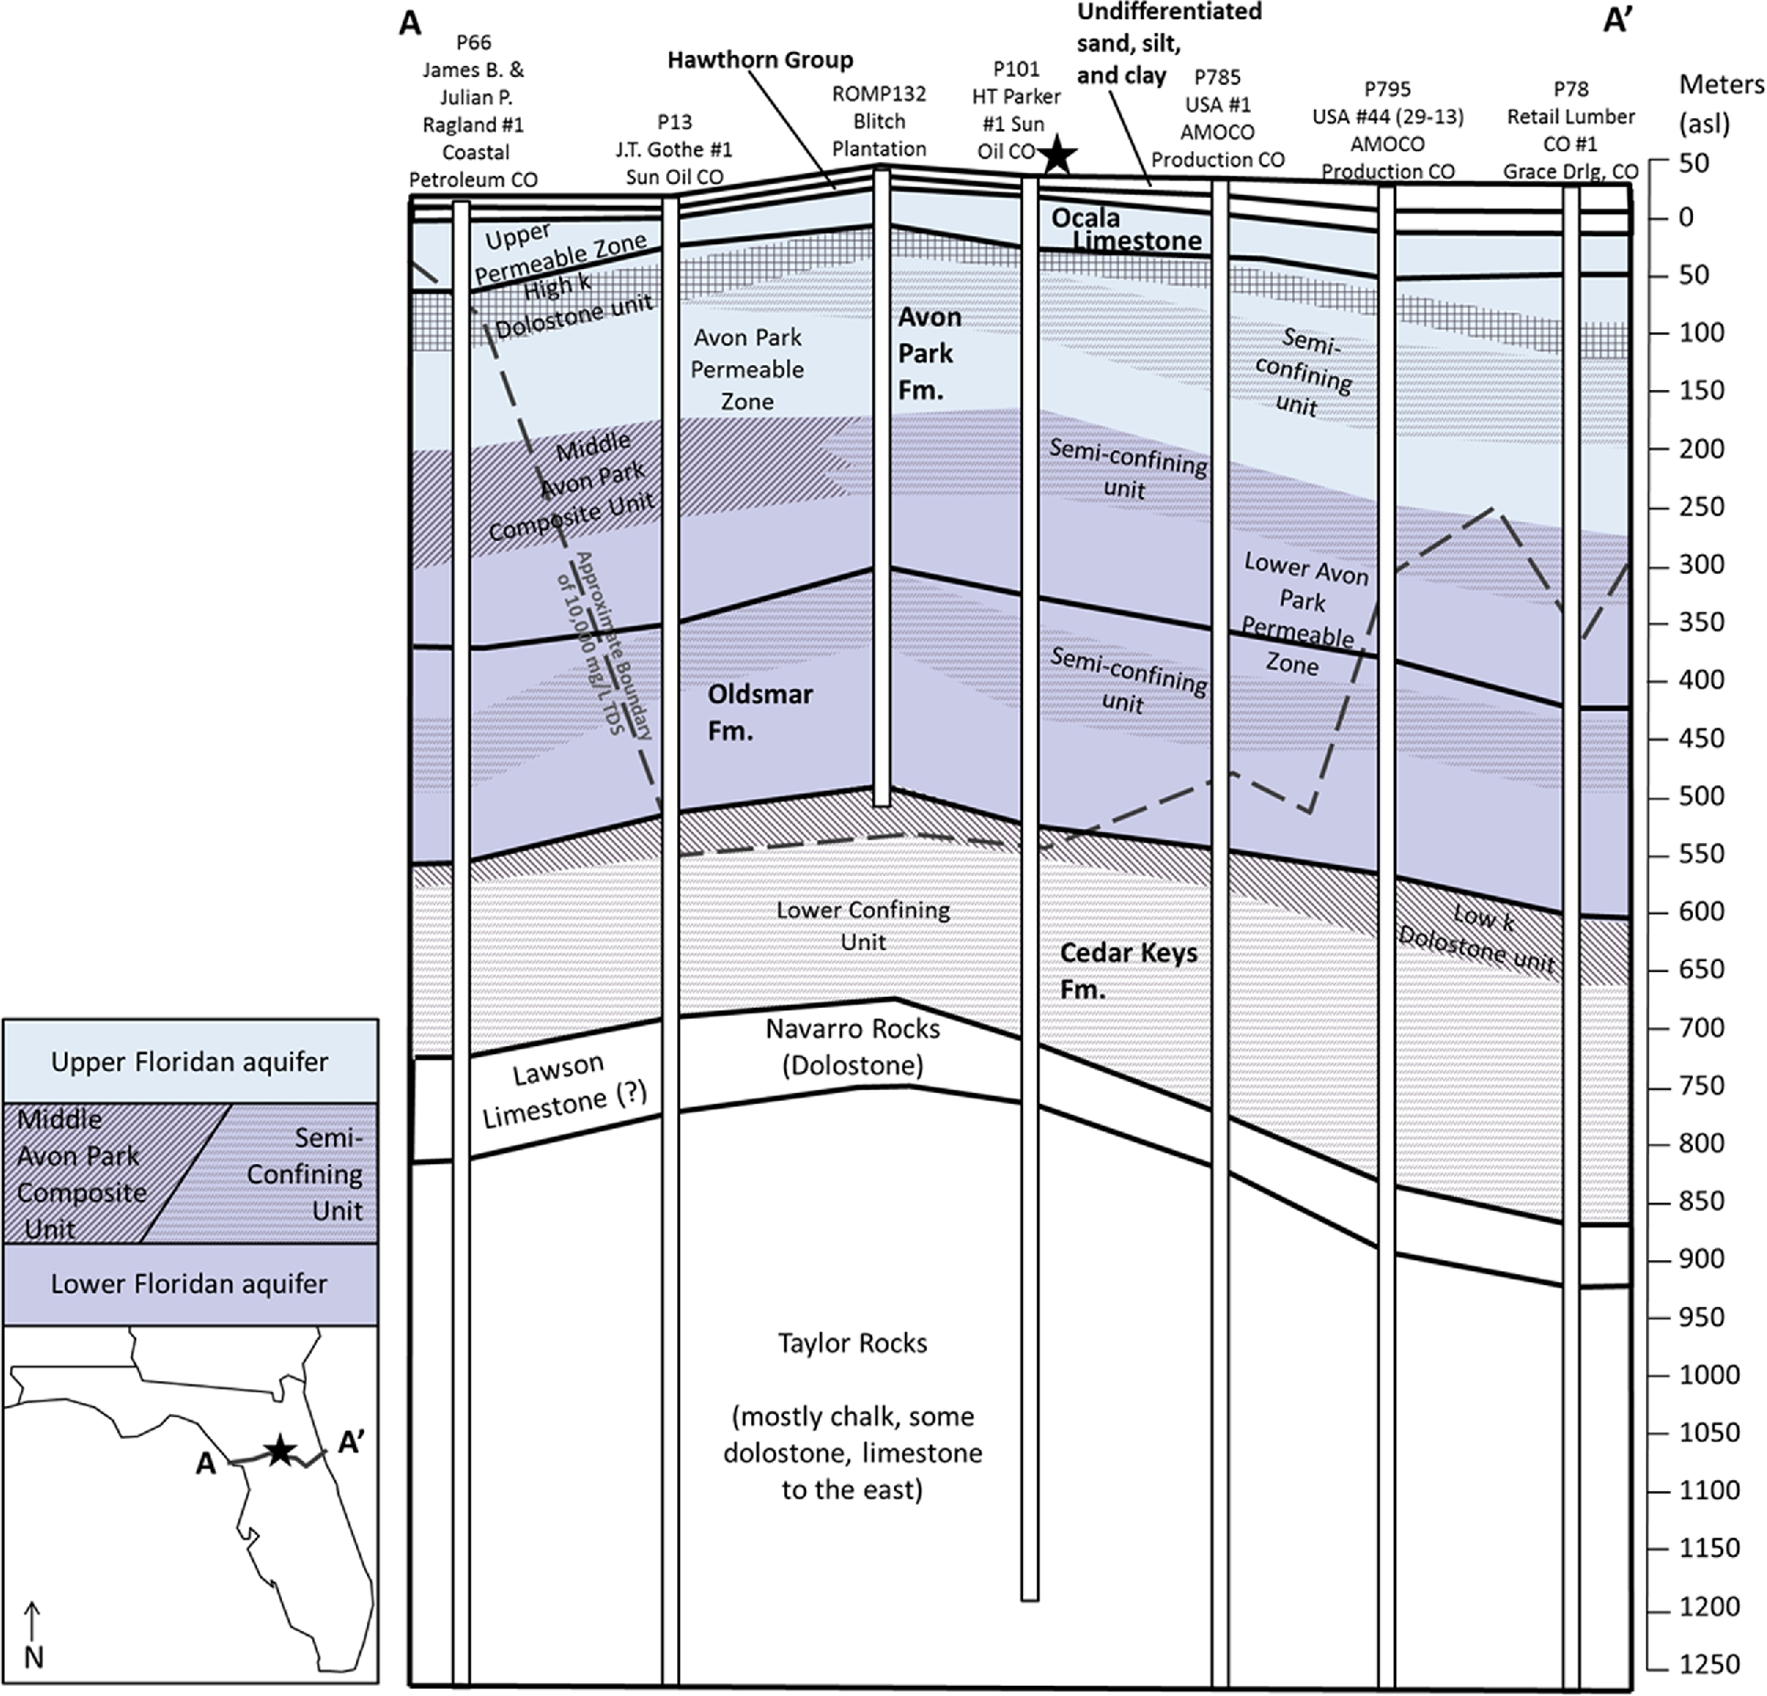
Figure 2. Generalized hydrogeological cross-section through the study area (black star). Adapted from Plate 20 of ...
Notes:
Figure 2. Generalized hydrogeological cross-section through the study area (black star). Adapted from Plate 20 of Williams & Kuniansky (2015).
Unless provided in the caption above, the following copyright applies to the content of this slide: © The Authors 2017. Published by Oxford University Press on behalf of The Royal Astronomical Society.

Slide 3
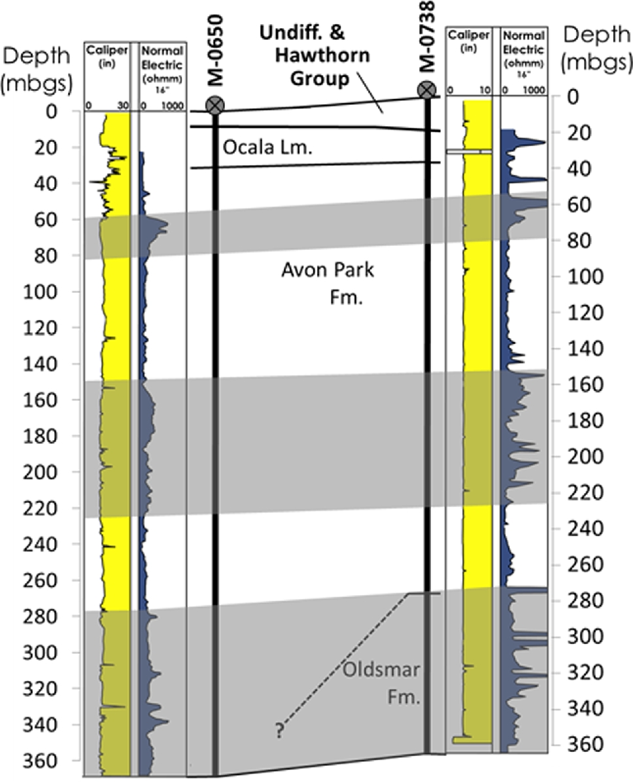
Figure 3. Geological cross-section between the M-0650 and M-0738 boreholes within Indian Lake State Forest. Caliper ...
Notes:
Figure 3. Geological cross-section between the M-0650 and M-0738 boreholes within Indian Lake State Forest. Caliper (yellow) and electrical resistivity (dark blue) logs for each borehole are shown. Continuous zones of high resistivity are shaded grey and connected between the two boreholes. The top of the shallowest high resistivity zone has previously been defined as the top of a semi-confining unit (MCU-1 of Miller 1986) (St. Johns River Water Management District, Hydrogeologic Information System).
Unless provided in the caption above, the following copyright applies to the content of this slide: © The Authors 2017. Published by Oxford University Press on behalf of The Royal Astronomical Society.

Slide 4
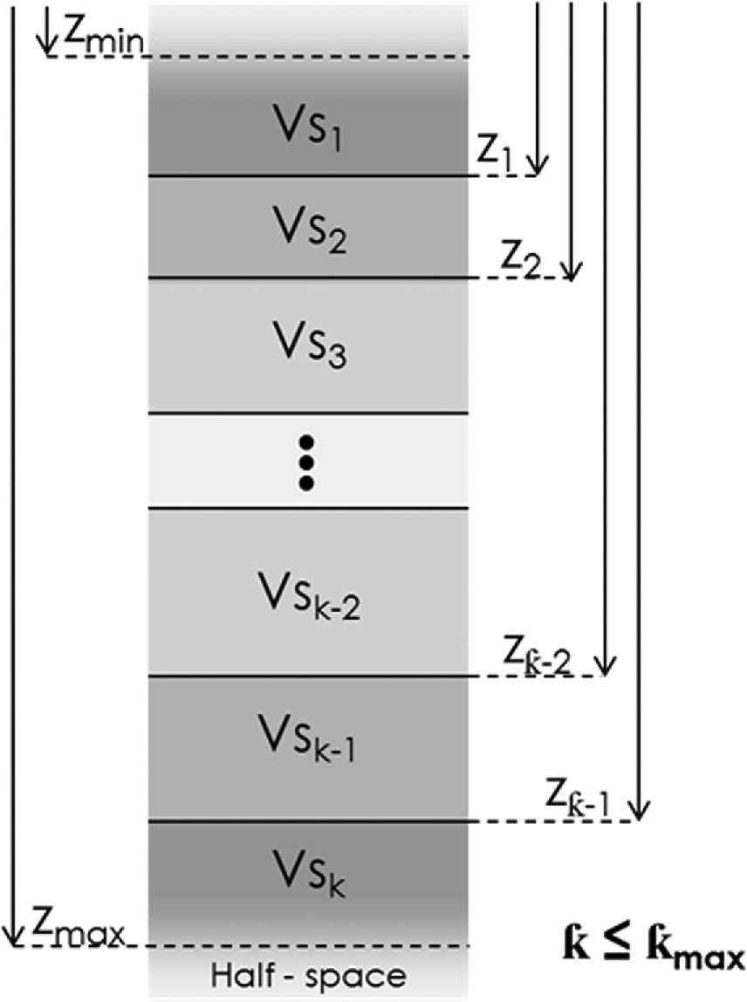
Figure 4. 1-D vertical shear-wave model parameterization with ƙ layers. Each layer has a uniform shear-wave velocity ...
Notes:
Figure 4. 1-D vertical shear-wave model parameterization with ƙ layers. Each layer has a uniform shear-wave velocity (Vs). The interface depths between layers (z) are restricted between the user defined minimum and maximum depths, zmin and zmax, respectively. In the transdimensional approach, ƙ is restricted between user defined ƙmin and ƙmax. The non-transdimensional approach uses a constant ƙ. Adapted from Malinverno (2002).
Unless provided in the caption above, the following copyright applies to the content of this slide: © The Authors 2017. Published by Oxford University Press on behalf of The Royal Astronomical Society.

Slide 5
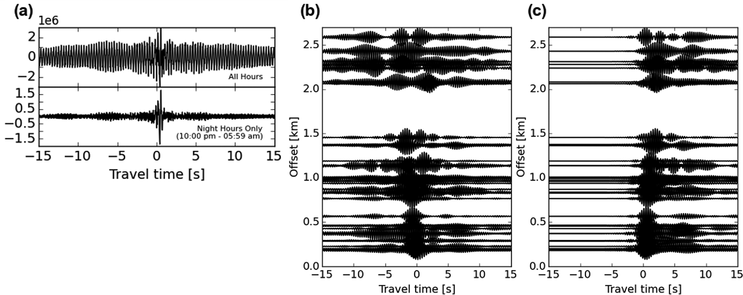
Figure 5. (a) Comparison of the cross-correlation for stations 6 and 9 for all hours of the data set and only ...
Notes:
Figure 5. (a) Comparison of the cross-correlation for stations 6 and 9 for all hours of the data set and only night-time hours. (b) Record section for 3 Hz centre frequency. Cross-correlations are mostly asymmetric. (c) Cross-correlations were made symmetric by averaging the positive and negative time lags. Signals at positive time were isolated by multiplying cross-correlations by a step function to avoid smearing from negative time lags due to filtering.
Unless provided in the caption above, the following copyright applies to the content of this slide: © The Authors 2017. Published by Oxford University Press on behalf of The Royal Astronomical Society.

Slide 6
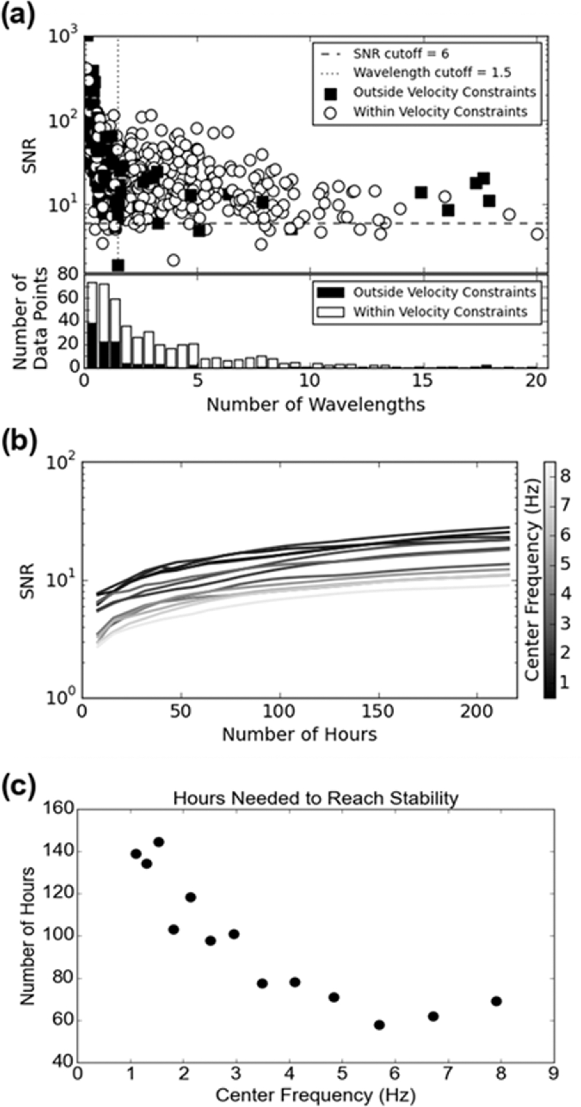
Figure 6. (a) The signal-to-noise ratio (SNR) of all the measured correlations are plotted on a semi-log scale in ...
Notes:
Figure 6. (a) The signal-to-noise ratio (SNR) of all the measured correlations are plotted on a semi-log scale in comparison to number of wavelengths travelled. The majority of measured velocities that were outside the accepted velocity range of 0.1–3 km (black squares) occur for wavelengths fewer than the lower cut-off criterion of 1.5. (b) SNR is shown in relation to the number of hours stacked. The average of all station pairs are shown for each frequency band. (c) The average number of hours needed for the cross-correlation to stabilize was averaged for all station pairs at each frequency band. An inverse relationship with frequency is observed.
Unless provided in the caption above, the following copyright applies to the content of this slide: © The Authors 2017. Published by Oxford University Press on behalf of The Royal Astronomical Society.

Slide 7
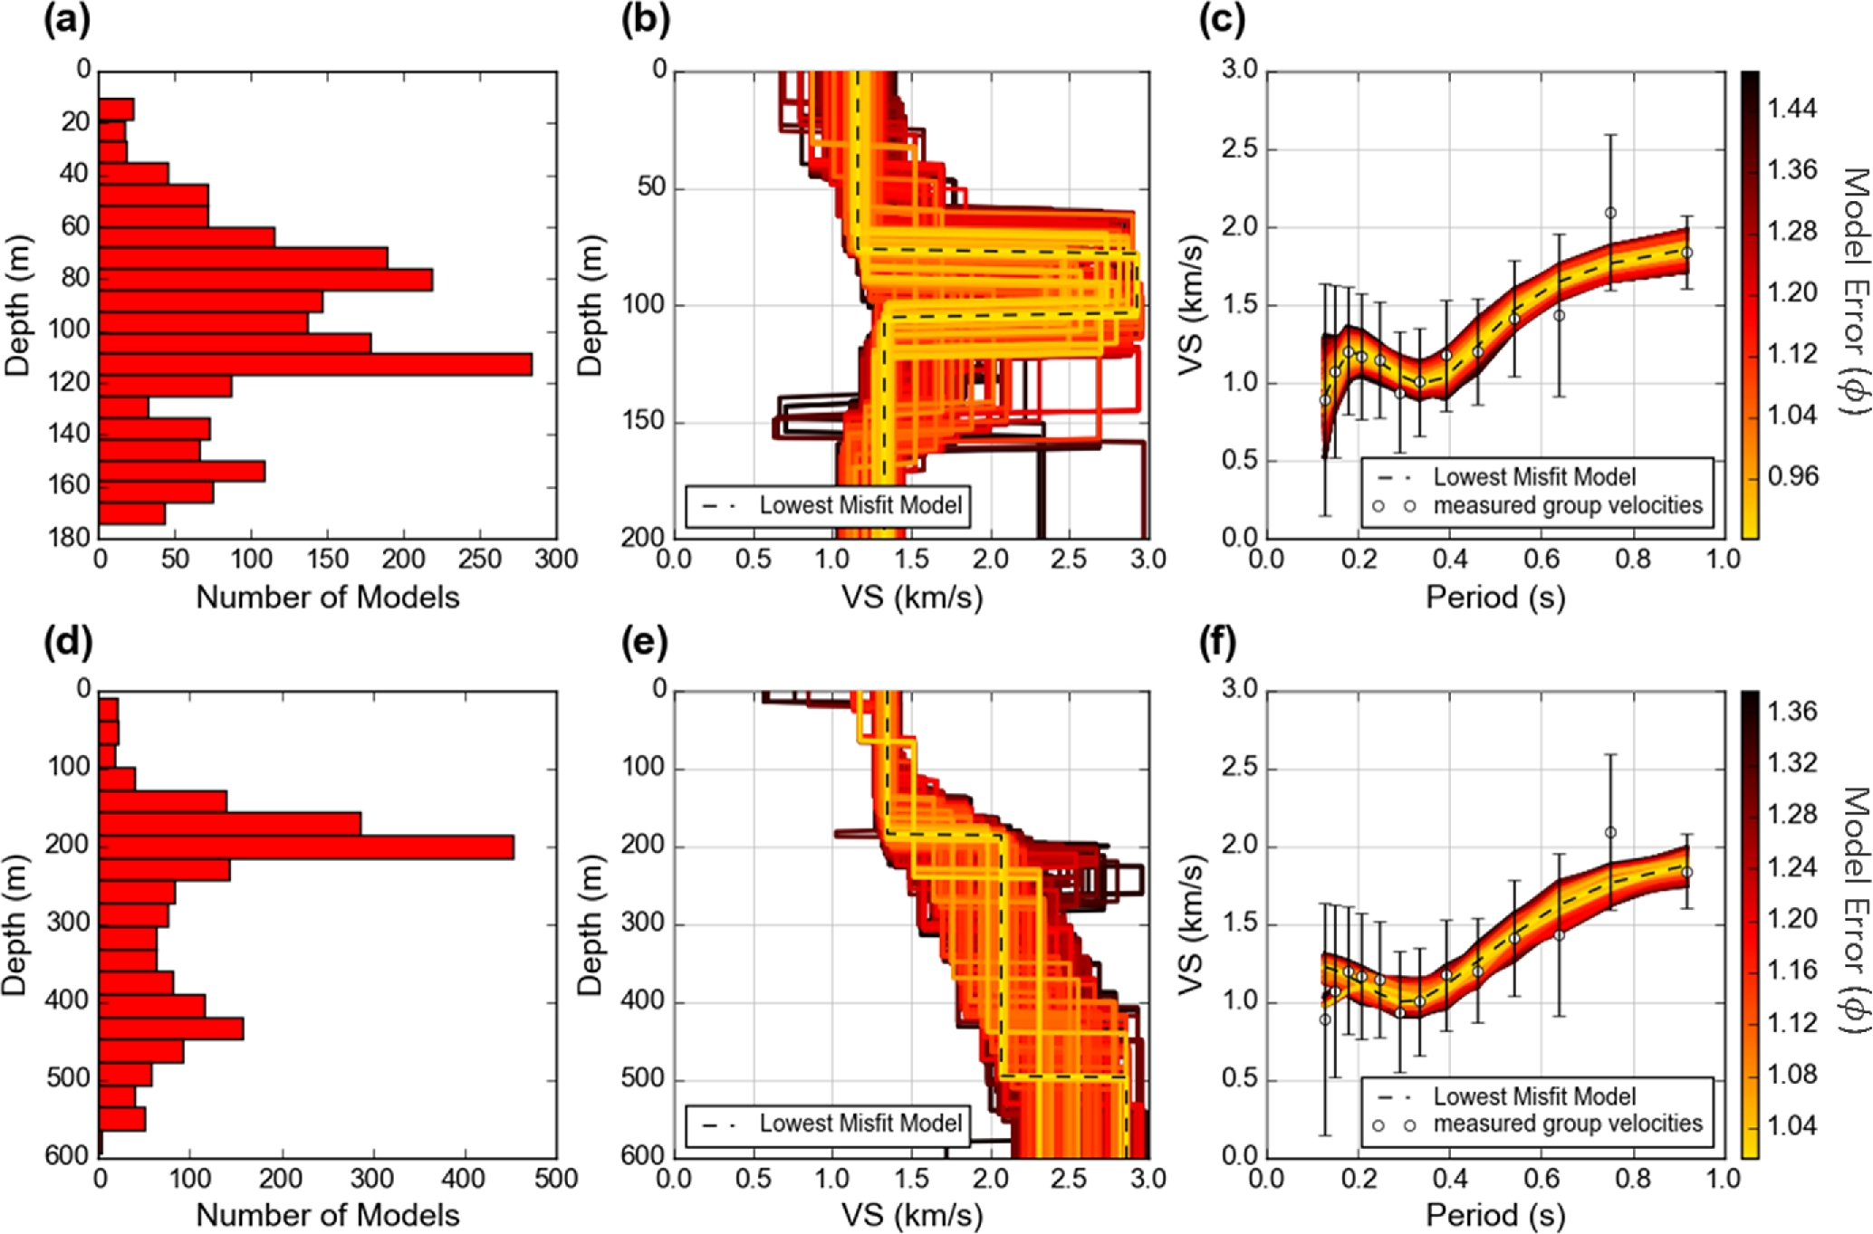
Figure 7. Results from the non-transdimensional algorithm, 3-layer models. (a) A histogram of interface depths, (b) ...
Notes:
Figure 7. Results from the non-transdimensional algorithm, 3-layer models. (a) A histogram of interface depths, (b) model shear-wave velocity (VS) profiles plotted in order of decreasing error and (c) their associated dispersion curves are shown for models constrained to a total depth of 200 m. The standard deviations for each group velocity measurement are shown as the error bars in the dispersion curve. (d)–(f) Same as (a)–(c) but for models restricted to a total depth of 600 m.
Unless provided in the caption above, the following copyright applies to the content of this slide: © The Authors 2017. Published by Oxford University Press on behalf of The Royal Astronomical Society.

Slide 8
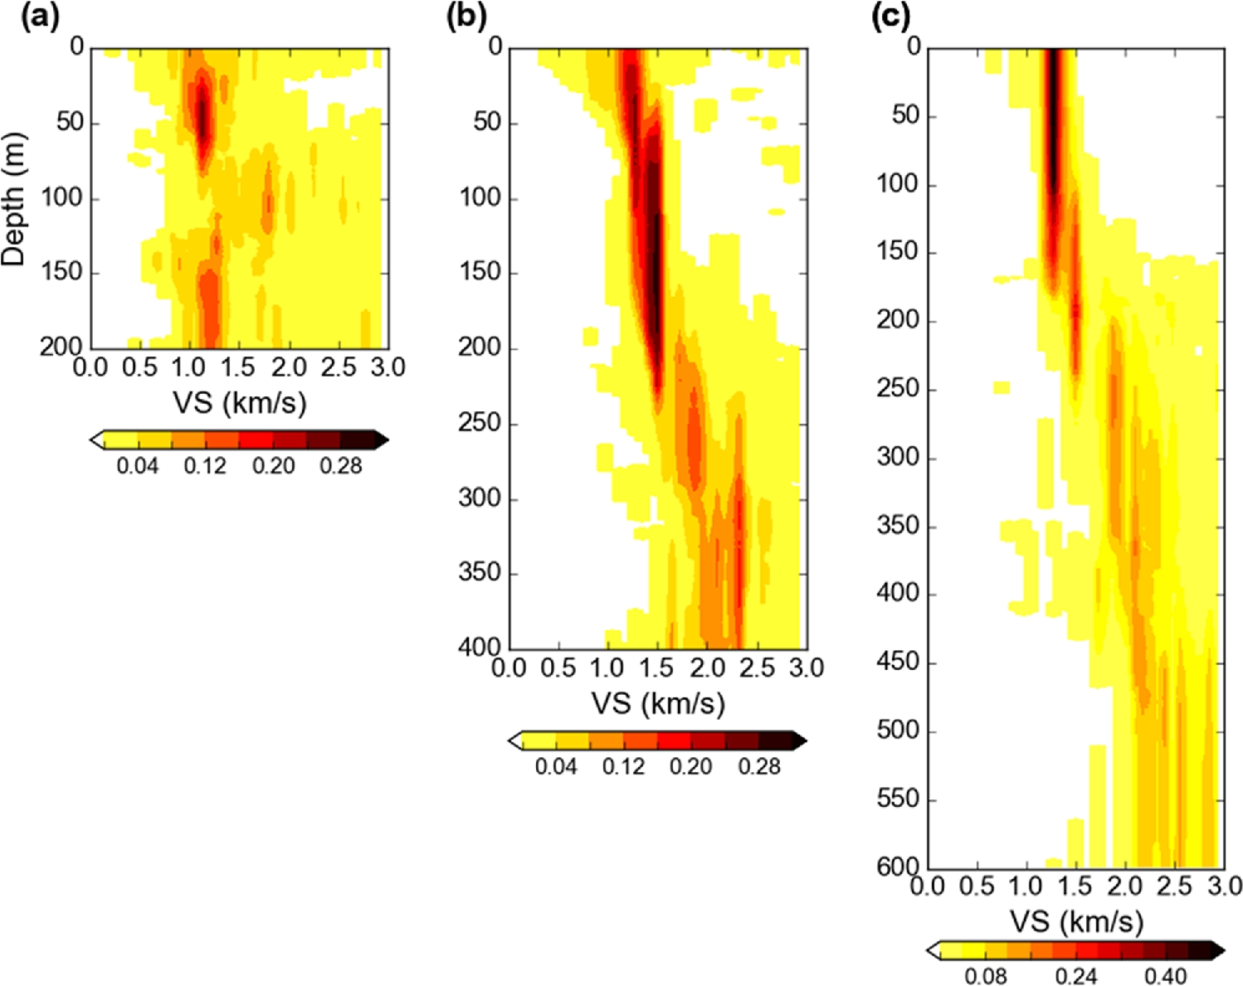
Figure 8. Probability density functions for five-layered models restricted to (a) 200 m depth, (b) 400 m depth and (c) ...
Notes:
Figure 8. Probability density functions for five-layered models restricted to (a) 200 m depth, (b) 400 m depth and (c) 600 m depth. Results are very similar to the four-layered models so only the five-layered results are shown.
Unless provided in the caption above, the following copyright applies to the content of this slide: © The Authors 2017. Published by Oxford University Press on behalf of The Royal Astronomical Society.

Slide 9
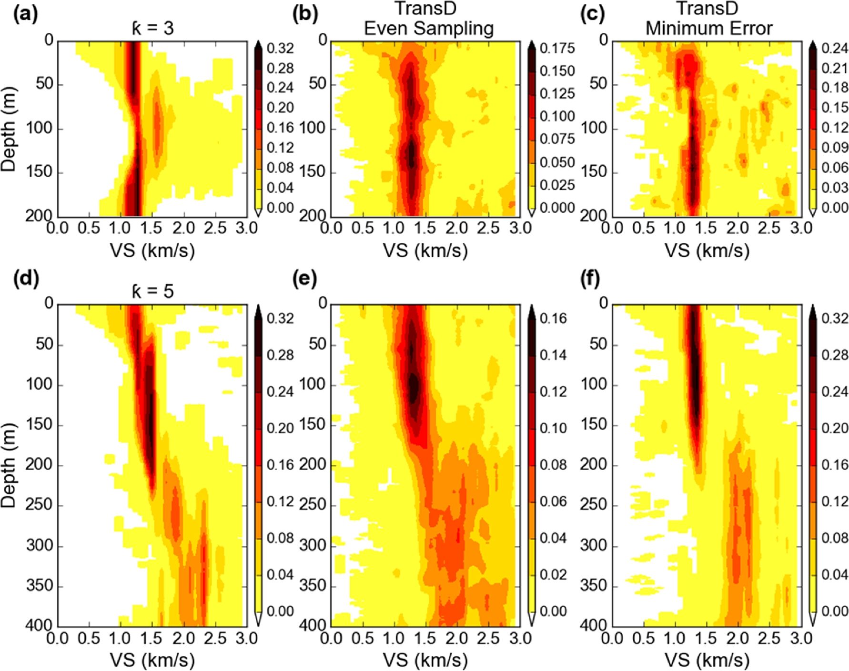
Figure 9. Comparison of probability density functions between the non-transdimensional, fixed layer models and the two ...
Notes:
Figure 9. Comparison of probability density functions between the non-transdimensional, fixed layer models and the two collection ensembles of the transdimensional algorithm. Results for models constrained to 200 m total depth are shown for (a) the fixed 3-layer ensemble, (b) the transdimensional, even sampling ensemble, and (c) the transdimensional, minimum error ensemble. (d)–(f) Same as in (a)–(c) but for 400 m models and 5-layer non-transdimensional ensemble.
Unless provided in the caption above, the following copyright applies to the content of this slide: © The Authors 2017. Published by Oxford University Press on behalf of The Royal Astronomical Society.

Slide 10
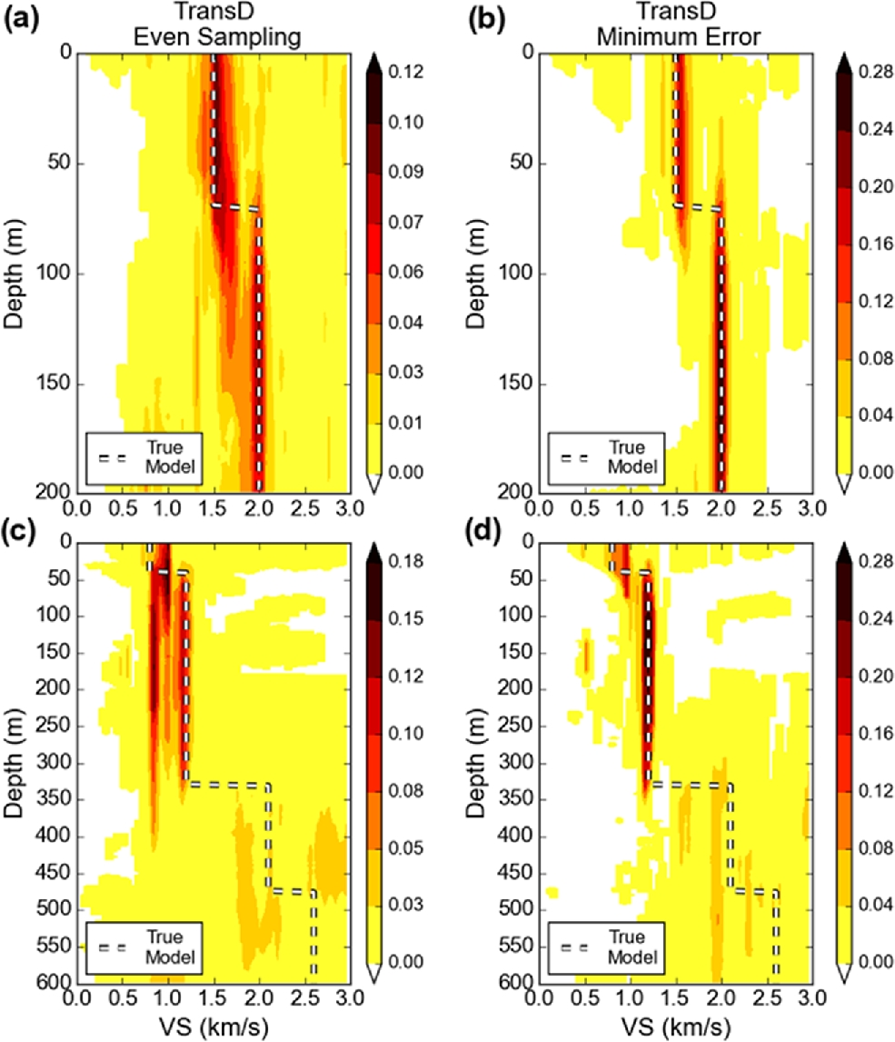
Figure A1. Probability density functions for verification test results of the transdimensional algorithm. The true ...
Notes:
Figure A1. Probability density functions for verification test results of the transdimensional algorithm. The true models are shown by the dashed lines. Results for the 200 m models are shown for the (a) even sampling ensemble, and (b) the minimum error ensemble. (c)–(d) Same as in (a)–(b) but for the 600 m models.
Unless provided in the caption above, the following copyright applies to the content of this slide: © The Authors 2017. Published by Oxford University Press on behalf of The Royal Astronomical Society.

Slide 11
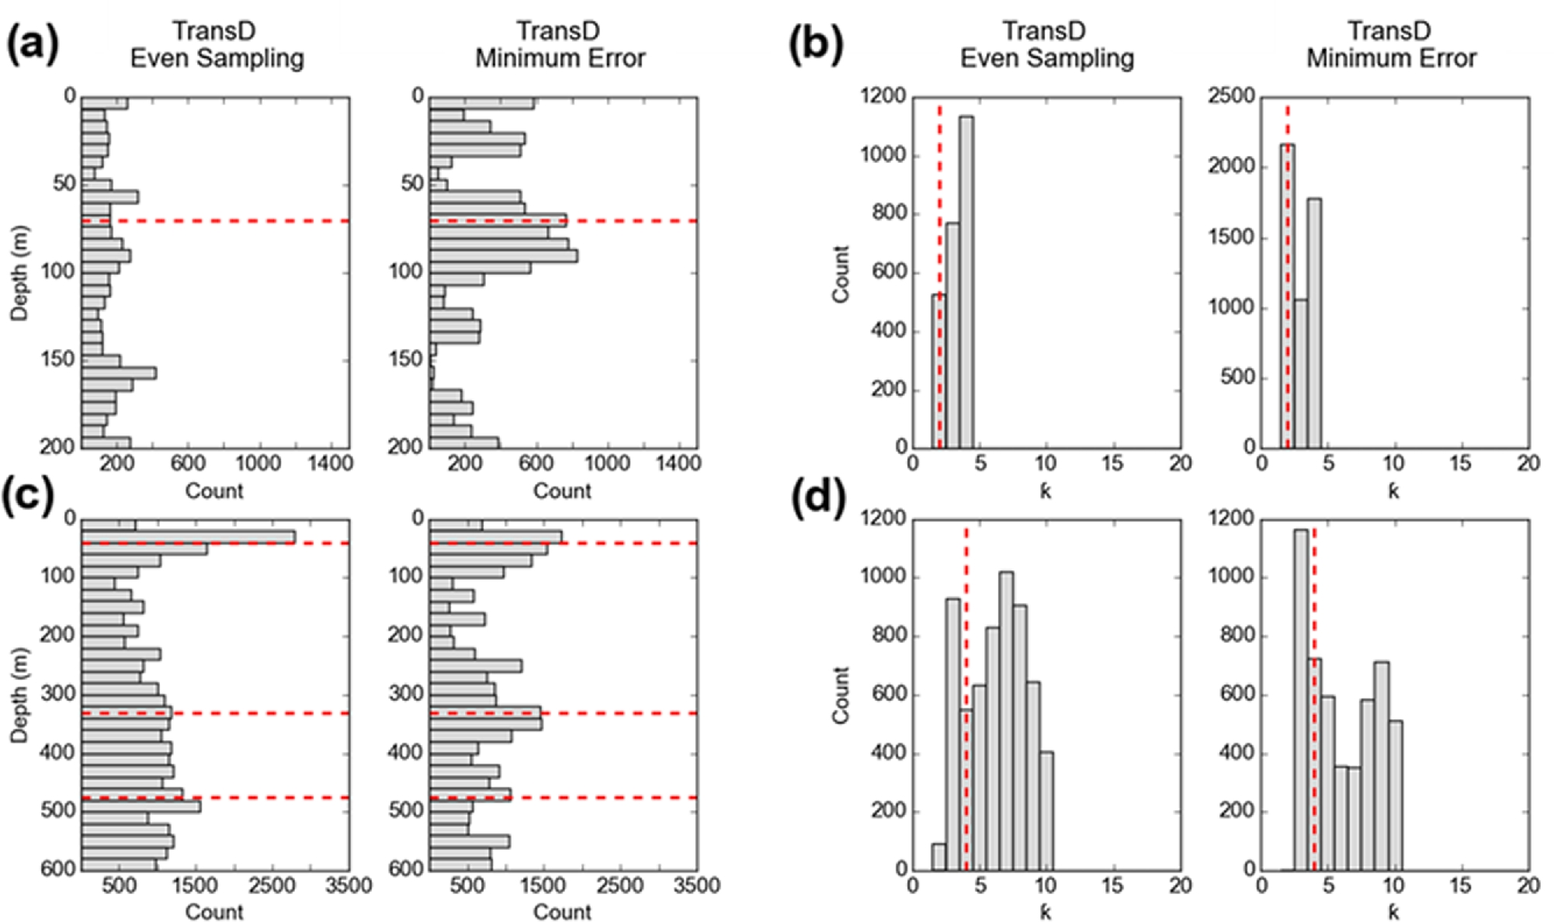
Figure A2. Verification test results of the transdimensional algorithm. (a) Histograms of interface depths for both ...
Notes:
Figure A2. Verification test results of the transdimensional algorithm. (a) Histograms of interface depths for both final ensembles of the 200 m models. Interface depths of the true models are shown with dashed red lines. (b) Histograms of the number of layers for both final ensembles of the 200 m models. Number of layers in the true models are shown with dashed red lines. (c)–(d) Same as in (a)–(b) but for the 600 m models.
Unless provided in the caption above, the following copyright applies to the content of this slide: © The Authors 2017. Published by Oxford University Press on behalf of The Royal Astronomical Society.

Slide 12
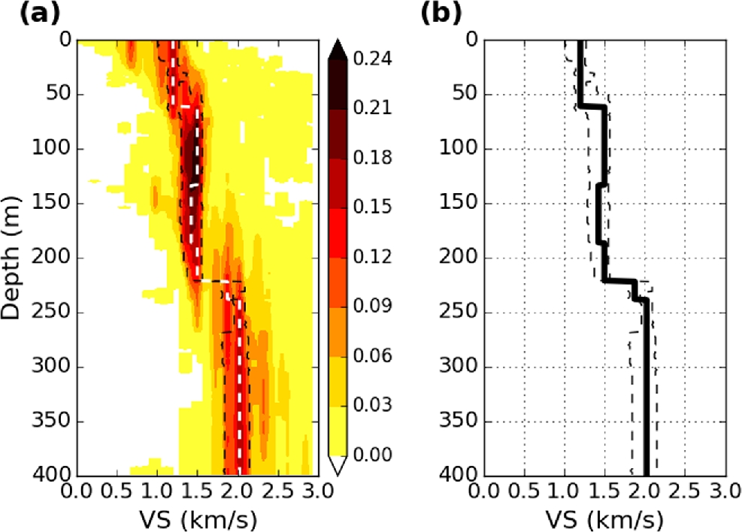
Figure 10. Final preferred model based on previous results and added constraints. (a) Probability density function and ...
Notes:
Figure 10. Final preferred model based on previous results and added constraints. (a) Probability density function and its mean (white dashed line) taken as the final velocity model for the study site (b). Both subplots show the 2σ confidence bounds (dashed black lines) around the mean velocity model.
Unless provided in the caption above, the following copyright applies to the content of this slide: © The Authors 2017. Published by Oxford University Press on behalf of The Royal Astronomical Society.

