Slide 1
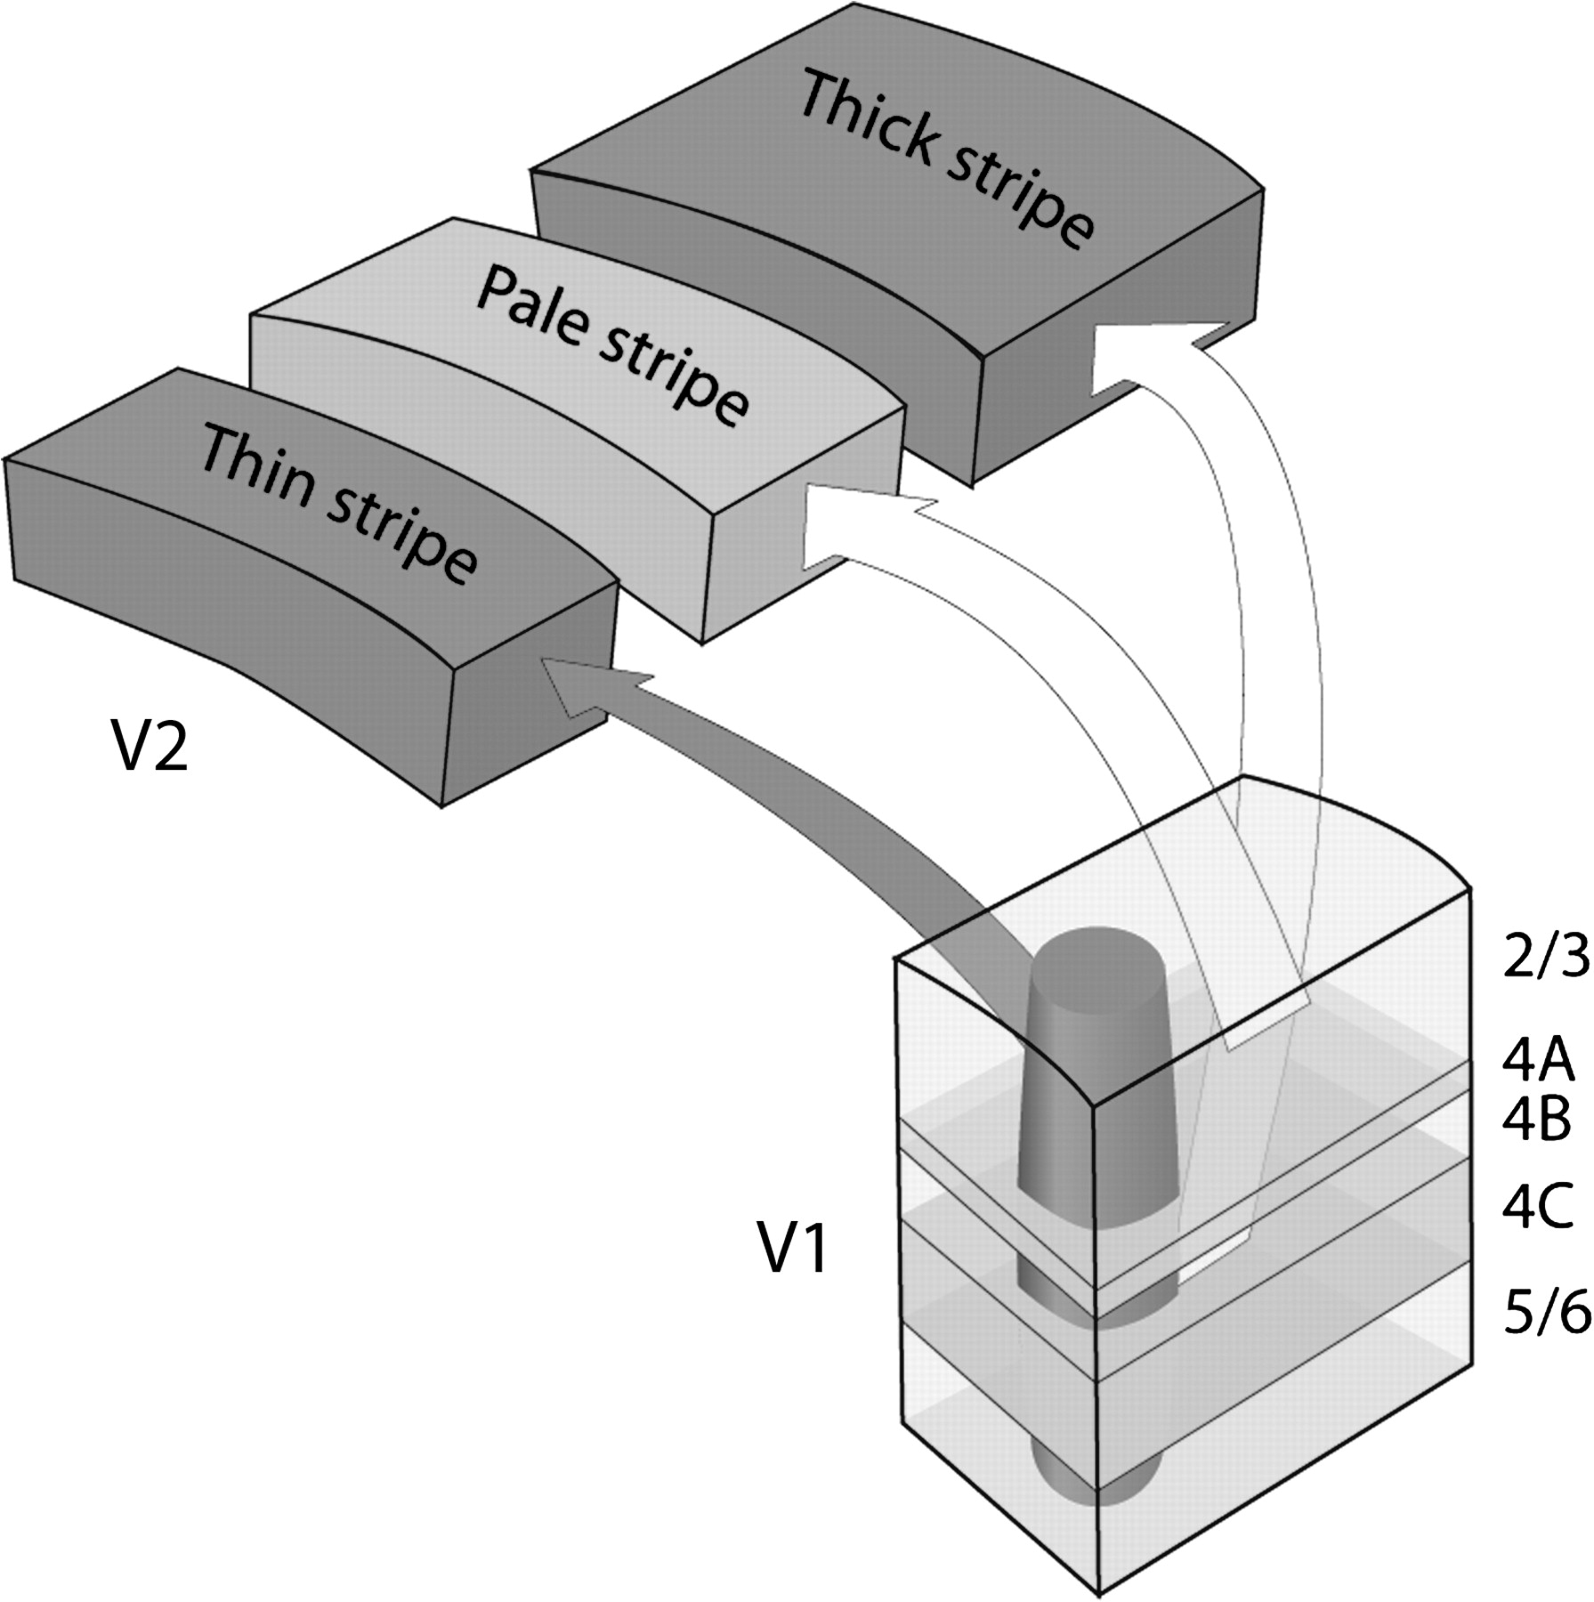
Figure 1. Pattern of projections from V1 to V2, according to Livingstone and Hubel (1984, 1987). The input to each V2 ...
Notes:
Figure 1. Pattern of projections from V1 to V2, according to Livingstone and Hubel (1984, 1987). The input to each V2 stripe is supplied by a single V1 source: layer 2/3 patches → thin stripes; layer 2/3 interpatches → pale stripes; layer 4B → thick stripes.
Unless provided in the caption above, the following copyright applies to the content of this slide: © The Author 2006. Published by Oxford University Press. All rights reserved. For permissions, please e-mail: journals.permissions@oxfordjournals.org

Slide 2
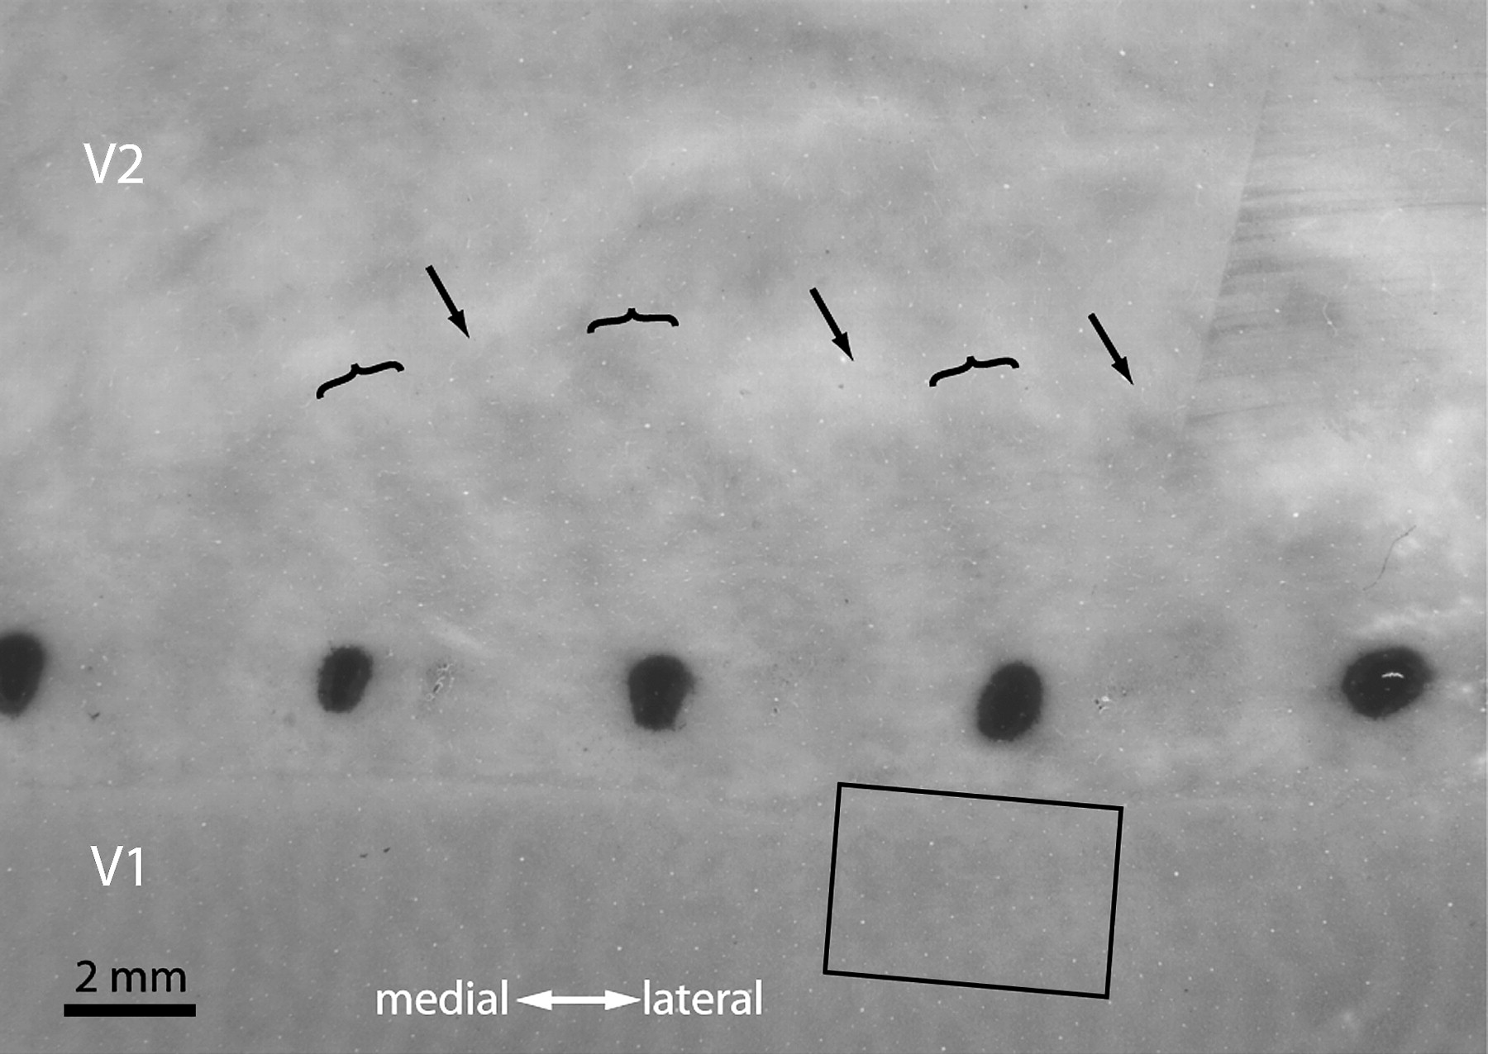
Figure 2. CO section from a flatmount of the right hemisphere, showing a string of CTB-Au injections in V2. Alternating ...
Notes:
Figure 2. CO section from a flatmount of the right hemisphere, showing a string of CTB-Au injections in V2. Alternating thin (arrows) and thick stripes (brackets) are visible. The rectangular box contains the field of retrogradely labeled cells, analyzed for different layers in subsequent figures. In this section, the box grazes the border between 4B and 4Cα. Ocular dominance columns are visible in layer 4C because one eye was enucleated 3 days before perfusion, in connection with an unrelated experiment.
Unless provided in the caption above, the following copyright applies to the content of this slide: © The Author 2006. Published by Oxford University Press. All rights reserved. For permissions, please e-mail: journals.permissions@oxfordjournals.org

Slide 3
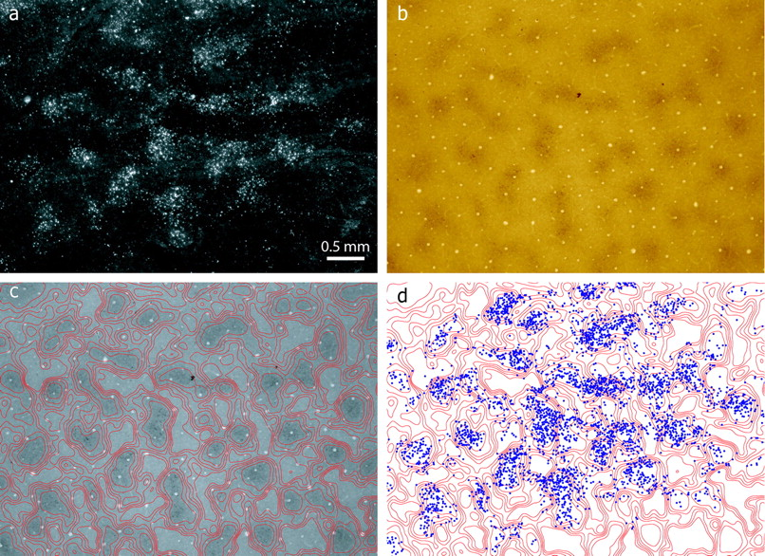
Figure 3. Cell labeling in layer 3. (a) This darkfield image from a section 200 μm superficial to the section in Figure ...
Notes:
Figure 3. Cell labeling in layer 3. (a) This darkfield image from a section 200 μm superficial to the section in Figure 2 shows clusters of CTB-Au–filled cells. The field is from the boxed region in Figure 2. (b) The same section, now viewed in brightfield, shows the CO patches. (c) Density contours, dividing the section into 6 zones of equal area based on the intensity of CO activity. (d) Alignment of cells (blue dots) and patches, shown by superimposing the position of each CTB-Au–filled cell on the CO contours.
Unless provided in the caption above, the following copyright applies to the content of this slide: © The Author 2006. Published by Oxford University Press. All rights reserved. For permissions, please e-mail: journals.permissions@oxfordjournals.org

Slide 4
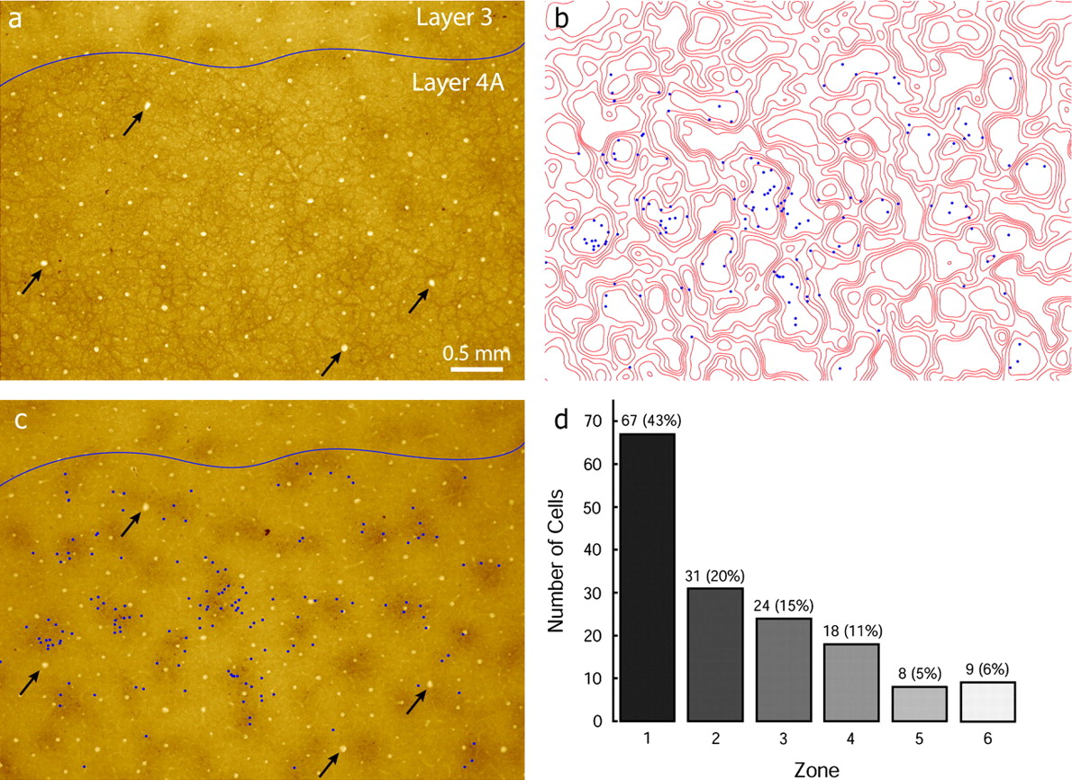
Figure 4. Cell labeling in layer 4A. (a) Same field as in Figure 3, from a section 100 μm deeper, showing the ...
Notes:
Figure 4. Cell labeling in layer 4A. (a) Same field as in Figure 3, from a section 100 μm deeper, showing the characteristic “honeycomb” CO pattern in layer 4A. (b) Alignment of cells and patches in layer 4A. Because patches are not visible in layer 4A, contour lines were transferred from Figure 3c. (c) Superimposition of labeled cells in 4A on CO section from layer 2/3, to show that 4A cells projecting to thin stripes were clustered in patches. Arrows denote blood vessels used for alignment. (d) Histogram showing that 63% of labeled cells were located in the 2 darkest zones of CO staining.
Unless provided in the caption above, the following copyright applies to the content of this slide: © The Author 2006. Published by Oxford University Press. All rights reserved. For permissions, please e-mail: journals.permissions@oxfordjournals.org

Slide 5
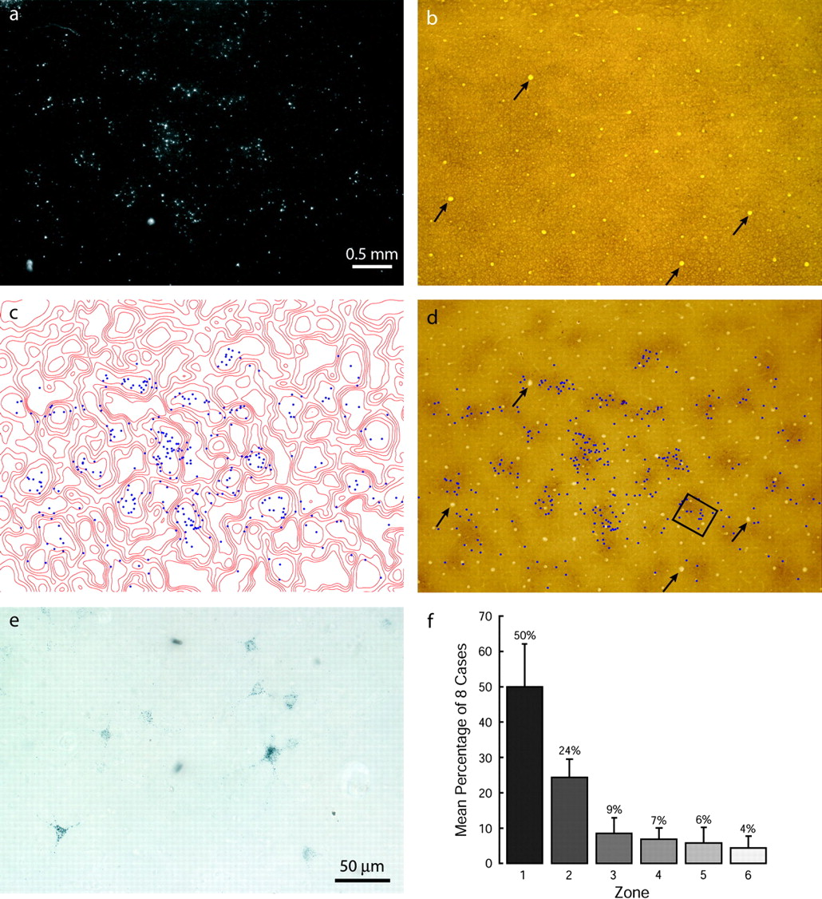
Figure 5. Cell labeling in layer 4B. (a) Same field as in Figure 3, from a section 150 μm deeper, showing clusters of ...
Notes:
Figure 5. Cell labeling in layer 4B. (a) Same field as in Figure 3, from a section 150 μm deeper, showing clusters of labeled cells in darkfield. (b) Adjacent CO section, 50 μm deeper, at the layer 4B/4Cα border. (c) Labeled cells in 4B superimposed on contours of CO density from Figure 3d. (d) Labeled cells in 4B superimposed on the CO-staining pattern in Figure 3b. (e) Magnified view of the box in (d) showing CTB-Au–filled cells in a CO patch. (f) Histogram from all 8 cases, showing that a mean percentage of 74% of layer 4B cells was located in CO patches.
Unless provided in the caption above, the following copyright applies to the content of this slide: © The Author 2006. Published by Oxford University Press. All rights reserved. For permissions, please e-mail: journals.permissions@oxfordjournals.org

Slide 6
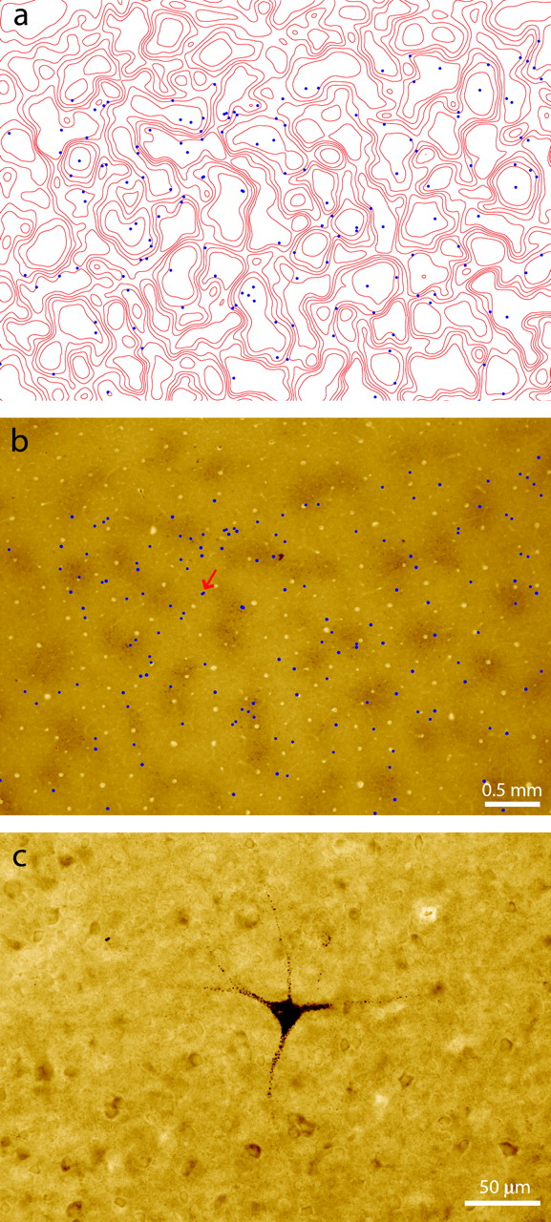
Figure 6. Cell labeling in layers 5 and 6. (a) Position of cells in 5 serial sections plotted on contours of CO density ...
Notes:
Figure 6. Cell labeling in layers 5 and 6. (a) Position of cells in 5 serial sections plotted on contours of CO density from layer 2/3. (b) Position of cells plotted directly on pattern of CO activity from layer 2/3. The cells are not located preferentially in patches. (c) A Meynert cell filled with CTB-Au in layer 6. Its location is marked with a red arrow in (b).
Unless provided in the caption above, the following copyright applies to the content of this slide: © The Author 2006. Published by Oxford University Press. All rights reserved. For permissions, please e-mail: journals.permissions@oxfordjournals.org

Slide 7
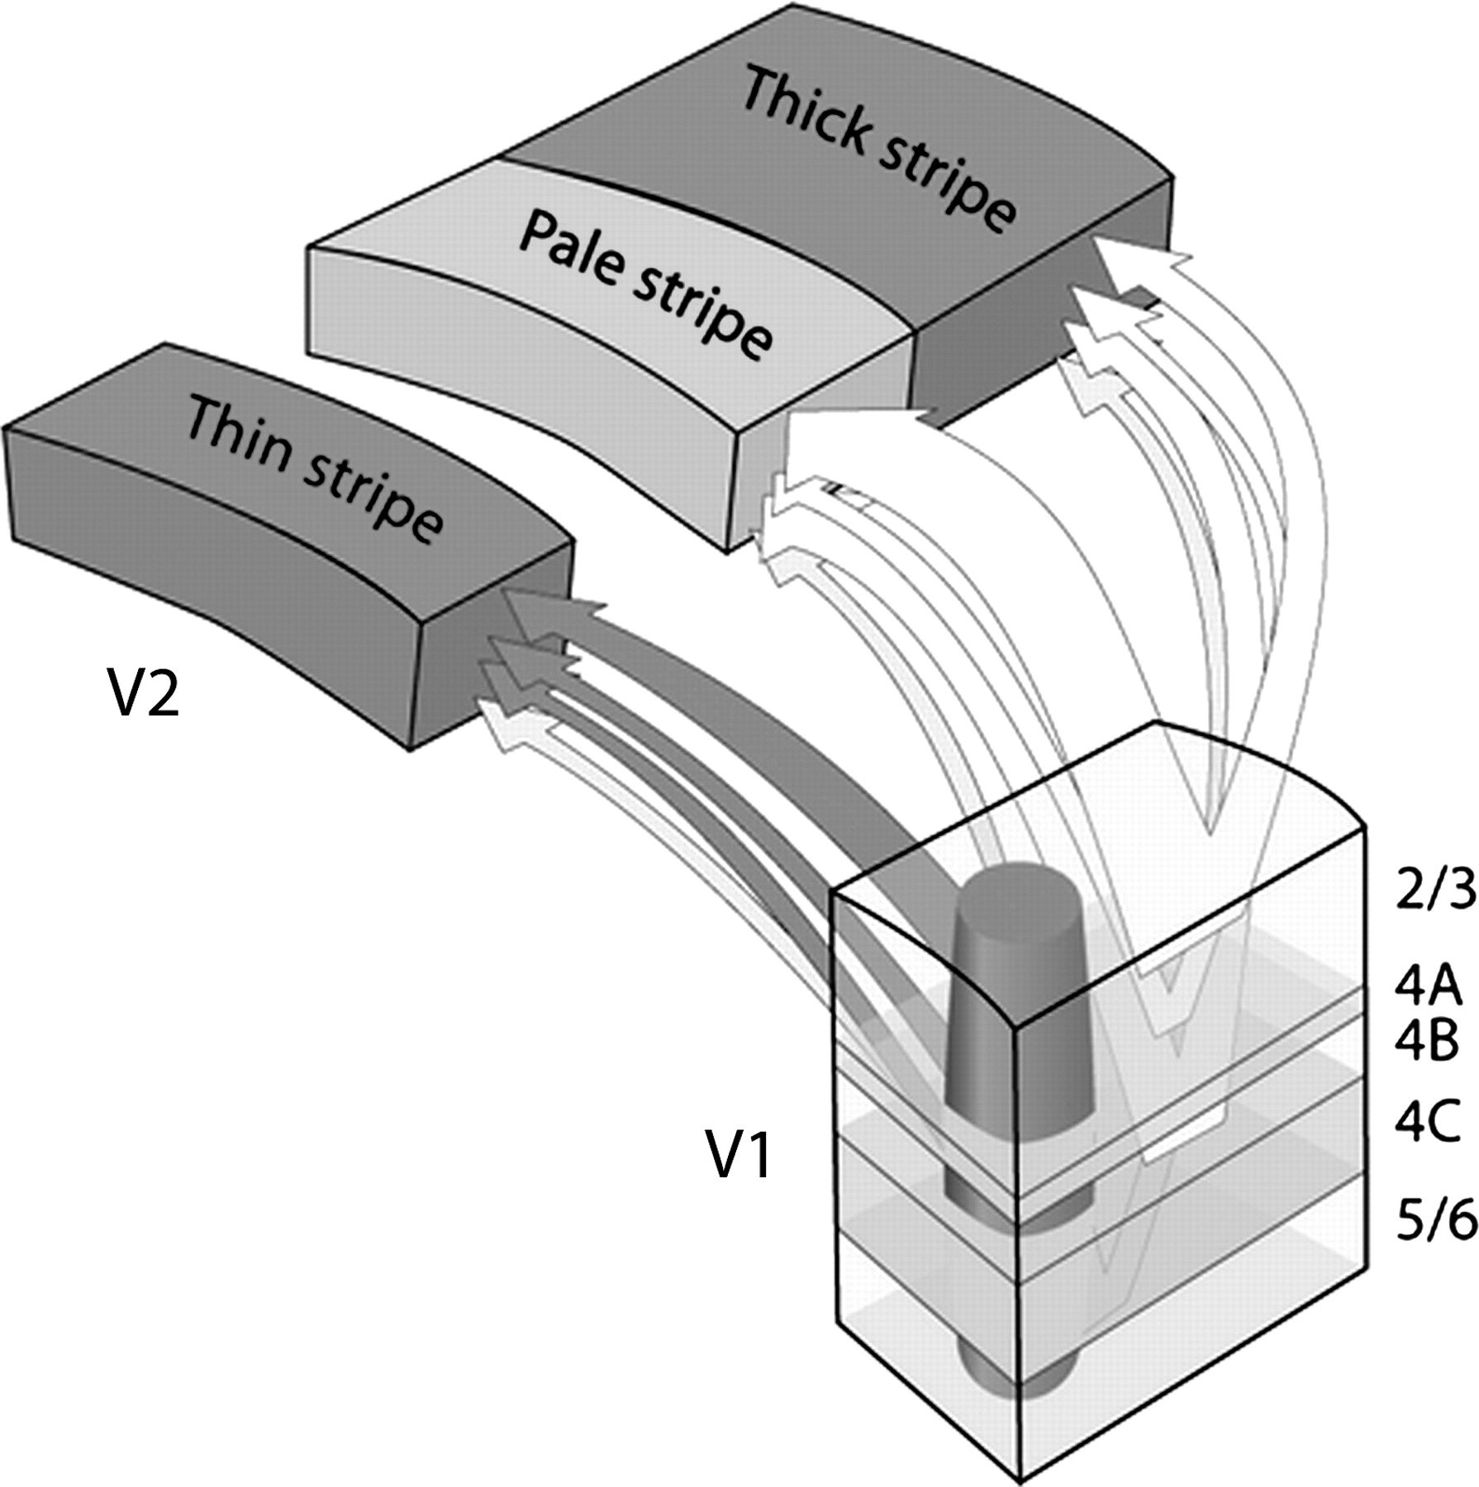
Figure 7. Summary of V1 to V2 projections. For all stripes the strongest input comes from layer 2/3, but 4A, 4B, and ...
Notes:
Figure 7. Summary of V1 to V2 projections. For all stripes the strongest input comes from layer 2/3, but 4A, 4B, and 5/6 also contribute. The input is dichotomized: patches → thin stripes; interpatches → pale, thick stripes, except from layer 5/6.
Unless provided in the caption above, the following copyright applies to the content of this slide: © The Author 2006. Published by Oxford University Press. All rights reserved. For permissions, please e-mail: journals.permissions@oxfordjournals.org

