Slide 1
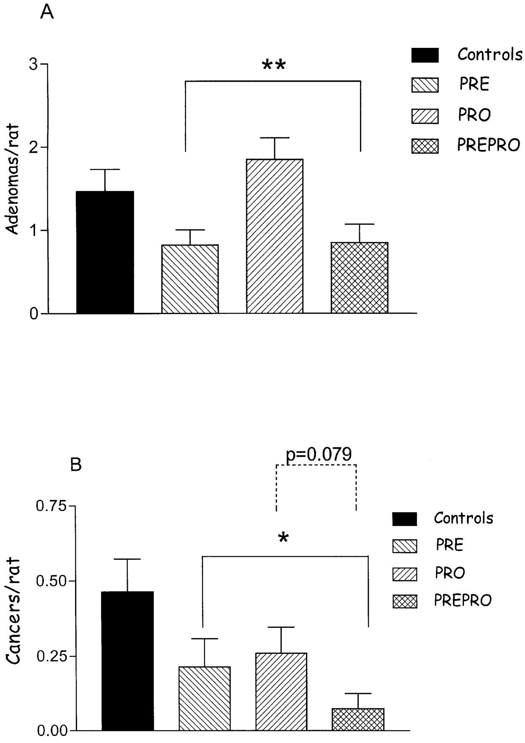
Fig. 1. ( A ) Bars represent the mean number (+SE) of adenomas/rat (considering all the rats in the group) in the ...
Notes:
Fig. 1. ( A ) Bars represent the mean number (+SE) of adenomas/rat (considering all the rats in the group) in the colorectum in Controls ( n = 28), PRE ( n = 28), PRO ( n = 27) and PREPRO ( n = 27) groups. **Synergy1-treated groups (PRE and PREPRO) are significantly different ( P < 0.001) from groups not treated with Synergy1 (Controls and PRO). ( B ) Bars represent the mean number (+SE) of cancers/rat in the colorectum in Controls ( n = 28), PRE ( n = 28), PRO ( n = 27) and PREPRO ( n = 27) groups. *Synergy1-treated groups (PRE and PREPRO) are significantly different ( P < 0.05) from groups not treated with Synergy1 (Controls and PRO). P = 0.079 refers to the level of statistical significance of the effect of probiotics (PRO and PREPRO groups) when compared with groups not treated with probiotics (Controls and PRE).
Unless provided in the caption above, the following copyright applies to the content of this slide: © Oxford University Press

Slide 2
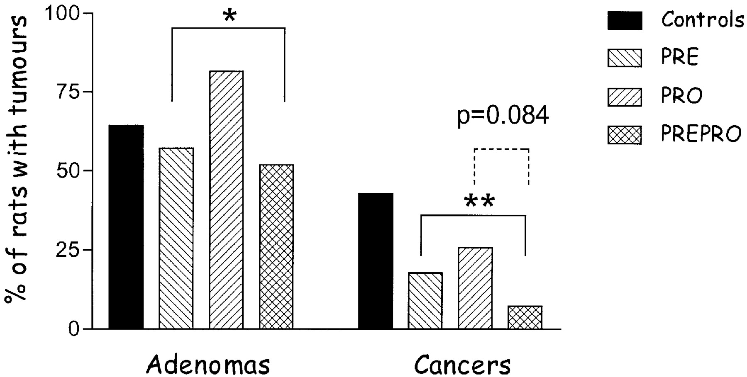
Fig. 2. Bars represent the incidence of adenomas or cancers (number of rats with tumours/number of rats in that ...
Notes:
Fig. 2. Bars represent the incidence of adenomas or cancers (number of rats with tumours/number of rats in that group ×100) in the different groups. *,**Synergy1-treated groups (PRE and PREPRO) are significantly different ( P < 0.05, P < 0.01, for adenomas and cancers, respectively) from groups not treated with Synergy1 (Controls and PRO). P = 0.084 refers to the level of statistical significance of the effect of probiotics (PRO and PREPRO groups) when compared with groups not treated with probiotics (Controls and PRE).
Unless provided in the caption above, the following copyright applies to the content of this slide: © Oxford University Press

Slide 3
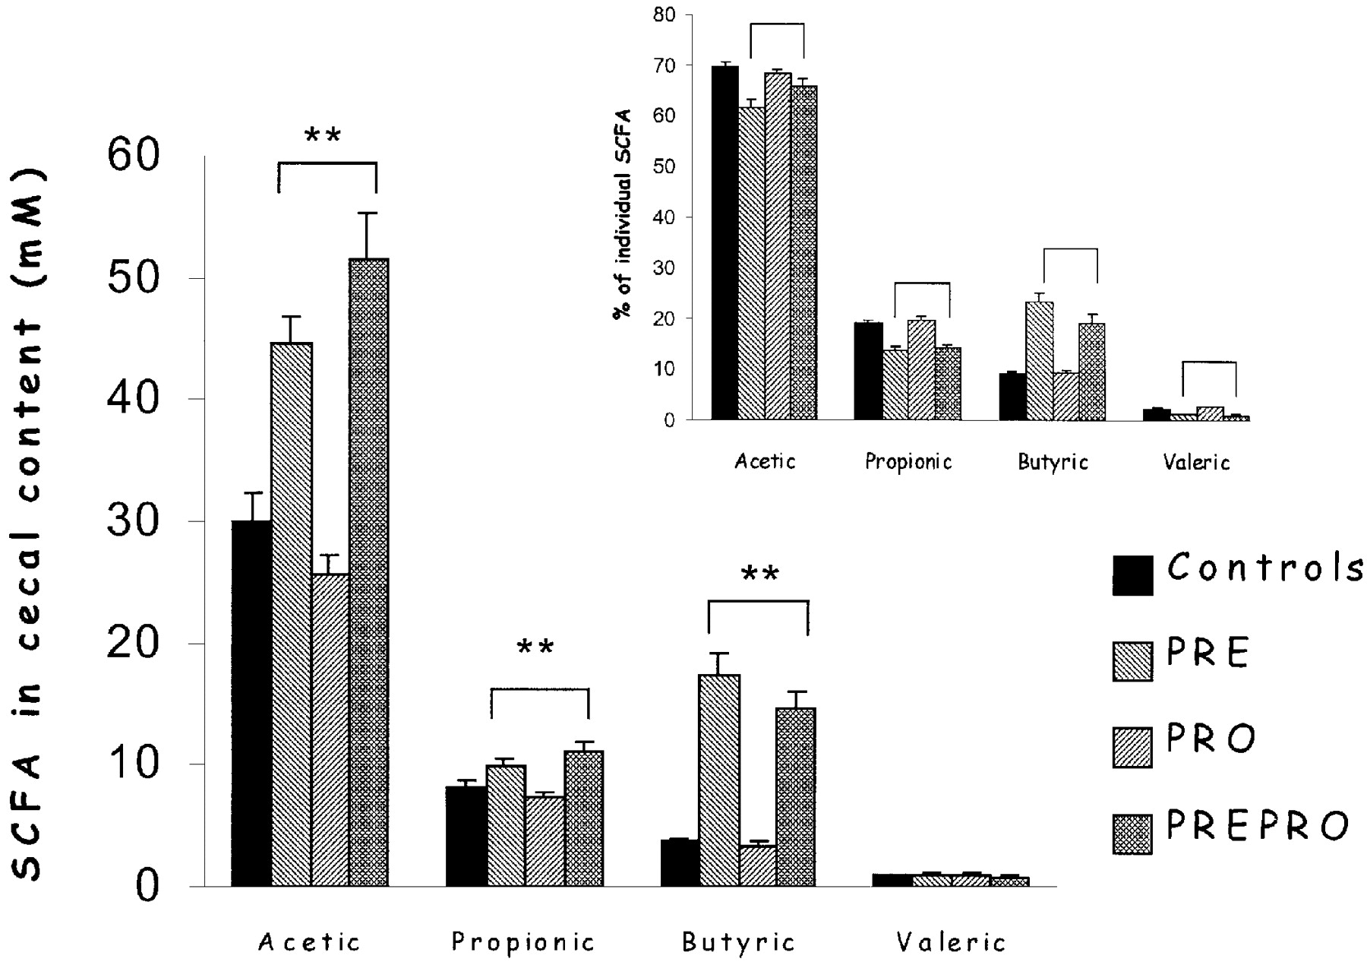
Fig. 3. SCFA concentration in the caecal content of rats fed the experimental diets. Bars are means ± SE. ...
Notes:
Fig. 3. SCFA concentration in the caecal content of rats fed the experimental diets. Bars are means ± SE. **Synergy1-treated groups (PRE and PREPRO) are significantly different ( P < 0.001) from groups not treated with Synergy1 (Controls and PRO). (Insert) Per cent of individual SCFA/total SCFA in the caecum. Means ± SE. **Synergy1-treated groups (PRE and PREPRO) are significantly different ( P < 0.001) from groups not treated with Synergy1 (Controls and PRO).
Unless provided in the caption above, the following copyright applies to the content of this slide: © Oxford University Press

Slide 4
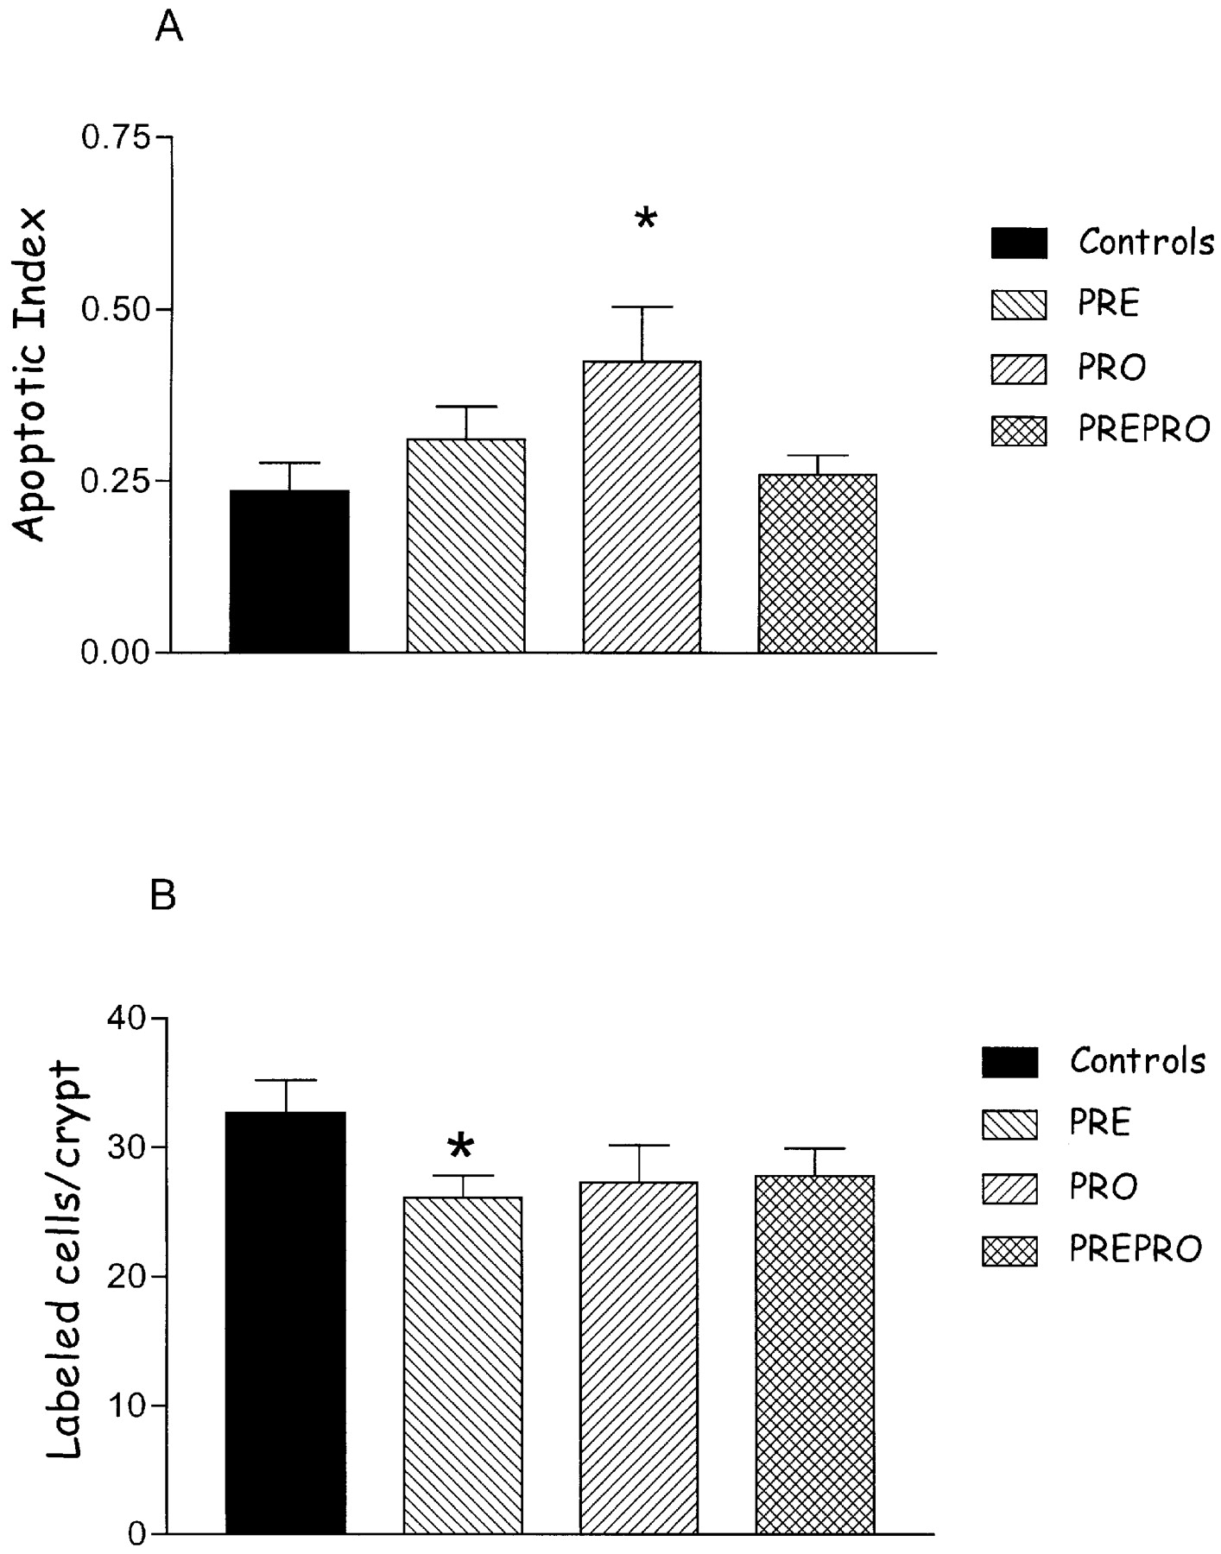
Fig. 4. ( A ) AI in the colonic mucosa of rats in Controls ( n = 13), PRE ( n = 15), PRO ( n = 10) and PREPRO ( n = ...
Notes:
Fig. 4. ( A ) AI in the colonic mucosa of rats in Controls ( n = 13), PRE ( n = 15), PRO ( n = 10) and PREPRO ( n = 17) groups. *Significantly different from Controls ( P < 0.05; F -test for interaction: P < 0.05). ( B ) Number of PCNA LC/crypt in the colonic mucosa of rats in Controls ( n = 10), PRE ( n = 11), PRO ( n = 9) and PREPRO ( n = 13) groups. *Significantly different when compared to Controls ( P < 0.05; F -test for interaction: P < 0.05).
Unless provided in the caption above, the following copyright applies to the content of this slide: © Oxford University Press

Slide 5
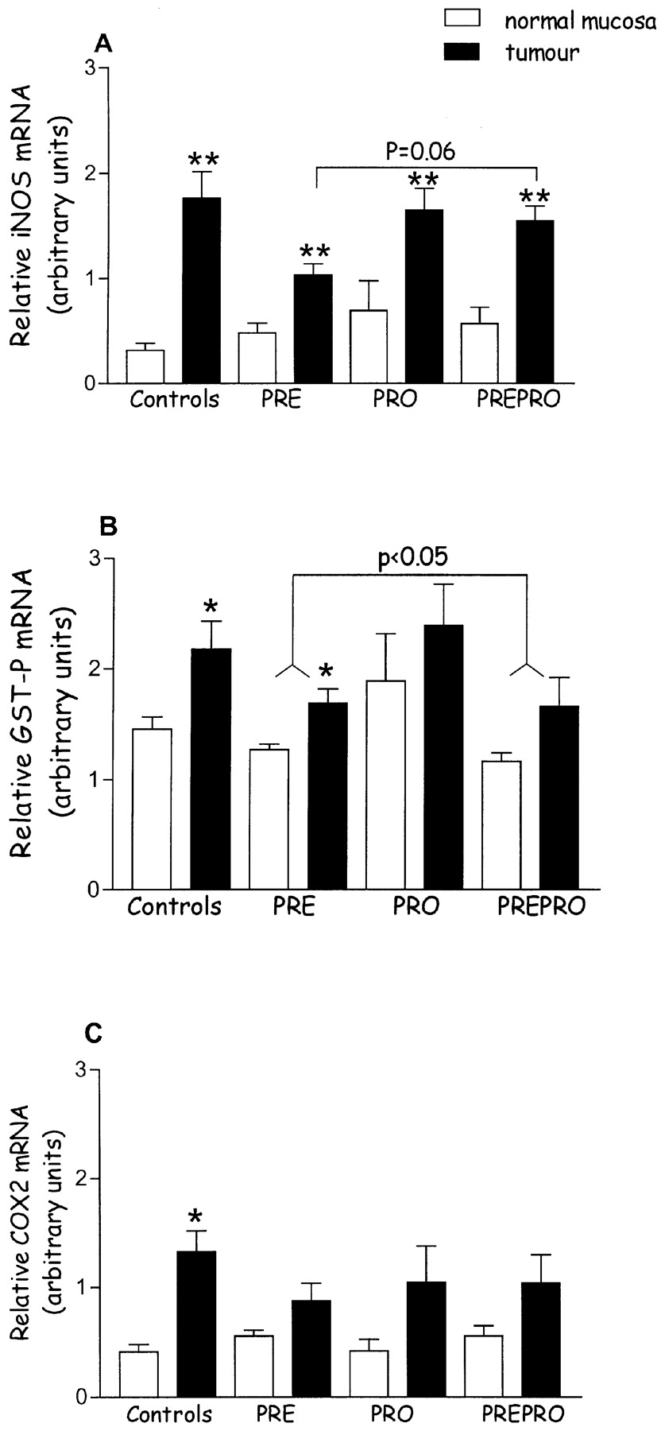
Fig. 5. ( A ) Relative expression of iNOS in the normal mucosa (white bars) and in tumours (black bars) in Controls, ...
Notes:
Fig. 5. ( A ) Relative expression of iNOS in the normal mucosa (white bars) and in tumours (black bars) in Controls, PRE, PRO, PREPRO groups, as shown. Values are means ± SE ( n = 10, 8, 6 and 6 for controls, PRE, PRO and PREPRO, respectively); ** P < 0.01 by ANOVA, compared with normal matched mucosa; P = 0.06 over the bar refers to the level of statistical significance of the effect of Synergy1 (PRE and PREPRO groups) compared with groups not treated with Synergy1 (Controls and PRO). ( B ) Relative GST-P expression in the normal mucosa (white bars) and tumours (black bars) in Controls, PRE, PRO, PREPRO groups, as shown. Values are means ± SE ( n = 10, 8, 6 and 6 for Controls, PRE, PRO and PREPRO, respectively); * P < 0.05 by ANOVA, compared with normal matched mucosa; P = 0.05 over the bar refers to the level of statistical significance of the effect of Synergy1, obtained by comparing tumours or normal mucosa in the rats treated with Synergy1 (PRE and PREPRO groups) with tumours and normal mucosa from groups not treated with Synergy1 (Controls and PRO). ( C ) Relative expression of COX-2 in the normal mucosa (white bars) and in tumours (black bars) in Controls, PRE, PRO, PREPRO groups, as shown. Values are means ± SE ( n = 10, 8, 6 and 6 for Controls, PRE, PRO and PREPRO, respectively); ** P < 0.01 by ANOVA, compared with normal matched mucosa.
Unless provided in the caption above, the following copyright applies to the content of this slide: © Oxford University Press

