Slide 1
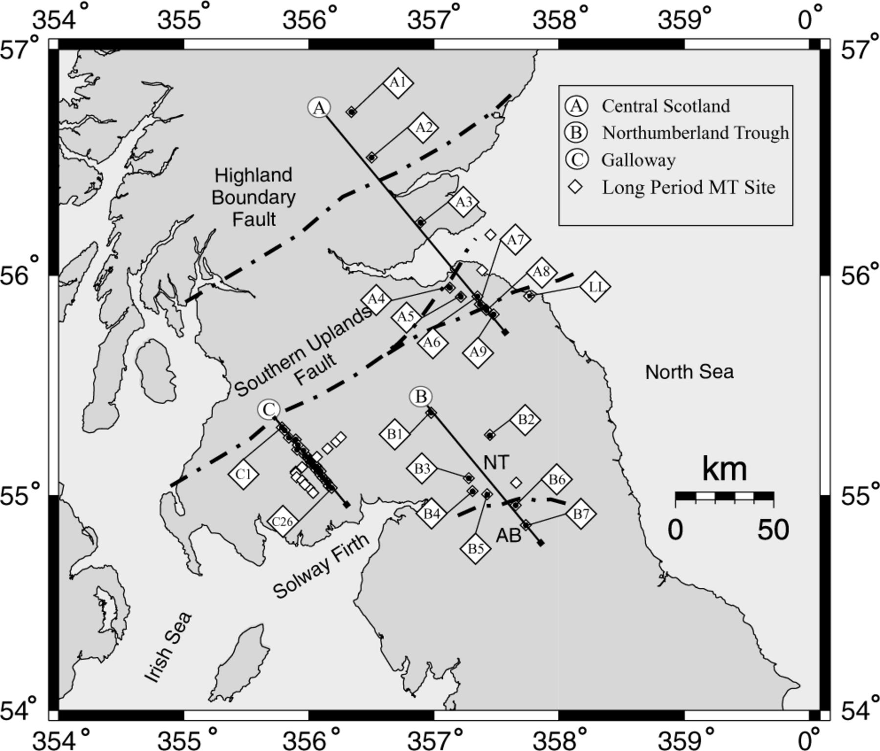
Figure 1. The northern England and southern Scotland region showing the available long period (750 s) ‘Iapetus’ ...
Notes:
Figure 1. The northern England and southern Scotland region showing the available long period (750 s) ‘Iapetus’ Magnetotelluric data set. Also shown are three profiles A—Central Scotland; B—Northumberland Trough (NT) and C—Galloway. AB is the Alston block; bold dot and dash lines indicate major faults.
Unless provided in the caption above, the following copyright applies to the content of this slide: © 2006 The Authors Journal compilation © 2006 RAS

Slide 2
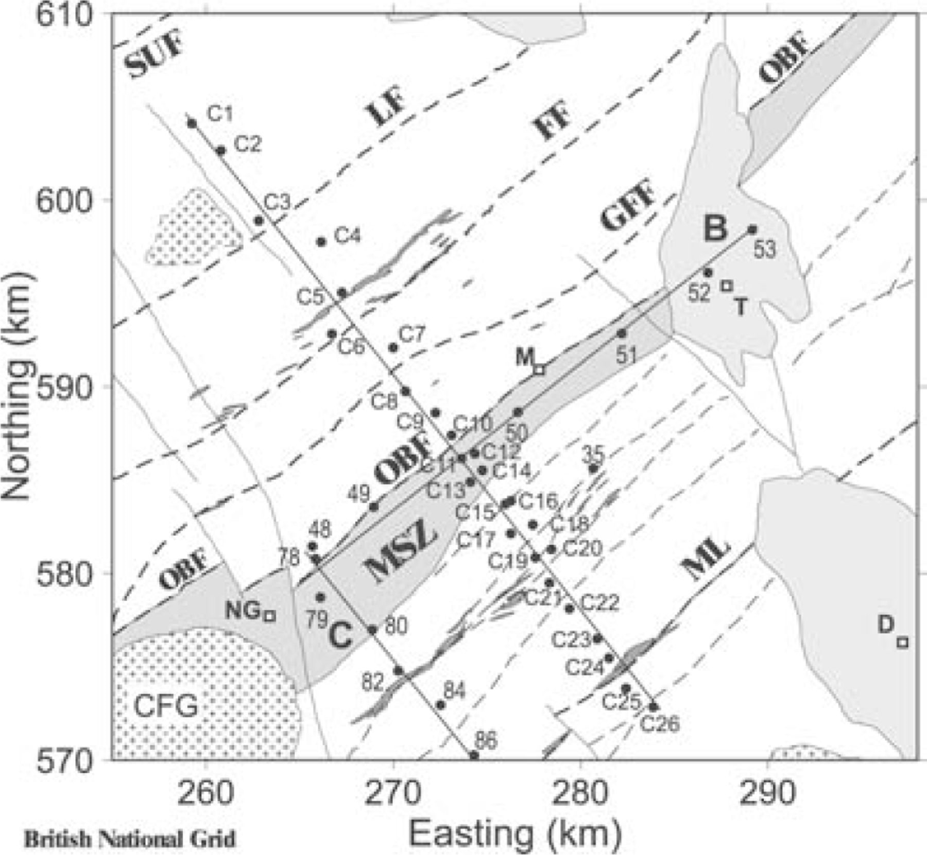
Figure 2. Location of MT sites along profile C of Fig. 2 in relation to the geology of Galloway. Black dashed lines, ...
Notes:
Figure 2. Location of MT sites along profile C of Fig. 2 in relation to the geology of Galloway. Black dashed lines, NE–SW tract bounding faults (Caledonian); continuous lines, NW–SE normal faults (Carboniferous); unshaded areas, Ordovician and Silurian greywackes; light-shaded areas, Carboniferous/Permo–Triassic sediments; thin dark streaks, carbonaceous shales; broad dark zone, Moniaive Shear Zone (MSZ); + +, granite batholiths (CFG; Cairnsmore of Fleet). SUF; Southern Uplands Fault; LF, Leadhills Fault; FF, Fardingmullach Fault; GFF, Glen Foumart Fault; OBF, Orlock Bridge Fault; ML, Moffat Line. D, Dumfries; T, Thornhill; M, Moniaive and NG, New Galloway. After Tauber et al. (2003).
Unless provided in the caption above, the following copyright applies to the content of this slide: © 2006 The Authors Journal compilation © 2006 RAS

Slide 3
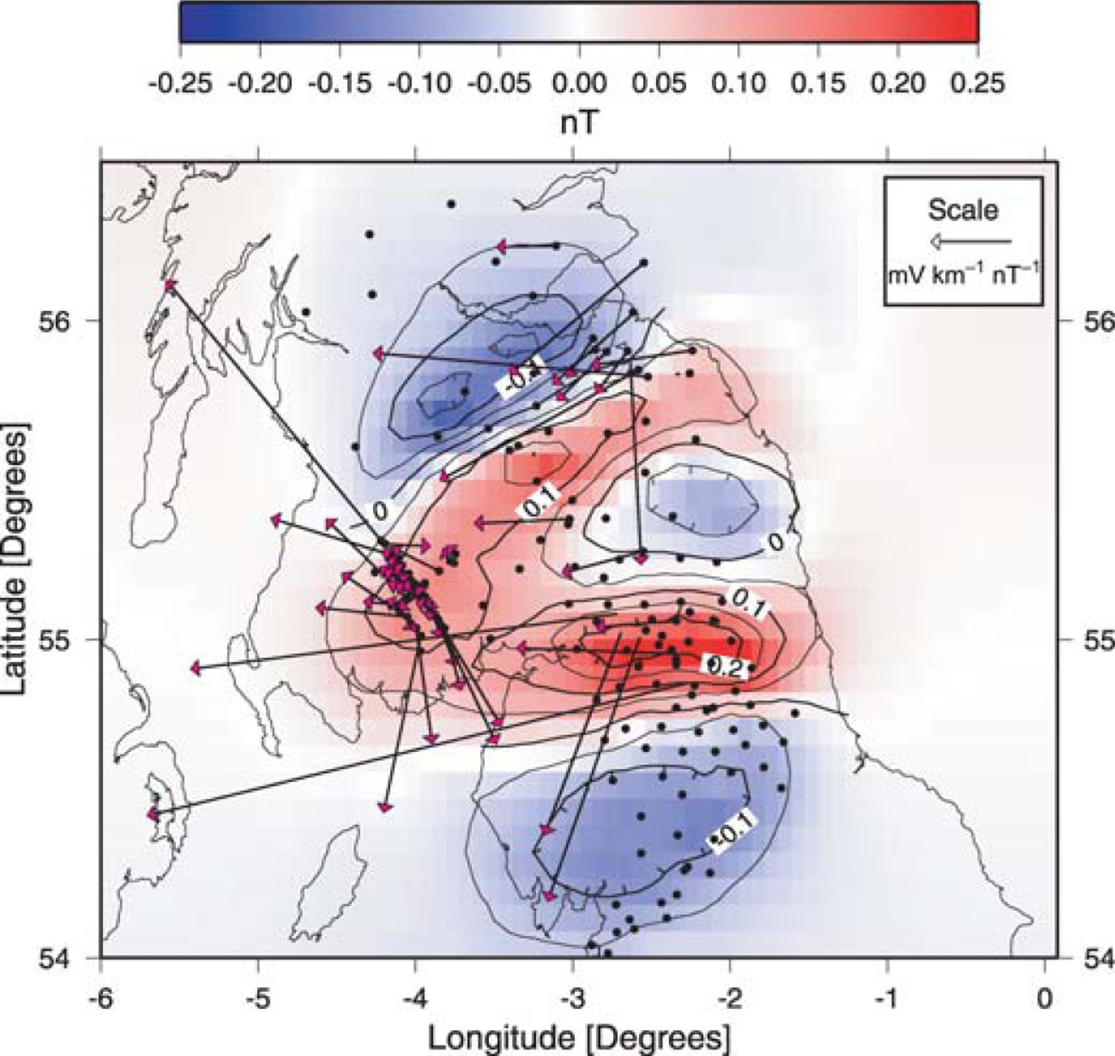
Figure 3. Hypothetical event map showing the magnetic variation anomalies (contours and shading) and telluric vectors ...
Notes:
Figure 3. Hypothetical event map showing the magnetic variation anomalies (contours and shading) and telluric vectors (arrows) at selected sites in the NESS region. The black dots indicate Geomagnetic Deep Sounding sites.
Unless provided in the caption above, the following copyright applies to the content of this slide: © 2006 The Authors Journal compilation © 2006 RAS

Slide 4
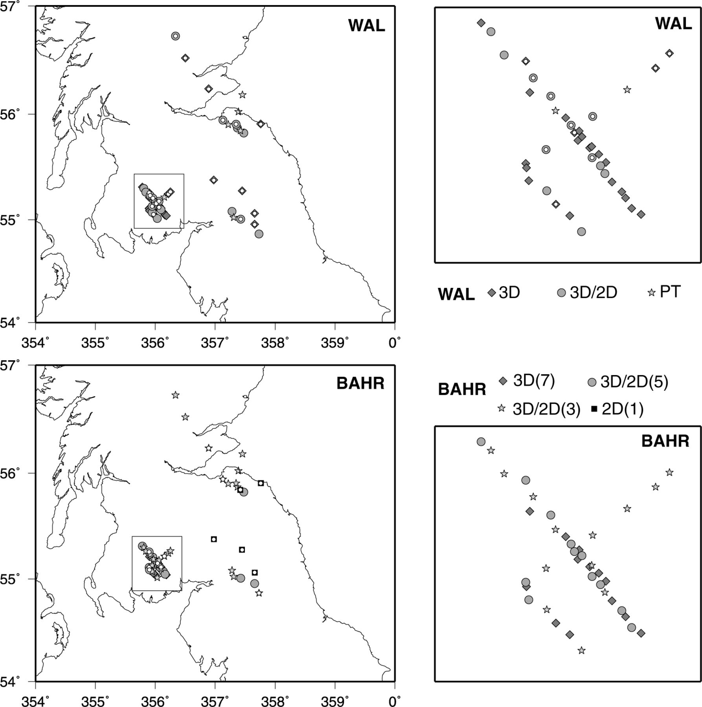
Figure 4. Dimensionality of the MT sites using the WAL (top) and Bahr (bottom) criteria. Diamonds—3-D structure; ...
Notes:
Figure 4. Dimensionality of the MT sites using the WAL (top) and Bahr (bottom) criteria. Diamonds—3-D structure; Circles—3-D galvanic distortion of a 2-D region/Bahr class 5; Stars–pure twist of the electric field (WAL)/weak galvanic distortion, Bahr class 3; squares—2-D region. The white circles highlight sites where the dimensionality was difficult to determine. The Galloway survey of Tauber et al. (2003) has been expanded for clarity. See text for details.
Unless provided in the caption above, the following copyright applies to the content of this slide: © 2006 The Authors Journal compilation © 2006 RAS

Slide 5
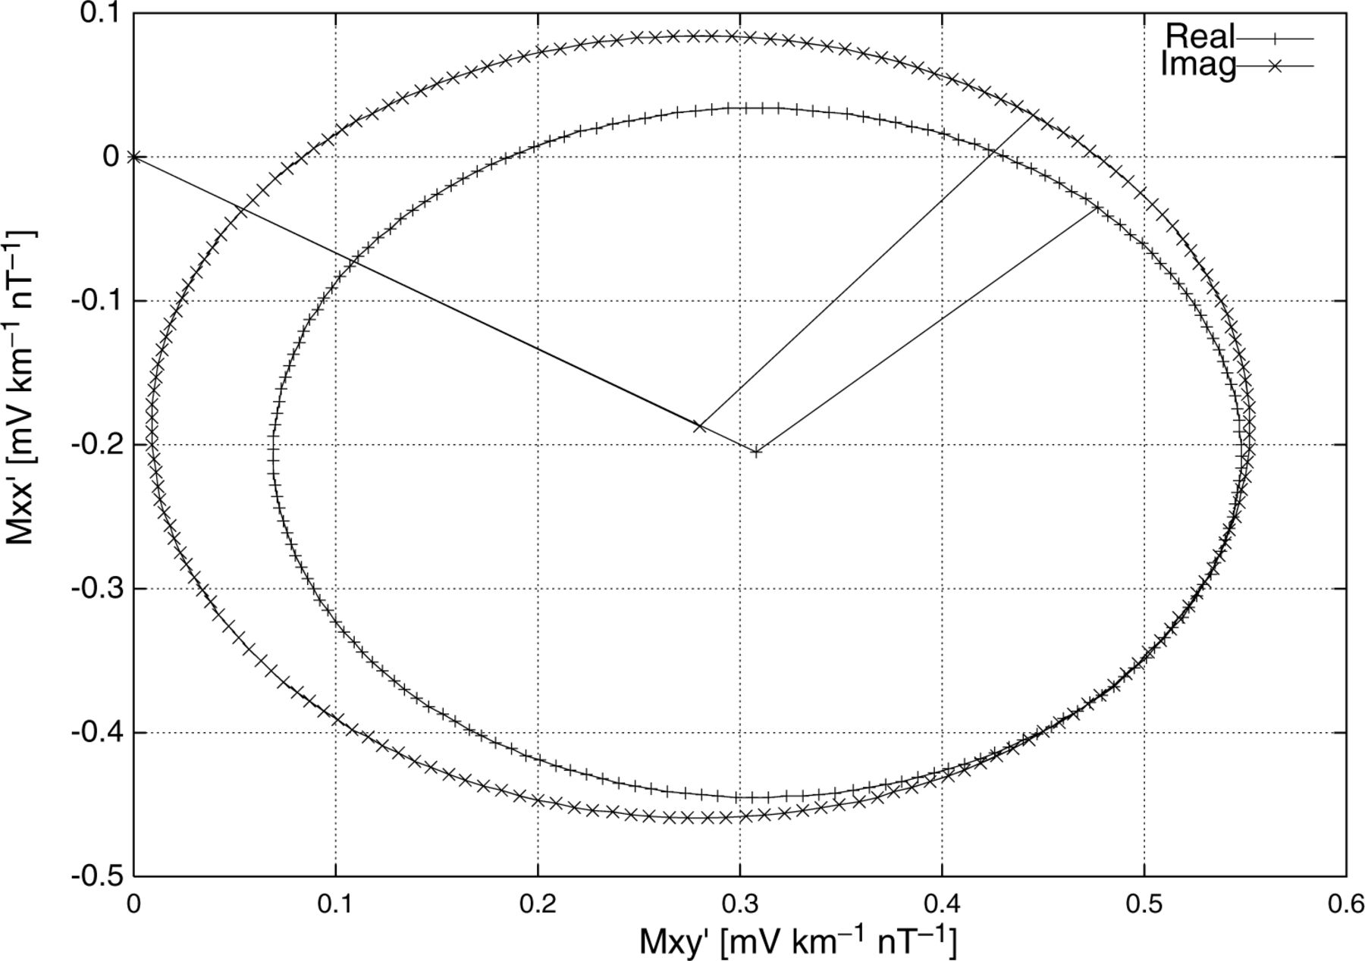
Figure 5. Real (+) and Imaginary (x) Mohr circles for the Galloway site C11.
Notes:
Figure 5. Real (+) and Imaginary (x) Mohr circles for the Galloway site C11.
Unless provided in the caption above, the following copyright applies to the content of this slide: © 2006 The Authors Journal compilation © 2006 RAS

Slide 6
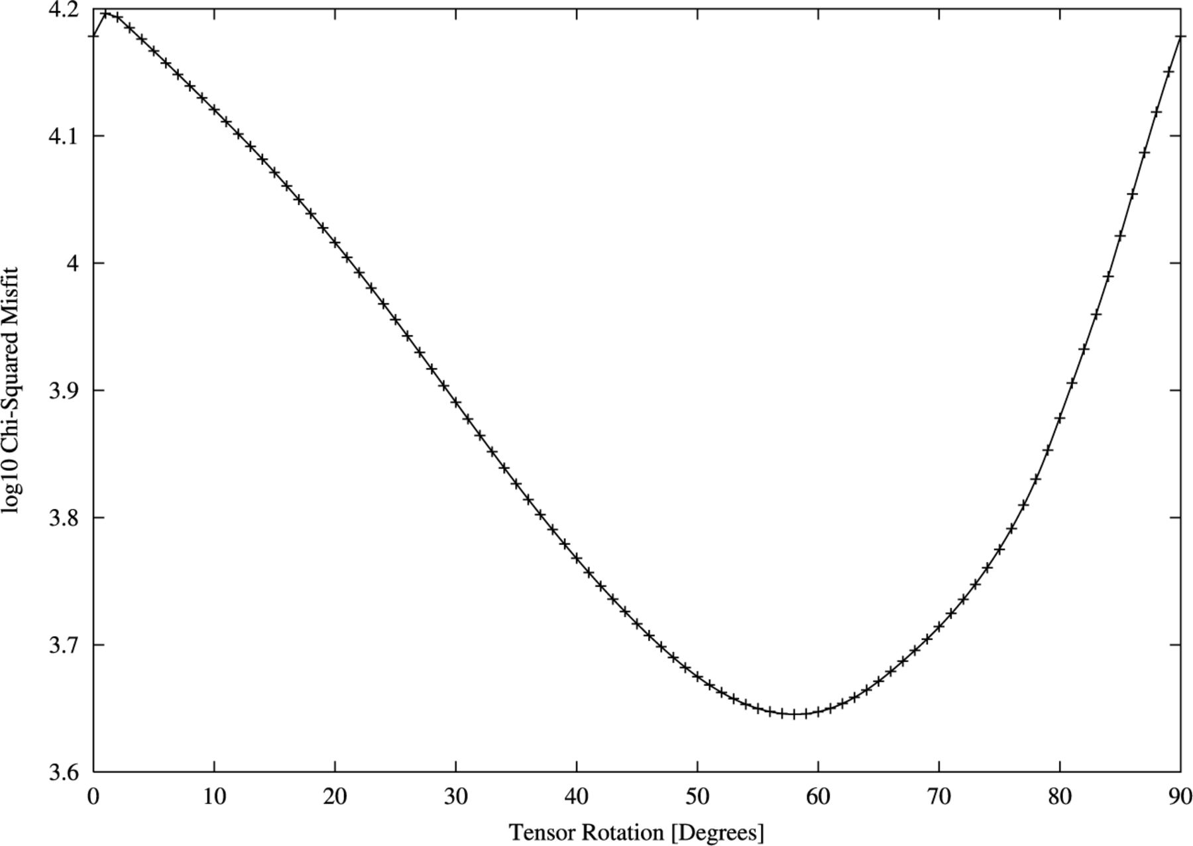
Figure 6. Dependence of the total misfit on the angle (°; clockwise from geographic north) through which the MT tensors ...
Notes:
Figure 6. Dependence of the total misfit on the angle (°; clockwise from geographic north) through which the MT tensors of all sites were rotated.
Unless provided in the caption above, the following copyright applies to the content of this slide: © 2006 The Authors Journal compilation © 2006 RAS

Slide 7
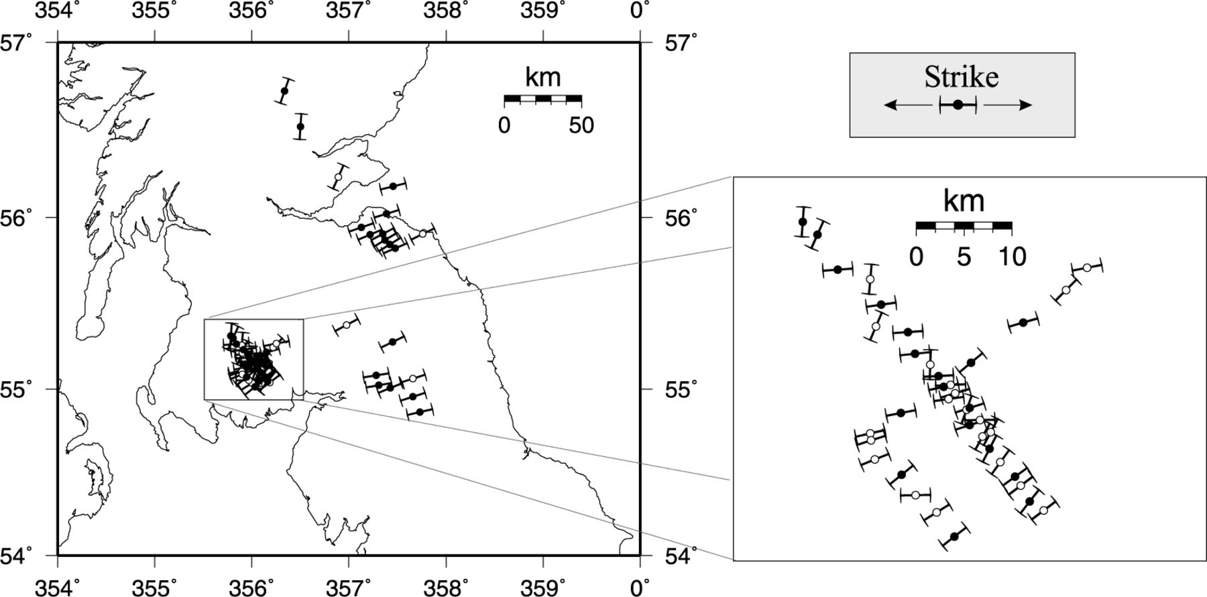
Figure 7. Electromagnetic strike (parallel to the side bars) of each site determined using the method of Smith (1995). ...
Notes:
Figure 7. Electromagnetic strike (parallel to the side bars) of each site determined using the method of Smith (1995). Sites which generated an acceptable misfit are shown with filled circles; the unfilled circles denote sites where the fit is poor.
Unless provided in the caption above, the following copyright applies to the content of this slide: © 2006 The Authors Journal compilation © 2006 RAS

Slide 8
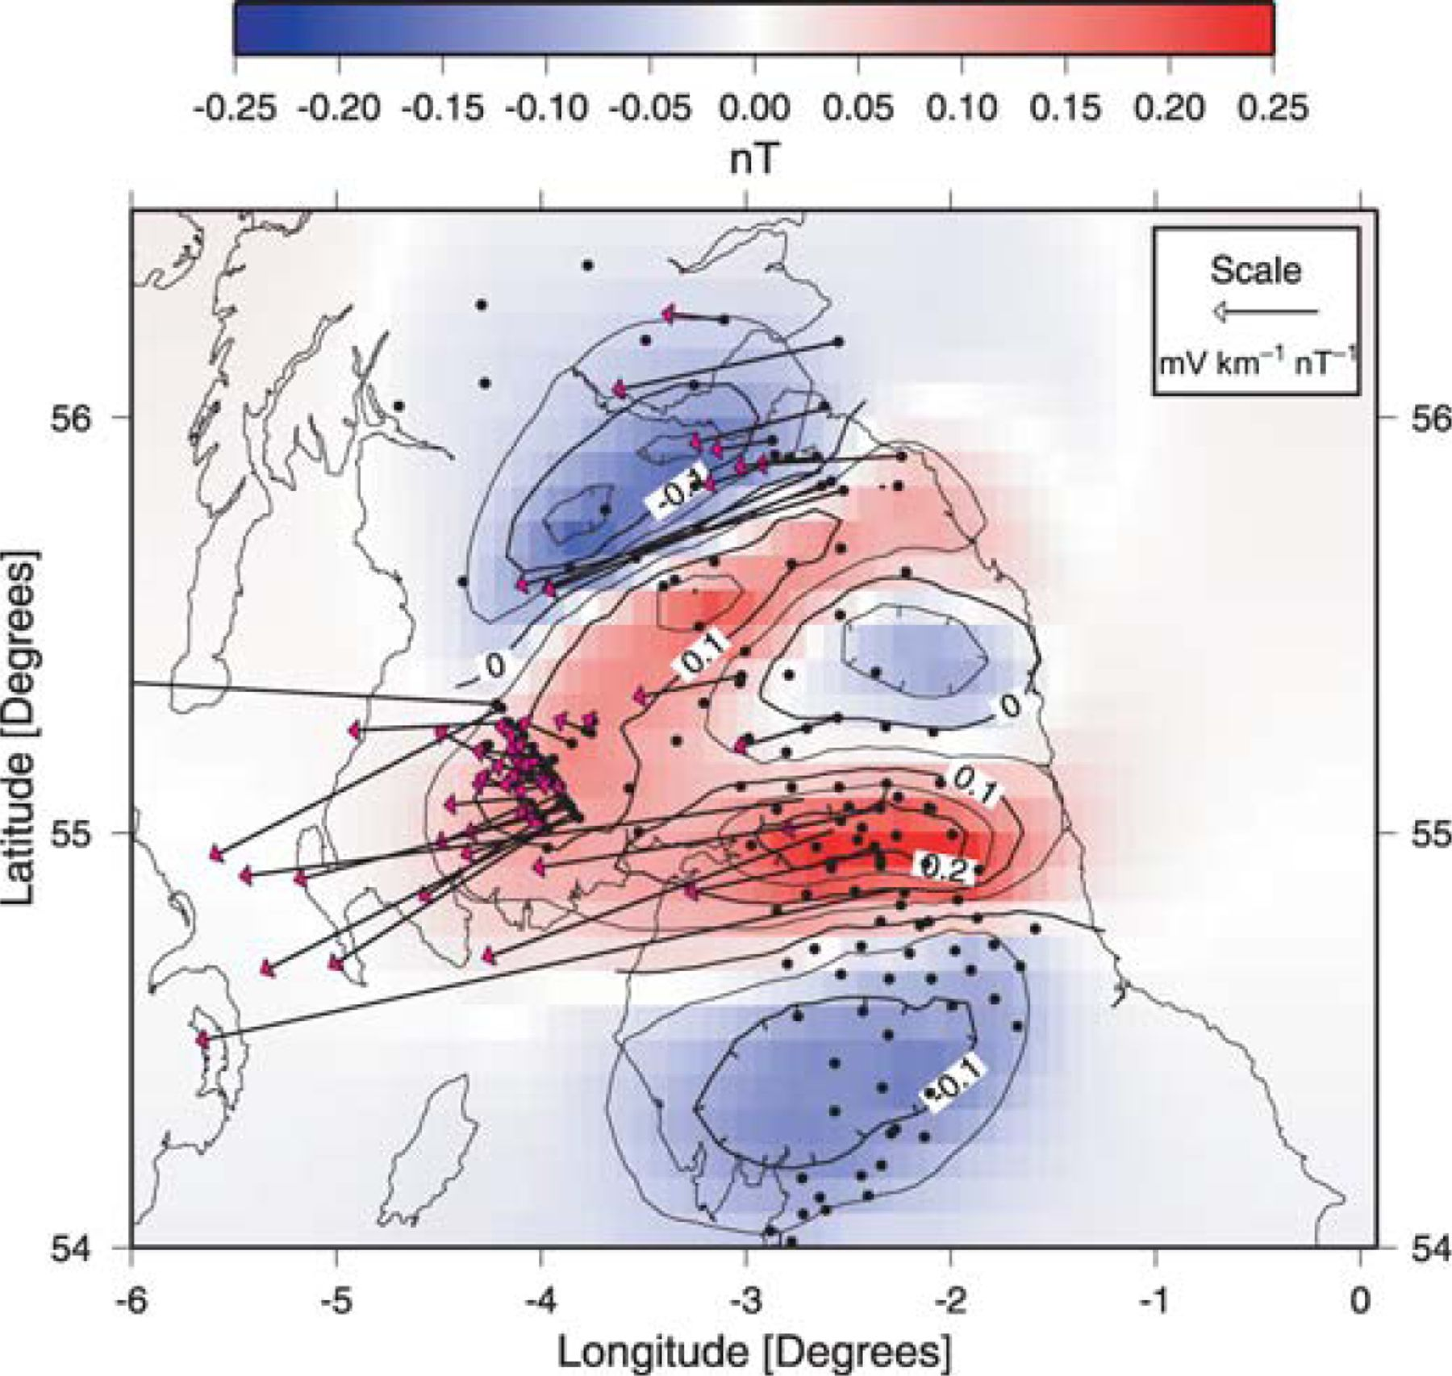
Figure 8. The e_{x} telluric vectors recovered via tensor decomposition.
Notes:
Figure 8. The ex telluric vectors recovered via tensor decomposition.
Unless provided in the caption above, the following copyright applies to the content of this slide: © 2006 The Authors Journal compilation © 2006 RAS

Slide 9
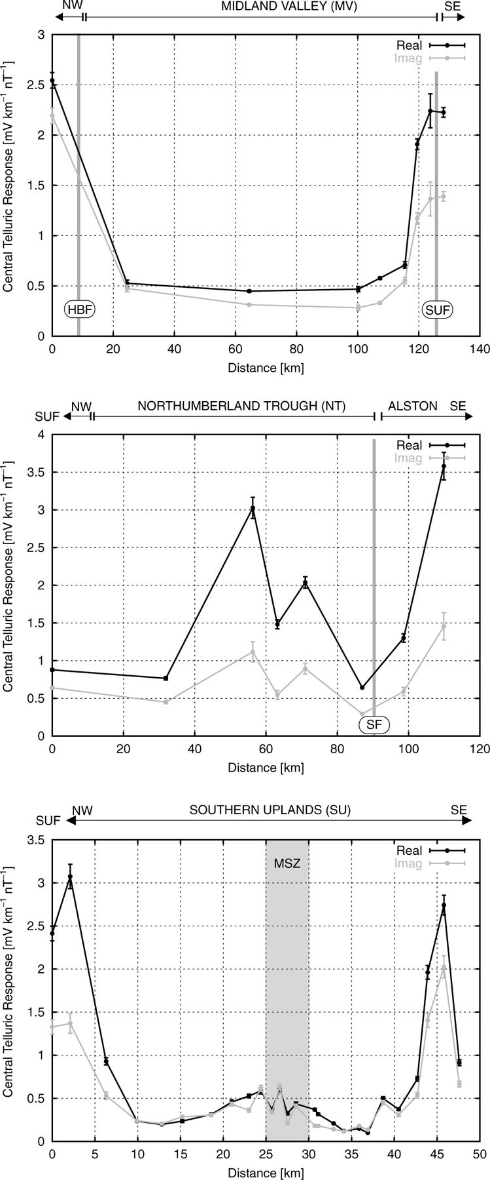
Figure 9. The central telluric response for the three NESS profiles. Profile A (top)—Central Scotland; Profile B ...
Notes:
Figure 9. The central telluric response for the three NESS profiles. Profile A (top)—Central Scotland; Profile B (middle)–Northumberland Trough; Profile C (bottom)—Galloway. See also Fig. 1 and text for further details.
Unless provided in the caption above, the following copyright applies to the content of this slide: © 2006 The Authors Journal compilation © 2006 RAS

