Slide 1
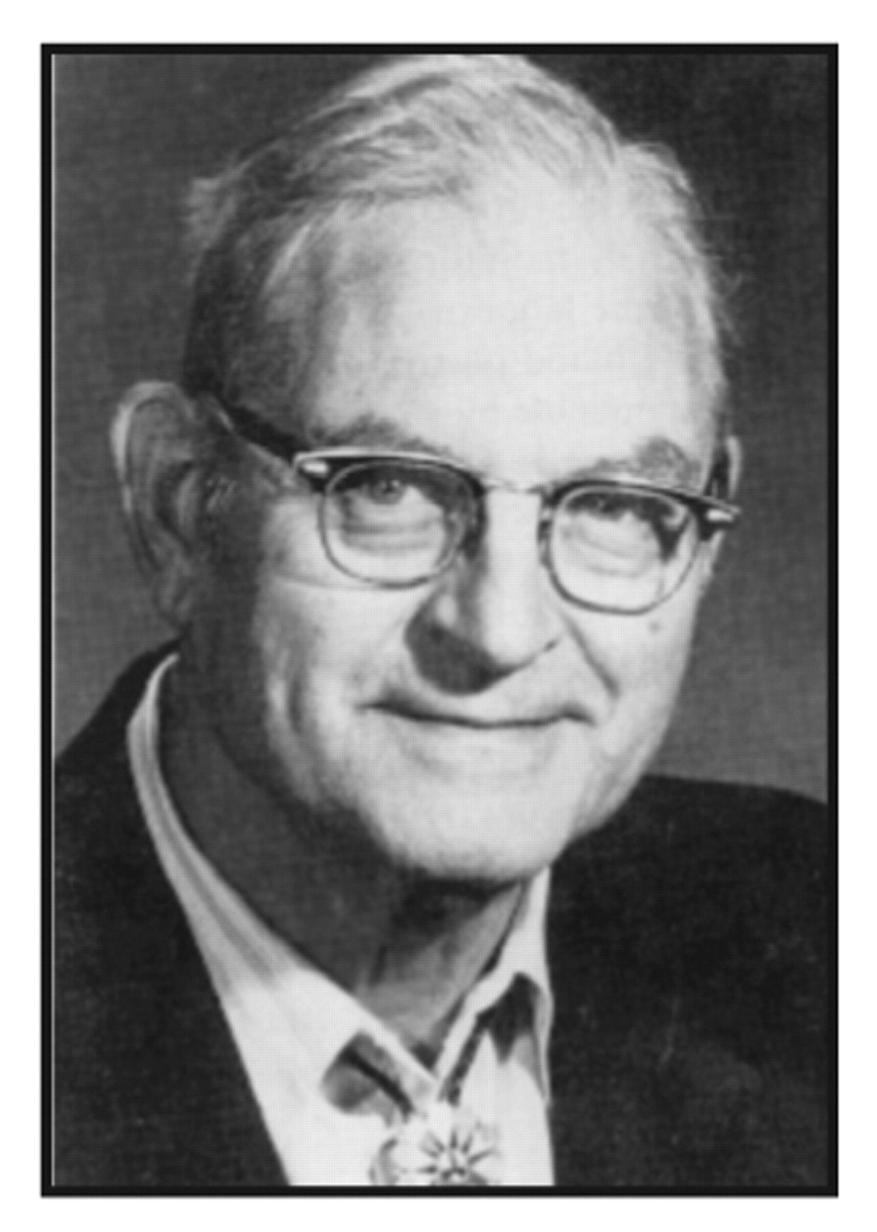
Robert Guthrie (1916–1995)
Notes:
Robert Guthrie (1916–1995)
Unless provided in the caption above, the following copyright applies to the content of this slide: Copyright© by the American Society for Clinical Pathology (ASCP)

Slide 2
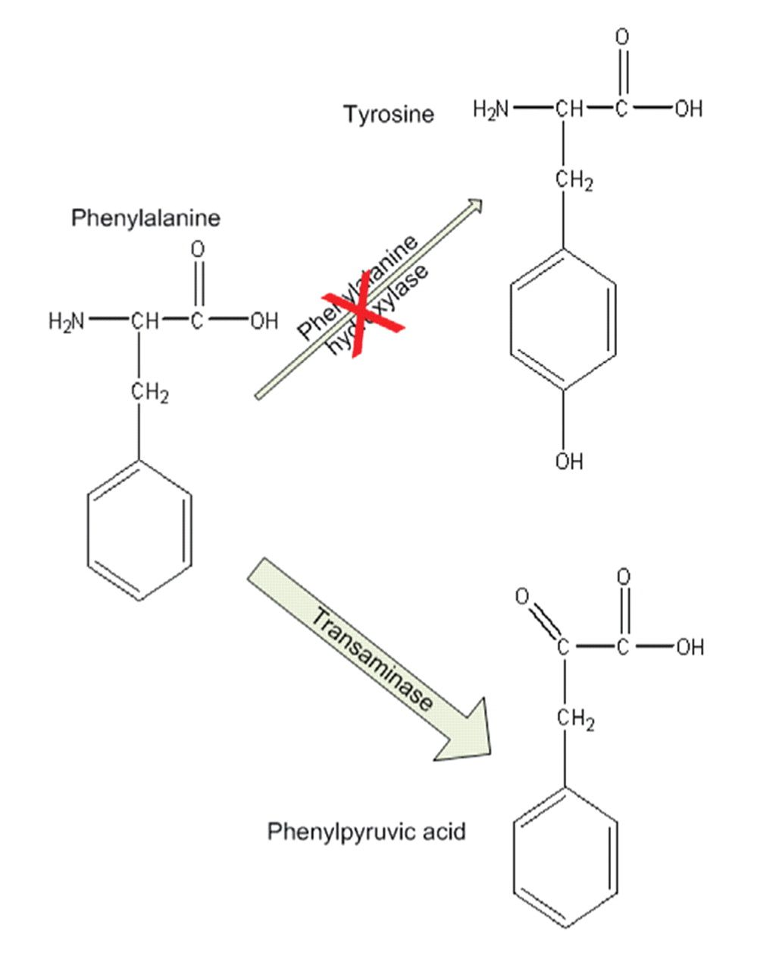
Figure 1 Metabolic basis of phenylketonuria (PKU). The underlying defect in PKU is a deficiency in the enzyme that ...
Notes:
Figure 1 Metabolic basis of phenylketonuria (PKU). The underlying defect in PKU is a deficiency in the enzyme that converts phenylalanine to tyrosine (phenylalanine hydroxylase), as indicated by the red X. The resulting phenylpyruvic acid builds up over time and becomes toxic to brain development and leads to mental retardation.
Unless provided in the caption above, the following copyright applies to the content of this slide: Copyright© by the American Society for Clinical Pathology (ASCP)

