Slide 1
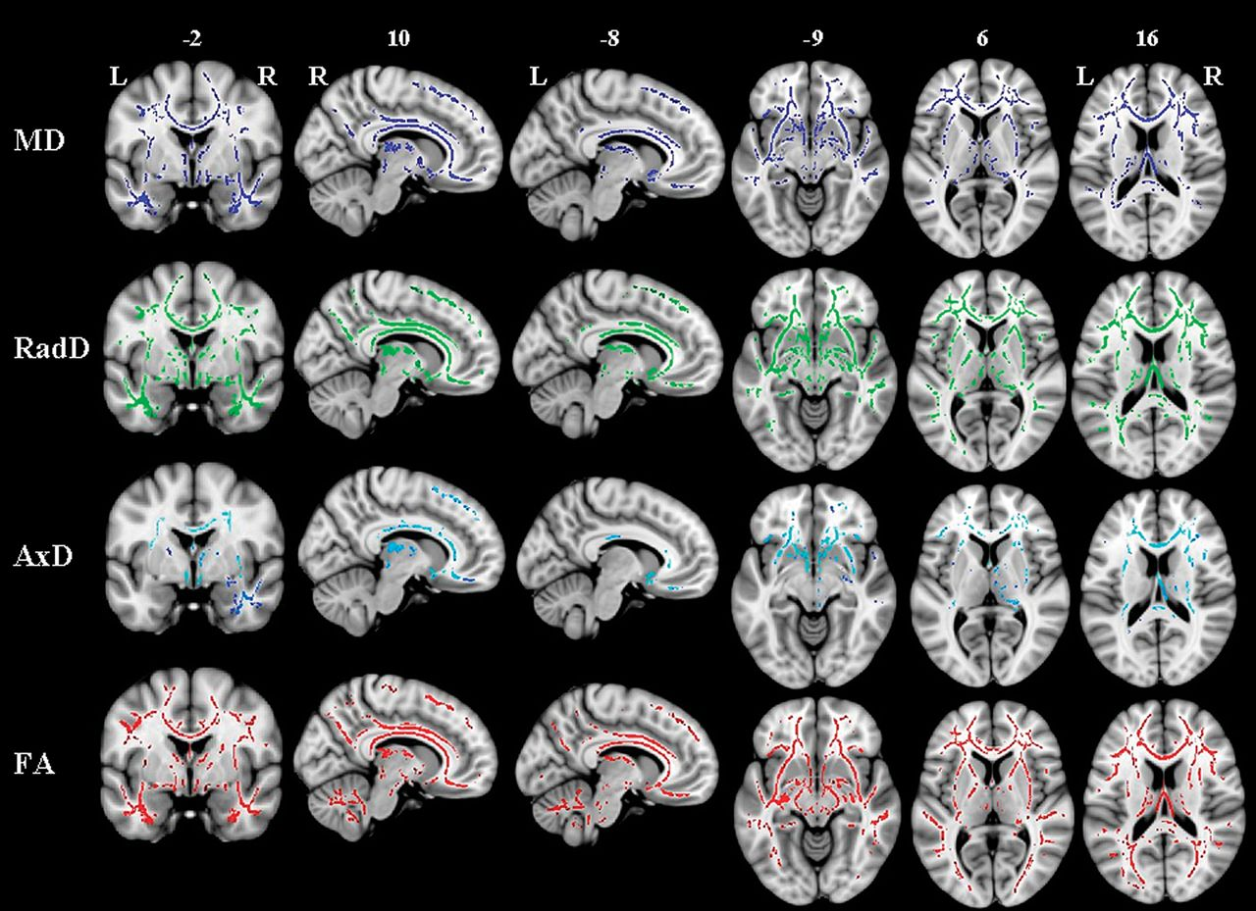
Figure 1. TBSS result in bvFTD compared with age-matched healthy controls. Voxelwise group differences are shown in ...
Notes:
Figure 1. TBSS result in bvFTD compared with age-matched healthy controls. Voxelwise group differences are shown in blue (MD), green (radD), cyan (axD), and red (FA). Results are overlaid on the coronal, sagittal, and axial sections of the MNI standard brain in neurological convention (right is right) and displayed at P < 0.05 corrected for multiple comparisons (familywise error).
Unless provided in the caption above, the following copyright applies to the content of this slide: © The Author 2011. Published by Oxford University Press. All rights reserved. For permissions, please e-mail: journals.permissions@oup.com

Slide 2
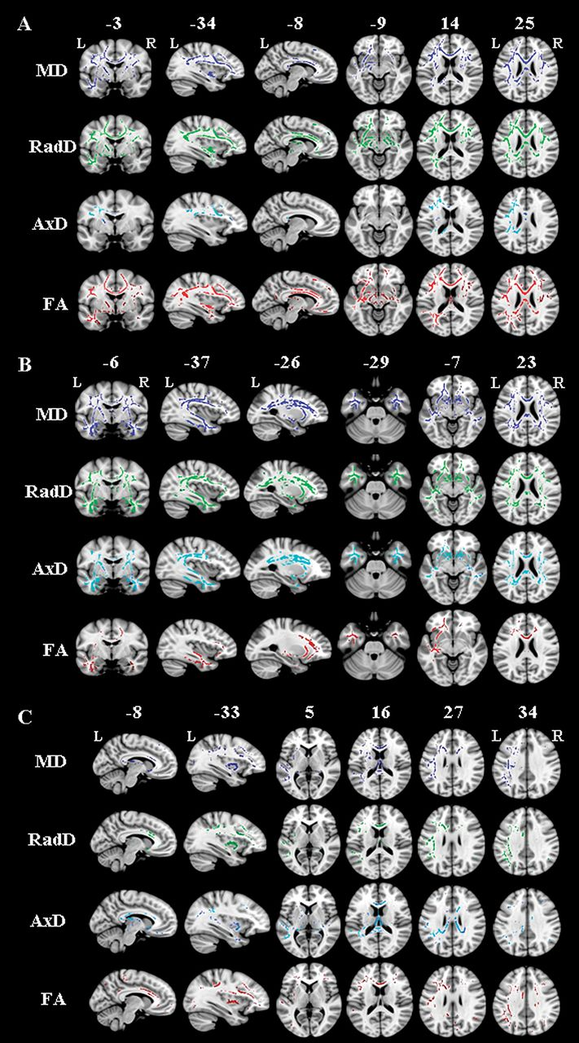
Figure 2. TBSS results in the variants of PPA compared with age-matched healthy controls: (A) nonfluent/agrammatic ...
Notes:
Figure 2. TBSS results in the variants of PPA compared with age-matched healthy controls: (A) nonfluent/agrammatic variant, (B) semantic variant, and (C) logopenic variant. Voxelwise group differences are shown in blue (MD), green (radD), cyan (axD), and red (FA). Results are overlaid on the coronal, sagittal, and axial sections of the MNI standard brain in neurological convention (right is right) and displayed at P < 0.05 corrected for multiple comparisons (family-wise error) for the nonfluent/agrammatic and semantic variants and at P < 0.05 uncorrected for the logopenic variant.
Unless provided in the caption above, the following copyright applies to the content of this slide: © The Author 2011. Published by Oxford University Press. All rights reserved. For permissions, please e-mail: journals.permissions@oup.com

Slide 3
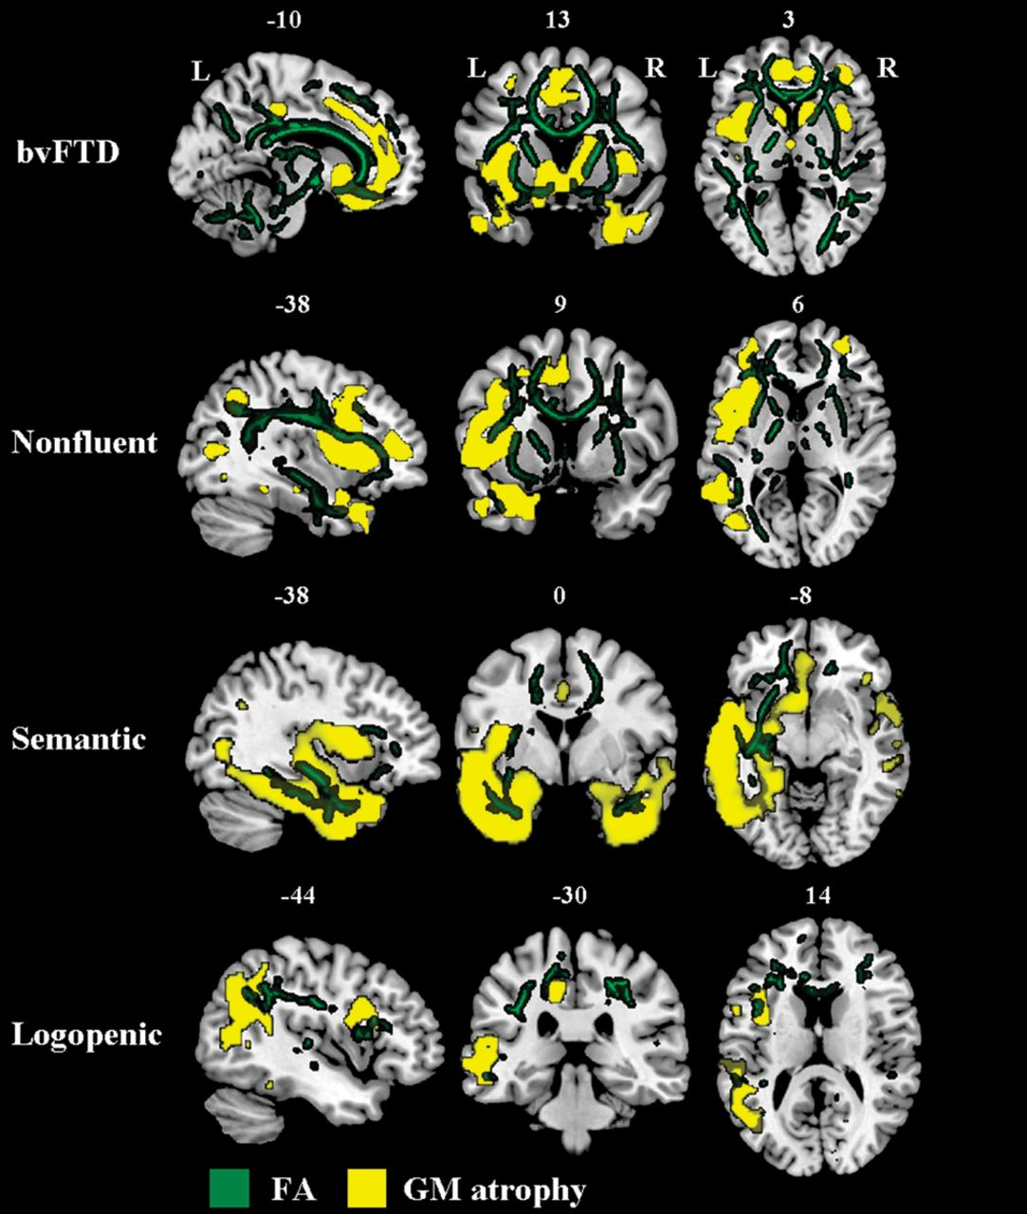
Figure 3. Results of TBSS and VBM analyses are overlaid onto a common reference image (i.e., coronal, sagittal, and ...
Notes:
Figure 3. Results of TBSS and VBM analyses are overlaid onto a common reference image (i.e., coronal, sagittal, and axial sections of the MNI standard brain) to show the anatomical localization of WM FA changes (dark green) and GM atrophy (yellow) in patients with bvFTD and each PPA variant. Results are shown in neurological convention (right is right) and displayed at the threshold specified in text.
Unless provided in the caption above, the following copyright applies to the content of this slide: © The Author 2011. Published by Oxford University Press. All rights reserved. For permissions, please e-mail: journals.permissions@oup.com

