Slide 1
Figure 1. Structure of d(TpA)* and the precursor cyclobutane photoadduct (1).
Notes:
Figure 1. Structure of d(TpA)* and the precursor cyclobutane photoadduct (1).
Unless provided in the caption above, the following copyright applies to the content of this slide: © 2007 The Author(s).This is an Open Access article distributed under the terms of the Creative Commons Attribution Non-Commercial License (http://creativecommons.org/licenses/by-nc/2.0/uk/) which permits unrestricted non-commercial use, distribution, and reproduction in any medium, provided the original work is properly cited.

Slide 2
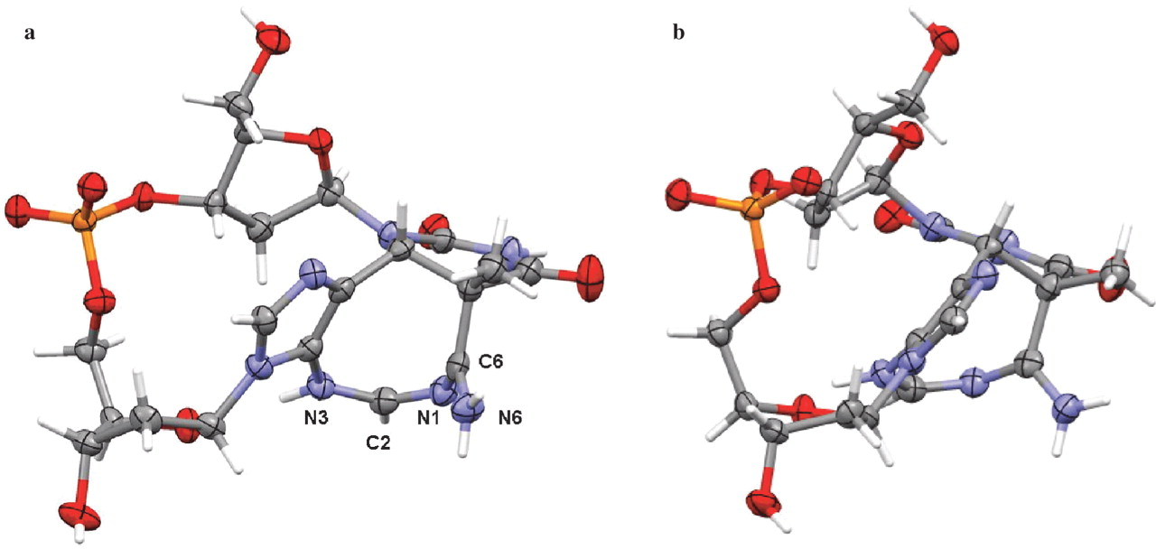
Figure 2. Two views (a and b) of the d(TpA)* structure, showing thermal ellipsoids for the non-hydrogen atoms. Drawn ...
Notes:
Figure 2. Two views (a and b) of the d(TpA)* structure, showing thermal ellipsoids for the non-hydrogen atoms. Drawn with the MERCURY program (18).
Unless provided in the caption above, the following copyright applies to the content of this slide: © 2007 The Author(s).This is an Open Access article distributed under the terms of the Creative Commons Attribution Non-Commercial License (http://creativecommons.org/licenses/by-nc/2.0/uk/) which permits unrestricted non-commercial use, distribution, and reproduction in any medium, provided the original work is properly cited.

Slide 3
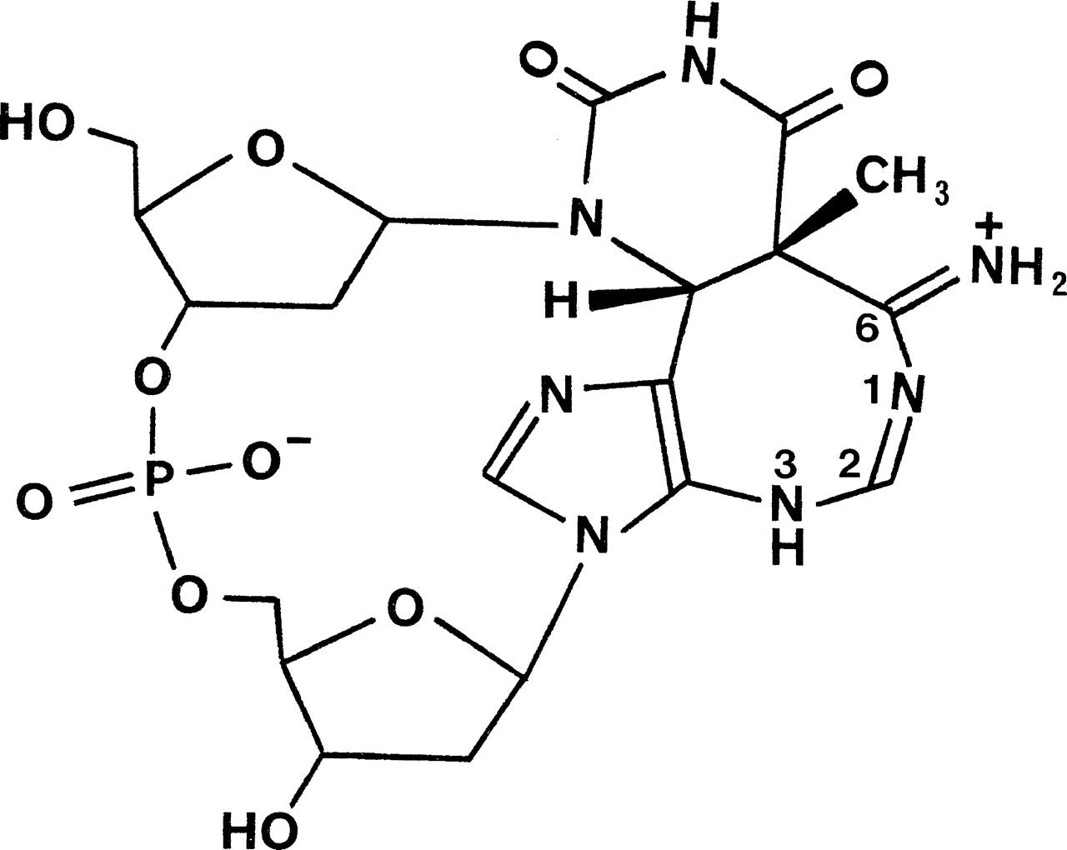
Figure 3. Zwitterionic form of the d(TpA)* molecules in the crystals grown for structure determination.
Notes:
Figure 3. Zwitterionic form of the d(TpA)* molecules in the crystals grown for structure determination.
Unless provided in the caption above, the following copyright applies to the content of this slide: © 2007 The Author(s).This is an Open Access article distributed under the terms of the Creative Commons Attribution Non-Commercial License (http://creativecommons.org/licenses/by-nc/2.0/uk/) which permits unrestricted non-commercial use, distribution, and reproduction in any medium, provided the original work is properly cited.

Slide 4
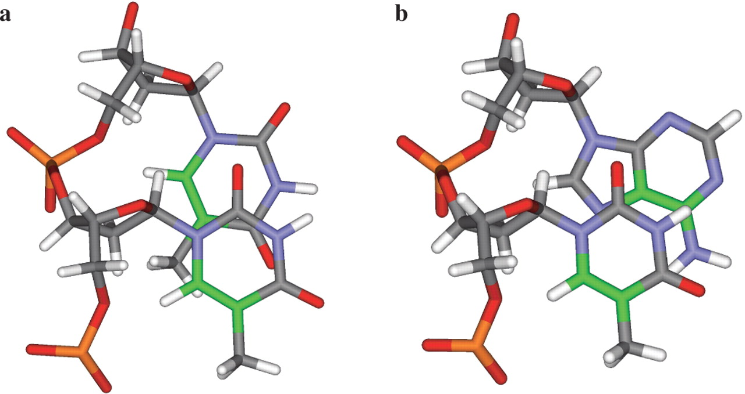
Figure 4. Views of (a) the TpT and (b) the TpA steps in canonical B-DNA, looking down the helix axis. The C5–C6 atoms ...
Notes:
Figure 4. Views of (a) the TpT and (b) the TpA steps in canonical B-DNA, looking down the helix axis. The C5–C6 atoms and bonds have been coloured green.
Unless provided in the caption above, the following copyright applies to the content of this slide: © 2007 The Author(s).This is an Open Access article distributed under the terms of the Creative Commons Attribution Non-Commercial License (http://creativecommons.org/licenses/by-nc/2.0/uk/) which permits unrestricted non-commercial use, distribution, and reproduction in any medium, provided the original work is properly cited.

