Slide 1
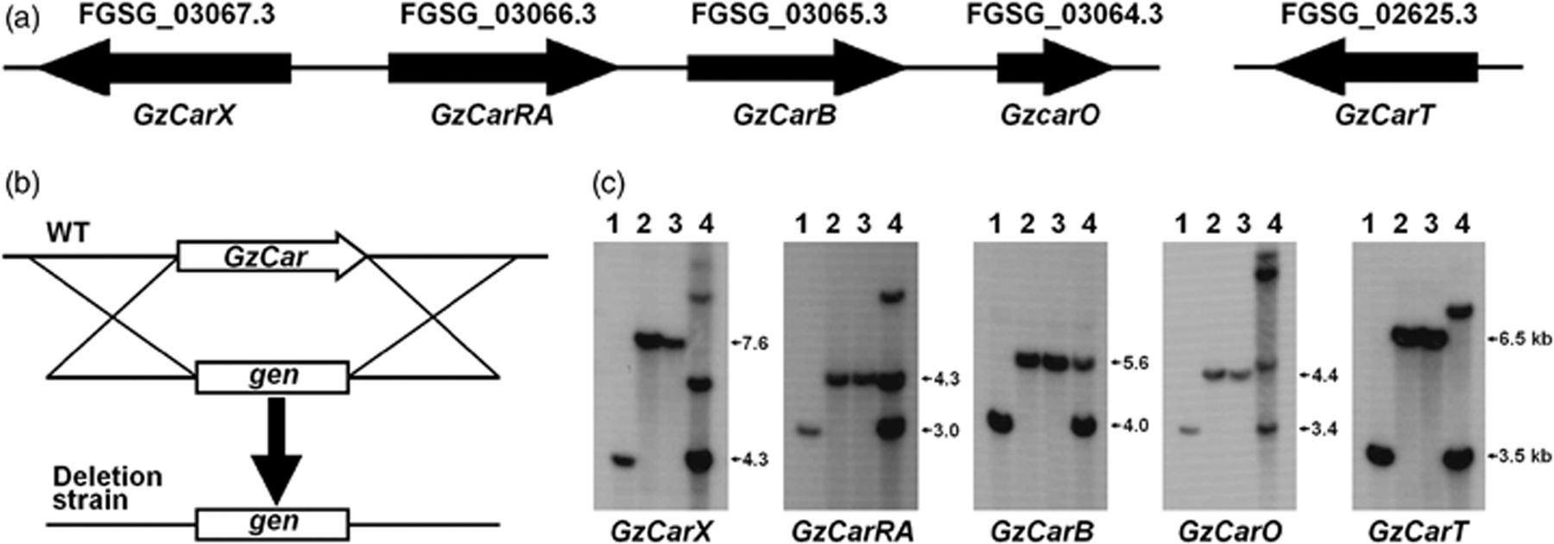
1 Functional analysis of the carotenoid biosynthetic genes. (a) Organization of the carotenoid biosynthetic ...
Notes:
1 Functional analysis of the carotenoid biosynthetic genes. (a) Organization of the carotenoid biosynthetic genes in Gibberella zeae. Numbers and arrows indicate the ORFs and transcriptional direction, respectively. (b) Deletion strategy. The target gene in the wild-type strain GZ03643 (WT) was replaced with geneticin-resistant gene (gen) through homologous recombinations. (c) Southern hybridization to confirm gene replacement events. Lane 1, wild-type strain GZ03643; lane 2, targeted-gene deletion strain originated from the wild type; lane 3, targeted-gene deletion strain originated from Δpks12; lane 4, strain that carries ectopic transformation event. Sizes of DNA are indicated on the right of the blot.
Unless provided in the caption above, the following copyright applies to the content of this slide: © 2009 Federation of European Microbiological Societies. Published by Blackwell Publishing Ltd. All rights reserved

Slide 2
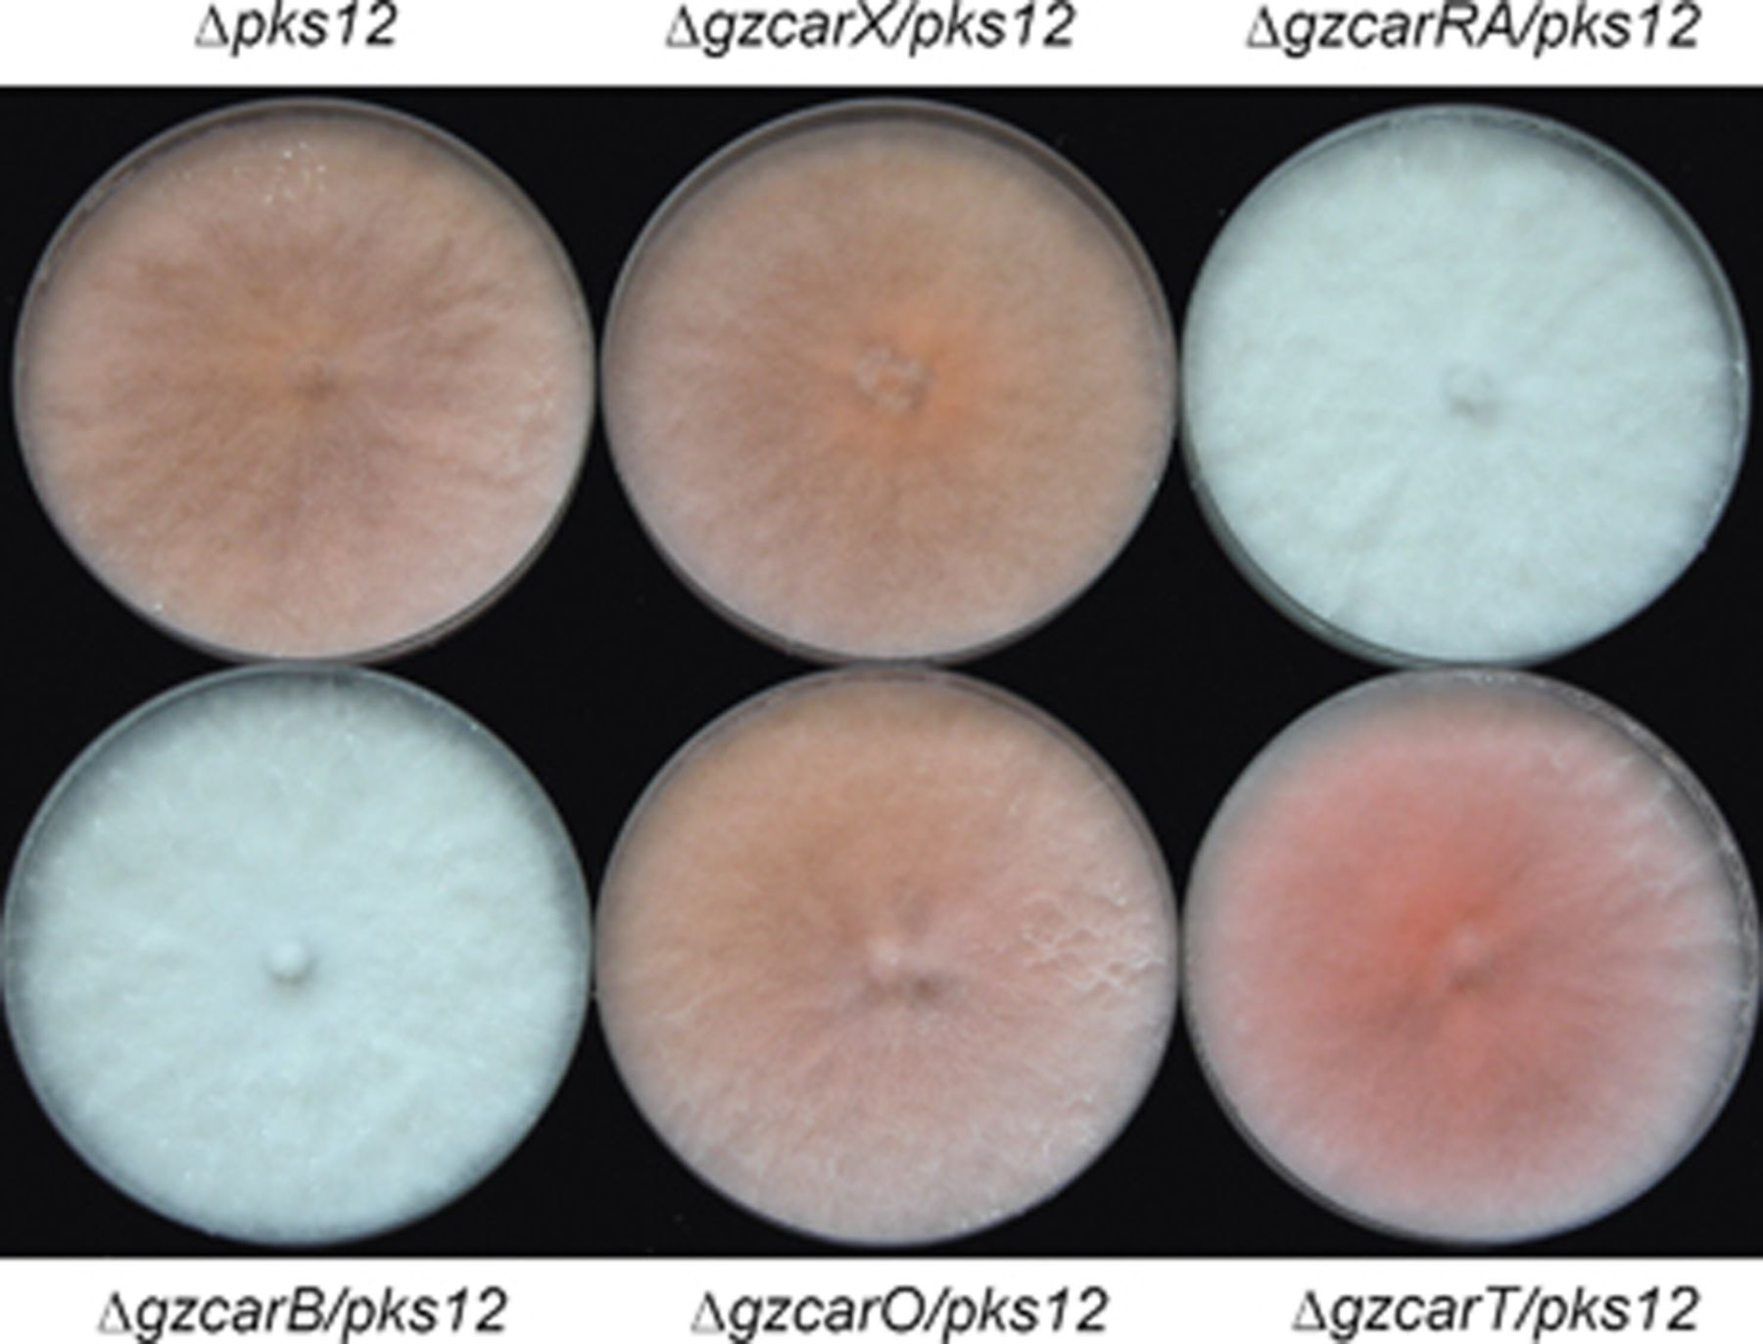
2 Pigmentation of transgenic strains. Photographs were taken 7 days after inoculation on CM.
Notes:
2 Pigmentation of transgenic strains. Photographs were taken 7 days after inoculation on CM.
Unless provided in the caption above, the following copyright applies to the content of this slide: © 2009 Federation of European Microbiological Societies. Published by Blackwell Publishing Ltd. All rights reserved

Slide 3
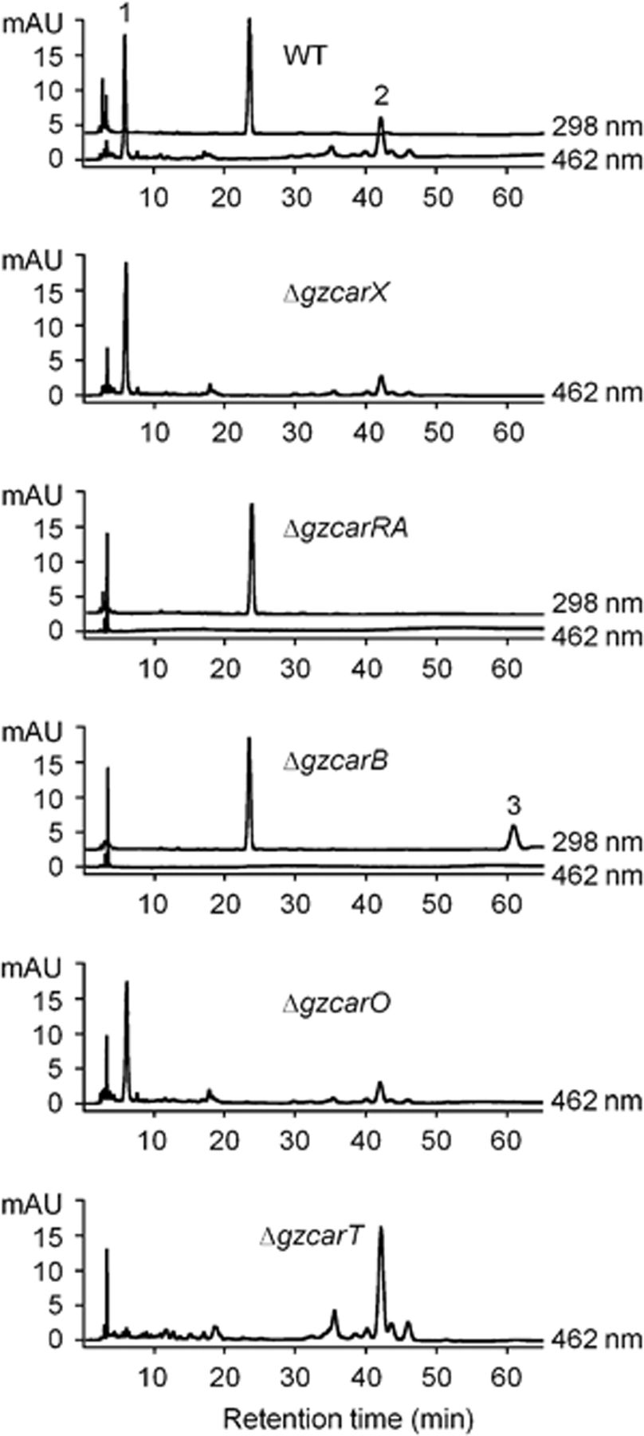
3 HPLC analysis of carotenoids produced by the wild-type and transgenic strains. Samples were analyzed at ...
Notes:
3 HPLC analysis of carotenoids produced by the wild-type and transgenic strains. Samples were analyzed at either 298 or 462 nm. Retention times for neurosporaxanthin (1), torulene (2), and phytoene (3) are 7.3, 43.0, and 62.2 min, respectively.
Unless provided in the caption above, the following copyright applies to the content of this slide: © 2009 Federation of European Microbiological Societies. Published by Blackwell Publishing Ltd. All rights reserved

Slide 4
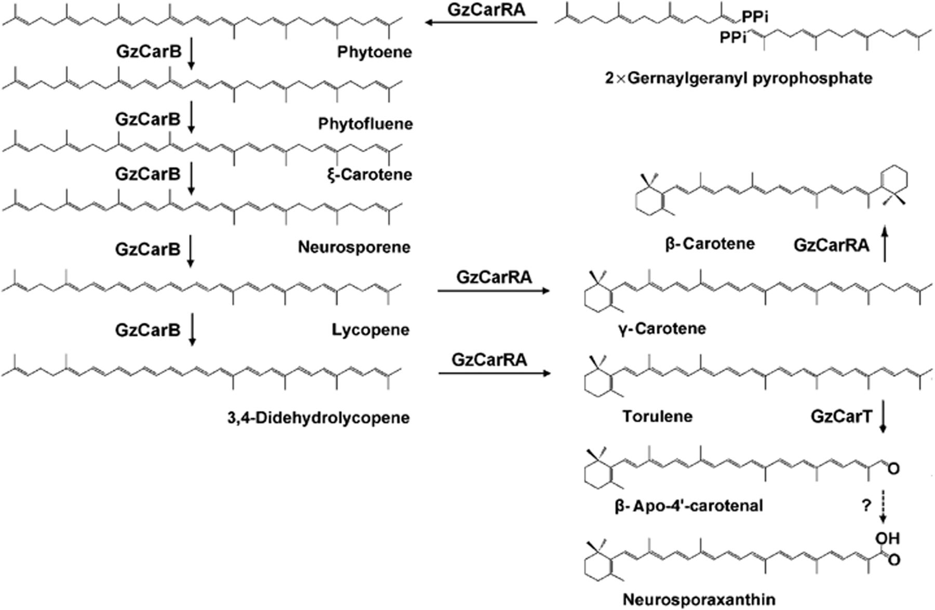
4 Proposed carotenoid biosynthetic pathway in Gibberella zeae.
Notes:
4 Proposed carotenoid biosynthetic pathway in Gibberella zeae.
Unless provided in the caption above, the following copyright applies to the content of this slide: © 2009 Federation of European Microbiological Societies. Published by Blackwell Publishing Ltd. All rights reserved

