Slide 1
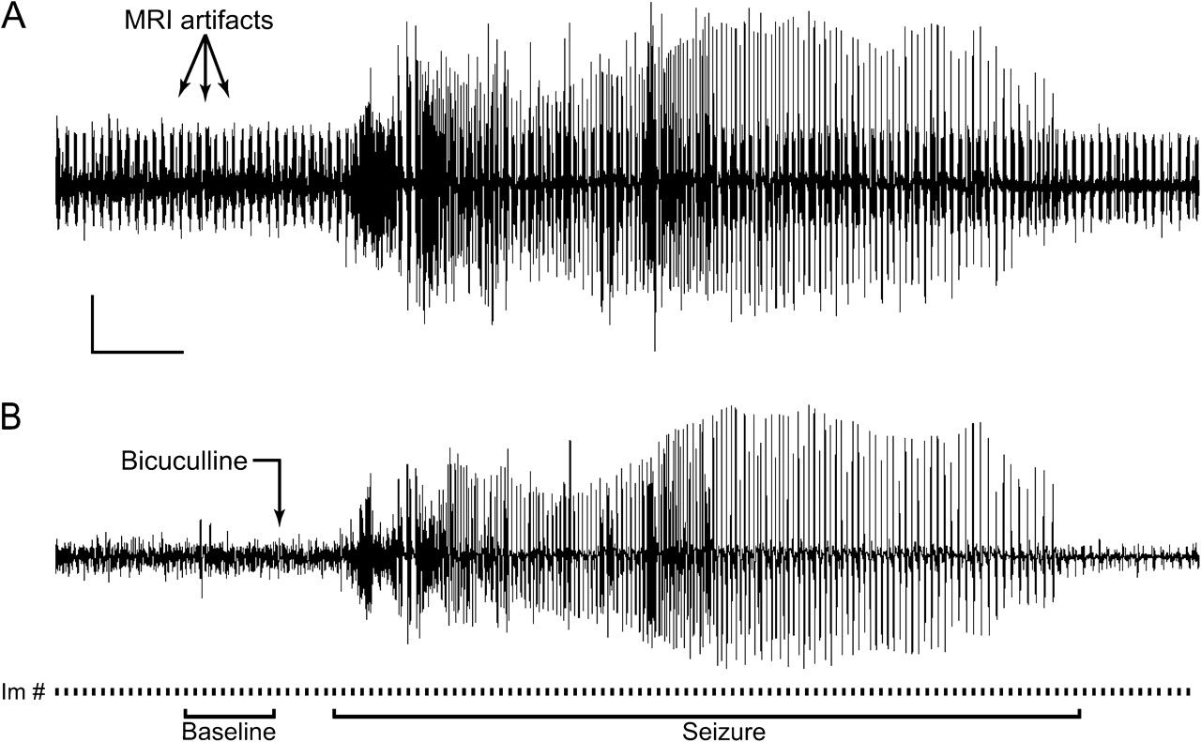
Figure 1. Simultaneous EEG and fMRI during bicuculline-induced generalized tonic–clonic seizures. (A) Unprocessed EEG ...
Notes:
Figure 1. Simultaneous EEG and fMRI during bicuculline-induced generalized tonic–clonic seizures. (A) Unprocessed EEG trace during fMRI recording showing MRI artifacts during each image acquisition. (B) Same EEG trace as in (A) after filtering reveals clear EEG signal allowing the precise identification of seizure onset and end times. Arrow denotes time point of injection of the GABA-A antagonist bicuculline. This induced a generalized tonic–clonic seizure a short time later. Seizures always started with synchronized high amplitude, high-frequency oscillations, progressing into clonic paroxysmal discharges of lower frequency toward the end. Bottom line of (B) illustrates image acquisitions. Acquisitions of 11 slices/s (▪) were obtained continuously with 2 s in between image acquisition intervals. The t-maps (e.g., Figs 2 and 3) were calculated for each group of 10 consecutive images (30 s) from seizure onset onwards, compared with 10 baseline images directly preceding the injection of bicuculline (Baseline). The time courses of signal changes (e.g., Figs 4 and 6) were calculated at 3-s intervals (using each individual image acquisition). Scale bars in (A) represent amplitude (1 mV) and time (30 s), respectively.
Unless provided in the caption above, the following copyright applies to the content of this slide: © The Author 2007. Published by Oxford University Press. All rights reserved. For permissions, please e-mail: journals.permissions@oxfordjournals.org

Slide 2
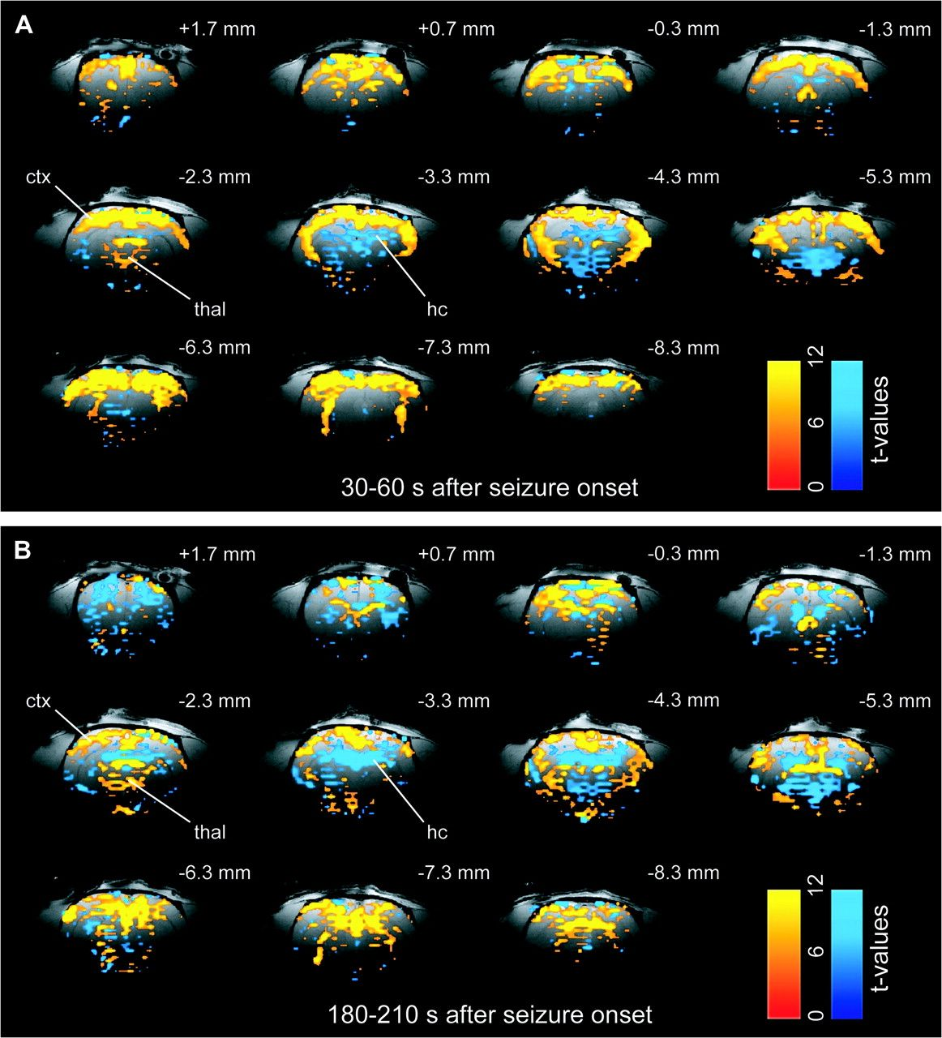
Figure 2. Example of BOLD increases and decreases during bicuculline-induced generalized seizures. (A) During beginning ...
Notes:
Figure 2. Example of BOLD increases and decreases during bicuculline-induced generalized seizures. (A) During beginning of the seizure, the BOLD signal showed not only a mixed pattern of widespread increases across the whole brain, including cortex (ctx) and thalamus (thal) but also prominent focal decreases, especially in hippocampus (hc). (B) Toward the end of the seizure, BOLD increases became less prevalent, though still prominent, whereas decreases became more widespread throughout the brain. In (A) and (B), t-maps are shown for 30 s of data (10 consecutive fMRI images acquired every 3 s) during seizure compared with 30 s of baseline (see Fig. 1). Maps are superimposed on high-resolution anatomical images. Slices are shown from anterior to posterior, with approximate coordinates relative to bregma (Paxinos and Watson 1998). Color bars indicate t-values for increases (warm colors) and decreases (cold colors).
Unless provided in the caption above, the following copyright applies to the content of this slide: © The Author 2007. Published by Oxford University Press. All rights reserved. For permissions, please e-mail: journals.permissions@oxfordjournals.org

Slide 3
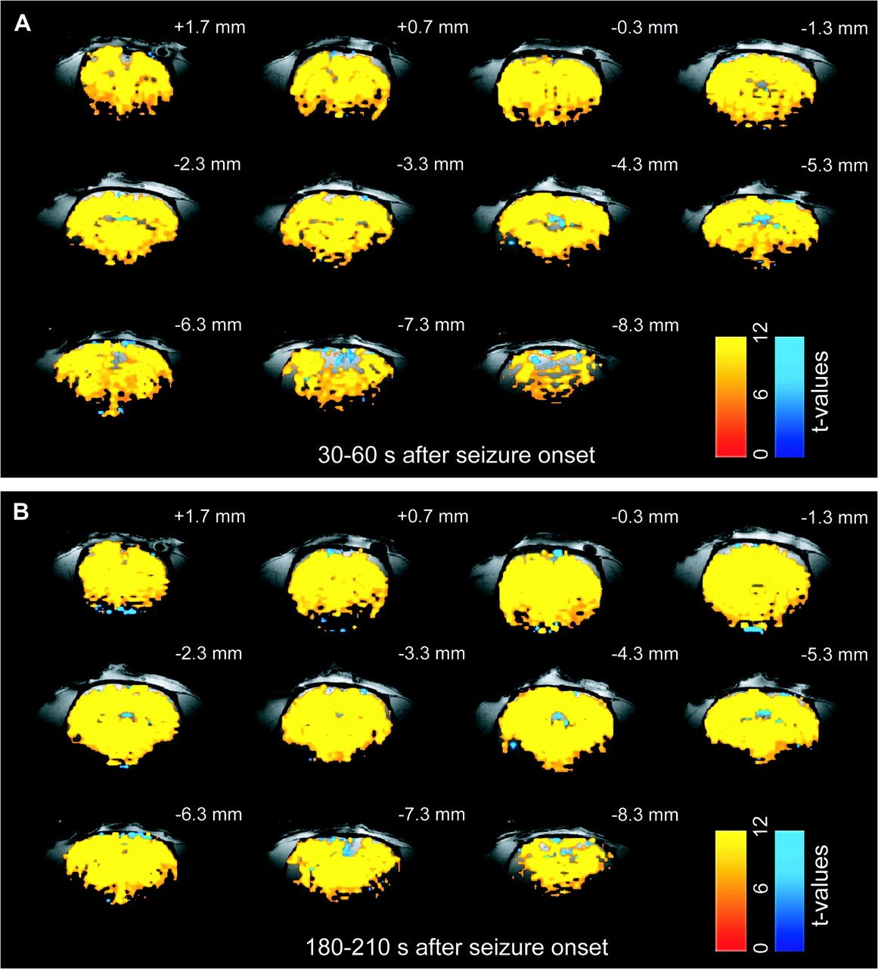
Figure 3. Example of uniform increases in the flow-related CBV response during bicuculline-induced generalized ...
Notes:
Figure 3. Example of uniform increases in the flow-related CBV response during bicuculline-induced generalized seizures. (A) In contrast to the BOLD response, the CBV showed prominent and homogenous increases throughout the whole brain (including hippocampus) and stayed elevated even toward the end of the seizure (B). In (A) and (B), t-maps are shown for 30 s of data (10 consecutive fMRI images acquired every 3 s) during seizure compared with 30 s of baseline (see Fig. 1). Maps are superimposed on high-resolution anatomical images. Slices are shown from anterior to posterior with approximate coordinates relative to bregma (Paxinos and Watson 1998). Color bars indicate t-values for increases (warm colors) and decreases (cold colors) in CBV. Note that in reality, exogenous paramagnetic contrast causes a decreased signal with increased CBV; however, for clarity, we have inverted the scale and used warm colors to represent increased CBV.
Unless provided in the caption above, the following copyright applies to the content of this slide: © The Author 2007. Published by Oxford University Press. All rights reserved. For permissions, please e-mail: journals.permissions@oxfordjournals.org

Slide 4
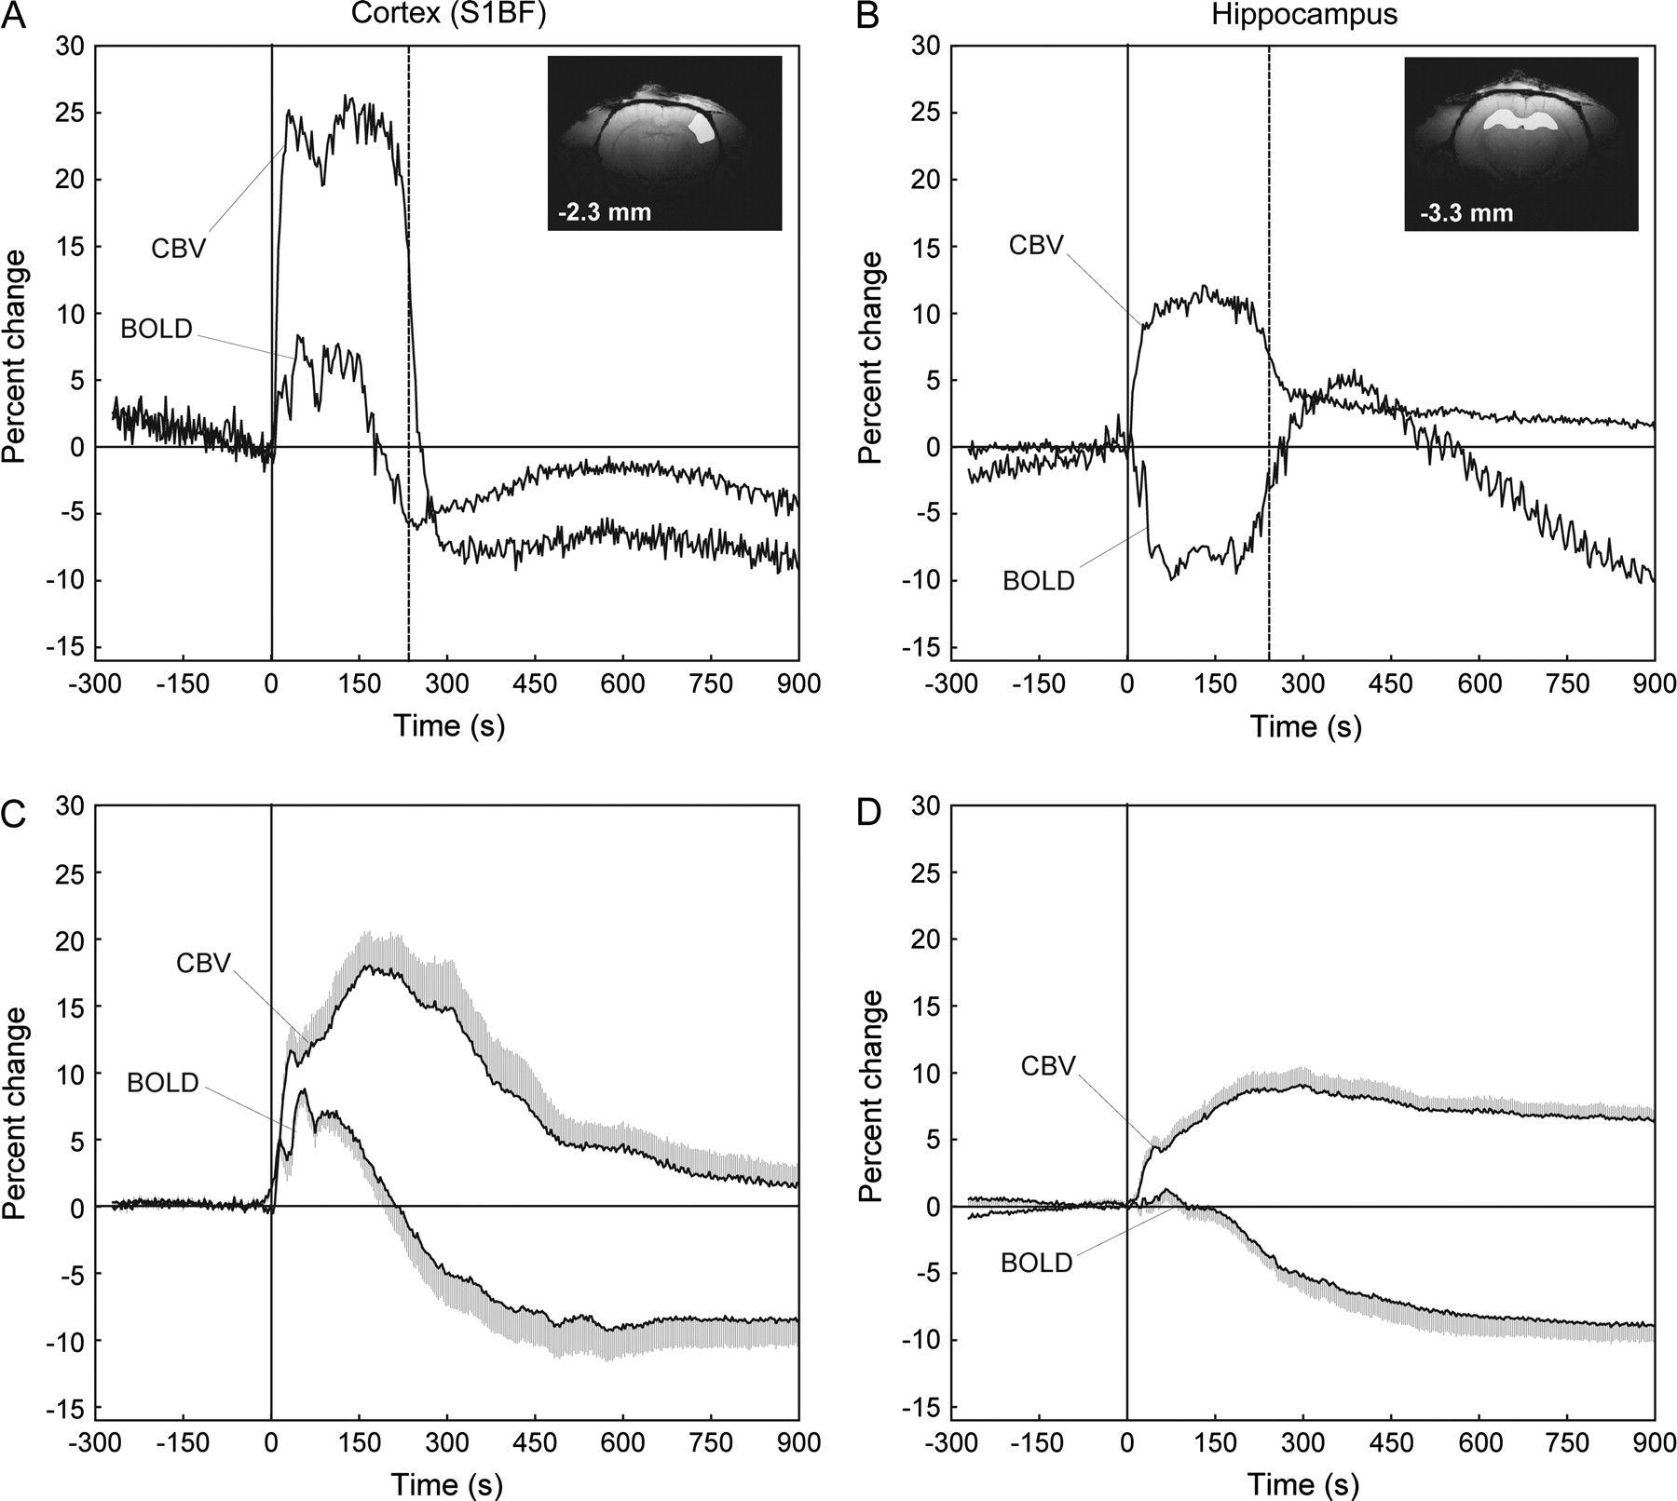
Figure 4. Time course of BOLD fMRI diverges from flow-related CBV changes in hippocampus during bicuculline-induced ...
Notes:
Figure 4. Time course of BOLD fMRI diverges from flow-related CBV changes in hippocampus during bicuculline-induced generalized seizures. Signals are displayed as percent change relative to 30 s of baseline data. (A, B) Changes in the barrel field somatosensory cortex (S1BF) (A) and the hippocampus (B) of an individual rat (same experiment as Figs 2 and 3). (C, D) Mean changes in cortex (S1BF) (C) and hippocampus (D) across experiments. During seizures the BOLD signal showed a prominent increase in S1BF, accompanied by increases of the CBV signal as shown in (A) and (C). However, despite strong increases of the CBV signal during seizures in the hippocampus, the BOLD signal in the hippocampus on average only increased slightly (D) or even decreased in many cases (B). See also Supplementary Figure 1 online. Anatomical insets in (A) and (B) indicate ROIs chosen for all interrogations with approximate coordinates relative to bregma (Paxinos and Watson 1998). For (C) and (D), time courses are depicted as mean ± SEM (unidirectional only). Straight vertical line at zero point marks seizure onset in all graphs and broken vertical lines in (A) and (B) denote average seizure end time calculated from the BOLD and the CBV run for this particular animal. Mean signals in (C, D) are based on 20 experiments from 14 rats for BOLD signals and 14 experiments in 10 rats for CBV. Note that in reality, exogenous paramagnetic contrast causes a decreased signal with increased CBV; however, for clarity, we have inverted the CBV signals so that upward deflections represent increased CBV.
Unless provided in the caption above, the following copyright applies to the content of this slide: © The Author 2007. Published by Oxford University Press. All rights reserved. For permissions, please e-mail: journals.permissions@oxfordjournals.org

Slide 5
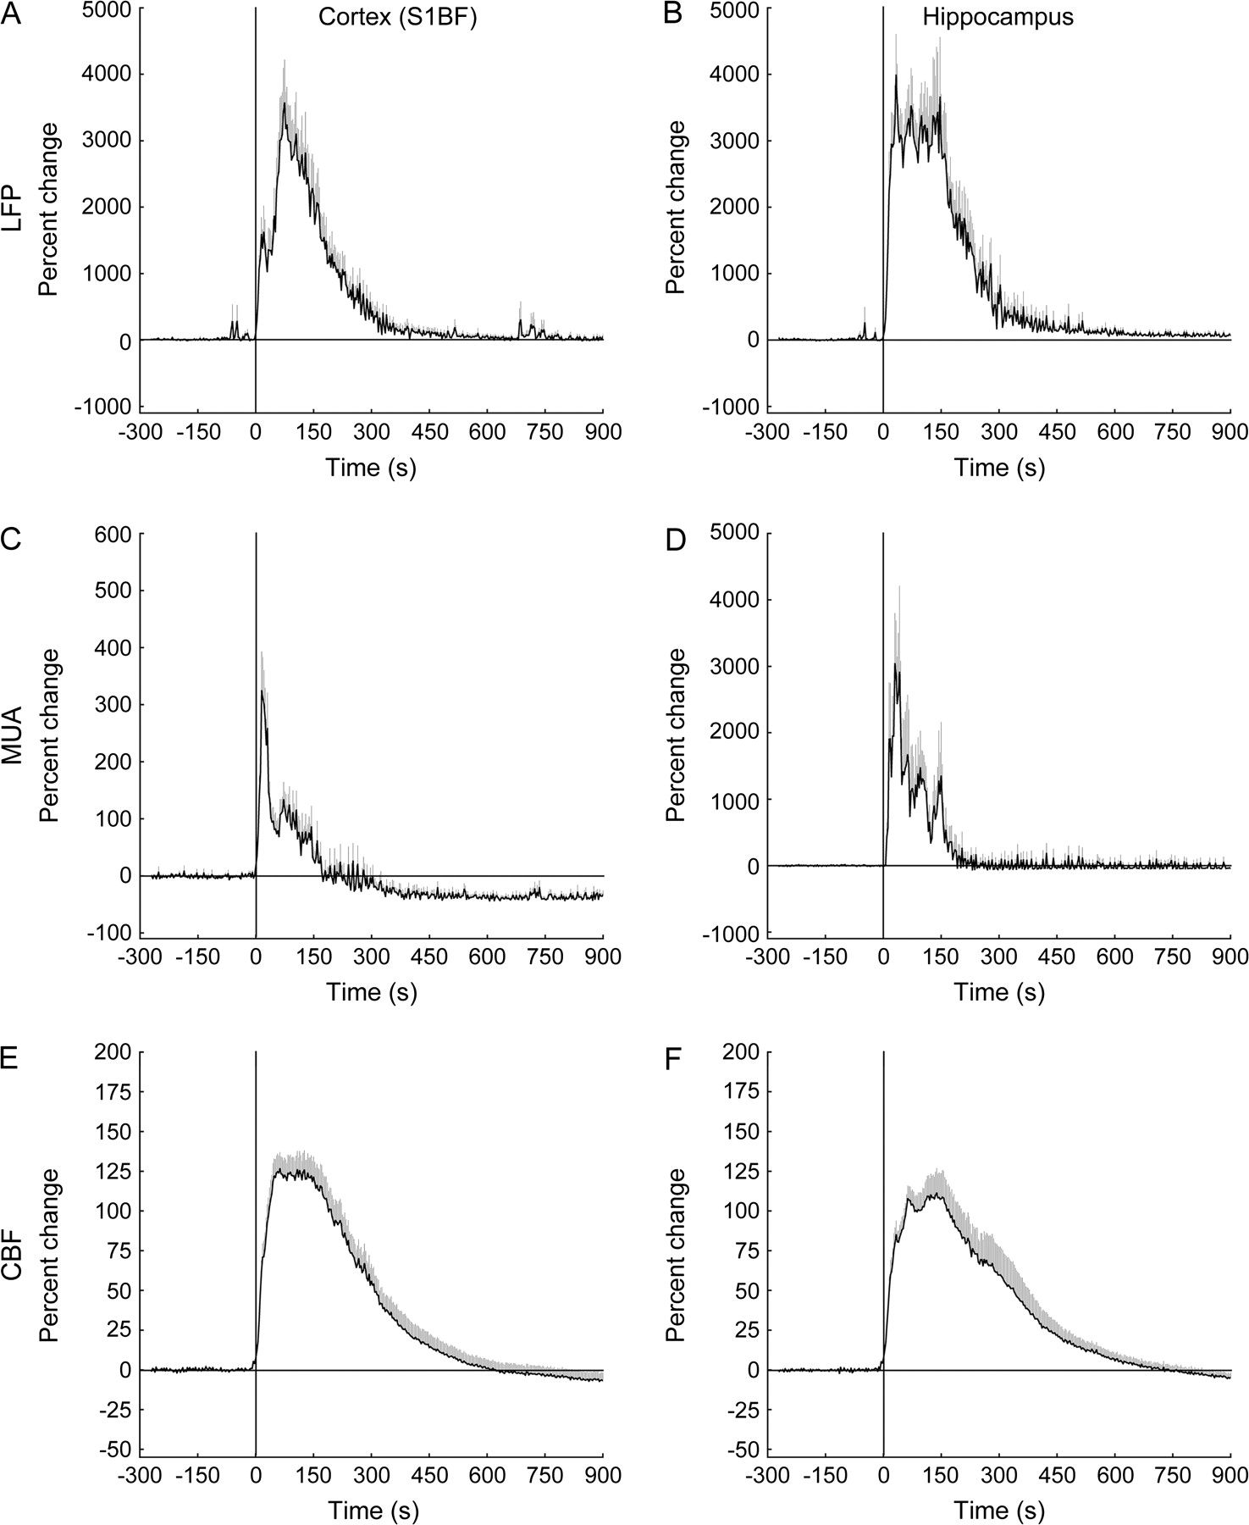
Figure 5. Neuronal activity and CBF in both cortex (S1BF) and hippocampus show only increases during ...
Notes:
Figure 5. Neuronal activity and CBF in both cortex (S1BF) and hippocampus show only increases during bicuculline-induced generalized seizures. Average time courses of percent signal change compared with 30 s of baseline data. Time courses are depicted as mean ± SEM (unidirectional only) and straight vertical line at time = 0 marks seizure onset. Time courses on the left represent recordings for LFP power (A), MUA power (C), and CBF (E) in the barrel field cortex (S1BF) and on the right side for LFP power (B), MUA power (D), and CBF (F) from hippocampus. Recording sites were matched to ROIs chosen in fMRI experiments (Fig. 4). During seizures, LFP (A) and MUA (C) showed a marked increase in power in S1BF, accompanied by strong increases in CBF (E). Interestingly, hippocampal recordings also showed intense signal increases for LFP (B), MUA (D), and CBF (F) during seizures that were in marked contrast to the only slight increases or even decreases observed in the BOLD signal (Fig. 4B,D). The signal changes in MUA power in the hippocampus during the first 150 s of seizures significantly exceeded those in the cortex (P = 0.004, 2-tailed unpaired t-test, n = 43). Note that y-axes in (C) and (D) are not drawn to the same scale. In both regions, the MUA also revealed a decrease in power after termination of the seizures, representing postictal depression commonly observed with this seizure type (postictal depression not visible in (D) due to scale). In (A–F) mean signals are based on the following number of experiments/animals: for cortex (S1BF) LFP (42/24), hippocampus LFP (38/22), cortex (S1BF) MUA (27/16), hippocampus MUA (16/10), cortex (S1BF) CBF (39/23), and hippocampus CBF (35/21). See also Supplementary Figure 2 online.
Unless provided in the caption above, the following copyright applies to the content of this slide: © The Author 2007. Published by Oxford University Press. All rights reserved. For permissions, please e-mail: journals.permissions@oxfordjournals.org

Slide 6
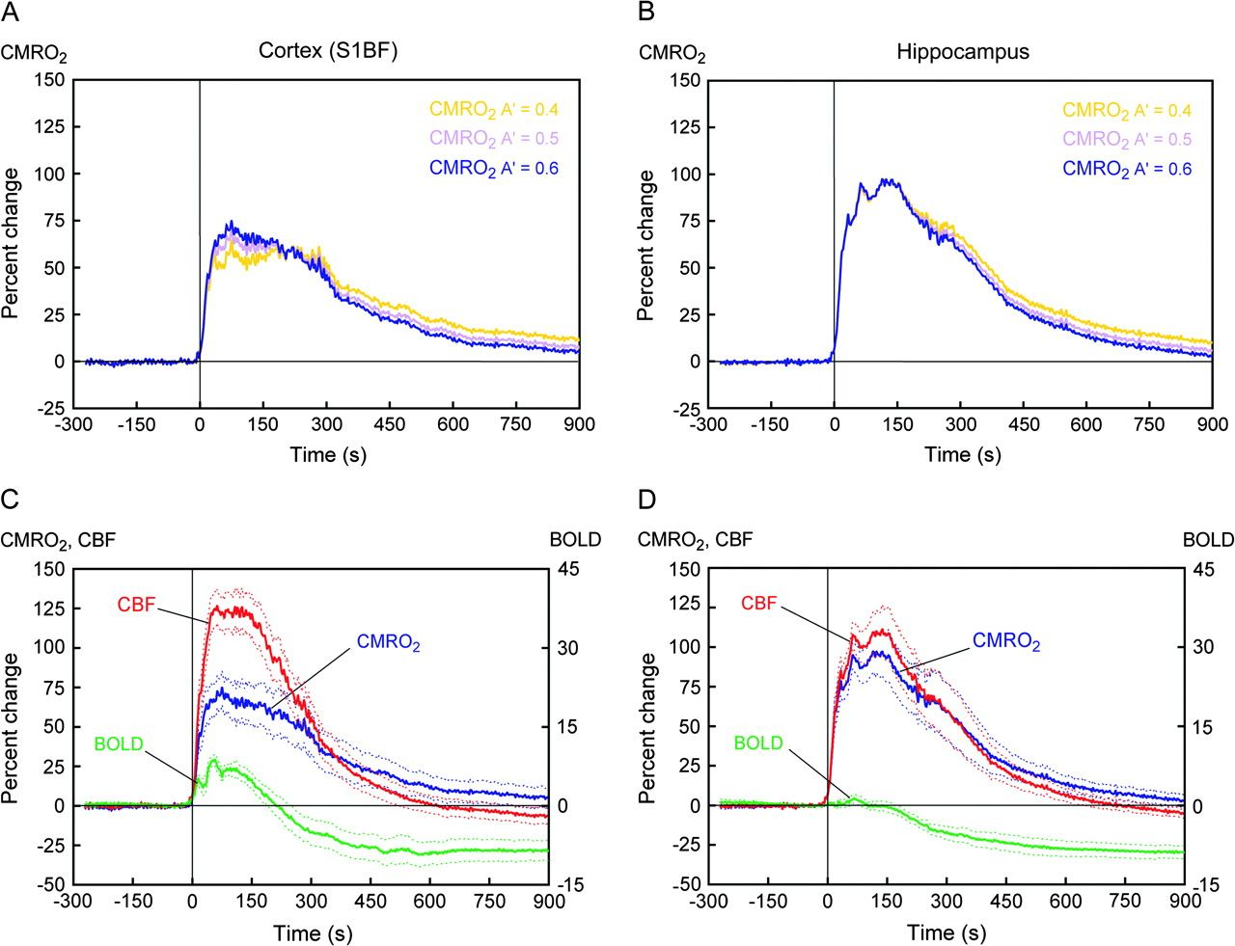
Figure 6. Blood supply exceeds oxygen consumption in cortex (S1BF) but not hippocampus. Average time courses of percent ...
Notes:
Figure 6. Blood supply exceeds oxygen consumption in cortex (S1BF) but not hippocampus. Average time courses of percent signal change over time compared with 30 s of baseline data. In all graphs, the straight vertical line at time = 0 marks seizure onset. (A, B) Time courses of mean signal change in CMRO2 over time, calculated for 3 different values of the BOLD calibration parameter À (0.4, 0.5, and 0.6) for the barrel field cortex (S1BF) (A) and hippocampus (B). In all cases, CMRO2 showed a pronounced increase in both structures during seizures but was higher in hippocampus compared with cortex, independent of À. (C, D) Relationship between the mean percent signal changes for BOLD, CBF, and estimated CMRO2 (À = 0.6) for cortex (S1BF) (C) and hippocampus (D). In the cortex, the increase in CBF during seizures was nearly double compared with the increase in CMRO2, accompanied by an increase in the BOLD signal. In the hippocampus, however, increases of CBF and CMRO2 during seizures nearly matched, and no signal changes were observed in the BOLD signal on average, despite strong neuronal activity in both structures. Data shown are derived from same experiments as Figures 4 and 5. Time courses represent mean ± SEM, except CMRO2 where error was calculated as described in Materials and Methods. See also Supplementary Figure 2 online.
Unless provided in the caption above, the following copyright applies to the content of this slide: © The Author 2007. Published by Oxford University Press. All rights reserved. For permissions, please e-mail: journals.permissions@oxfordjournals.org

Slide 7
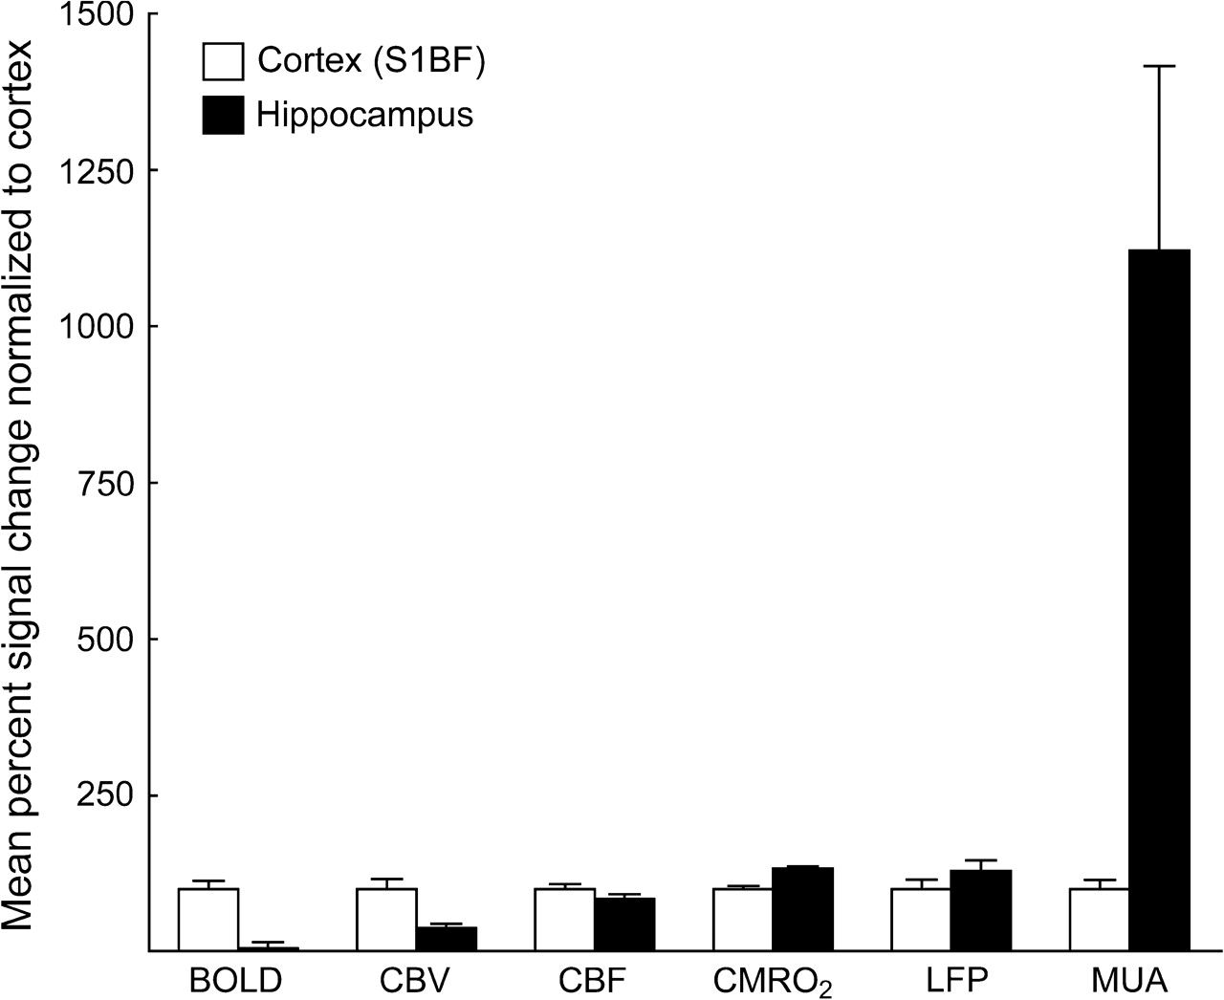
Figure 7. Summary of mean percent signal changes during seizures for all variables. CBV, CBF, and CMRO₂ ...
Notes:
Figure 7. Summary of mean percent signal changes during seizures for all variables. CBV, CBF, and CMRO2 always increased together with neuronal activity (LFP and MUA) in cortex (S1BF) and hippocampus during seizures. However, the hippocampal BOLD signal was much smaller compared with cortex. This is in striking contrast to the pronounced increases in CMRO2 and MUA in the hippocampus compared with the cortex. These data suggest a complex nonlinear relationship between the BOLD response and hemodynamic, metabolic, and neuronal activity, which may produce negative BOLD signals with large increases in neuronal activity. The histogram displays the mean percent signal change during the first 150 s after seizure onset (vs. 30-s baseline) for BOLD, CBV, CBF, CMRO2 (À = 0.6), LFP power, and MUA power in cortex and hippocampus. All values are displayed as mean + SEM normalized to cortex (S1BF).
Unless provided in the caption above, the following copyright applies to the content of this slide: © The Author 2007. Published by Oxford University Press. All rights reserved. For permissions, please e-mail: journals.permissions@oxfordjournals.org

