Slide 1
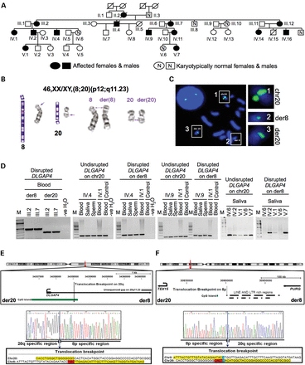
Figure 1. DLGAP4 is disrupted by the translocation t(8;20)(p12;q11.23) segregating with early-onset, non-progressive, ...
Notes:
Figure 1. DLGAP4 is disrupted by the translocation t(8;20)(p12;q11.23) segregating with early-onset, non-progressive, mild cerebellar ataxia. (A) Pedigree of investigated family. (B) Ideograms and translocation chromosomes. (C) FISH mapping of chr20q11.23 breakpoint showing three signals using spanning BAC CTD-2301L1. (D) PCR amplification of disrupted and undisrupted DLGAP4 alleles in t(8;20) carriers and phenotypically normal unrelated (controls) or related (IV.6 and V.6) controls. (E) Representative UCSC genome browser view of the breakpoint region on 20q11.23 showing disruption of DLGAP4, 820 bp downstream (at chr20: 34358534, hg18) of the first untranslated exon. Electropherogram shows base level resolution of the breakpoint on chromosome der20 with a ‘TGG’ deletion (red highlight). (F) Translocation breakpoint on 8p12 (at chr8: 30901056, hg18) disrupts a region dense in repetitive elements. Electropherogram shows the der8 breakpoint region having a ‘CACT’ deletion (red highlight). The cytosine base (blue highlight) at the breakpoint could be part of 8p or 20q. Yellow highlights indicate the sequence adjacent to breakpoints. Illustrations are drawn to scale; curved arrows denote promoter regions of genes.
Unless provided in the caption above, the following copyright applies to the content of this slide: © The Author 2014. Published by Oxford University PressThis is an Open Access article distributed under the terms of the Creative Commons Attribution Non-Commercial License (http://creativecommons.org/licenses/by-nc/4.0/), which permits non-commercial re-use, distribution, and reproduction in any medium, provided the original work is properly cited. For commercial re-use, please contact journals.permissions@oup.com

Slide 2
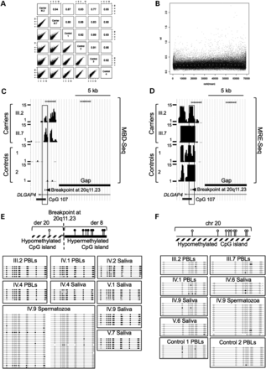
Figure 2. Monoallelic changes in DNA methylation at DLGAP4 are induced by the t(8;20) translocation. (A and B) ...
Notes:
Figure 2. Monoallelic changes in DNA methylation at DLGAP4 are induced by the t(8;20) translocation. (A and B) Normalized unique MBD-Seq peak reads in carriers (III.2, III.7) and four normal unrelated controls (Controls 1–4) showing genome-wide distribution of reads and peaks. (C and D) UCSC genome browser views showing the translocated DLGAP4 CpG island (CpG 107) to be differentially methylated (hypermethylated: MBD-Seq and hypomethylated: MRE-Seq) in carriers and completely hypomethylated in controls. Rectangles show regions used for bisulfite allelic sequencing (see below). (E) Bisulfite allelic sequencing showing the disrupted DLGAP4 CpG island (CpG 107) to be hypermethylated (individual CpGs: filled circles) in the somatic cells of all male and female carriers tested. CpG methylation at DLGAP4 is absent in purified spermatozoa DNA from translocation carrier IV.9 but is re-established in his somatic cells. (F) The undisrupted DLGAP4 CpG island (CpG 107) is hypomethylated (individual CpGs: hollow circles) in all carriers. DLGAP4 CpG island is bi-allelically hypomethylated in all related (IV.6 and V.6) and unrelated phenotypically normal controls (Controls 1 and 2).
Unless provided in the caption above, the following copyright applies to the content of this slide: © The Author 2014. Published by Oxford University PressThis is an Open Access article distributed under the terms of the Creative Commons Attribution Non-Commercial License (http://creativecommons.org/licenses/by-nc/4.0/), which permits non-commercial re-use, distribution, and reproduction in any medium, provided the original work is properly cited. For commercial re-use, please contact journals.permissions@oup.com

Slide 3
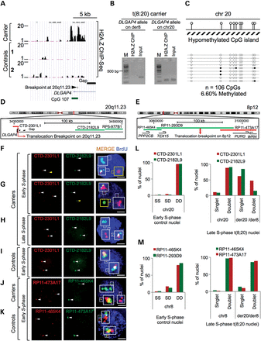
Figure 3. Monoallelic chromatin modifications at DLGAP4 induced by the t(8;20) translocation. (A) The UCSC genome ...
Notes:
Figure 3. Monoallelic chromatin modifications at DLGAP4 induced by the t(8;20) translocation. (A) The UCSC genome browser view of ChIP-Seq analysis showing H2A.Z enrichment (H2A.Z ChIP-Seq) at the DLGAP4 locus. (B and C) H2A.Z ChIP followed by bisulfite allelic sequencing at DLGAP4. The H2A.Z antibody enriches for hypomethylated CpGs (individual CpGs: hollow circles) at the undisrupted chr20 homologue of DLGAP4. (D and E) Maps of loci showing biotin (green) and digoxigenin (red) labeled probes used for DNA FISH and replication timing analysis. (F and G) Representative images of BrdU (blue) positive early S-phase replicating nuclei showing the disrupted DLGAP4 allele to replicate asynchronously (singlet's, yellow arrows). The undisrupted DLGAP4 allele (doublets, white arrows) replicates in early S-phase. Scale bars 10 μm. (H) Representative images showing the disrupted DLGAP4 allele to have replicated in BrdU (blue) positive late S-phase nuclei (doublets, white arrows). Scale bars 10 μm. (I) Both DLGAP4 homologues (doublets, white arrows 2DD) replicate in early S-phase in multiple controls. BrdU stained nuclei are show in blue. Scale bars 10 μm. (J and K) Both 8p12 loci on translocation chromosomes [der8 and der20 (2DD, white arrows)] and undisrupted chromosome [chr8 (2DD, white arrows)] remain early replicating in translocation carriers, similar to that in controls. Scale bars 10 μm. BrdU stained nuclei are show in blue. Scale bars 10 µm. (L) Statistical analyses show a higher percentage of delayed replicating DLGAP4 allele (singlet, S) in only the der8 homologue of carriers (CTD-2182L9 green bars). 100 BrDU positive nuclei were quantified in each case. Replicated loci are annotated as doublets (DD). (M) Statistical analyses show that 8p12 remains early replicating in carriers similar to that in controls. 100 BrDU positive nuclei were quantified in each case. Unreplicated loci are annotated as singlets (S), whereas replicated loci are annotated as doublets (DD).
Unless provided in the caption above, the following copyright applies to the content of this slide: © The Author 2014. Published by Oxford University PressThis is an Open Access article distributed under the terms of the Creative Commons Attribution Non-Commercial License (http://creativecommons.org/licenses/by-nc/4.0/), which permits non-commercial re-use, distribution, and reproduction in any medium, provided the original work is properly cited. For commercial re-use, please contact journals.permissions@oup.com

Slide 4
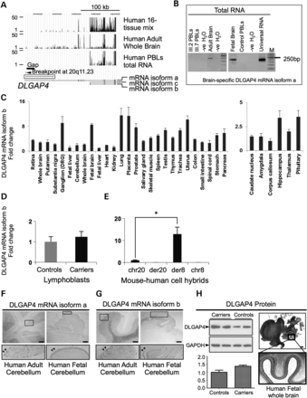
Figure 4. t(8;20) perturbs expression of DLGAP4 gene products in translocation carriers. (A) The representative UCSC ...
Notes:
Figure 4. t(8;20) perturbs expression of DLGAP4 gene products in translocation carriers. (A) The representative UCSC Genome Browser view illustrates the expression of DLGAP4 mRNA isoforms a, b and c using high-throughput RNA-Seq. (B) Quantification of DLGAP4 mRNA isoform a expression in carrier and control human tissues. (C) Quantification of the DLGAP4 mRNA isoform b in a human multi-tissue panel. Error bars show the range. (D and E) Increased expression of DLGAP4 mRNA isoform b in translocation carrier LCLs and higher monoallelic expression in hybrid cells having the translocated der8 allele. Error bars show the range. *Indicates P < 0.01. (F and G) In situ hybridizations showing expression of DLGAP4 mRNA isoforms a and b (darkly stained regions) in Purkinje neurons in adult human cerebellum and external granular layer cells of fetal human cerebellum, respectively. Selected regions are shown at higher magnification in separate panels below. Scale bars 1 mm. (H) Western blots showing elevated expression of DLGAP4 (108 kDa) protein in translocation carrier LCLs compared with controls. Error bars show the range. Immunohistochemistry showing DLGAP4 protein expression in Purkinje neurons and external granular layer cells of control human fetal cerebellum (darkly stained regions). Selected regions are shown at higher magnification in a separate panel. Scale bars 1 mm.
Unless provided in the caption above, the following copyright applies to the content of this slide: © The Author 2014. Published by Oxford University PressThis is an Open Access article distributed under the terms of the Creative Commons Attribution Non-Commercial License (http://creativecommons.org/licenses/by-nc/4.0/), which permits non-commercial re-use, distribution, and reproduction in any medium, provided the original work is properly cited. For commercial re-use, please contact journals.permissions@oup.com

Slide 5
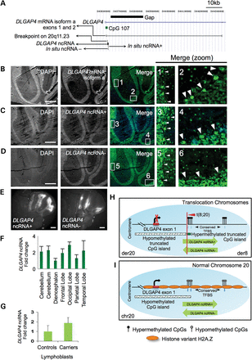
Figure 5. t(8;20) disrupts novel bi-directionally expressed ncRNAs at DLGAP4. (A) UCSC Genome Browser snapshot showing ...
Notes:
Figure 5. t(8;20) disrupts novel bi-directionally expressed ncRNAs at DLGAP4. (A) UCSC Genome Browser snapshot showing the breakpoint locus on 20q11.23 annotated with DLGAP4 mRNA isoform a and novel bi-directional DLGAP4 ncRNAs (ncRNA+ and ncRNA−). (B–D) In situ hybridizations showing the spatio-temporal expression of DLGAP4 mRNA isoform a, DLGAP4 ncRNA+ and ncRNA− in adult human cerebellum sections. Selected regions are shown at higher magnification in numbered boxes. White arrows show the regions of high expression. Note that DLGAP4 mRNA isoform a and ncRNA+ are highly expressed in Purkinje neurons of the human cerebellum. The DLGAP4 ncRNA− is more abundant in the molecular layer of the adult human cerebellum. DLGAP4 mRNA (isoform a) appears to have an increased abundance in the cytoplasm of Purkinje cells, whereas DLGAP4 ncRNA+ appears to be localized in the nucleus and the cytoplasm of these cells. Selected regions are shown at higher magnification in separate panels. Scale bars, 1 mm. (E) Bi-directional and complementary expression of Dlgap4 ncRNA+ and Dlgap4 ncRNA− in adult mouse cerebellum brain sections. Scale bars, 1 mm. (F) Quantification of DLGAP4 candidate ncRNA expression in the total RNA from a human brain panel. Error bars show the range. (G) Slightly increased expression of DLGAP4 ncRNA is identified in translocation carriers compared with controls. Error bars show the range. (H and I) Model showing ncRNAs at DLGAP4, relative to monoallelic CpG methylation, H2A.Z enrichment and DLGAP4 mRNA isoform a expression at the disrupted (der20/der8) and undisrupted (chr20) DLGAP4 homologues of translocation carriers. TFBS (HMR conserved TFBS UCSC track, hg18) includes binding sites for RP58 and USF1.
Unless provided in the caption above, the following copyright applies to the content of this slide: © The Author 2014. Published by Oxford University PressThis is an Open Access article distributed under the terms of the Creative Commons Attribution Non-Commercial License (http://creativecommons.org/licenses/by-nc/4.0/), which permits non-commercial re-use, distribution, and reproduction in any medium, provided the original work is properly cited. For commercial re-use, please contact journals.permissions@oup.com

