Slide 1
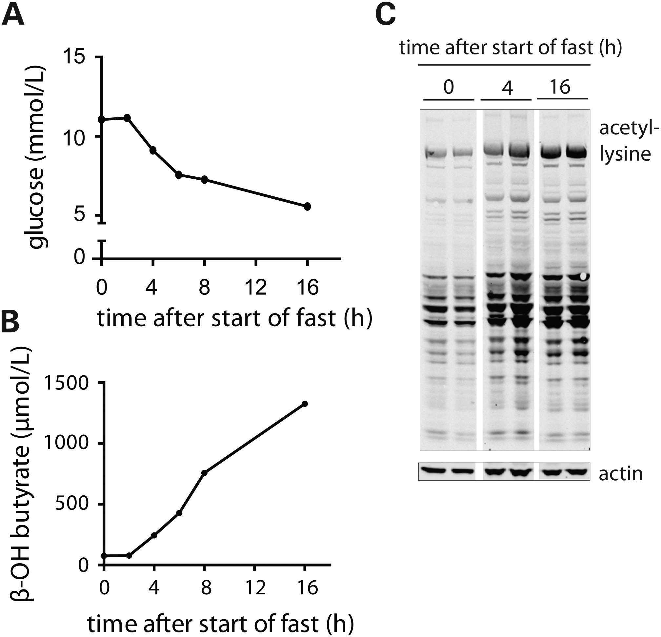
Figure 1. Hepatic protein acetylation increases in response to food withdrawal. (A–C) Mice were subjected to food ...
Notes:
Figure 1. Hepatic protein acetylation increases in response to food withdrawal. (A–C) Mice were subjected to food withdrawal for up to 16 h. Levels of blood glucose (A); plasma ketone bodies (3-hydroxybutyrate) (B); and hepatic protein acetylation (C) were measured at different time intervals.
Unless provided in the caption above, the following copyright applies to the content of this slide: © The Author 2014. Published by Oxford University Press. All rights reserved. For Permissions, please email: journals.permissions@oup.com

Slide 2
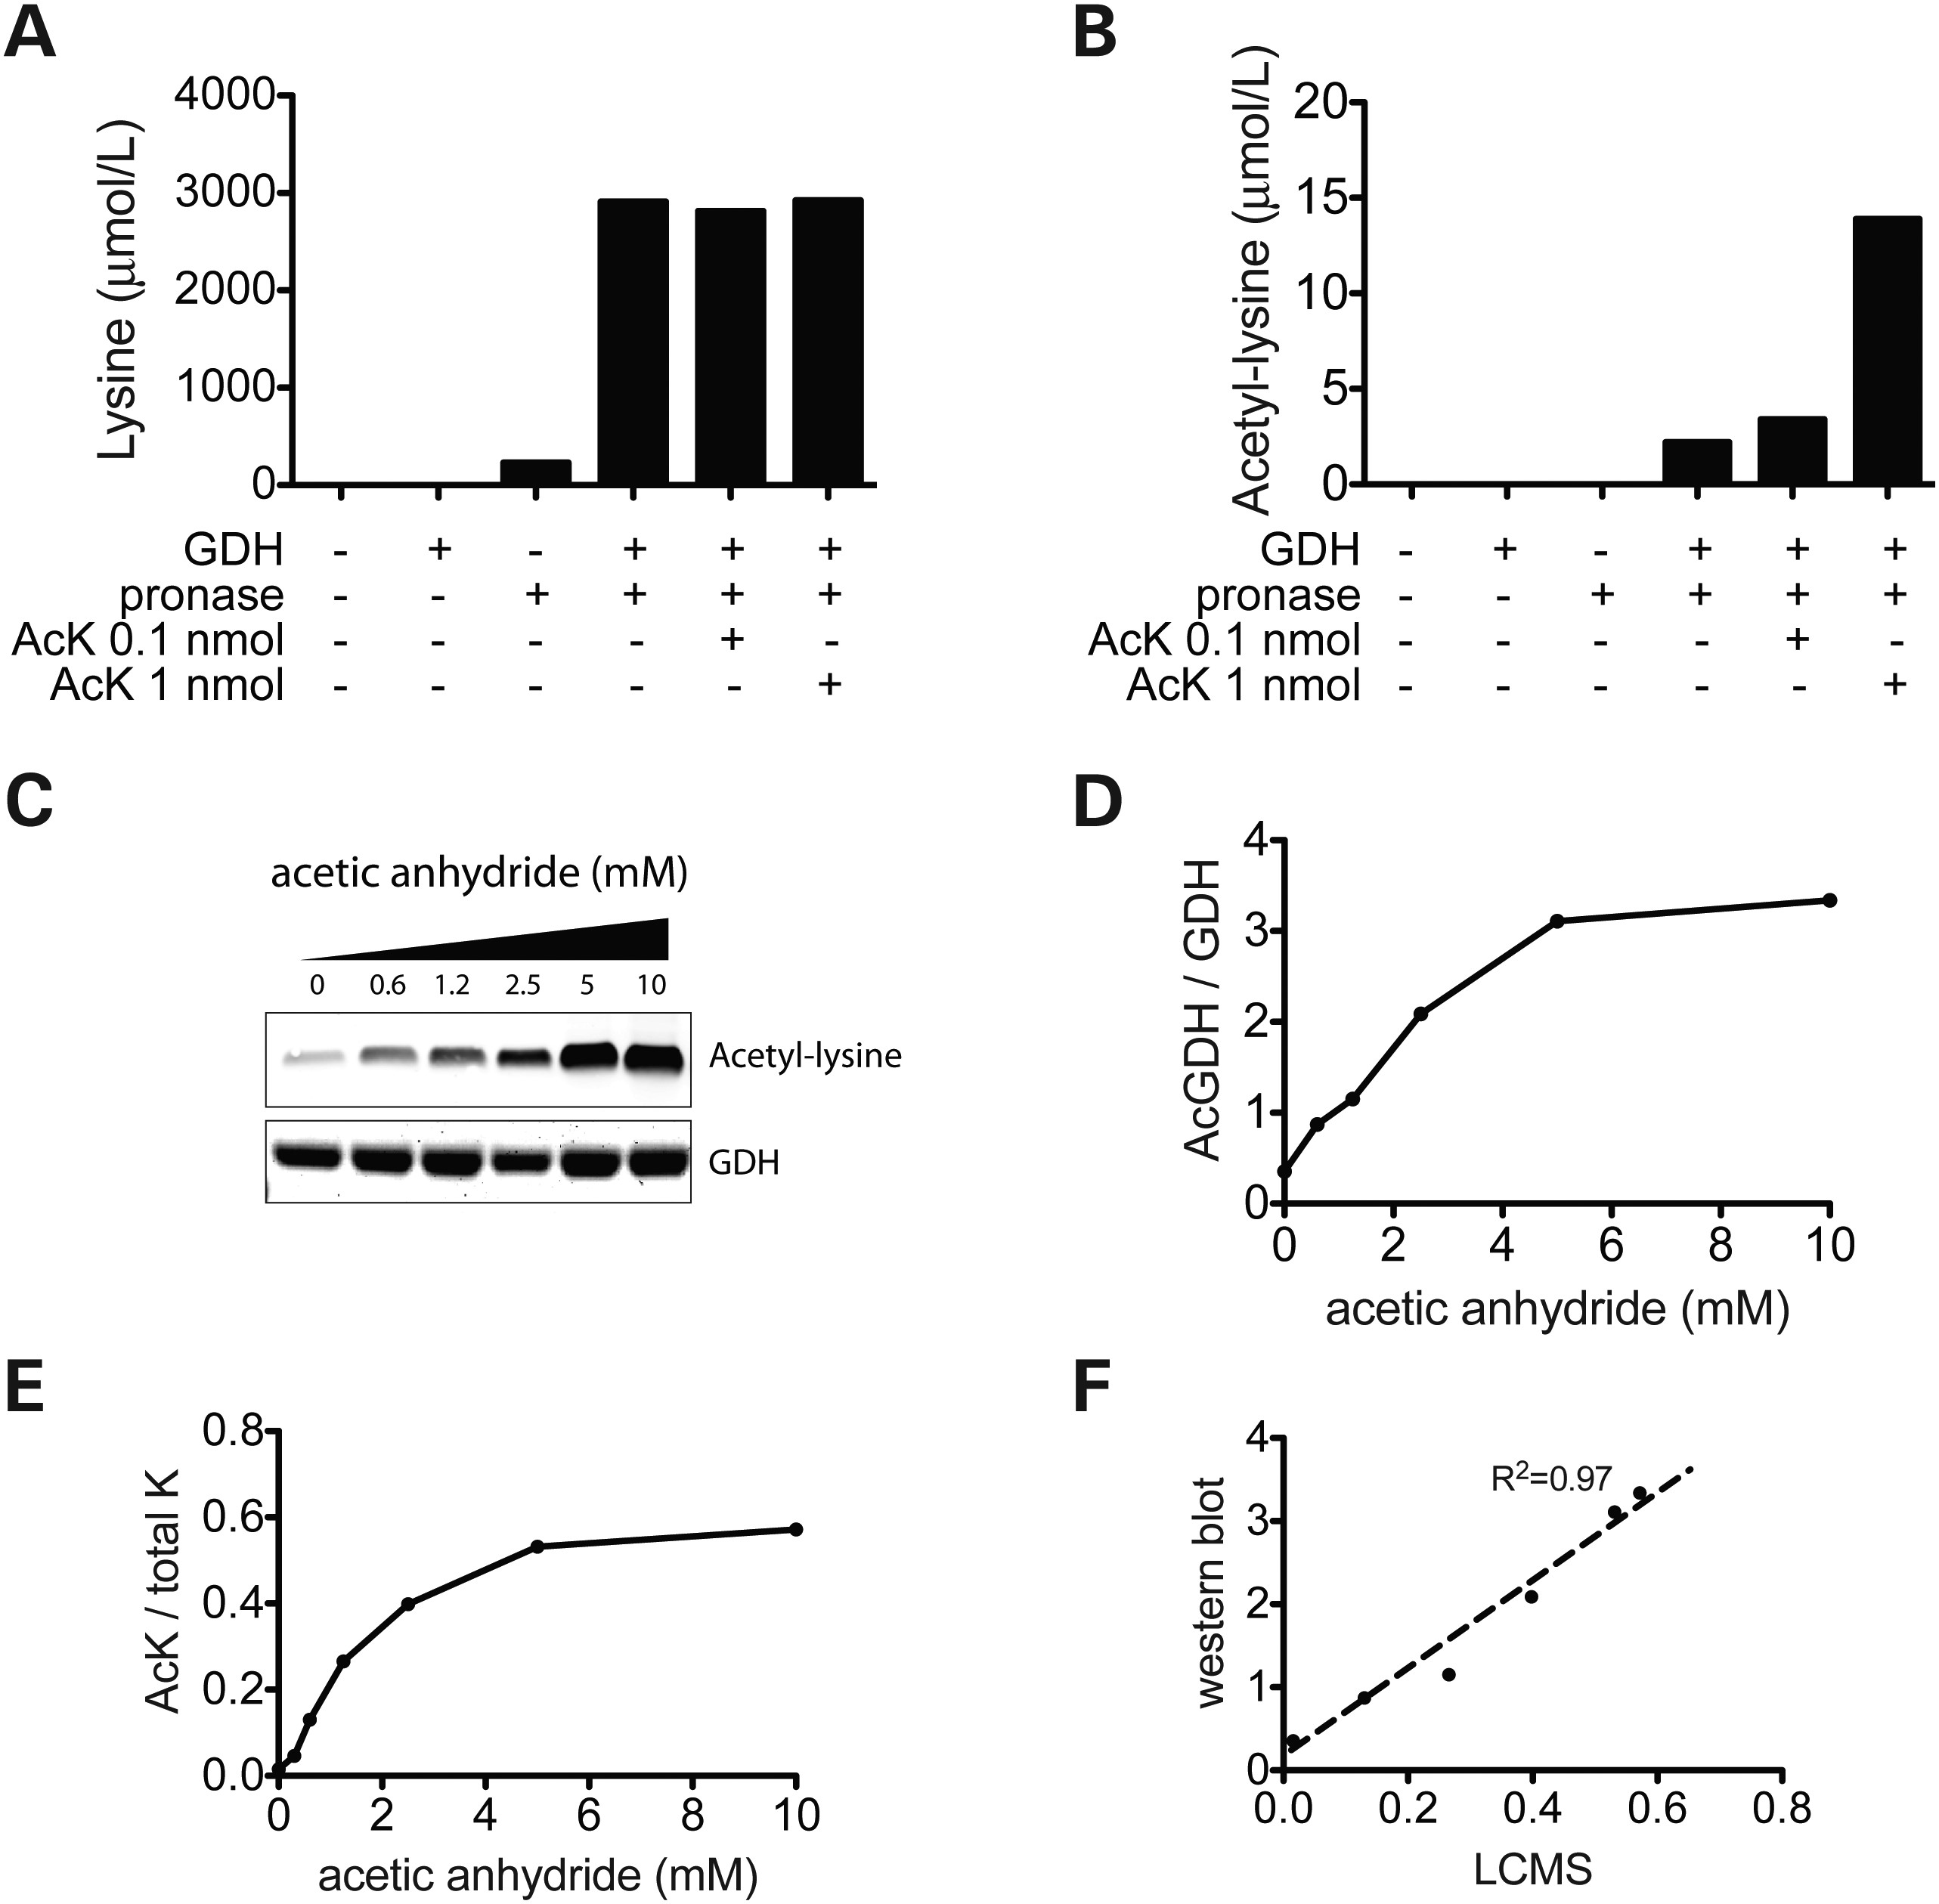
Figure 2. Quantitative measurements of acetylated lysines. (A and B) Purified bovine GDH was incubated with and without ...
Notes:
Figure 2. Quantitative measurements of acetylated lysines. (A and B) Purified bovine GDH was incubated with and without pronase and addition of acetyl lysine (AcK) spikes at 0.1 and 1 nmol, followed by lysine analysis (A) and acetyl lysine analysis (B). (C) GDH was acetylated in vitro using increasing concentrations (0–10 mm) of acetic anhydride followed by analysis of lysine acetylation by western blot. GDH was detected by coomassie staining. (D) Quantification of acetyl lysine signals from C. (E) Acetyl lysine/lysine ratios (AcK/total K) were analyzed by LC–MS/MS after pronase incubation. (F) Correlation of western blot acetylation analysis and LC–MS/MS analysis.
Unless provided in the caption above, the following copyright applies to the content of this slide: © The Author 2014. Published by Oxford University Press. All rights reserved. For Permissions, please email: journals.permissions@oup.com

Slide 3
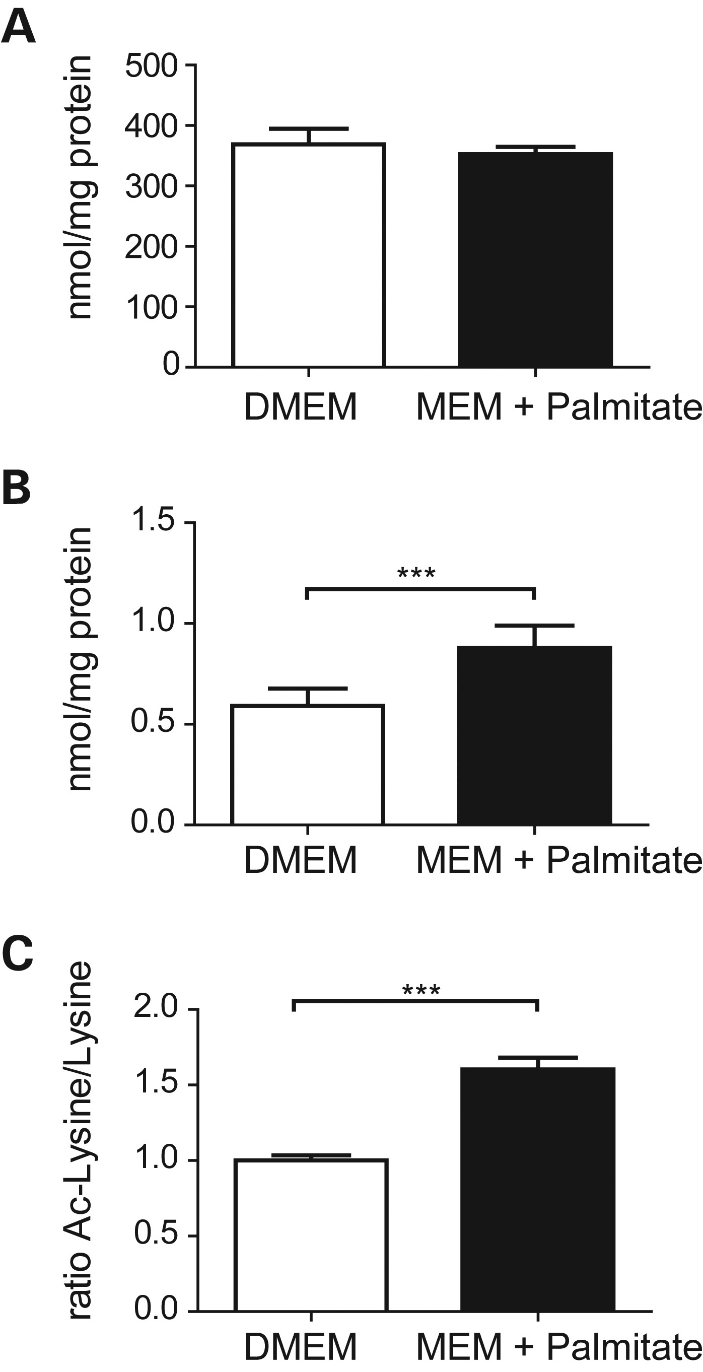
Figure 3. Acetylation increases in fibroblasts with activated fatty acid oxidation. Five human dermal fibroblast cell ...
Notes:
Figure 3. Acetylation increases in fibroblasts with activated fatty acid oxidation. Five human dermal fibroblast cell lines were used to analyze lysine acetylation upon culturing cells in either rich DMEM containing high glucose (25 mm) and 10% FBS (white bars: DMEM) or in palmitate/carnitine containing MEM with low glucose (5 mm) and without FBS (black bars: MEM + palmitate). (A) Protein-derived lysine levels in pronase treated cell lysates analyzed by LC–MS/MS (mean ± SEM, n = 5). (B) Acetyl lysine levels in pronase treated cell lysates analyzed by LC–MS/MS (mean ± SEM, n = 5 and *** indicates P < 0.001). (C) Ratio of acetyl lysine/lysine derived from the data presented in (A) and (B) (mean ± SEM, n = 5 and *** indicates P < 0.001).
Unless provided in the caption above, the following copyright applies to the content of this slide: © The Author 2014. Published by Oxford University Press. All rights reserved. For Permissions, please email: journals.permissions@oup.com

Slide 4
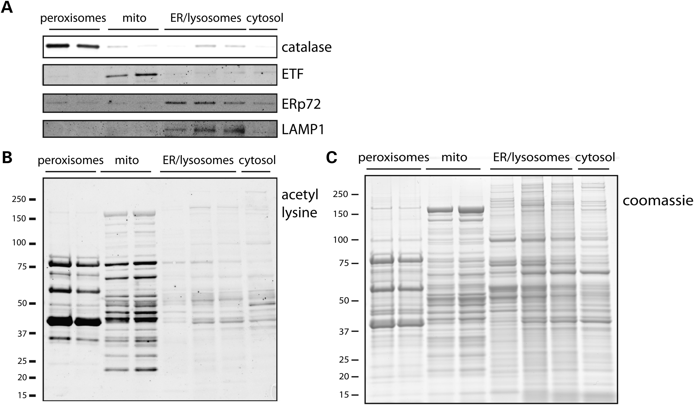
Figure 4. Acetylation is abundant in mitochondria and peroxisomes in human liver. Western blot analysis of peroxisomal, ...
Notes:
Figure 4. Acetylation is abundant in mitochondria and peroxisomes in human liver. Western blot analysis of peroxisomal, mitochondrial, ER-lysosomal and cytosolic fractions of human liver obtained by fractionation of post-nuclear supernatants using nycodenz gradient centrifugation. (A) Catalase (peroxisomes), ETF (mitochondria), ERp72 (ER) and LAMP1 (lysosomes) were used as organellar protein marker. Equal amounts of protein were loaded in each lane. (B) Lysine acetylation levels in different organelles of human liver analyzed with α-acetyl lysine western blot. Equal amounts of protein were loaded in each lane. (C) Coomassie staining of samples in (A) and (B).
Unless provided in the caption above, the following copyright applies to the content of this slide: © The Author 2014. Published by Oxford University Press. All rights reserved. For Permissions, please email: journals.permissions@oup.com

Slide 5
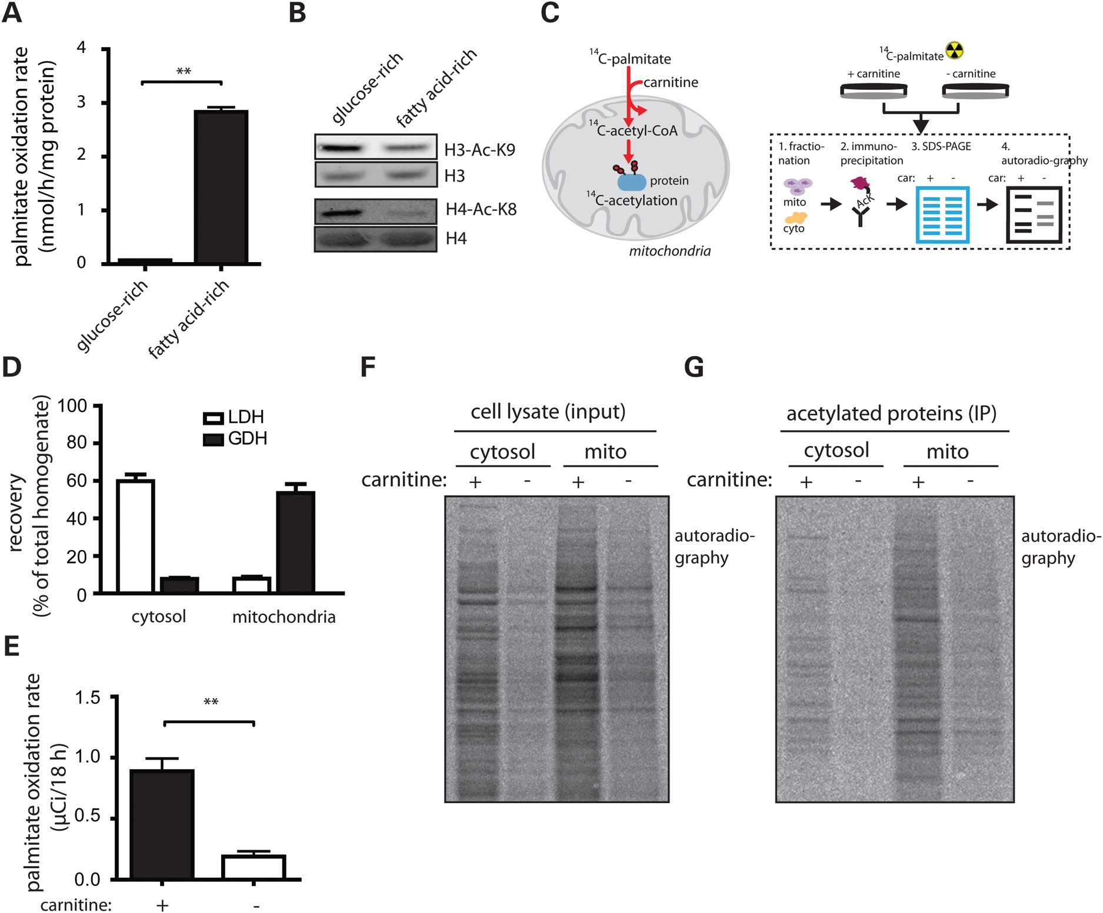
Figure 5. Acetyl-CoA generated by fatty acid oxidation directly provides acetyl units for mitochondrial protein ...
Notes:
Figure 5. Acetyl-CoA generated by fatty acid oxidation directly provides acetyl units for mitochondrial protein acetylation. (A) Palmitate oxidation rate in Fao hepatoma cells subjected to glucose-rich and fatty acid-rich culture conditions. Glucose-rich medium contained 5.6 mm glucose and dialyzed serum, whereas medium for fatty acid-rich conditions contained 5.6 mm galactose, 50 µm carnitine, 100 µm palmitate and dialyzed serum. The rate was assessed by measuring 3H2O generated by oxidation of [9,10-3H]-palmitate (mean ± SEM, n = 3 and ** indicates P < 0.01). (B) Acetylation levels of H3K9 and H4K8 in Fao cells in glucose-rich and fatty acid-rich conditions. (C) Graphical summary of the 14C-labeled mitochondrial protein acetylation generated through 14C-palmitate oxidation and experimental set-up. Fao cells were grown in fatty acid-rich conditions in medium containing 14C-palmitate, with and without carnitine supplementation for 18 h. Acetylated proteins were purified using α-acetyl lysine immunoprecipitation, resolved by SDS-PAGE and 14C incorporation into acetylated proteins was analyzed using radiography. (D) Distribution of cytosolic marker LDH and mitochondrial marker GDH in organellar fractions after fractionation of Fao cells by differential centrifugation. (E) Palmitate oxidation rate in Fao cells with and without carnitine supplementation. The rate was assessed by quantifying 14C incorporation into CO2 (mean ± SEM, n = 4 and ** indicates P < 0.01). (F and G) Radiography of 14C incorporated into total cell lysates (F) and acetylated proteins (G) in mitochondrial and cytosolic fractions from cells exposed to 14C-palmitate with and without carnitine supplementation.
Unless provided in the caption above, the following copyright applies to the content of this slide: © The Author 2014. Published by Oxford University Press. All rights reserved. For Permissions, please email: journals.permissions@oup.com

Slide 6
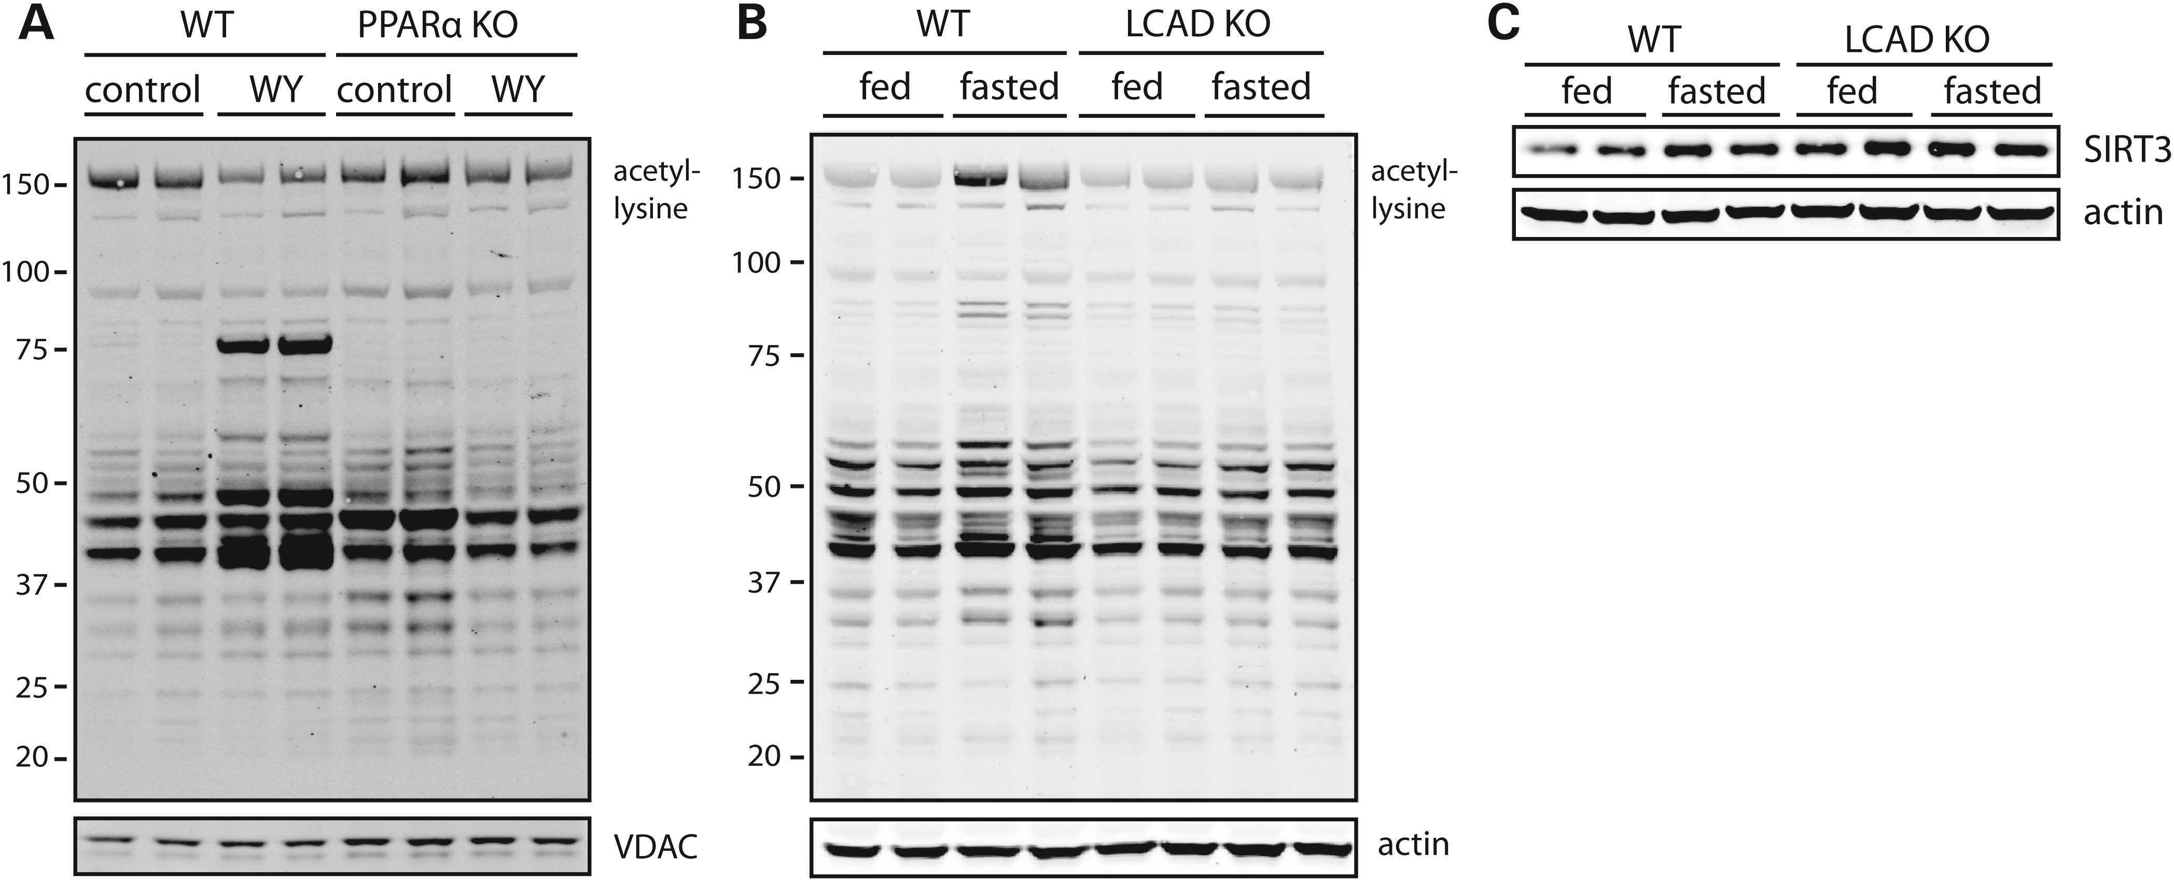
Figure 6. Hepatic protein hyperacetylation does not occur in mice deficient in fatty acid oxidation. (A) Protein ...
Notes:
Figure 6. Hepatic protein hyperacetylation does not occur in mice deficient in fatty acid oxidation. (A) Protein acetylation levels in liver lysates of WT and PPARα KO mice fed a diet with WY14643 for 2 weeks or a control diet. (B) Protein acetylation levels in whole liver lysates of WT and LCAD KO mice which were fed or fasted overnight. (C) SIRT3 protein expression in the livers of WT and LCAD KO mice, which were fed or fasted overnight.
Unless provided in the caption above, the following copyright applies to the content of this slide: © The Author 2014. Published by Oxford University Press. All rights reserved. For Permissions, please email: journals.permissions@oup.com

