Slide 1
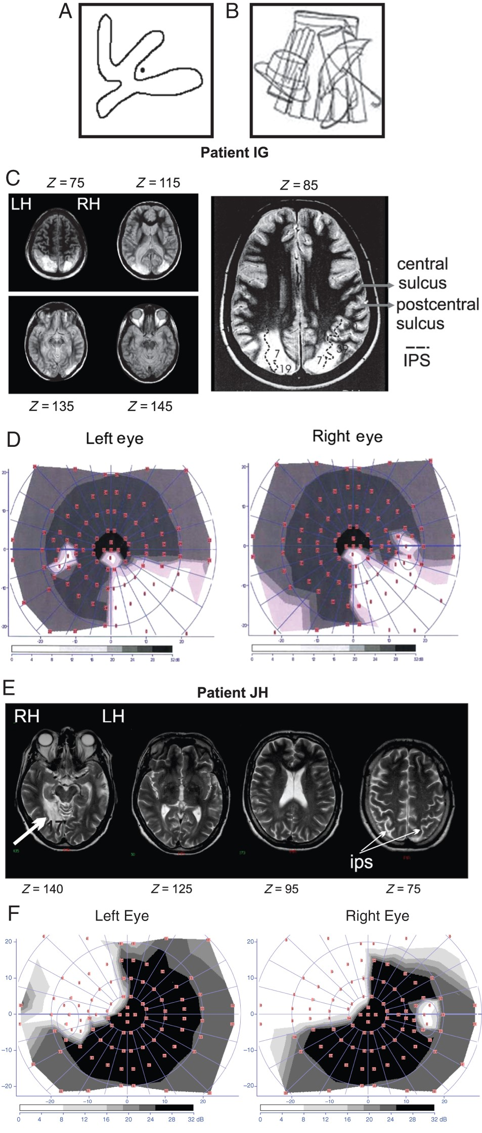
Figure 1. Example figures for testing simultanagnosia, MRIs, and visual field perimetry of patients IG and JH. (A and ...
Notes:
Figure 1. Example figures for testing simultanagnosia, MRIs, and visual field perimetry of patients IG and JH. (A and B) Figures typically used to test for simultanagnosia. In (A), the patient is asked to determine whether the dot is inside or outside of the object. In (B), the patient is asked to distinguish and name all the overlapping objects in the figure. (C) T2-weighted magnetic resonance sections of patient IG's brain showing fairly symmetric bilateral lesions located at the upper and lateral occipito-parietal junction, cortically and subcortically, involving mainly the intraparietal and the parieto-occipital sulci with full damage to Brodmann's area 7 in the superior parietal lobule (SPL). Horizontal (axial) sections are shown with the corresponding z coordinates in standard Talairach space, from dorsal to ventral regions (Talairach and Tournoux 1988). The Z = 85 section is shown expanded on the right to delineate damaged brain areas more precisely. Brodmann's areas are numbered inside gray circles. The dotted lines outline the intraparietal sulcus (IPS). LH, left hemisphere, RH, right hemisphere. (D) Visual field perimetry for patient IG showing quadrantanopia in the right lower quadrant of the visual field of both eyes, due to the subcortical damage of the optical radiations below the PPC in the left hemisphere. (E) T2-weighted magnetic resonance sections of patient JH's brain showing unilateral damage restricted to the optical radiations and the primary visual cortex (V1, Brodmann's area 17) in the right hemisphere. Horizontal (axial) sections are shown with the corresponding z coordinates in standard Talairach space, from dorsal to ventral regions (Talairach and Tournoux 1988) to attest that the posterior cerebral artery infarct fully spared the parietal cortex. (F) Visual field perimetry for patient JH shows quadrantanopia in the left upper quadrant of the visual field of both eyes.
Unless provided in the caption above, the following copyright applies to the content of this slide: © The Author 2015. Published by Oxford University Press. All rights reserved. For Permissions, please e-mail: journals.permissions@oup.com

Slide 2
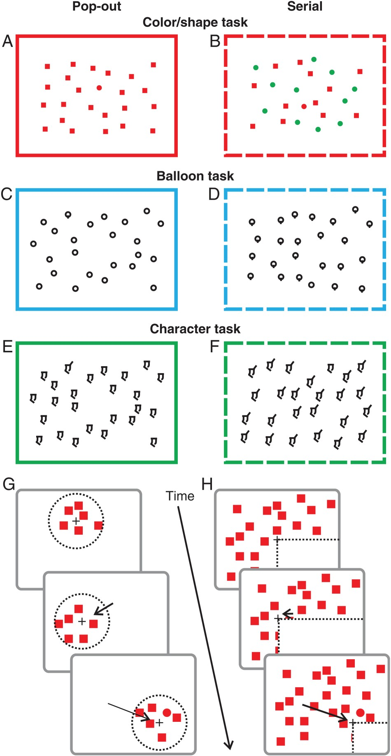
Figure 2. Visual search arrays and examples of gaze-contingent displays. (A and B) Color/shape task. In the pop-out ...
Notes:
Figure 2. Visual search arrays and examples of gaze-contingent displays. (A and B) Color/shape task. In the pop-out condition (A), participants searched for a red circle among red squares. In the serial condition (B), participants searched for a red circle among green circles and red squares. (C and D) Balloon task. In the pop-out condition (C), participants searched for a lollipop shape among circles (feature-present), whereas in the serial condition (D), participants searched for a circle among lollipops (feature-absent). (E and F) Character task. Similar to the balloon task, in the pop-out condition (E), participants searched for an object with an additional feature (oriented bar on the top left of the object) among other objects without the feature, while the serial condition (F) required looking for the unique object without the additional feature. (G) Gaze-contingent display. Within the gaze-contingent condition, participants viewed the search arrays through different sized visible windows that were centered on the fovea and moved with gaze in real time. The area surround the visible window was white. The dotted circle shows the visible window and the cross depicts the current foveal location. The black arrows depict the direction of the saccade to current gaze. As the participants looks around, only a certain part of the array is visible at a given time. (H) Gaze-contingent mask mimicking quadrantanopia. Control participants also performed each task with a gaze-contingent mask that occluded the bottom-right visual quadrant relative to gaze position.
Unless provided in the caption above, the following copyright applies to the content of this slide: © The Author 2015. Published by Oxford University Press. All rights reserved. For Permissions, please e-mail: journals.permissions@oup.com

Slide 3
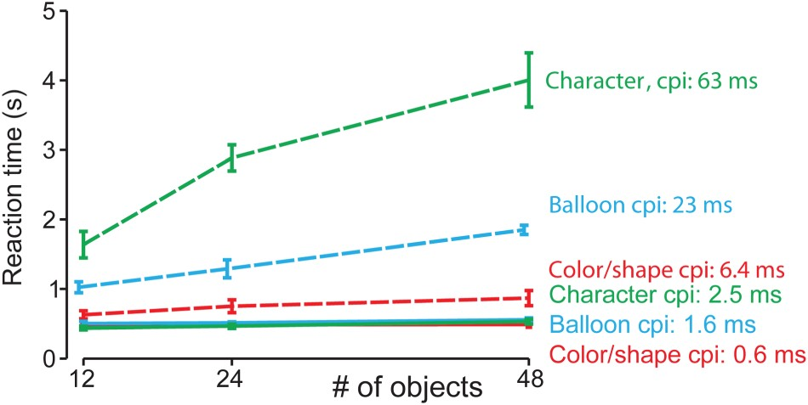
Figure 3. Cost per item across the different visual search tasks. Reaction times (RTs) for the controls are shown for ...
Notes:
Figure 3. Cost per item across the different visual search tasks. Reaction times (RTs) for the controls are shown for different object numbers within each task. The color/shape tasks are shown in red, the balloon tasks in blue and the character tasks. Pop-out tasks are shown as solid lines and serial tasks are shown in dotted lines. Cost-per-item slopes are shown on the left with italics denoting serial tasks and were calculated using linear fits across the three object numbers. The standard errors are across subjects.
Unless provided in the caption above, the following copyright applies to the content of this slide: © The Author 2015. Published by Oxford University Press. All rights reserved. For Permissions, please e-mail: journals.permissions@oup.com

Slide 4
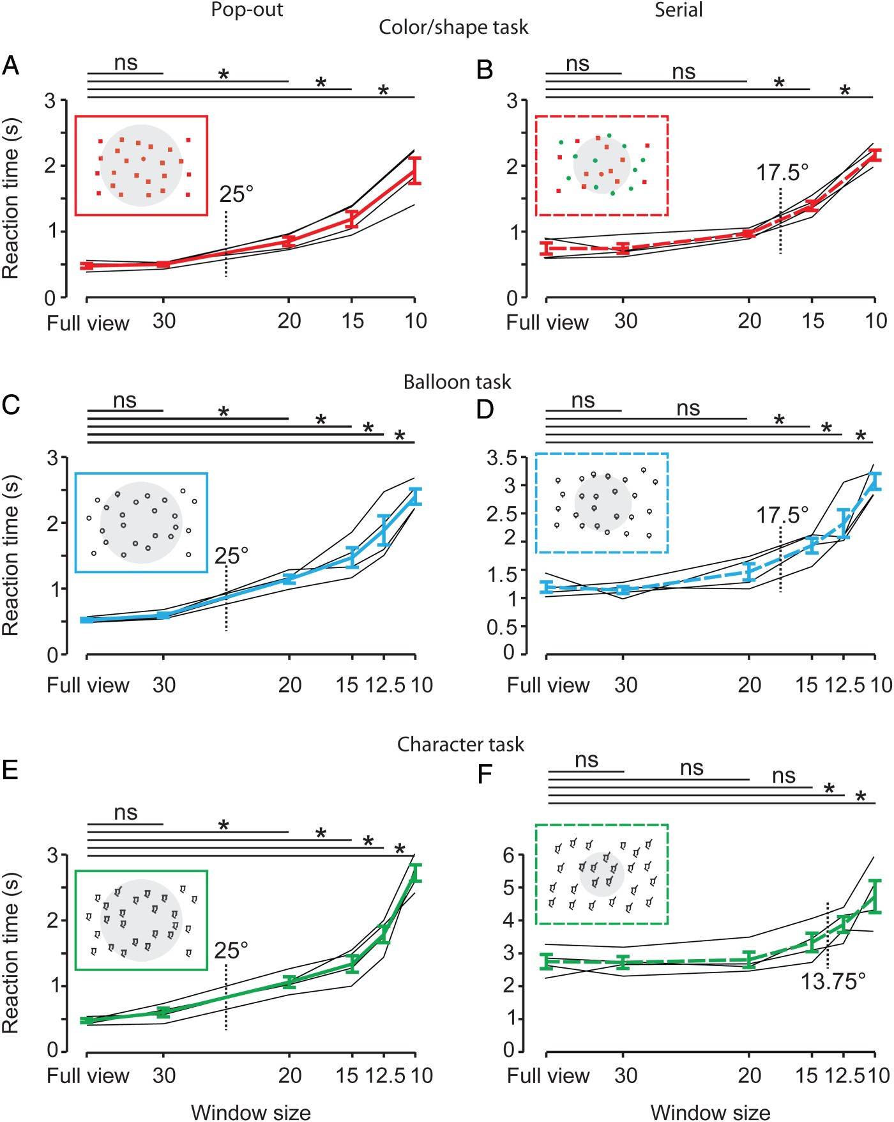
Figure 4. Reaction times for different visible windows. Mean reaction times are shown across controls within each task ...
Notes:
Figure 4. Reaction times for different visible windows. Mean reaction times are shown across controls within each task for the color/shape tasks in red (A and B), the balloon task in blue (C and D), and the character task in green (E and F). Individual reaction times are also shown for each participant (thin black lines). Pop-out tasks are shown in the left panel and the serial tasks are shown in the right panel. Note the difference in the ranges of reaction times in the y-axis. The horizontal lines above each figure depict each statistical comparison performed (multiple paired t-test, corrected using Bonferroni), ns, nonsignificant (P > 0.05, Bonferroni corrected), *P < 0.05, Bonferroni corrected). Window size is the diameter of the visible window centered on the current foveal location. The gray circles in the stimulus icons depict the estimated size of the attentional window based on the statistical comparisons.
Unless provided in the caption above, the following copyright applies to the content of this slide: © The Author 2015. Published by Oxford University Press. All rights reserved. For Permissions, please e-mail: journals.permissions@oup.com

Slide 5
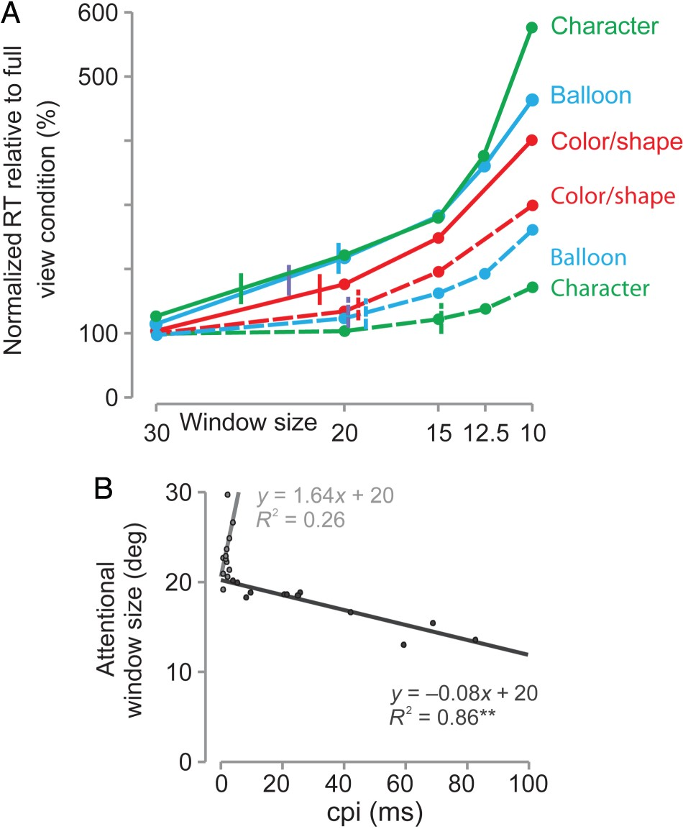
Figure 5. Normalized RTs, attentional window sizes, and the relationship to cost-per-item. (A) Normalized RTs across ...
Notes:
Figure 5. Normalized RTs, attentional window sizes, and the relationship to cost-per-item. (A) Normalized RTs across all conditions. The percentage increase relative to full view condition (in percentage) was calculated for each subject and each visible window by dividing the relevant RT for each visible window by the RT in the full view condition and converting this value into percentages, where 100% would be the same RT as the full view condition and 600% would be a 6-fold increase relative to the full view condition. Dots depict averages across subjects at each visible window, solid lines represent pop-out tasks, and dashed lines depict serial tasks. The color-coded vertical lines delineate the average attentional window for each task. (B) Relationship between attentional window size and cpi. Each data point represents a single subject within each task color coded for the pop-out (light gray dots) and the serial (dark gray dots). The linear fits are shown by the corresponding colors as are the slopes, intercepts, and R2 values. **Significance at P < 0.01.
Unless provided in the caption above, the following copyright applies to the content of this slide: © The Author 2015. Published by Oxford University Press. All rights reserved. For Permissions, please e-mail: journals.permissions@oup.com

Slide 6
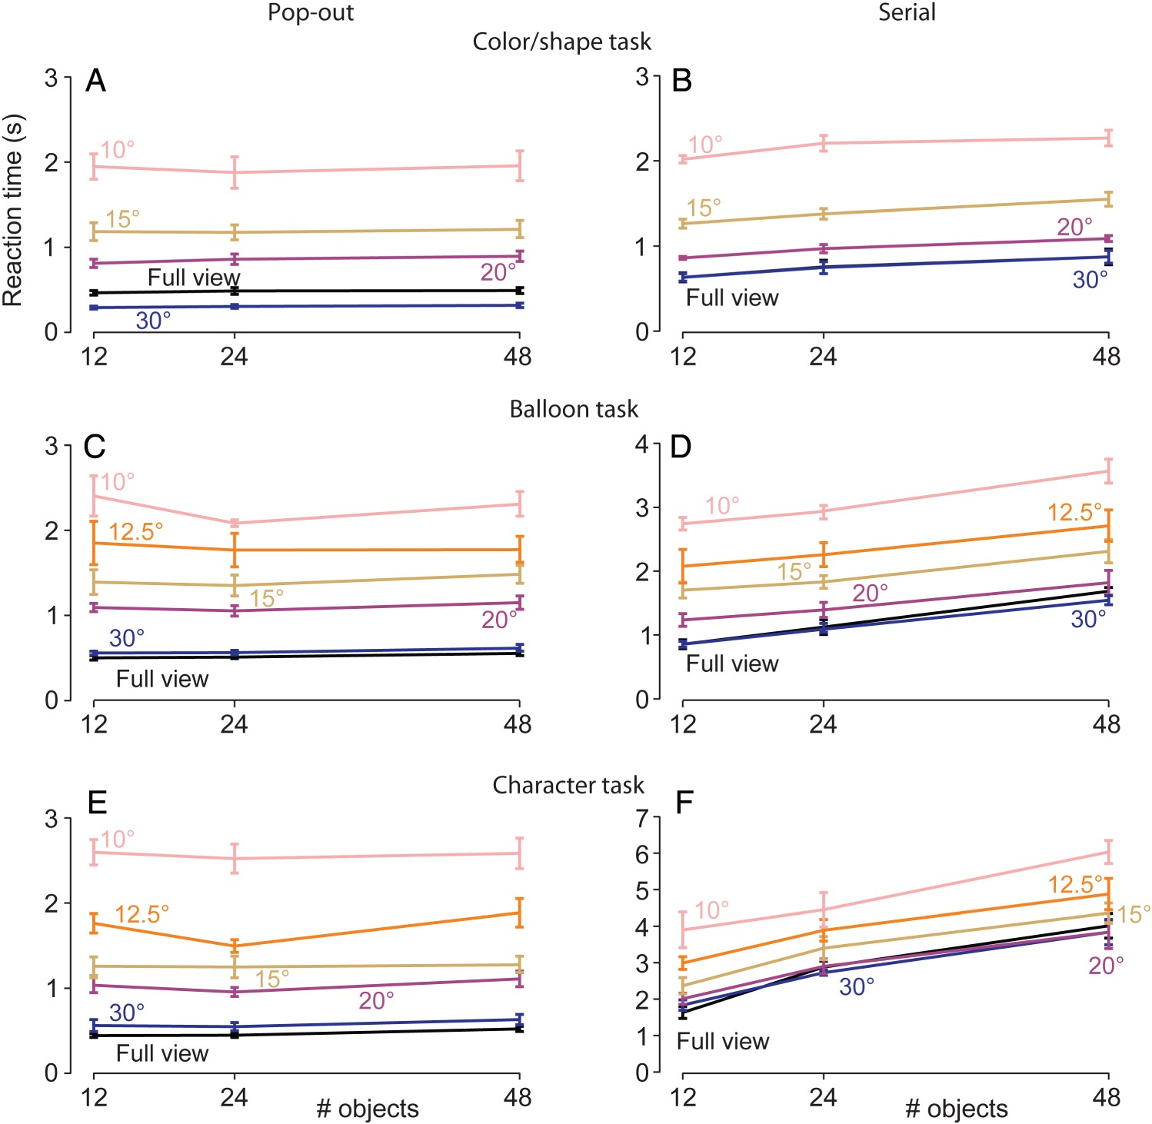
Figure 6. Visible window sizes versus number of objects. Reaction times for different visible windows are plotted as a ...
Notes:
Figure 6. Visible window sizes versus number of objects. Reaction times for different visible windows are plotted as a function of number of objects for the color/shape tasks (A and B), the balloon tasks (C and D), and the character tasks (E and F). The pop-out tasks are in the left panel and the serial tasks are in the right panel. Visible windows are color coded and labeled in the figures.
Unless provided in the caption above, the following copyright applies to the content of this slide: © The Author 2015. Published by Oxford University Press. All rights reserved. For Permissions, please e-mail: journals.permissions@oup.com

Slide 7
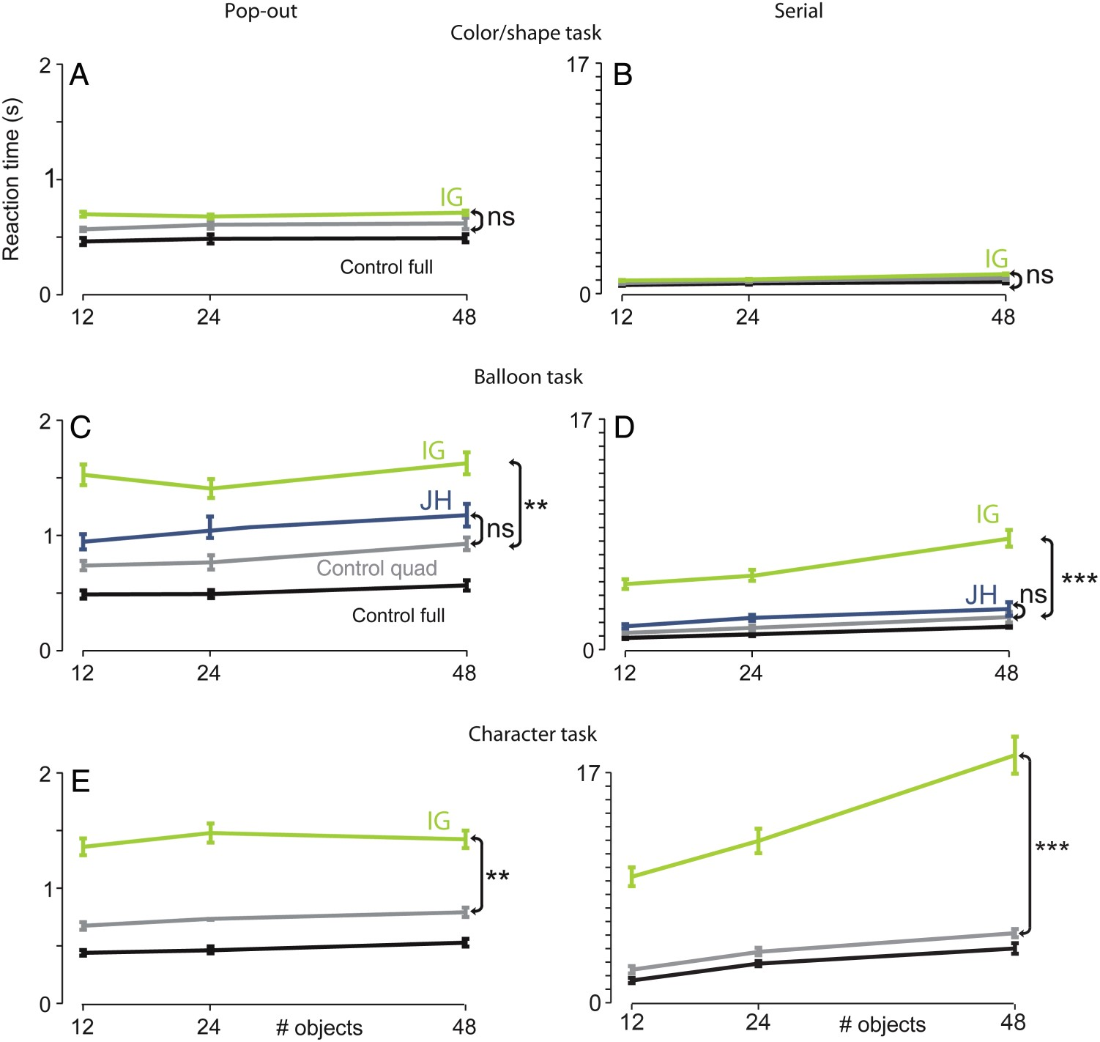
Figure 7. IG and JH's performance across the different tasks. IG's reaction times (light green lines) along with ...
Notes:
Figure 7. IG and JH's performance across the different tasks. IG's reaction times (light green lines) along with controls full view (black lines) and quadrantanopia (gray lines) conditions are shown as a function of the number of objects for the color/shape (A and B), the balloon (C and D) and the character (E and F) tasks. Mean RTs from control patient JH are also shown in C and D (in dark blue lines). The pop-out tasks are shown in the left panel (same y-axis range) and the serial tasks (same y-axis range) are shown in the right panel. The double arrows on the right of each figure show the comparisons made and the significance value (ns, nonsignificant, **P < 0.01, ***P < 0.001). Modified t-tests comparing a single subject against a group were used (Crawford and Garthwaite 2002b, 2007). Error bars for controls are SEM across the group of controls whereas for IG and JH are SEM across individual RTs.
Unless provided in the caption above, the following copyright applies to the content of this slide: © The Author 2015. Published by Oxford University Press. All rights reserved. For Permissions, please e-mail: journals.permissions@oup.com

Slide 8
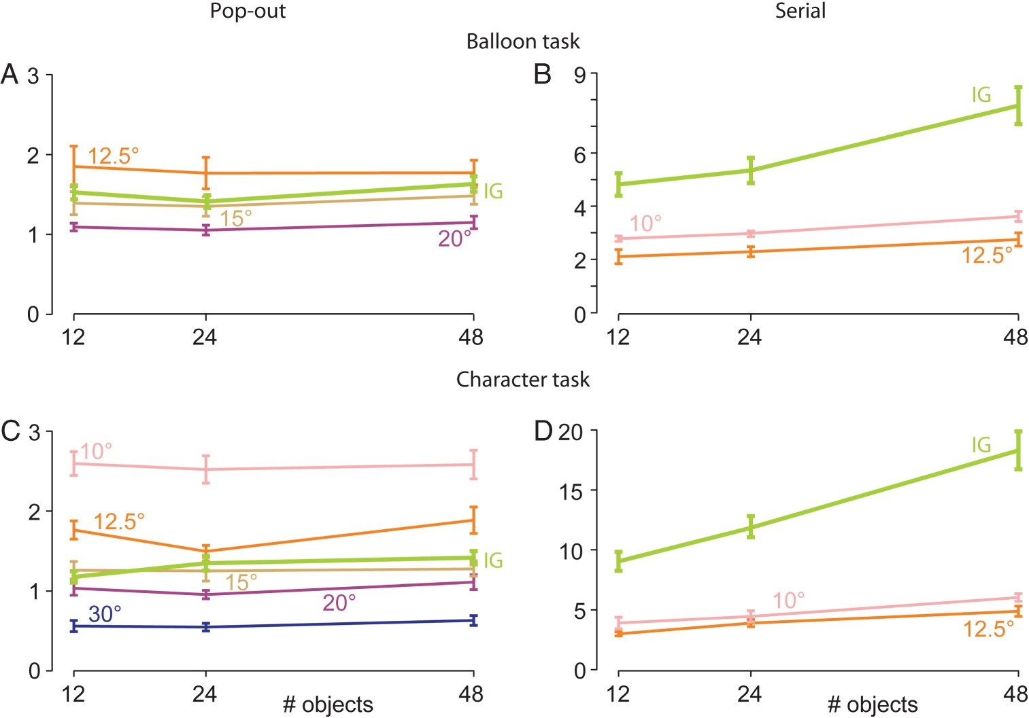
Figure 8. IG's performance compared with controls. IG's reaction times (light green lines) for targets that were in the ...
Notes:
Figure 8. IG's performance compared with controls. IG's reaction times (light green lines) for targets that were in the three quadrants outside of the quadrantanopic field at central fixation are shown along with the closest control RTs for the balloon pop-out (A), the balloon serial (B), the character pop-out (C), and the character serial (D) tasks. RTs for the controls for different window sizes are color-coded as in Figure 6.
Unless provided in the caption above, the following copyright applies to the content of this slide: © The Author 2015. Published by Oxford University Press. All rights reserved. For Permissions, please e-mail: journals.permissions@oup.com

Slide 9
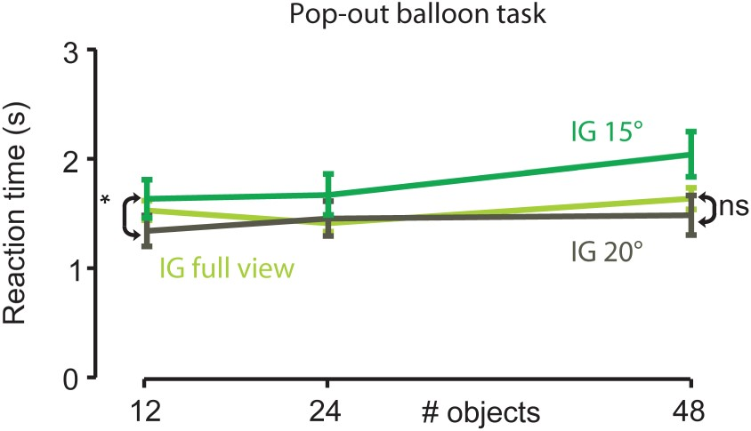
Figure 9. IGs performance in the pop-out balloon task with different visible windows. IGs search time is plotted ...
Notes:
Figure 9. IGs performance in the pop-out balloon task with different visible windows. IGs search time is plotted against number of objects in the full view condition (light green line) and with a visible window of 15° (green line) and 20° (khaki line). Error bars are SEM across RTs. Ns, nonsignificant. *P < 0.05.
Unless provided in the caption above, the following copyright applies to the content of this slide: © The Author 2015. Published by Oxford University Press. All rights reserved. For Permissions, please e-mail: journals.permissions@oup.com

Slide 10
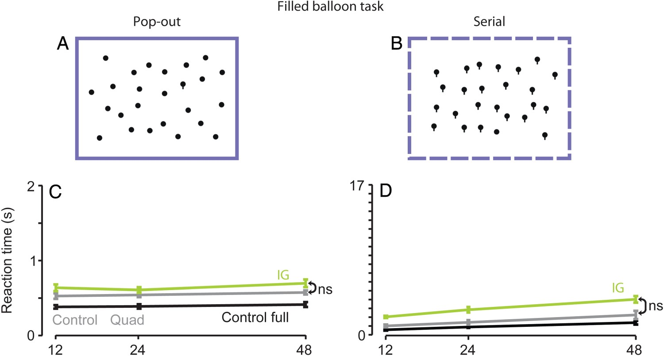
Figure 10. IG's performance in the filled balloon task. The visual search array is shown for the pop-out (A) and serial ...
Notes:
Figure 10. IG's performance in the filled balloon task. The visual search array is shown for the pop-out (A) and serial versions of the filled balloon (B) task. The arrays were identical to the balloon task except that the lollipops were filled. IG's reaction times (light green lines) along with controls full view (black lines) and quadrantanopia (gray lines) conditions are shown as a function of the number of objects (C and D) The pop-out tasks are shown in the left panel (same y-axis range as in Fig. 7) and the serial tasks (same y-axis range) are shown in the right panel. The double arrows on the right of each figure show the comparisons made and the significance value (ns, nonsignificant). Modified t-tests comparing a single subject against a group were used (Crawford and Garthwaite 2002b, 2007). Error bars for controls are SEM across the group of controls whereas for IG are SEM across her RTs.
Unless provided in the caption above, the following copyright applies to the content of this slide: © The Author 2015. Published by Oxford University Press. All rights reserved. For Permissions, please e-mail: journals.permissions@oup.com

