Slide 1
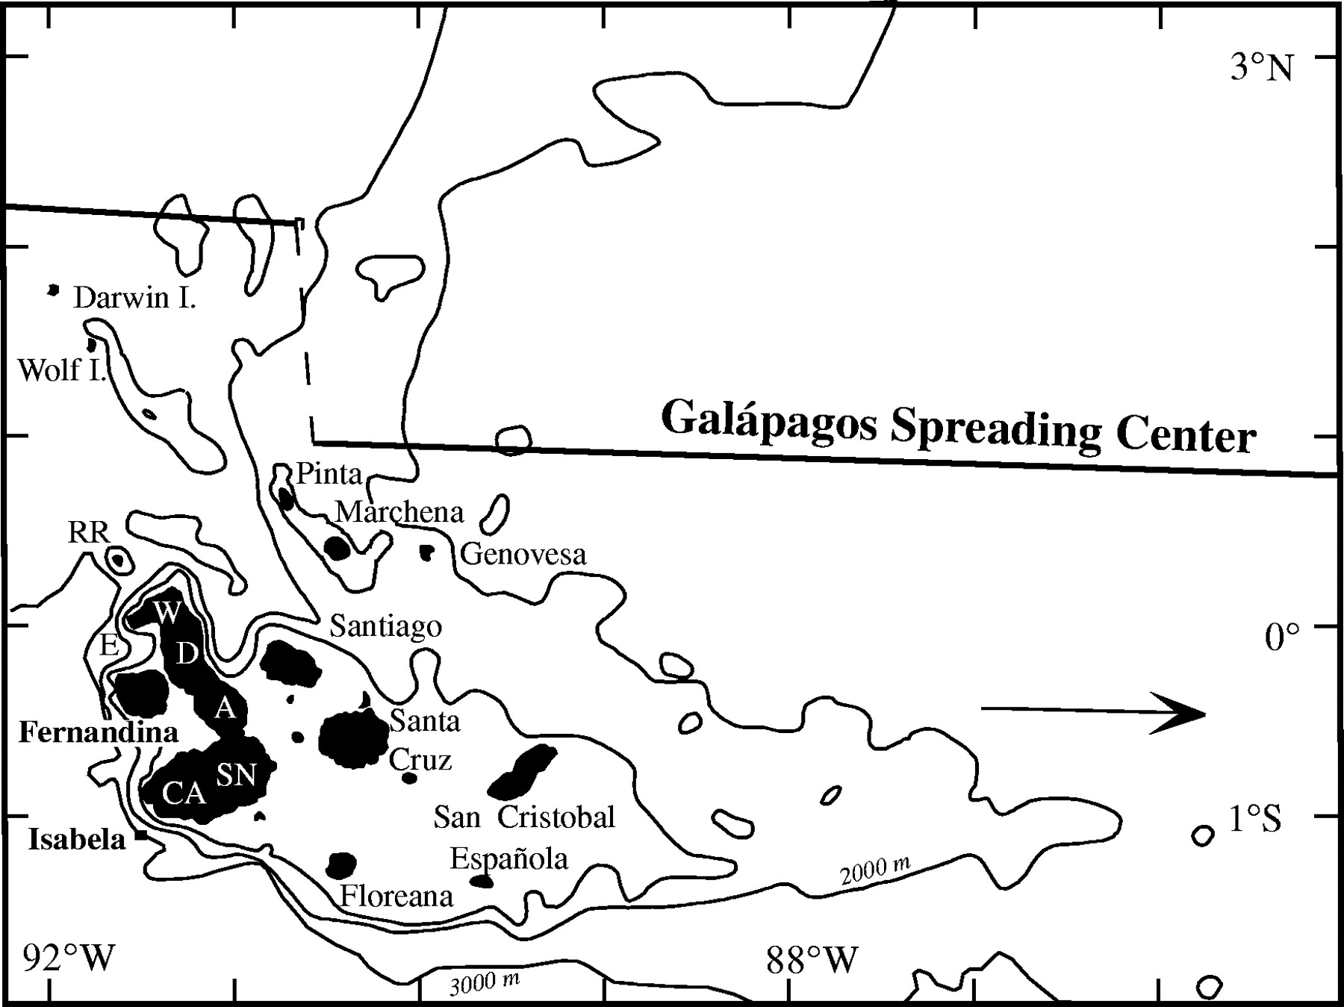
Fig. 1. Map of the Galápagos Islands, showing location of Wolf volcano and the Galápagos Spreading Center. Arrow ...
Notes:
Fig. 1. Map of the Galápagos Islands, showing location of Wolf volcano and the Galápagos Spreading Center. Arrow indicates the absolute motion of the Nazca plate. Volcanoes on Isabela Island are: E, Ecuador; W, Wolf; D, Darwin; A, Alcedo; SN, Sierra Negra; CA, Cerro Azul. RR, Roca Redonda volcano.
Unless provided in the caption above, the following copyright applies to the content of this slide: © The Author 2005. Published by Oxford University Press. All rights reserved. For Permissions, please e-mail: journals.permissions@oxfordjournals.org

Slide 2
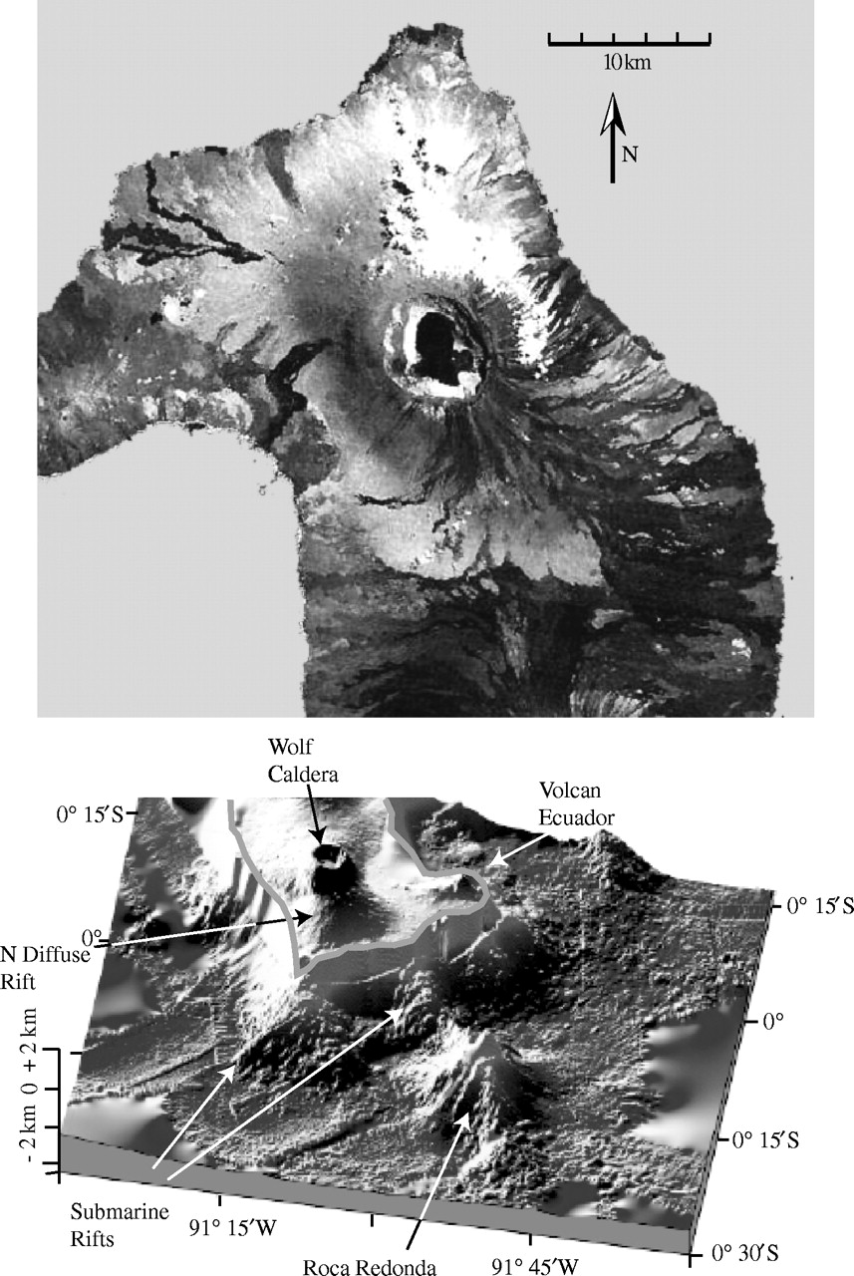
Fig. 2. Top: Landsat7 image of Wolf volcano, showing the distribution of young, unvegetated lava flows. Bottom: ...
Notes:
Fig. 2. Top: Landsat7 image of Wolf volcano, showing the distribution of young, unvegetated lava flows. Bottom: perspective of relief of submarine and subaerial sectors, looking from the NE. Data are merged bathymetry and side-scan sonar from the DRIFT4 cruise and subaerial DEM produced from radar data of the TOPSAR mission (Mouginis-Mark et al., 1996; data kindly provided by P. Mouginis-Mark).
Unless provided in the caption above, the following copyright applies to the content of this slide: © The Author 2005. Published by Oxford University Press. All rights reserved. For Permissions, please e-mail: journals.permissions@oxfordjournals.org

Slide 3
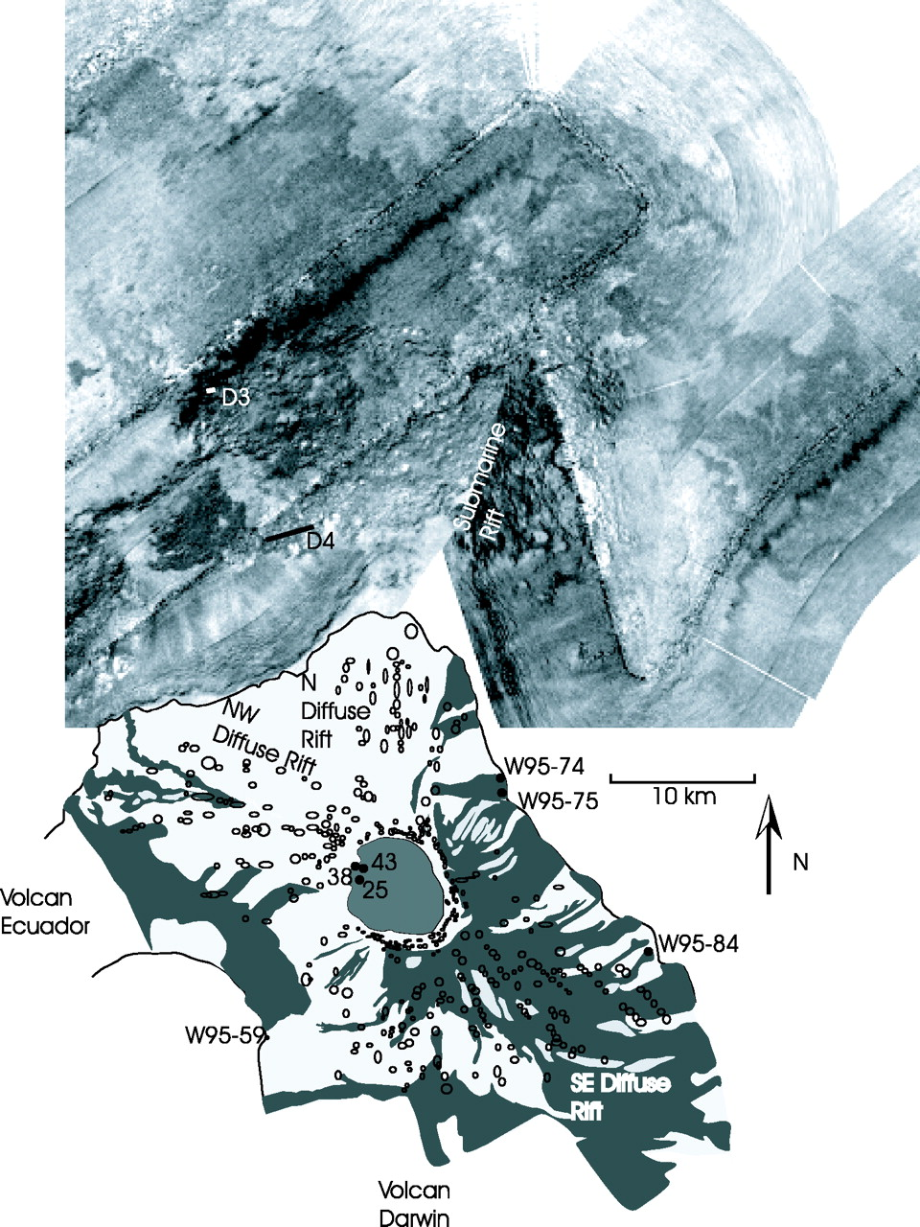
Fig. 3. Schematic geological map of Wolf volcano superimposed on side-scan sonar image of seafloor surrounding the ...
Notes:
Fig. 3. Schematic geological map of Wolf volcano superimposed on side-scan sonar image of seafloor surrounding the volcano. On the side-scan sonar image, light color indicates a weak return signal. Location of the two dredges (D3, D4) on Wolf's submarine flanks are indicated. Grey shading indicates the distribution of young, unvegetated lava flows on the volcano flanks and in the caldera. Outlined circles and ellipses indicate volcanic vents. Locations of the samples for which age determinations have been made (Table 4) are shown.
Unless provided in the caption above, the following copyright applies to the content of this slide: © The Author 2005. Published by Oxford University Press. All rights reserved. For Permissions, please e-mail: journals.permissions@oxfordjournals.org

Slide 4
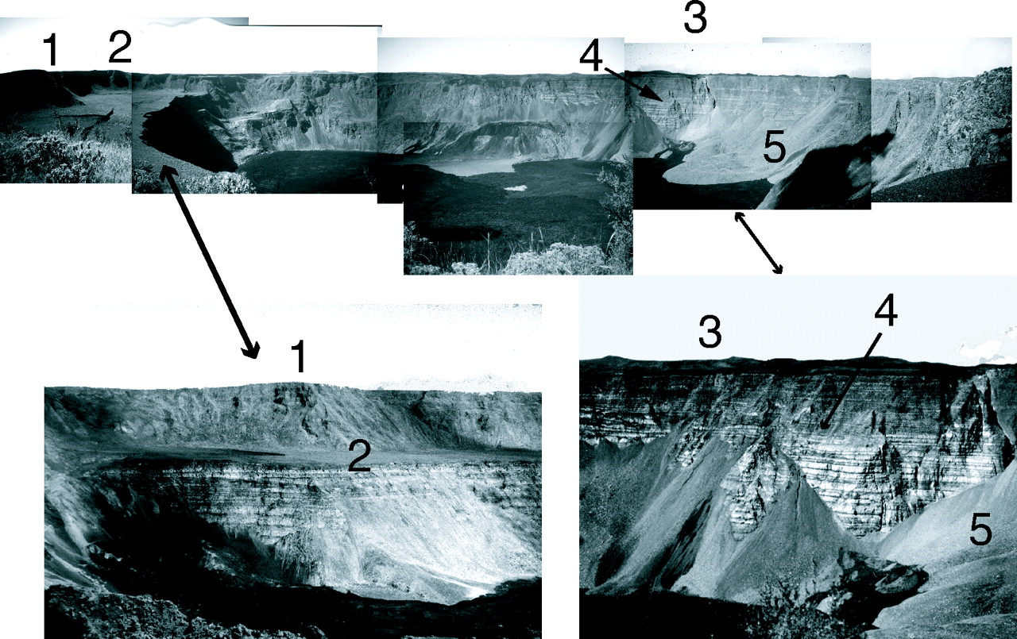
Fig. 4. (Top) Panorama of Wolf caldera, from the SW rim. The caldera is ∼5 km across in this view and 700 m deep. ...
Notes:
Fig. 4. (Top) Panorama of Wolf caldera, from the SW rim. The caldera is ∼5 km across in this view and 700 m deep. Some of the features discussed in the text are as follows. 1, The highest point in the Galápagos Islands. The base of this rock rib exposes the oldest known rocks on Wolf volcano. 2, The bench, marking the level to which the caldera was filled. Young fissure cuts the bench. 3, Hills on the horizon mark locations of circumferential vents, some of which erupt lavas that then cascade down the caldera walls. 4, The best locality exposing the contact between caldera-filling facies and caldera rim facies. 5, The lobe of the largest avalanche deposit, which is overlain by young lava flow that has ponded in the caldera. (Bottom left) The bench, which is made up of caldera-filling lavas, as viewed from the SW caldera rim. The 1982 vent is visible in the lower left. (Bottom right) Detail of the contact between caldera-filling facies below, and caldera-rim facies above, on the south caldera wall.
Unless provided in the caption above, the following copyright applies to the content of this slide: © The Author 2005. Published by Oxford University Press. All rights reserved. For Permissions, please e-mail: journals.permissions@oxfordjournals.org

Slide 5
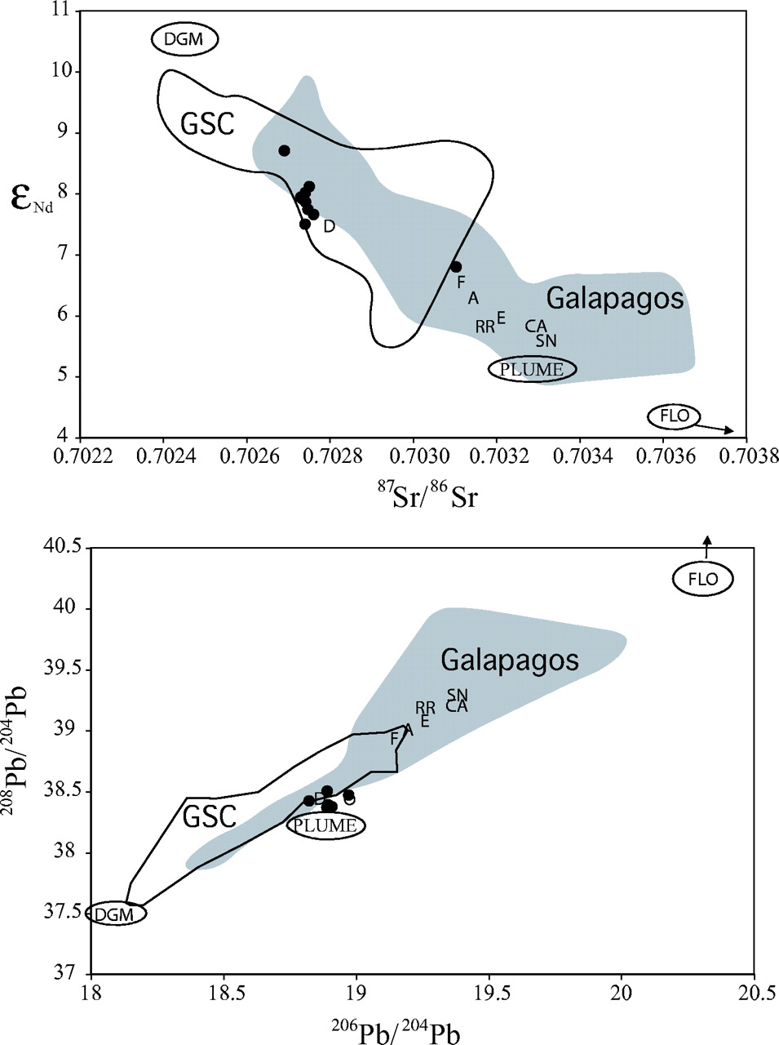
Fig. 5. Sr–Nd–Pb isotopic composition of lavas from Wolf volcano (•), compared with the range for the GSC (Schilling ...
Notes:
Fig. 5. Sr–Nd–Pb isotopic composition of lavas from Wolf volcano (•), compared with the range for the GSC (Schilling et al., 2003) and the entire Galápagos Archipelago (White et al. 1993). Wolf data are those reported in Table 3 and three samples from White et al. (1993); average values are used for samples that were analyzed at both Cornell and WHOI. Mantle source reservoirs assigned by Harpp & White (2001) are DGM, PLUME, and FLO. Average values for the other western Galápagos volcanoes (from White et al., 1993) are indicated by letters (E, Ecuador; F, Fernandina; RR, Roca Redonda; D, Darwin; A, Alcedo; SN, Sierra Negra; CA, Cerro Azul).
Unless provided in the caption above, the following copyright applies to the content of this slide: © The Author 2005. Published by Oxford University Press. All rights reserved. For Permissions, please e-mail: journals.permissions@oxfordjournals.org

Slide 6
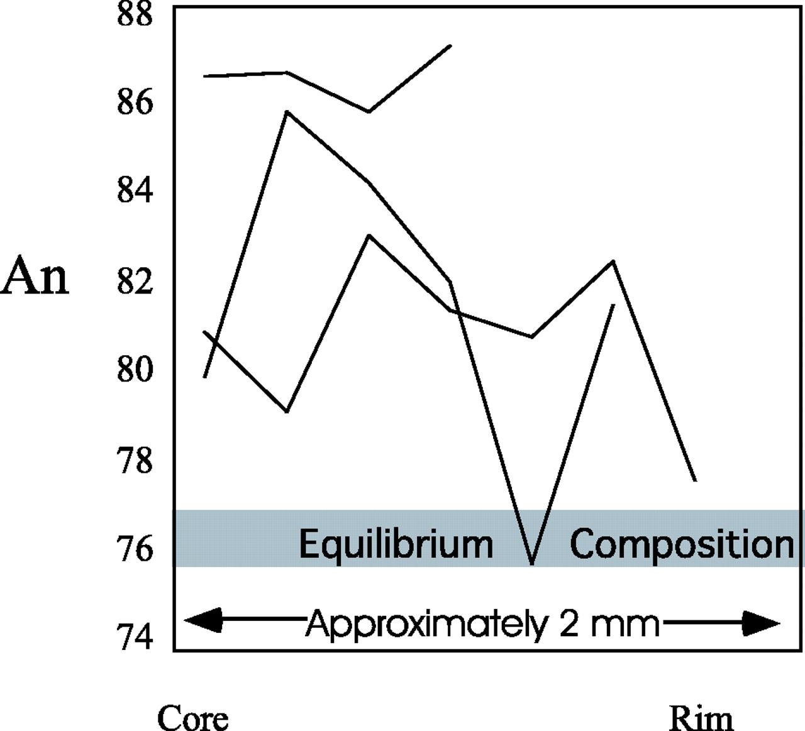
Fig. 6. Zoning profiles across plagioclase grains in sample W95-72, which is a plagioclase-accumulative lava. ...
Notes:
Fig. 6. Zoning profiles across plagioclase grains in sample W95-72, which is a plagioclase-accumulative lava. Plagioclase in equilibrium with a melt with equivalent Mg-number is An76 (as calculated by MELTS, Ghiorso & Sack, 1995).
Unless provided in the caption above, the following copyright applies to the content of this slide: © The Author 2005. Published by Oxford University Press. All rights reserved. For Permissions, please e-mail: journals.permissions@oxfordjournals.org

Slide 7
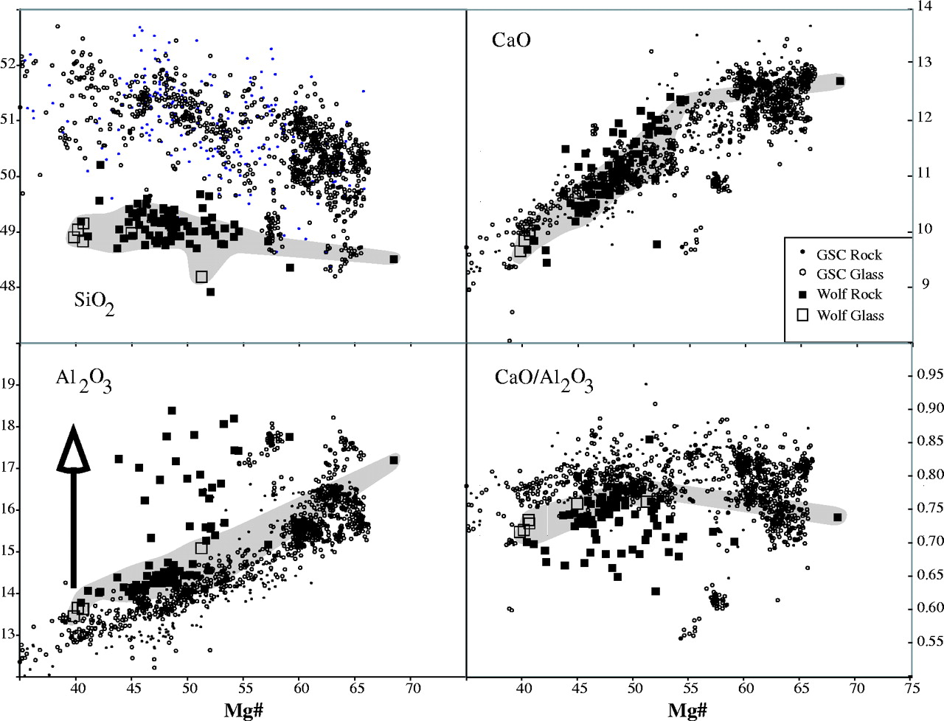
Fig. 7. Major element variation of Wolf lavas compared with those from the GSC (complete dataset of GSC rocks and ...
Notes:
Fig. 7. Major element variation of Wolf lavas compared with those from the GSC (complete dataset of GSC rocks and glasses compiled from PETDB database at http://www.petdb.org/). Field of non-accumulative Wolf lavas (those with <5% plagioclase phenocrysts) is shown in gray. Arrow on Al2O3 diagram indicates the compositional effect of adding 20% plagioclase.
Unless provided in the caption above, the following copyright applies to the content of this slide: © The Author 2005. Published by Oxford University Press. All rights reserved. For Permissions, please e-mail: journals.permissions@oxfordjournals.org

Slide 8
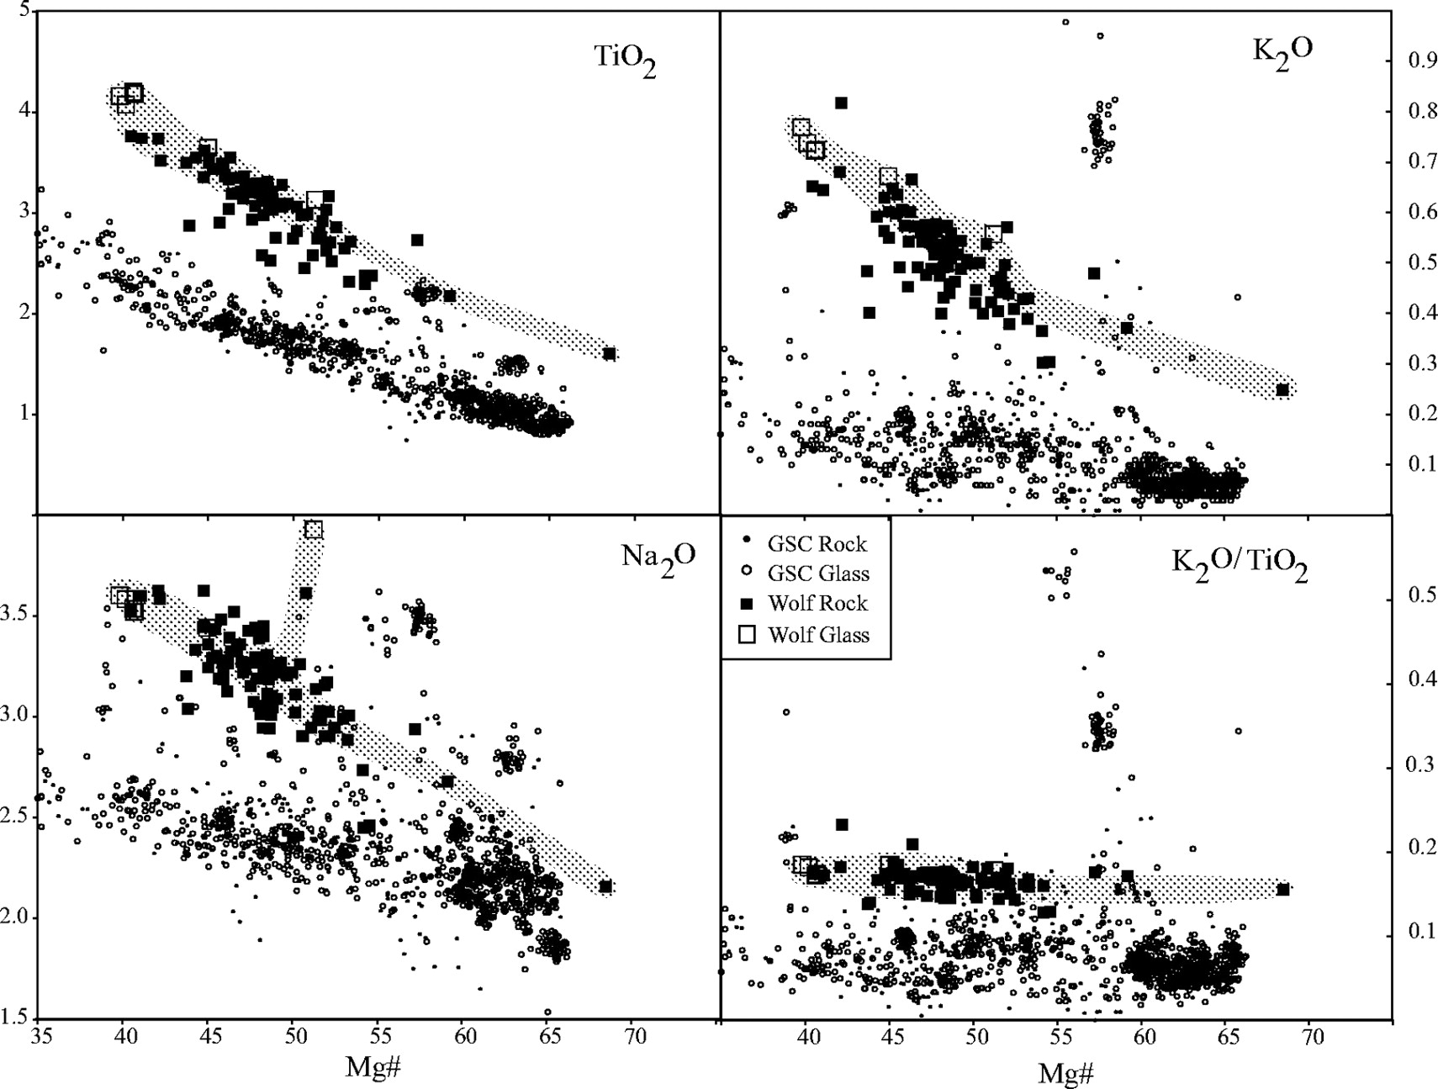
Fig. 7. Major element variation of Wolf lavas compared with those from the GSC (complete dataset of GSC rocks and ...
Notes:
Fig. 7. Major element variation of Wolf lavas compared with those from the GSC (complete dataset of GSC rocks and glasses compiled from PETDB database at http://www.petdb.org/). Field of non-accumulative Wolf lavas (those with <5% plagioclase phenocrysts) is shown in gray. Arrow on Al2O3 diagram indicates the compositional effect of adding 20% plagioclase.
Unless provided in the caption above, the following copyright applies to the content of this slide: © The Author 2005. Published by Oxford University Press. All rights reserved. For Permissions, please e-mail: journals.permissions@oxfordjournals.org

Slide 9
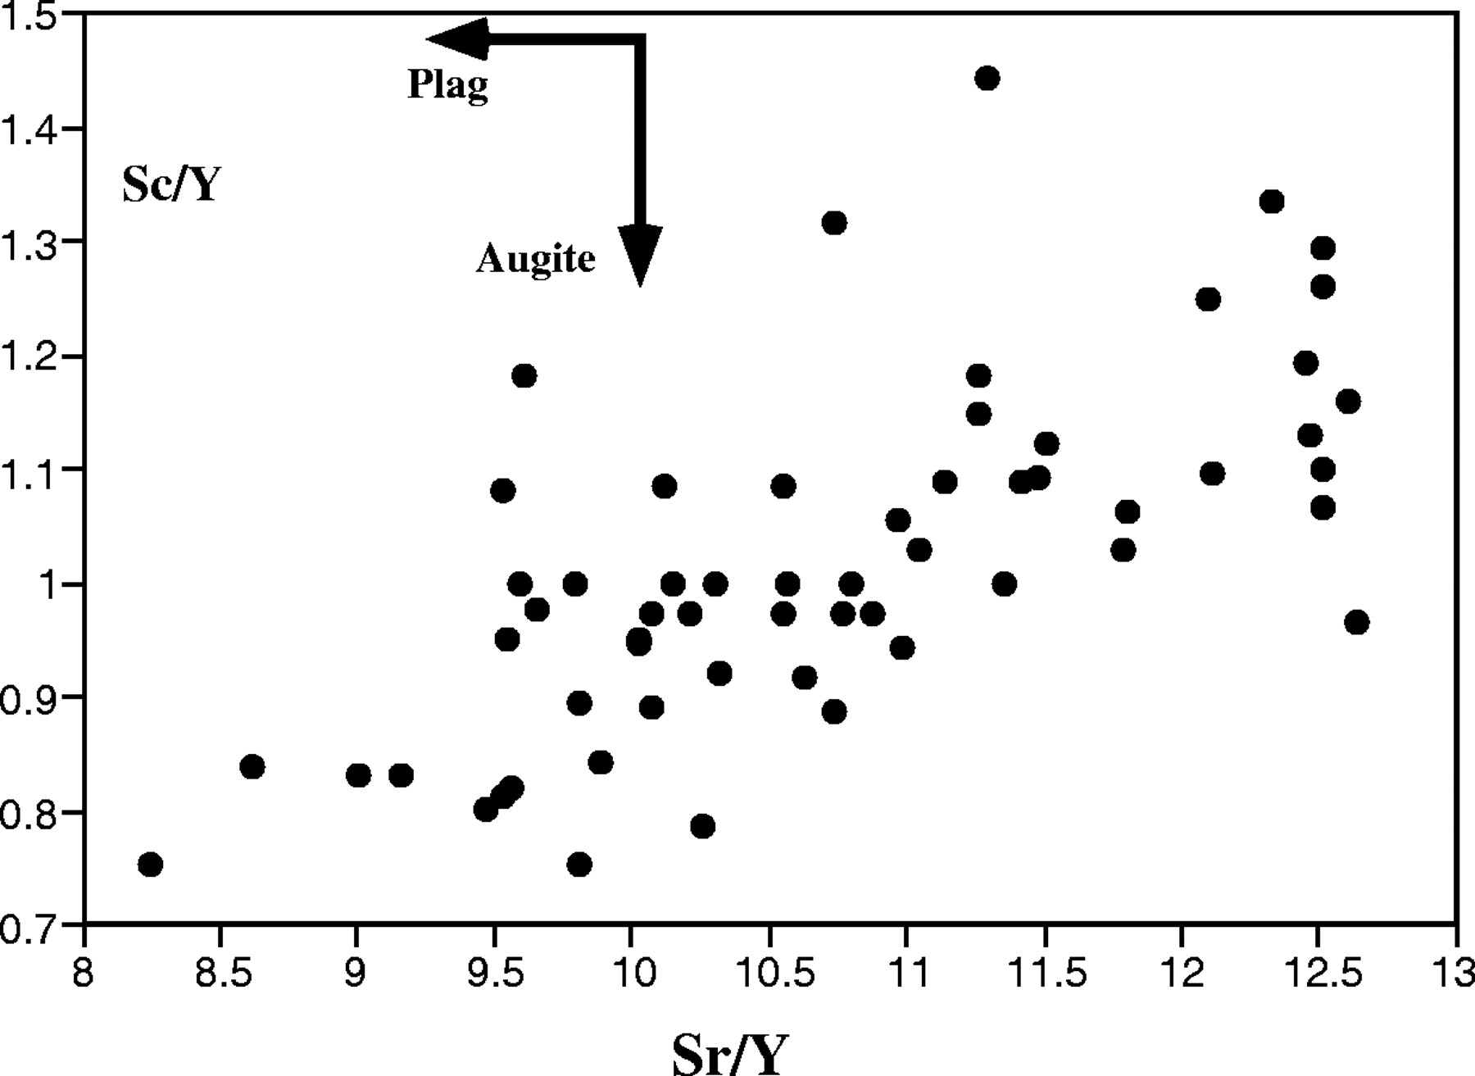
Fig. 8. Sc/Y and Sr/Y distributions in Wolf lavas. The data are explained by cotectic crystallization of ...
Notes:
Fig. 8. Sc/Y and Sr/Y distributions in Wolf lavas. The data are explained by cotectic crystallization of clinopyroxene and plagioclase.
Unless provided in the caption above, the following copyright applies to the content of this slide: © The Author 2005. Published by Oxford University Press. All rights reserved. For Permissions, please e-mail: journals.permissions@oxfordjournals.org

Slide 10
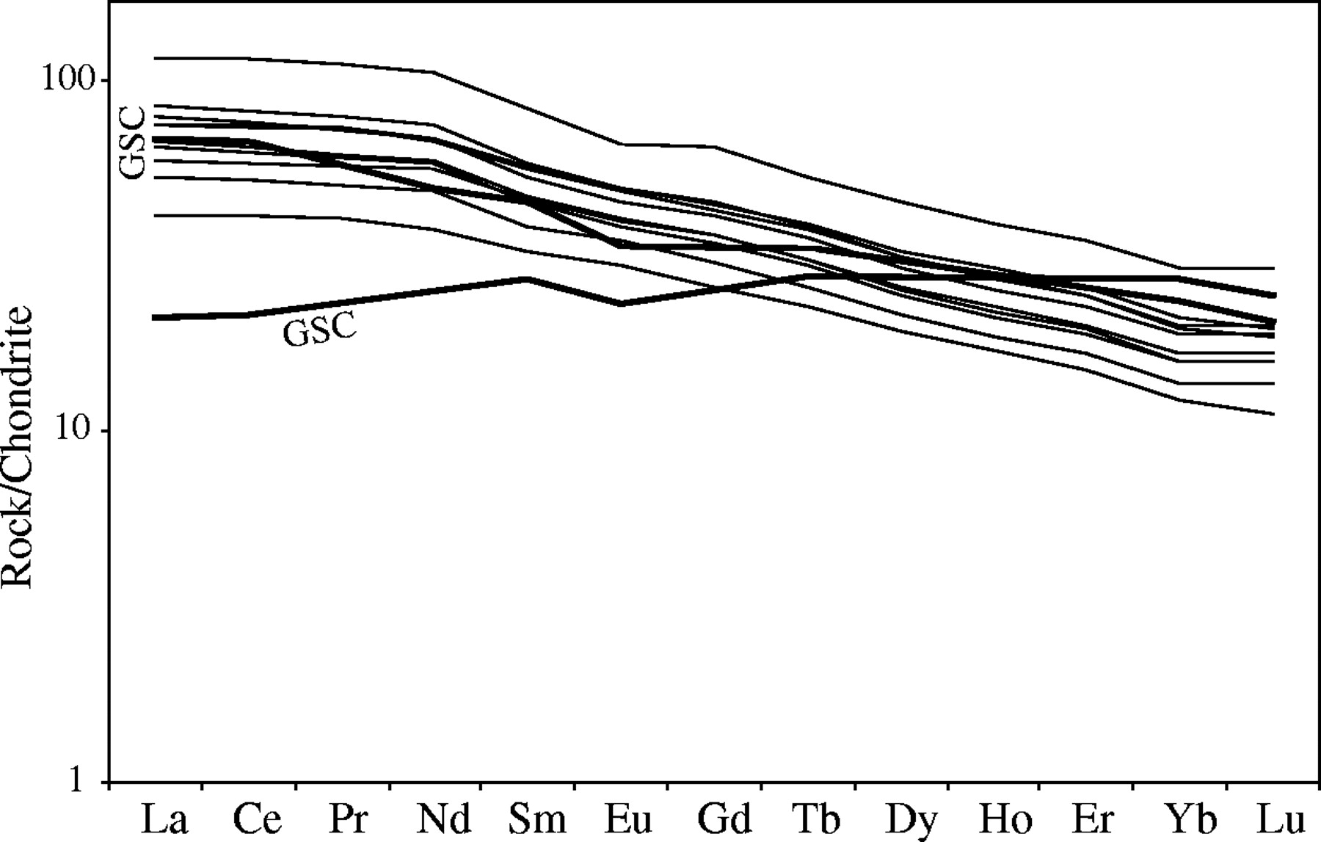
Fig. 9. Rare earth element compositions of Wolf lavas, compared with two samples of MORB from the GSC from regions ...
Notes:
Fig. 9. Rare earth element compositions of Wolf lavas, compared with two samples of MORB from the GSC from regions with identical Nd-isotopic compositions at 94·1–94·7°W and 89·1–89·7°W [data from Schilling et al. (1982)].
Unless provided in the caption above, the following copyright applies to the content of this slide: © The Author 2005. Published by Oxford University Press. All rights reserved. For Permissions, please e-mail: journals.permissions@oxfordjournals.org

Slide 11
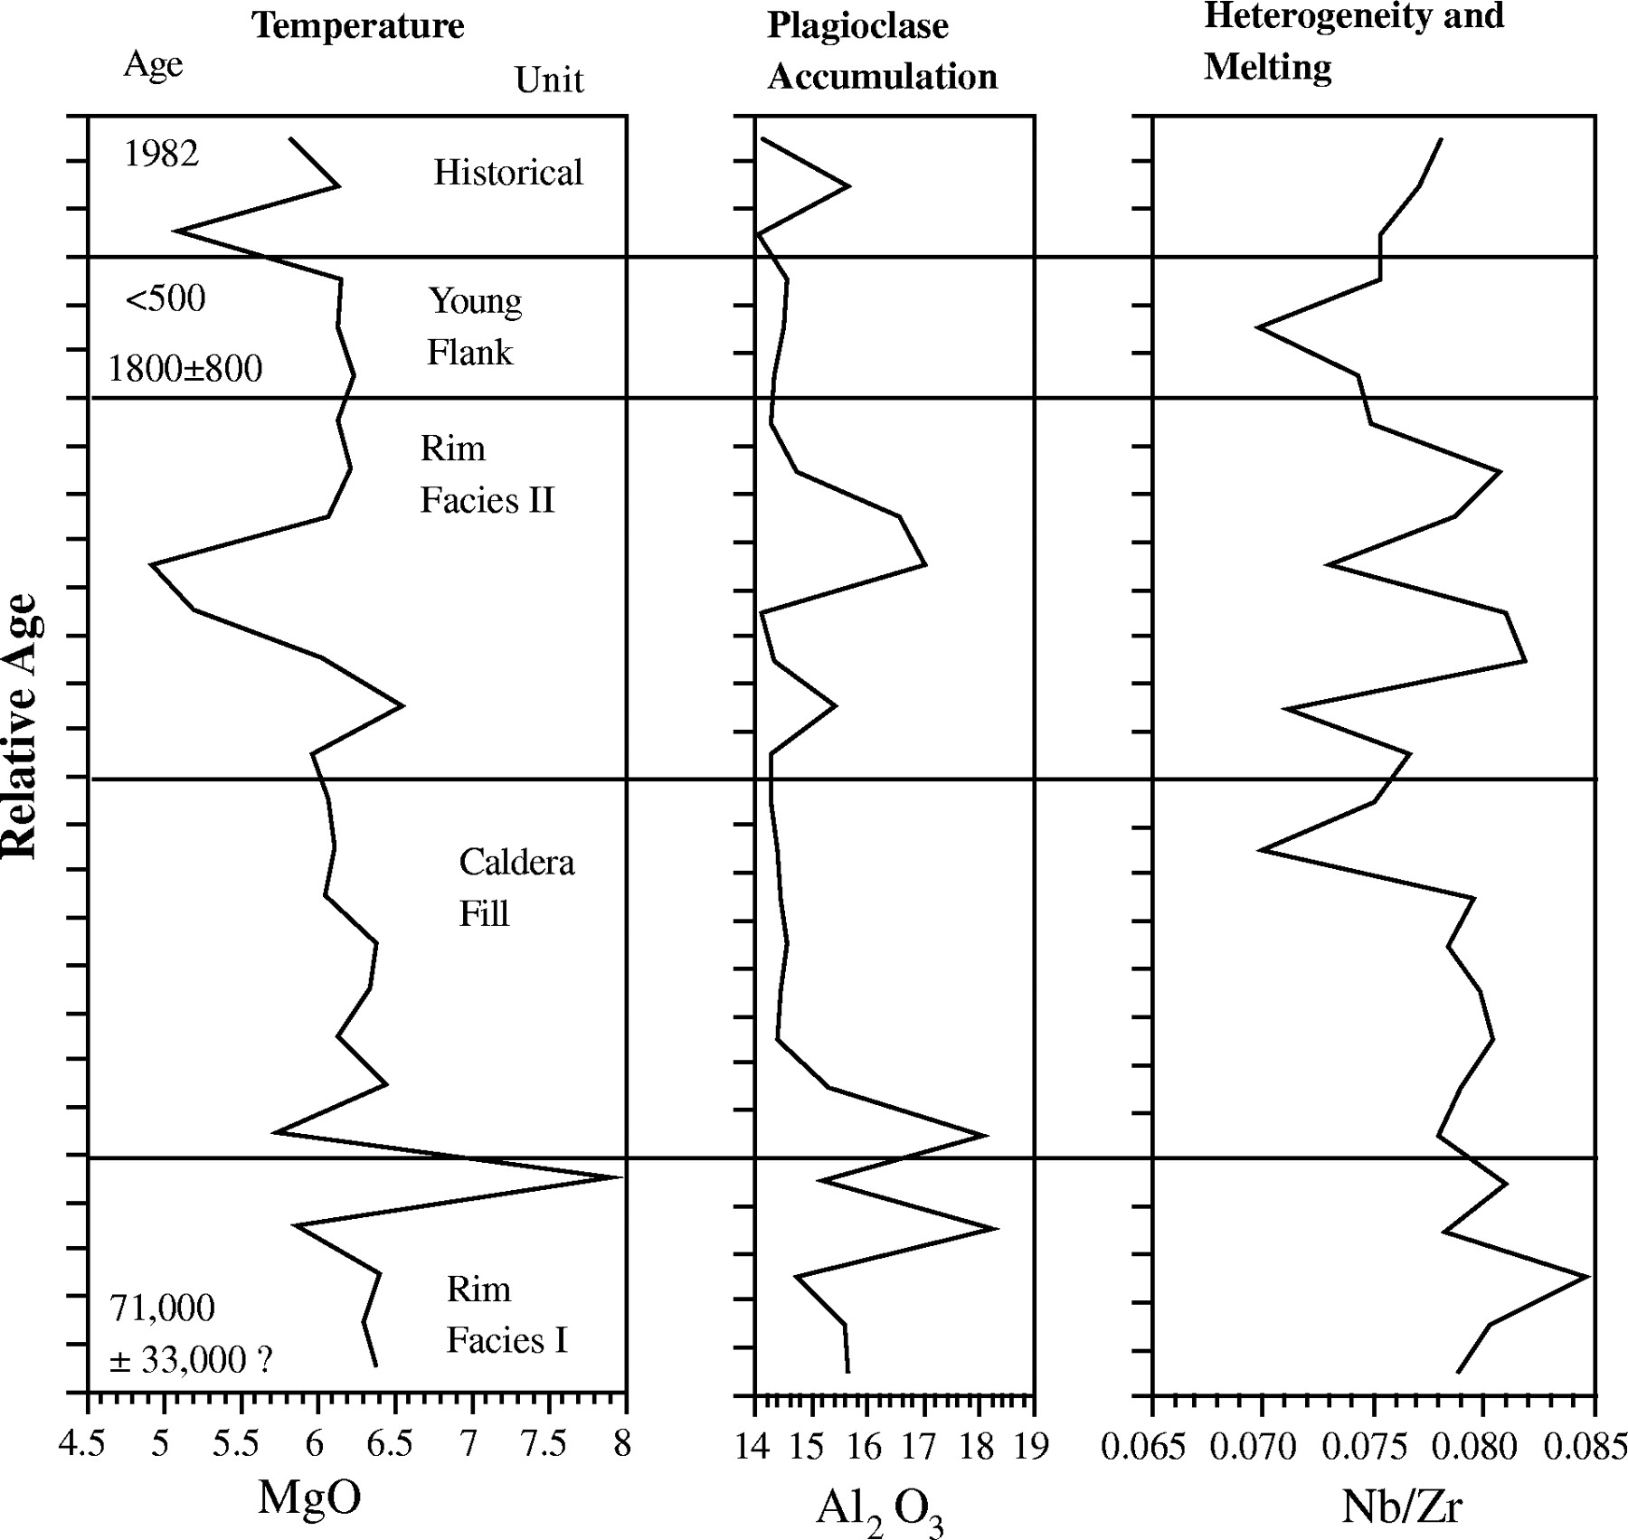
Fig. 10. Stratigraphic variation of MgO (wt %), Al₂O₃ (wt %), and Nb/Zr, based only on those ...
Notes:
Fig. 10. Stratigraphic variation of MgO (wt %), Al2O3 (wt %), and Nb/Zr, based only on those samples whose relative position is known. Boundaries between the units are indicated by horizontal lines, and could represent major breaks in time. Stratigraphic position of samples with age determinations (Table 4) is shown.
Unless provided in the caption above, the following copyright applies to the content of this slide: © The Author 2005. Published by Oxford University Press. All rights reserved. For Permissions, please e-mail: journals.permissions@oxfordjournals.org

Slide 12
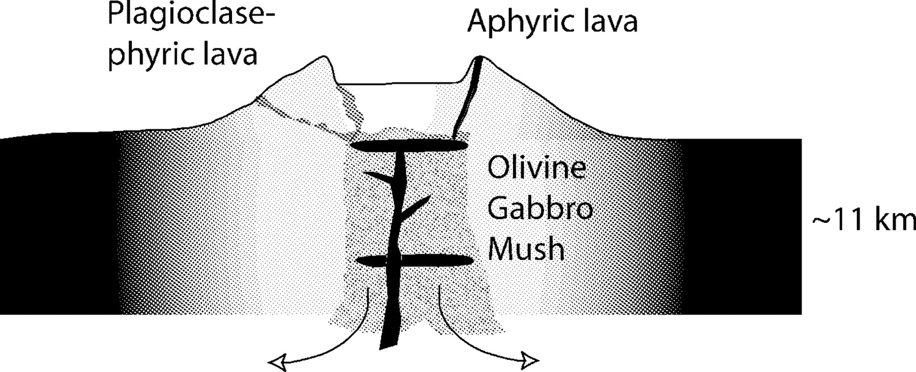
Fig. 11. Conceptual model of the Wolf magmatic plumbing system. Hot magma reacts with olivine gabbro mush, buffering ...
Notes:
Fig. 11. Conceptual model of the Wolf magmatic plumbing system. Hot magma reacts with olivine gabbro mush, buffering temperature and composition. The last stage of evolution is in a shallow sill, where plagioclase floats, and olivine, augite, and plagioclase are deposited on the floor. Plagioclase-phyric magmas rarely erupt from summit vents but are common on the flanks and caldera floor.
Unless provided in the caption above, the following copyright applies to the content of this slide: © The Author 2005. Published by Oxford University Press. All rights reserved. For Permissions, please e-mail: journals.permissions@oxfordjournals.org

Slide 13
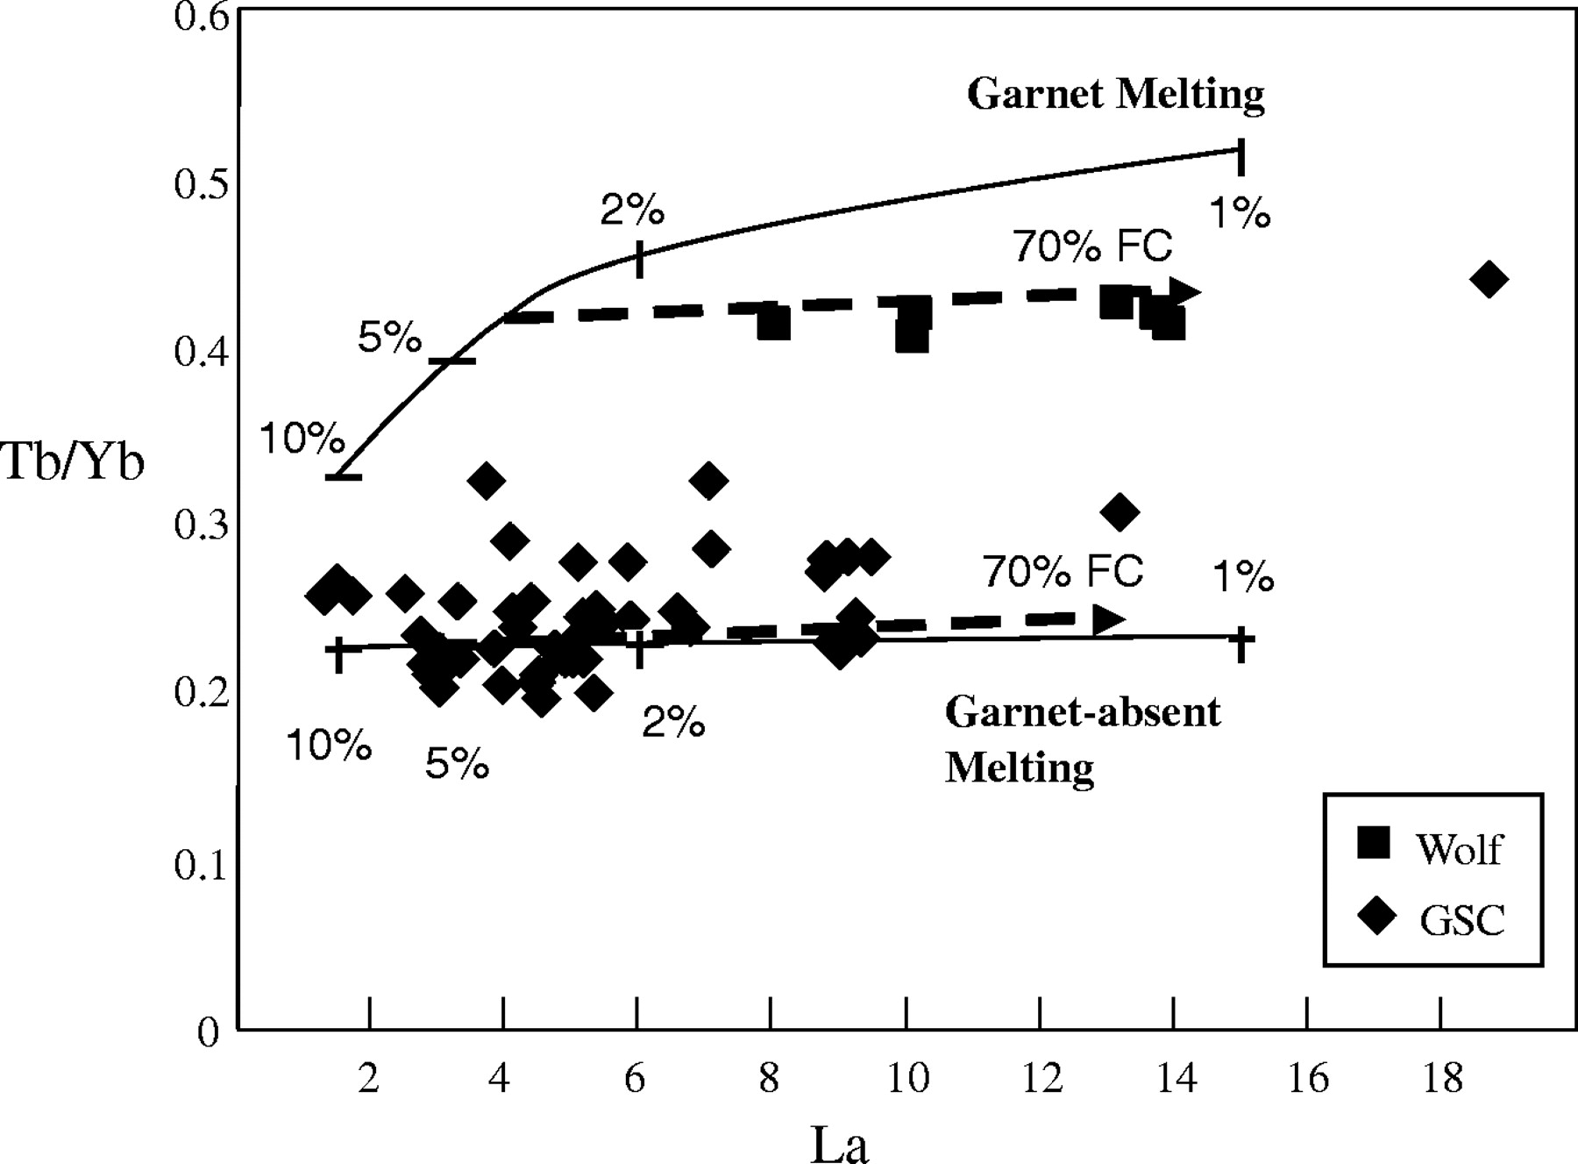
Fig. 12. Tb/Yb vs La illustrating HREE fractionation differences between Wolf volcano and GSC lavas. GSC magmas are ...
Notes:
Fig. 12. Tb/Yb vs La illustrating HREE fractionation differences between Wolf volcano and GSC lavas. GSC magmas are modeled as batch modal partial melts of a lherzolite source with 20% clinopyroxene and 30% orthopyroxene. The Wolf magmas are effectively modeled by lower extents of partial melting of the same source, but with 5% garnet. Tick marks are at 1%, 2%, 5%, and 10% melting. Dashed subhorizontal arrows indicate the effects of 70% fractional crystallization (FC). Distribution coefficients are those of McKenzie & O'Nions (1991).
Unless provided in the caption above, the following copyright applies to the content of this slide: © The Author 2005. Published by Oxford University Press. All rights reserved. For Permissions, please e-mail: journals.permissions@oxfordjournals.org

Slide 14
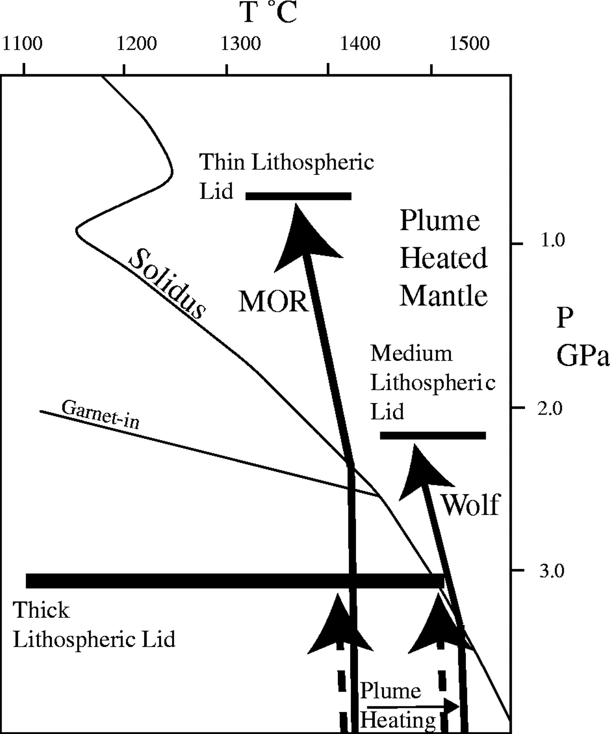
Fig. 13. Schematic model for partial melting at the margins of a mantle plume. Mantle solidus and garnet stability ...
Notes:
Fig. 13. Schematic model for partial melting at the margins of a mantle plume. Mantle solidus and garnet stability curves are from Asimow et al. (2001). Two differences are critical between melting at the GSC and beneath Wolf. First, at deep levels, the ambient mantle is heated by the plume beneath Wolf; this causes the mantle beneath Wolf to intersect the solidus in the presence of garnet. Second, a thicker lithospheric lid at Wolf compared with the GSC prevents mantle upwelling to shallower levels, and the extent of melting is lower. In the mid-plate setting, where the lithosphere is thick enough, melting does not occur in either the ambient mantle or the plume-heated mantle case.
Unless provided in the caption above, the following copyright applies to the content of this slide: © The Author 2005. Published by Oxford University Press. All rights reserved. For Permissions, please e-mail: journals.permissions@oxfordjournals.org

