Slide 1
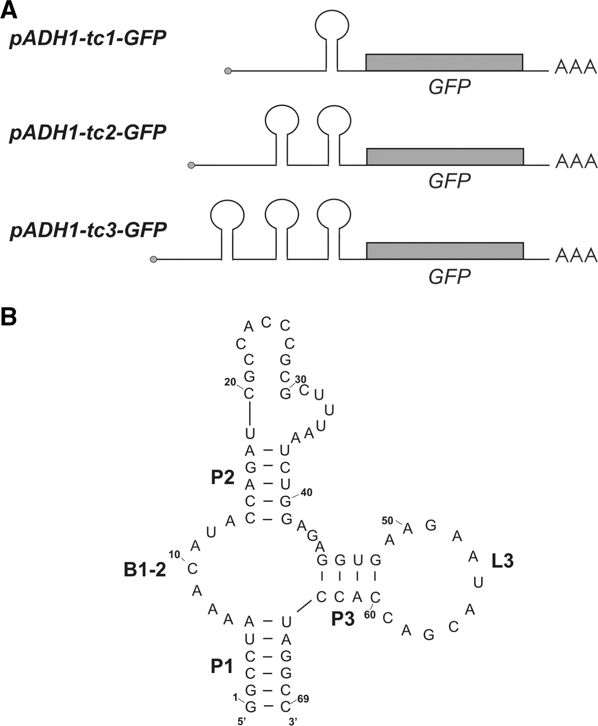
Figure 1. Tc aptamer-mediated translational inhibition. (A) Schematic view of the aptamer-containing mRNAs. The cap ...
Notes:
Figure 1. Tc aptamer-mediated translational inhibition. (A) Schematic view of the aptamer-containing mRNAs. The cap structure is shown as a ball. (B) Secondary structure of the tc aptamer [stem = pedestal (P), bulge (B) and loop (L)]. B1-2 and L3 are important for tc binding as it is supported by structural probing (34) and the crystal structure (35).
Unless provided in the caption above, the following copyright applies to the content of this slide: © 2009 The Author(s)This is an Open Access article distributed under the terms of the Creative Commons Attribution Non-Commercial License (http://creativecommons.org/licenses/by-nc/2.0/uk/) which permits unrestricted non-commercial use, distribution, and reproduction in any medium, provided the original work is properly cited.

Slide 2
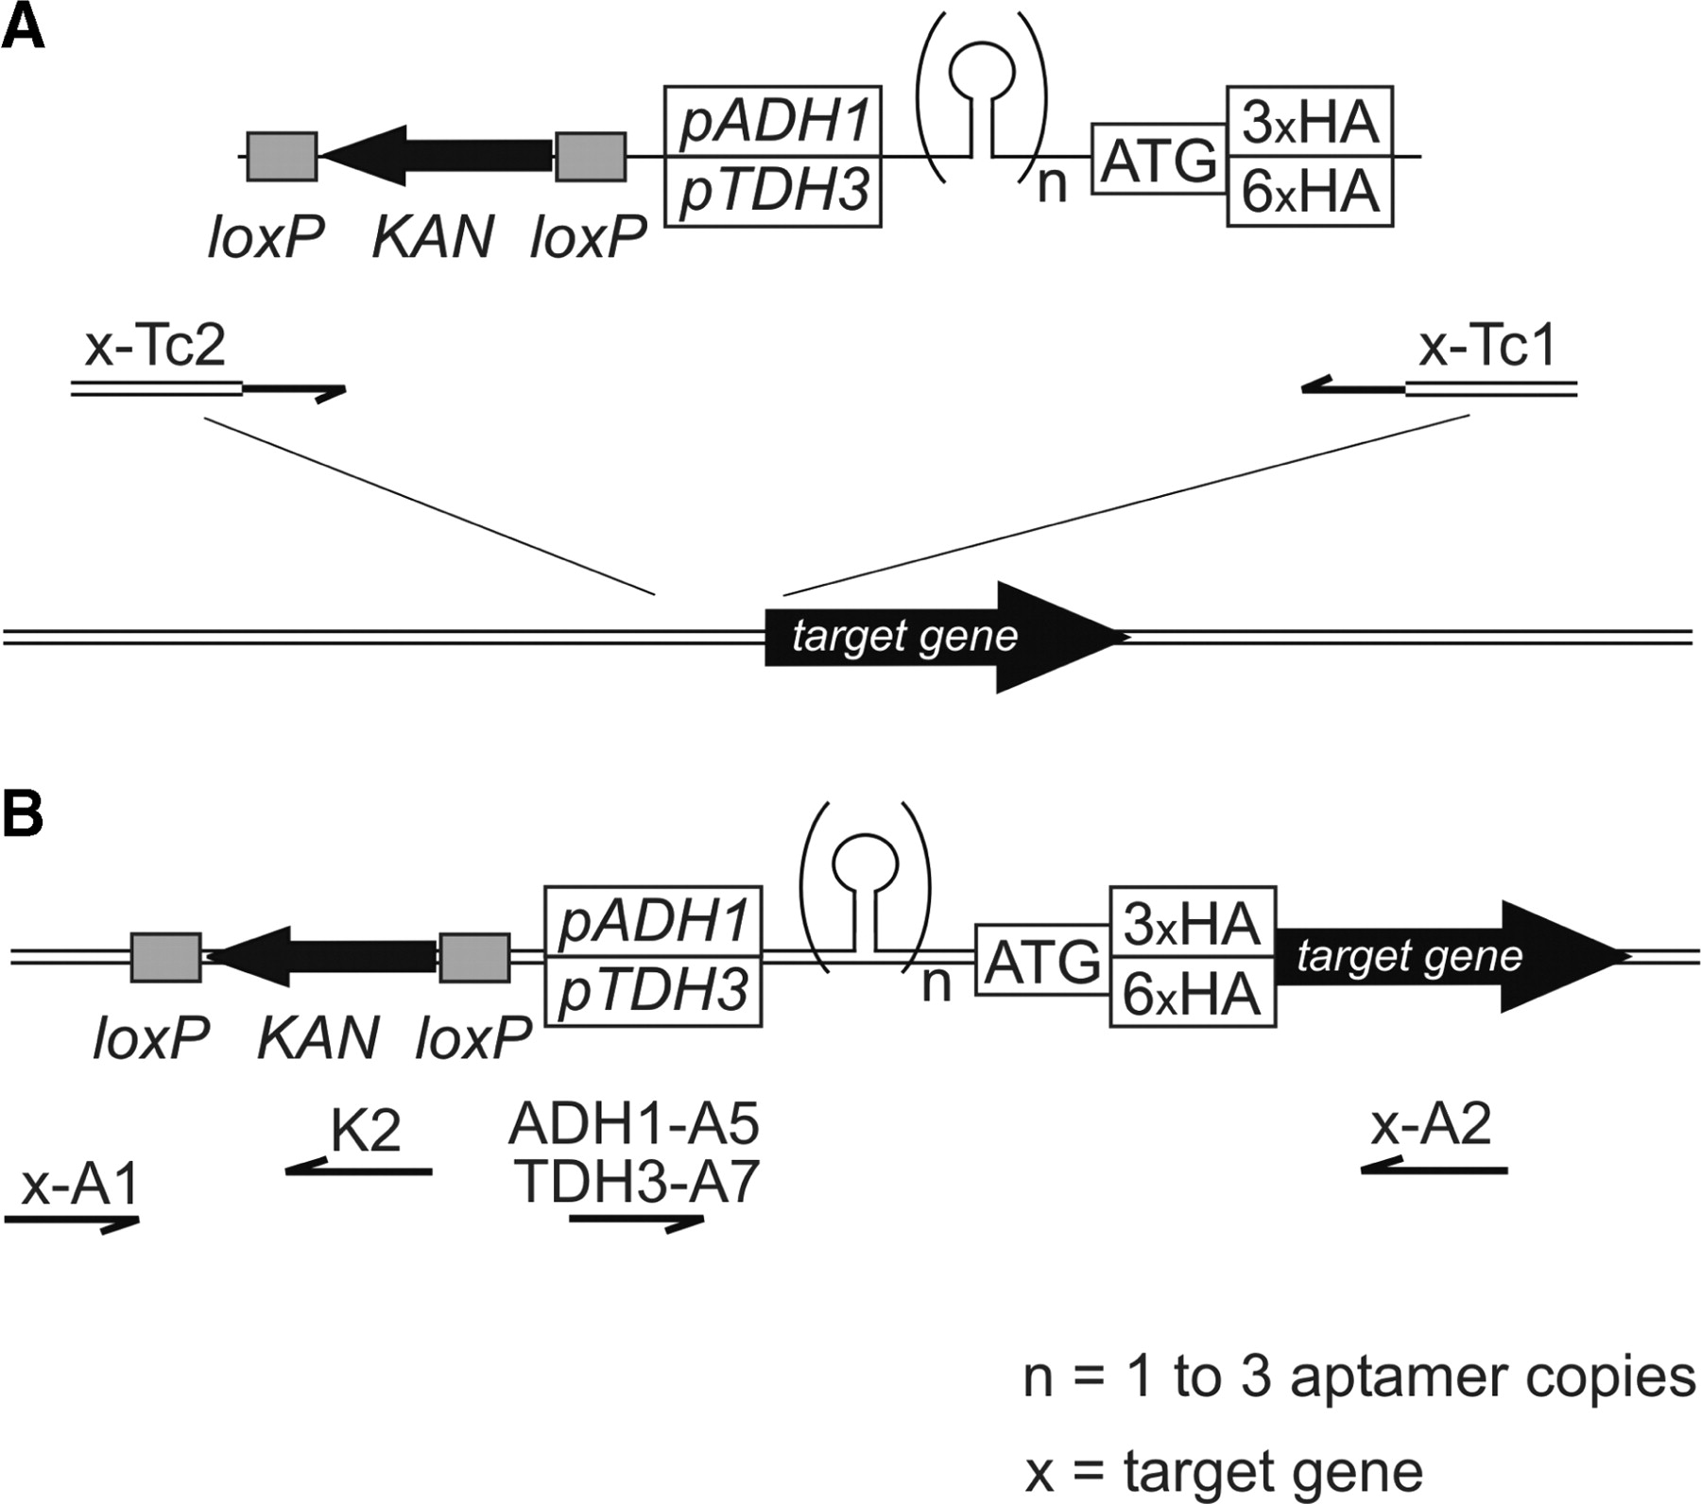
Figure 2. Universal insertion cassettes for tc aptamer-mediated regulation. (A) Schematic representation of the ...
Notes:
Figure 2. Universal insertion cassettes for tc aptamer-mediated regulation. (A) Schematic representation of the insertion cassette with a kanamycin-resistance gene (KAN; kanMX4 modul) flanked by loxP sites. The promoters pADH1 or pTDH3 are fused to a synthetic 5′UTR with n copies of the tc aptamer (n = 1, 2 and 3, respectively) followed by an HA-tag (either 3xHA or 6xHA) for protein quantification. All plasmid-encoded insertion cassettes can be PCR amplified with a single pair of target gene specific primers (x-Tc1 and x-Tc2). x-Tc2 shares 40-nt homology with the promoter and x-Tc1 40-nt homology with the open reading frame of the target gene. The double line represents the target chromosomal locus. (B) Chromosomal situation after integration. The gene of interest is expressed by a heterologous promoter (either pADH1 or pTDH3) and controlled by n copies of the tc aptamer in its 5′UTR. Primers to control successful integration are indicated.
Unless provided in the caption above, the following copyright applies to the content of this slide: © 2009 The Author(s)This is an Open Access article distributed under the terms of the Creative Commons Attribution Non-Commercial License (http://creativecommons.org/licenses/by-nc/2.0/uk/) which permits unrestricted non-commercial use, distribution, and reproduction in any medium, provided the original work is properly cited.

Slide 3
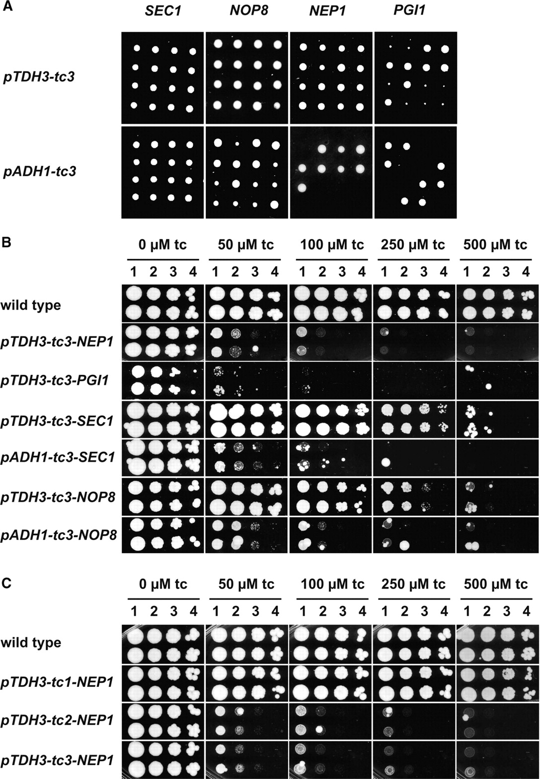
Figure 3. Tc aptamer-regulated expression of essential genes. (A) Segregation pattern of tc aptamer-regulated genes ...
Notes:
Figure 3. Tc aptamer-regulated expression of essential genes. (A) Segregation pattern of tc aptamer-regulated genes after tetrad analysis. Diploid strain CEN.PK122 was transformed with the tc aptamer insertion cassettes resulting in a heterozygous strain carrying a wild type and a tc aptamer modified allele of the target gene. After meiosis, the viability of the tc-regulated target genes was followed by tetrad dissection. For the pTDH3-driven constructs, four viable segregants were obtained for all target genes (upper four lanes). No viable segregants were obtained for the pADH1-driven PGI1 and NEP1 (2:2 segregation). (B) Growth dilution assays were performed for wild-type and insertion mutants. Cultures were grown overnight in YPD medium and diluted to a final density of OD600 of 1.0 (1). Ten-fold serial dilutions (corresponding to 2, 3 and 4) were spotted on YPD medium with increasing concentrations of tc. Colonies were grown for three days at 30°C. (C) Regulation of a pTDH3-driven NEP1 gene with one (pTDH3-tc1-NEP1), two (pTDH3-tc2-NEP1) or three (pTDH3-tc3-NEP1) copies of the tc aptamer.
Unless provided in the caption above, the following copyright applies to the content of this slide: © 2009 The Author(s)This is an Open Access article distributed under the terms of the Creative Commons Attribution Non-Commercial License (http://creativecommons.org/licenses/by-nc/2.0/uk/) which permits unrestricted non-commercial use, distribution, and reproduction in any medium, provided the original work is properly cited.

Slide 4
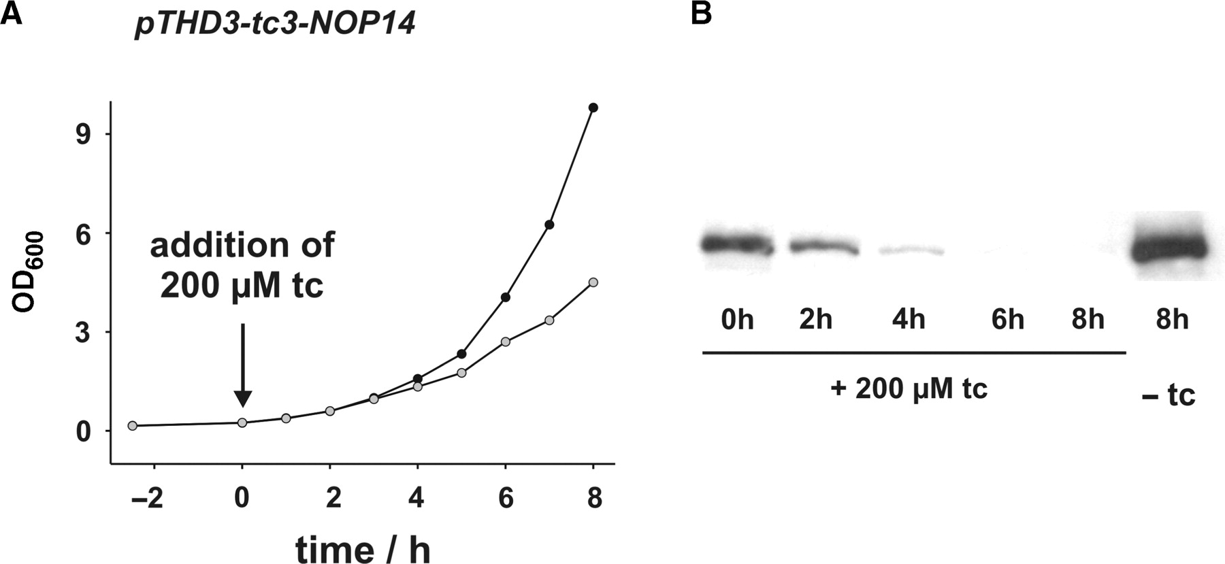
Figure 4. Repression kinetic of tc aptamer-controlled NOP14 expression. (A) Growth curves of a strain with NOP14 ...
Notes:
Figure 4. Repression kinetic of tc aptamer-controlled NOP14 expression. (A) Growth curves of a strain with NOP14 regulated by the tc aptamer (pTHD3-tc3-NOP14). A culture was diluted to an OD600 of 0.1 in YPD media and incubated for 2.5 h at 30°C. After splitting, one aliquot was treated with 200 µM tc. Growth was followed for 8 h (black dots, no tc, gray dots, 200 µM tc). (B) Samples were taken at indicated time points after treatment with tc and Nop14-HA protein amounts determined by western blot analysis.
Unless provided in the caption above, the following copyright applies to the content of this slide: © 2009 The Author(s)This is an Open Access article distributed under the terms of the Creative Commons Attribution Non-Commercial License (http://creativecommons.org/licenses/by-nc/2.0/uk/) which permits unrestricted non-commercial use, distribution, and reproduction in any medium, provided the original work is properly cited.

Slide 5
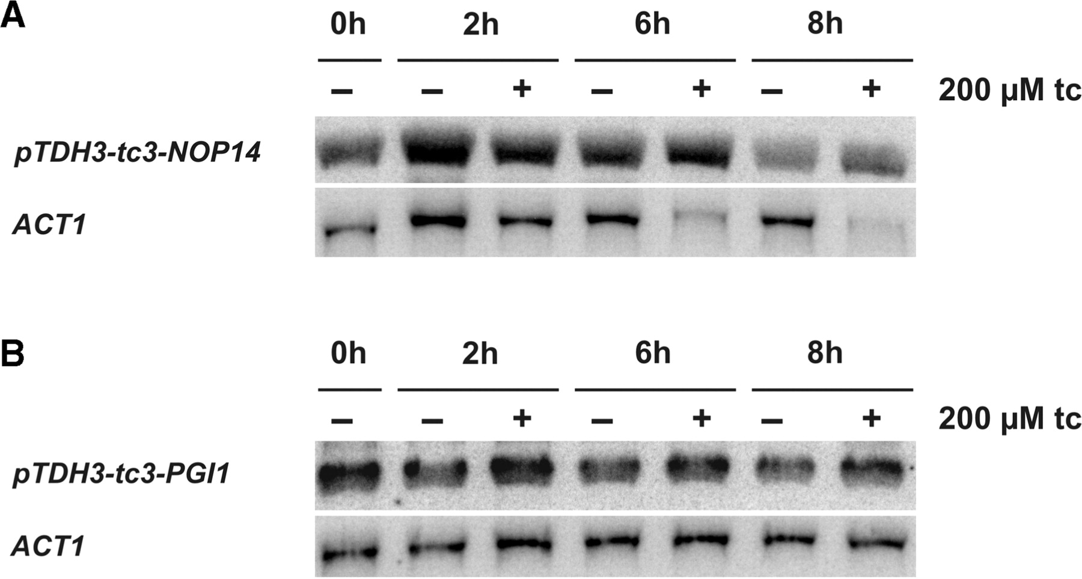
Figure 5. Northern blot analysis of tc aptamer-controlled NOP14 and PGI1 expression. Strains with (A) ...
Notes:
Figure 5. Northern blot analysis of tc aptamer-controlled NOP14 and PGI1 expression. Strains with (A) pTDH3-tc3-3HA-NOP14 and (B) pTDH3-tc3-3HA-PGI1 were grown in YPD media (NOP14) and YPF (PGI1), respectively. Overnight cultures were grown to an OD600 of 0.4 at 30°C. After splitting, one aliquot was treated with 200 µM tc. Samples were taken at indicated time points after treatment with tc and total RNA was prepared. mRNA amounts of NOP14 and PGI1 were determined by northern blot analysis. Actin mRNA (ACT1) was used as internal control.
Unless provided in the caption above, the following copyright applies to the content of this slide: © 2009 The Author(s)This is an Open Access article distributed under the terms of the Creative Commons Attribution Non-Commercial License (http://creativecommons.org/licenses/by-nc/2.0/uk/) which permits unrestricted non-commercial use, distribution, and reproduction in any medium, provided the original work is properly cited.

