Slide 1
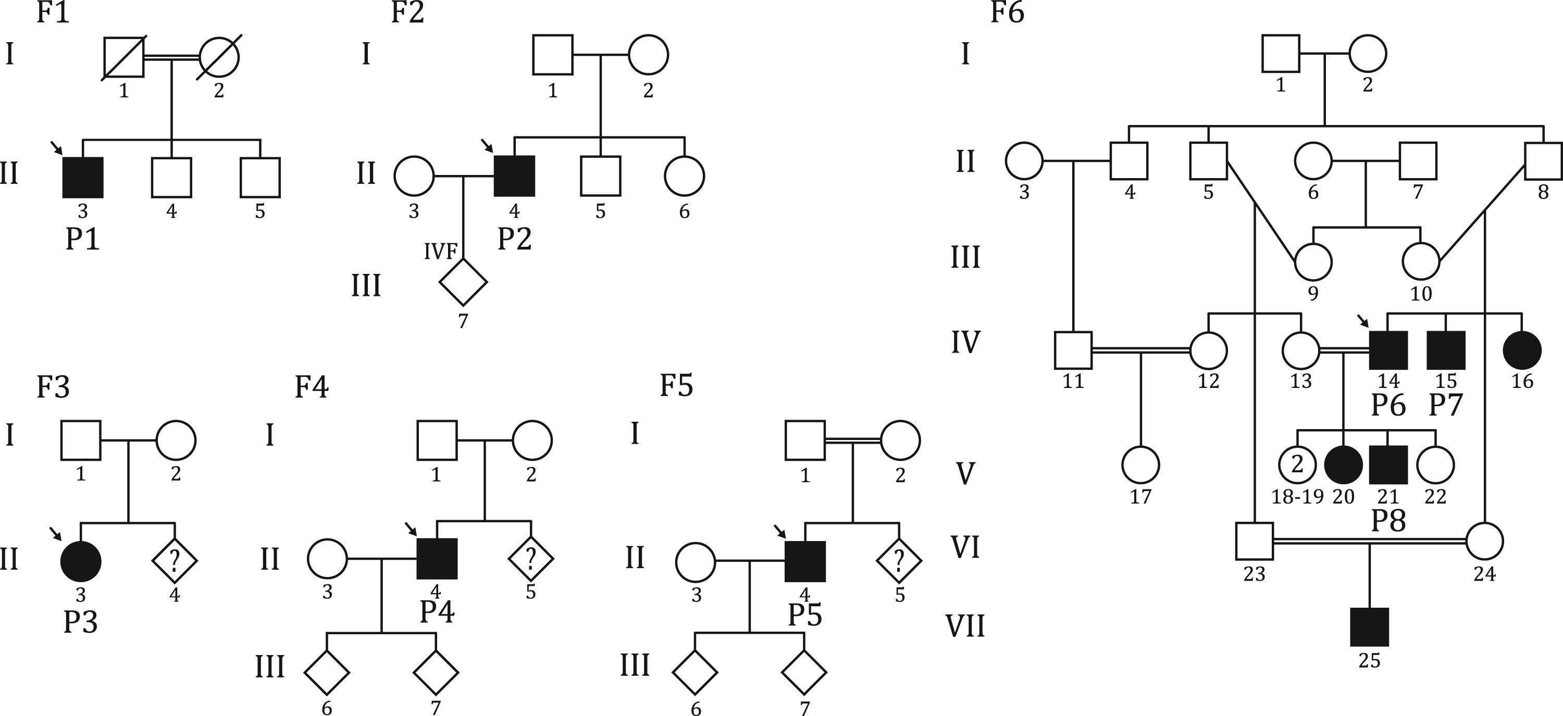
Figure 1 Pedigrees from families with pathogenic TTLL5 variants. The probands are: subject P1 [II:3, family F1; ...
Notes:
Figure 1 Pedigrees from families with pathogenic TTLL5 variants. The probands are: subject P1 [II:3, family F1; c.1782del;p.(Asp594Glufs*29)], subject P2 [II:4, family F2; c.349C > T;p.(Gln117*)], subject P3 [II:3, family F3; c.2132_2133insGATA;p.(Met712IleAspfs*15)], subject P4 [II:4, family F4; c.1627G > A;p.(Glu543Lys)], subject P5 [II:4, family F5; c.2266A > T;p.(Ile756Phe)], and subject P6 [IV:14, family F6; c.1627G > A;p.(Glu543Lys)].
Unless provided in the caption above, the following copyright applies to the content of this slide: © The Author 2016. Published by Oxford University Press. All rights reserved. For Permissions, please email: journals.permissions@oup.com

Slide 2
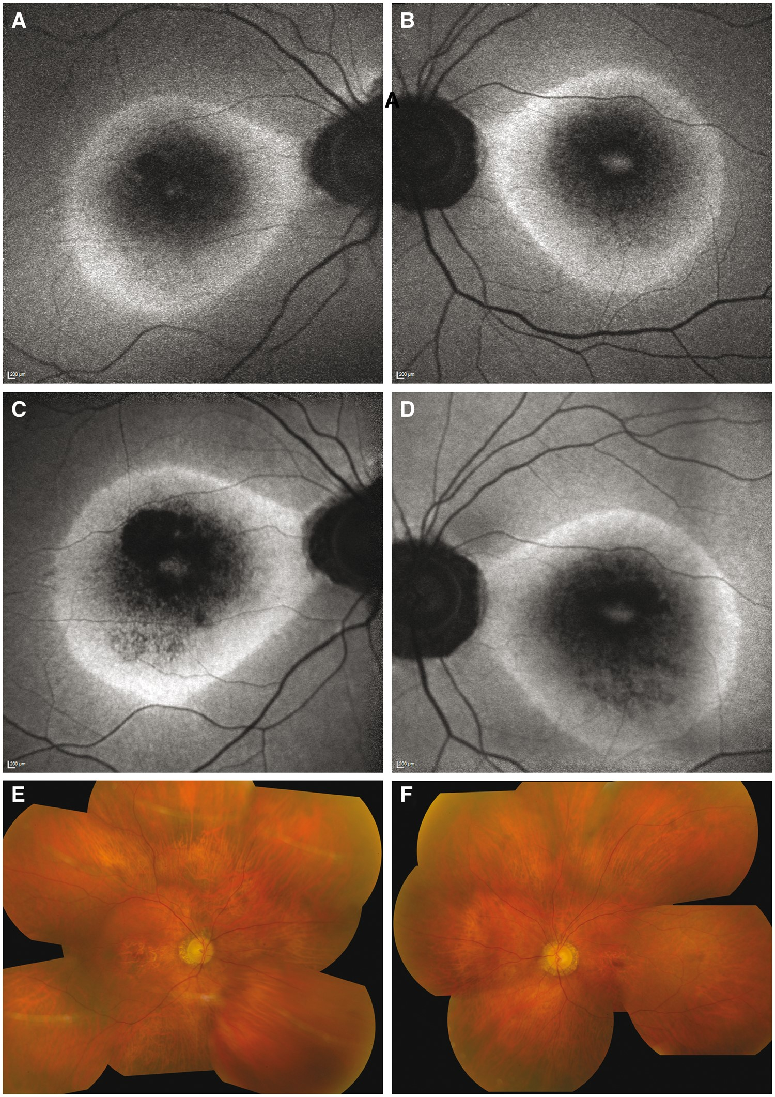
Figure 2 Fundi of index patient P1. Autofluorescence imaging of the right (A) and left (B) eye at age 66 years, ...
Notes:
Figure 2 Fundi of index patient P1. Autofluorescence imaging of the right (A) and left (B) eye at age 66 years, showing a distinctive pattern of abnormalities, including a hyperfluorescent ring and hyperfluorescent area at the fovea surrounded by patchy hypofluorescence in both eyes. Hypofluorescence around the optic nerve was also present. The same images, obtained 6 years later (C,D), showed an increase of hypofluorescent areas within the ring and a mild enlargement of the hyperfluorescent ring in both eyes. Composite pictures of the fundi at age 72, showing atrophic areas around the fovea and around the optic nerve (E,F). Peripheral retina was within normal limits.
Unless provided in the caption above, the following copyright applies to the content of this slide: © The Author 2016. Published by Oxford University Press. All rights reserved. For Permissions, please email: journals.permissions@oup.com

Slide 3
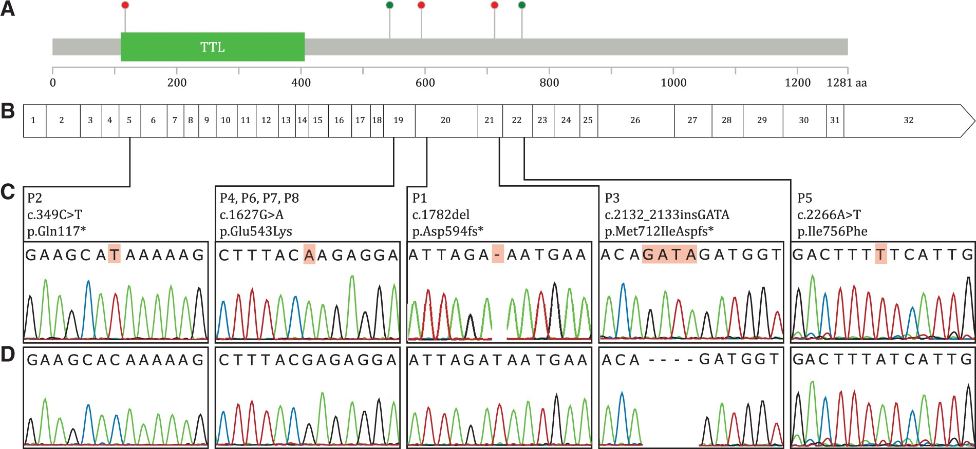
Figure 3 Mutation diagram of the TTLL5 protein (A), and corresponding cDNA. Red and green dots indicate truncating and ...
Notes:
Figure 3 Mutation diagram of the TTLL5 protein (A), and corresponding cDNA. Red and green dots indicate truncating and missense mutations, respectively. Exons are numbered and drawn to scale (B) with respect to the protein sequence. The TTL domain responsible for polyglutamylation activity is indicated. Chromatograms of the mutations identified (C), compared to their relevant wild type sequences (D).
Unless provided in the caption above, the following copyright applies to the content of this slide: © The Author 2016. Published by Oxford University Press. All rights reserved. For Permissions, please email: journals.permissions@oup.com

Slide 4
Figure 4 Relative expression of TTLL5 isoforms and their expression. TTLL5 has six known alternative transcripts (001, ...
Notes:
Figure 4 Relative expression of TTLL5 isoforms and their expression. TTLL5 has six known alternative transcripts (001, 002, 003, 016, 017, and 018), resulting from the splicing of the exons indicated here in dark grey (A). Their expression within seven different human tissues, measured by quantitative real time PCR, is indicated by both numerical values and shades of grey (B). Although all isoforms seem to be widely expressed, isoform 001 is the most prominent one, among all tissues considered (‘Total’ column). Asterisks show the position of the mutations identified in this work. TTLL5 isoform 001 expression in fibroblasts of the index patient P1 vs. a control, by quantitative PCR (C). TTLL5 mRNA amounts were normalized with respect to the housekeeping gene HPRT1.
Unless provided in the caption above, the following copyright applies to the content of this slide: © The Author 2016. Published by Oxford University Press. All rights reserved. For Permissions, please email: journals.permissions@oup.com

Slide 5
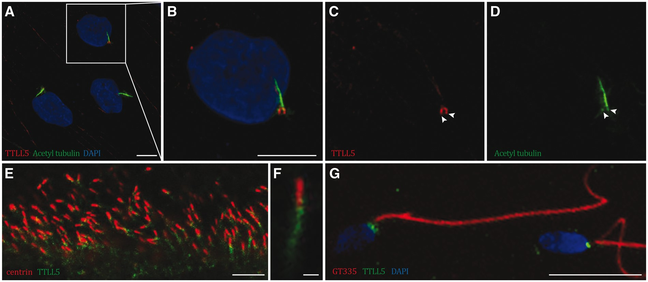
Figure 5 Immunofluorescence staining of ciliated control human skin fibroblasts (A-D). TTLL5 co-localizes with ...
Notes:
Figure 5 Immunofluorescence staining of ciliated control human skin fibroblasts (A-D). TTLL5 co-localizes with acetylated tubulin at the centrioles, as indicated by arrowheads (C,D). Immunofluorescence in rat retina sections (E, and magnified cilium in F) and in control human spermatozoon (G). TTLL5 decorates the basal body in photoreceptors and the centrioles in spermatozoa. Scale bars: A-E, 5 µm; F, 1 µm; G, 20 µm.
Unless provided in the caption above, the following copyright applies to the content of this slide: © The Author 2016. Published by Oxford University Press. All rights reserved. For Permissions, please email: journals.permissions@oup.com

