Slide 1
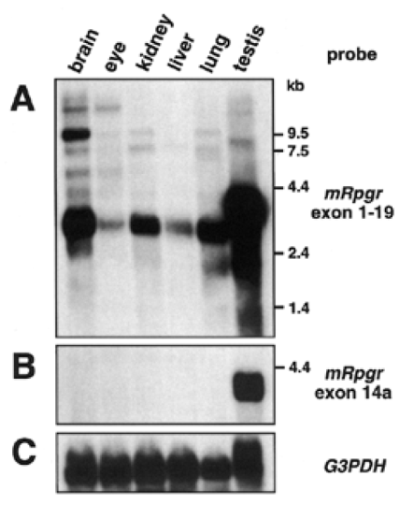
Figure 1 Expression studies of mRpgr in different tissues by northern blot analysis. (A) A full-length probe (exons ...
Notes:
Figure 1 Expression studies of mRpgr in different tissues by northern blot analysis. (A) A full-length probe (exons 1–19) detected signals in every tissue analysed, with main transcripts of 2.7–3.6 kb. The strongest mRpgr expression was observed in testis. In the eye, the ubiquitous transcript of ∼2.7 kb was present in much lower amounts compared with other tissues. Signals of higher molecular weights additionally are observed in all organs, as for example in eye and brain, where bands at 5, 9.5 and ∼20 kb were visible. (B) Hybridization of exon 14a of mRpgr revealed the 3.6 kb transcript in testis, but no signals in other tissues. (C) Hybridization of G3PDH as a control probe indicates equal amounts of poly(A)+ RNA in each lane.
Unless provided in the caption above, the following copyright applies to the content of this slide: © 1999 Oxford University Press

Slide 2
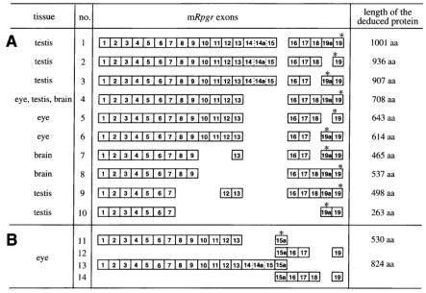
Figure 2 Mouse Rpgr mRNA isoforms isolated from brain, testis and eye cDNAs are depicted schematically in this figure. ...
Notes:
Figure 2 Mouse Rpgr mRNA isoforms isolated from brain, testis and eye cDNAs are depicted schematically in this figure. The tissue source of each isoform is indicated in the left column. In the right column, the length of the deduced protein sequence of each isoform is shown. Stop codons are indicated by asterisks (*). (A) Isoforms isolated from mouse brain, testis and eye RNA by a long-range PCR approach with primers in exons 1 and 19. (B) Isoforms isolated from mouse eye RNA by long-range PCR with primers in exons 1 and 15a (isoforms 11 and 13) and with primers in exons 15a and 19 (isoforms 12 and 14). aa, amino acids.
Unless provided in the caption above, the following copyright applies to the content of this slide: © 1999 Oxford University Press

Slide 3
Figure 3 Human RPGR mRNA isoforms isolated from testis and retina RNA by a long-range PCR approach with primers in ...
Notes:
Figure 3 Human RPGR mRNA isoforms isolated from testis and retina RNA by a long-range PCR approach with primers in exons 3 and 19 are drawn schematically. Exons 1 and 2 were added to the isoforms, although they were not amplified in this PCR experiment. Stop codons are indicated by asterisks (*). In testis, two isoforms were identified that differ in the length of their ORFs through alternative splicing of exons 14 and 15. The splice variant isolated from retina RNA contains a novel exon 15a that introduces a premature stop codon and shortens the ORF to 646 amino acids (aa).
Unless provided in the caption above, the following copyright applies to the content of this slide: © 1999 Oxford University Press

Slide 4
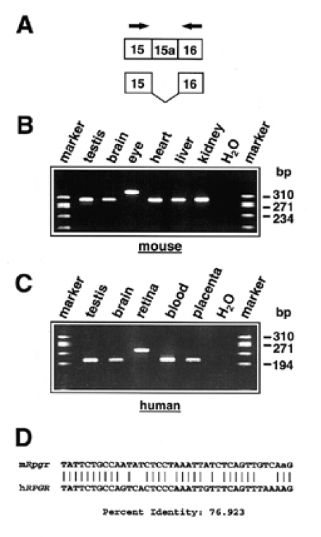
Figure 4 Analysis of exon 15a expression by RT-PCR in mouse and human tissues. (A) Primers for exon 15a amplification ...
Notes:
Figure 4 Analysis of exon 15a expression by RT-PCR in mouse and human tissues. (A) Primers for exon 15a amplification were located in exons 15 and 16 as indicated by arrows. (B) RT-PCR on various mouse tissues demonstrated exon 15a expression in the eye only. The obtained PCR product comprises 340 bp with, and 301 bp without, exon 15a. (C) Human exon 15a was amplified from retina RNA only. A product of 245 bp corresponds to the isoform with exon 15a, and a 206 bp product corresponds to the isoform without exon 15a. (D) Alignment of the mouse and human exon 15a sequence, generated with the GCG program BESTFIT, reveals an identity ofnearly 77% of the two exons.
Unless provided in the caption above, the following copyright applies to the content of this slide: © 1999 Oxford University Press

Slide 5
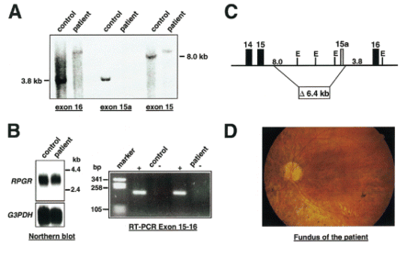
Figure 5 Molecular and ophthalmological characterization of an RP patient. (A) Hybridization of probes from exons 16, ...
Notes:
Figure 5 Molecular and ophthalmological characterization of an RP patient. (A) Hybridization of probes from exons 16, 15a and 15 to EcoRI-digested genomic DNA of the patient and a control. Signals were observed for exons 15 and 16 on the derivative and the native fragments in the patient and the control, whereas the exon 15a probe does not detect the corresponding genomic fragment in the patient. (B) Analysis of RPGR expression in RNA from lymphoblastoid cells of the patient and a healthy control. A northern blot with poly(A)+ RNA was hybridized with a full-length RPGR probe. Both the control and the patient show identical signals. In addition, RT-PCR with primers in exons 15 and 16 revealed a correctly spliced transcript in the patient as well as in the control. (C) Determination of the position of the deletion in the patient. Amplification and sequencing of a breakpoint-spanning fragment revealed the 5′ breakpoint on an 8.0 kb KcoRI fragment ∼1.5 kb downstream of exon 15 and the 3′ breakpoint on a 3.8 kb ficoRI fragment 70 bp downstream of exon 15a. (D) The ocular fundus of the patient at the age of 33 years. Note the constricted arterioles, the diffuse and patchy atrophy of the retinal pigment epithelium, including a bull's eye macular lesion, and some peripheral ‘spicule’ hyperpigmentations.
Unless provided in the caption above, the following copyright applies to the content of this slide: © 1999 Oxford University Press

Slide 6
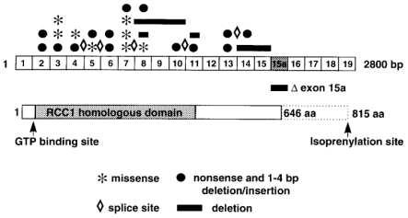
Figure 6 Distribution of mutations in RPGR. All mutations identified so far are located upstream of exon 15a ...
Notes:
Figure 6 Distribution of mutations in RPGR. All mutations identified so far are located upstream of exon 15a (6,8,14–21). Patient 2557 has a deletion of exon 15a only, as shown in this report. As exon 15a introduces a premature stop codon into the ORF, the deduced protein sequence of RPGR shortens from 815 to 646 amino acids (aa). Consequently, the isoprenylation site at the very C-terminus of the protein is not retained when the retina-specific exon 15a is used.
Unless provided in the caption above, the following copyright applies to the content of this slide: © 1999 Oxford University Press

