Slide 1
Figure 1 Schematic replication origin of E. coli.
Notes:
Figure 1 Schematic replication origin of E. coli.
Unless provided in the caption above, the following copyright applies to the content of this slide: © 2002 Federation of European Microbiological Societies.

Slide 2
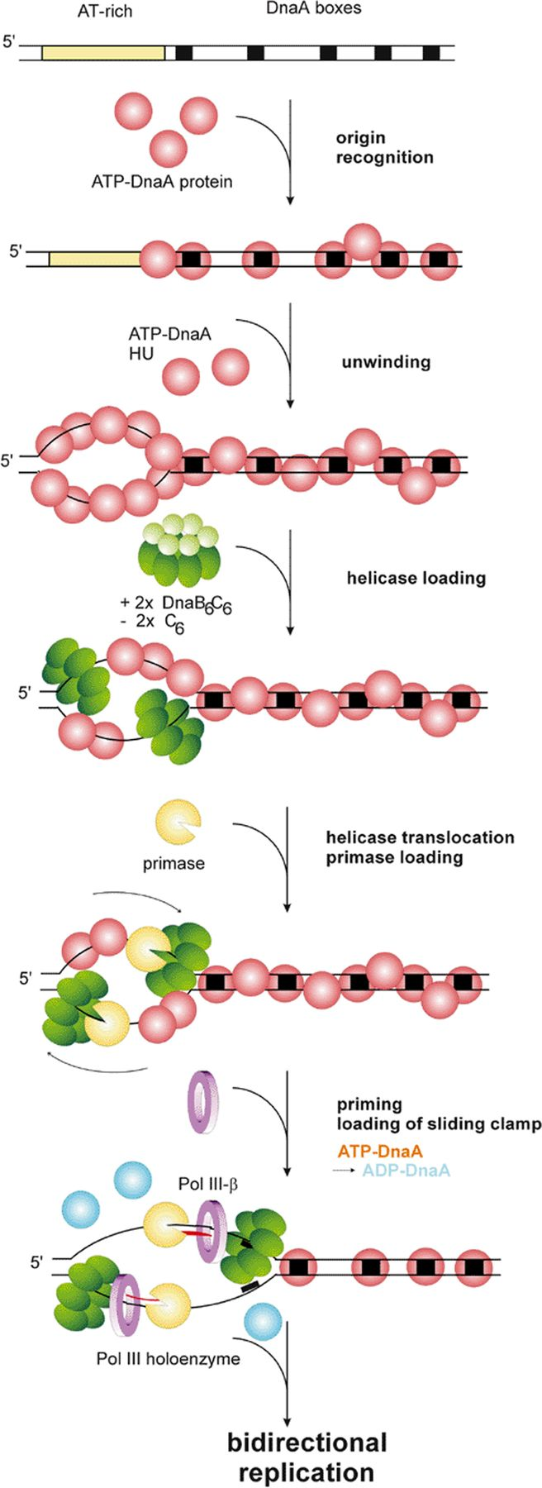
Figure 2 The initiation cycle of E. coli.
Notes:
Figure 2 The initiation cycle of E. coli.
Unless provided in the caption above, the following copyright applies to the content of this slide: © 2002 Federation of European Microbiological Societies.

Slide 3
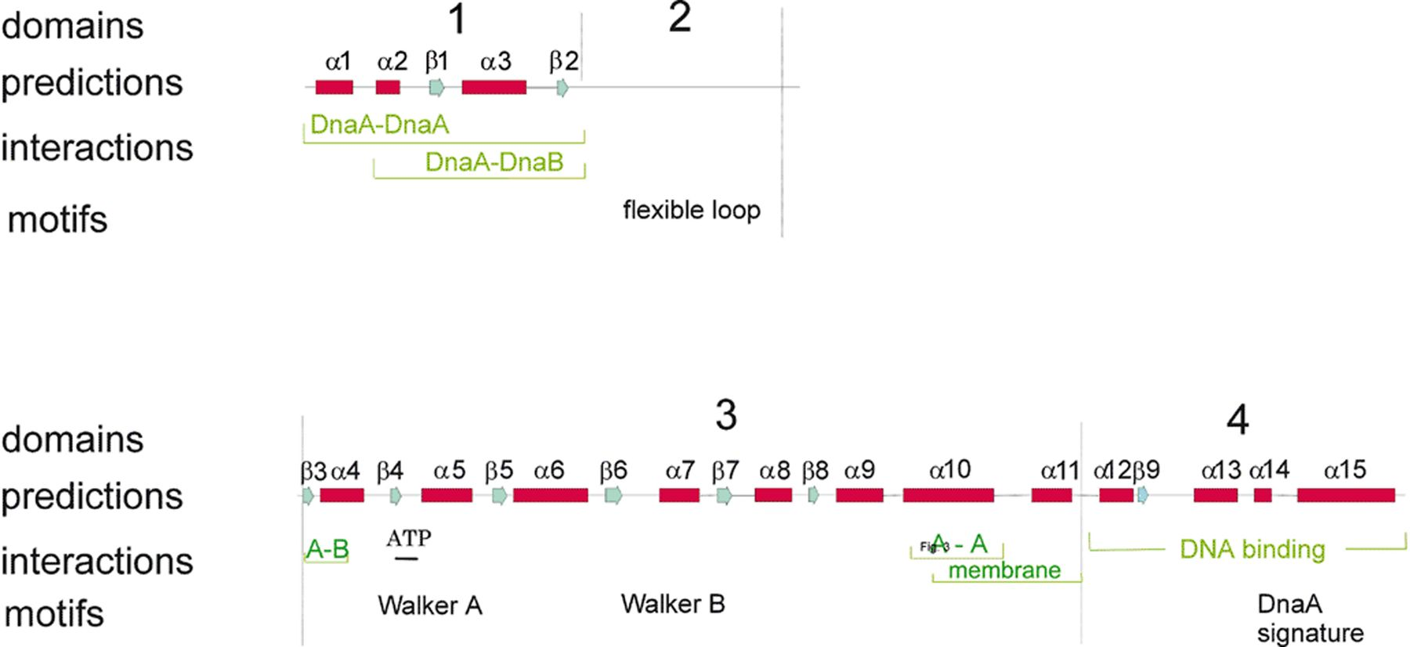
Figure 3 Secondary structure prediction for E. coli DnaA protein with sequence motifs and interaction domains.
Notes:
Figure 3 Secondary structure prediction for E. coli DnaA protein with sequence motifs and interaction domains.
Unless provided in the caption above, the following copyright applies to the content of this slide: © 2002 Federation of European Microbiological Societies.

Slide 4
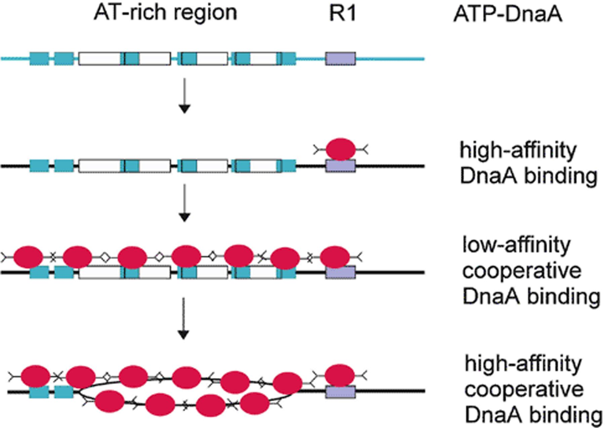
Figure 4 Mechanism of unwinding of the AT-rich region. ATP-DnaA is shown in red, ATP-DnaA boxes are shown in blue, the ...
Notes:
Figure 4 Mechanism of unwinding of the AT-rich region. ATP-DnaA is shown in red, ATP-DnaA boxes are shown in blue, the high-affinity box R1 in magenta.
Unless provided in the caption above, the following copyright applies to the content of this slide: © 2002 Federation of European Microbiological Societies.

Slide 5
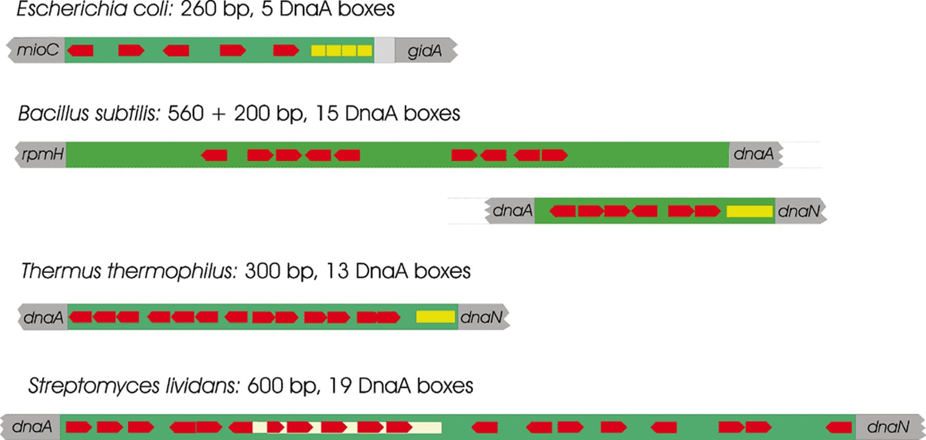
Figure 5 Replication origins of different bacteria. DnaA boxes are shown as red arrows, AT-rich regions are shown in ...
Notes:
Figure 5 Replication origins of different bacteria. DnaA boxes are shown as red arrows, AT-rich regions are shown in yellow.
Unless provided in the caption above, the following copyright applies to the content of this slide: © 2002 Federation of European Microbiological Societies.

