Slide 1
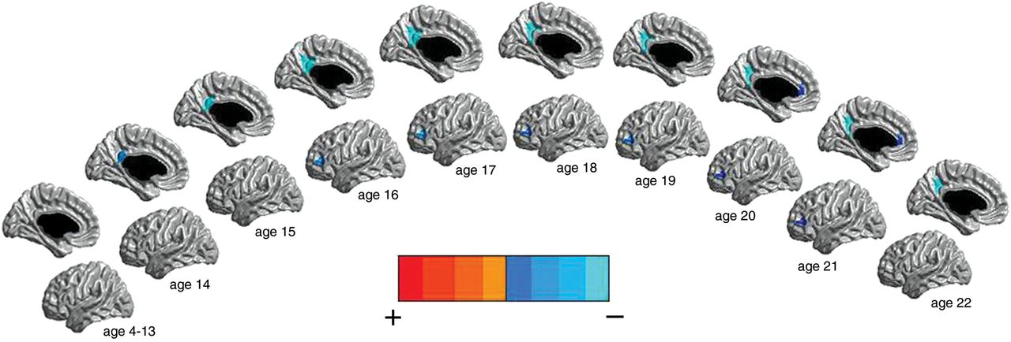
Figure 1. Males: testosterone effect on CTh of the left hemisphere across the age span (127 subjects and 199 scans). ...
Notes:
Figure 1. Males: testosterone effect on CTh of the left hemisphere across the age span (127 subjects and 199 scans). Midsagittal and lateral views are represented. There were negative associations between testosterone and CTh of the left posterior cingulate cortex, left anterior cingulate cortex, and left dorsolateral prefrontal cortex in postpubertal males. The scale used pictures the strongest positive associations in red and the strongest negative associations in light blue, with the shades in-between representing intermediate associations. All associations pictured were significant at P< 0.05, corrected for multiple comparisons, using RFT.
Unless provided in the caption above, the following copyright applies to the content of this slide: © The Author 2012. Published by Oxford University Press. All rights reserved. For Permissions, please e-mail: journals.permissions@oup.com

Slide 2
Figure 2. Females: testosterone effect on CTh of the right hemisphere across the age span (154 subjects and 270 scans). ...
Notes:
Figure 2. Females: testosterone effect on CTh of the right hemisphere across the age span (154 subjects and 270 scans). The midsagittal view is represented. There were positive (in prepubertal females), reversing to negative (in postpubertal females), associations between testosterone and CTh of the right somatosensory cortex. There were no significant associations between ages 9 and 19. The scale used pictures the strongest positive associations in red and the strongest negative associations in light blue, with the shades in-between representing intermediate associations. All associations pictured were significant at P< 0.05, corrected for multiple comparisons, using RFT.
Unless provided in the caption above, the following copyright applies to the content of this slide: © The Author 2012. Published by Oxford University Press. All rights reserved. For Permissions, please e-mail: journals.permissions@oup.com

Slide 3
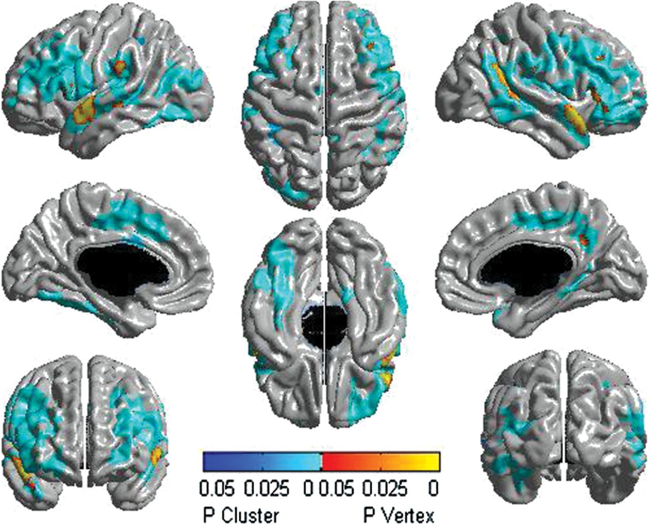
Figure 3. Sex by age by testosterone interaction on CTh in the complete sample (281 subjects and 469 scans). There were ...
Notes:
Figure 3. Sex by age by testosterone interaction on CTh in the complete sample (281 subjects and 469 scans). There were differences between males and females in testosterone-related cortical maturation throughout puberty involving diffuse regions of both the left and right hemispheres. The scale pictures significant interactions in yellow, red, and blue, with regions in yellow–red being significant at the peak level, whereas those in blue are significant at the cluster level. All associations pictured were significant at P< 0.05, corrected for multiple comparisons, using RFT.
Unless provided in the caption above, the following copyright applies to the content of this slide: © The Author 2012. Published by Oxford University Press. All rights reserved. For Permissions, please e-mail: journals.permissions@oup.com

Slide 4
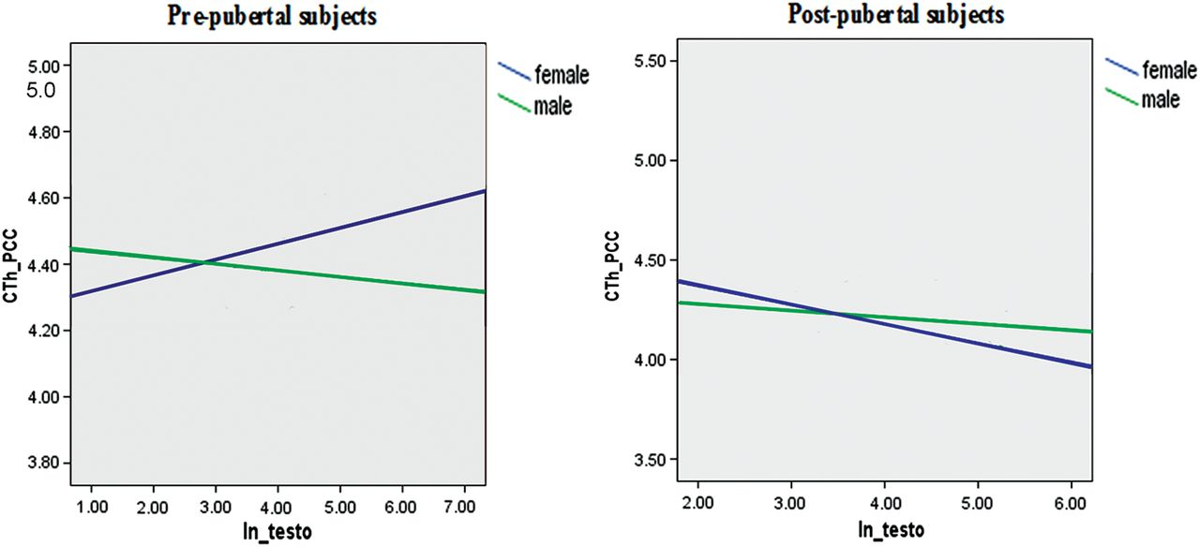
Figure 4. Sex and age effects: CTh changes associated with testosterone in pre- and postpubertal males and females. ...
Notes:
Figure 4. Sex and age effects: CTh changes associated with testosterone in pre- and postpubertal males and females. These graphs show a typical example of how sex and age modulated the relationship between testosterone and CTh. There was an increase in the CTh in the left posterior cingulate gyrus associated with testosterone in prepubertal females, a relationship that was reversed in postpubertal females (blue lines). Males showed a testosterone-related decrease in the CTh in the same area in both pre- and postpubertal subjects, although the strength of the association differed (green lines). CTh_PCC, cortical thickness of the left posterior cingulate gyrus; ln_testo, natural logarithm of testosterone.
Unless provided in the caption above, the following copyright applies to the content of this slide: © The Author 2012. Published by Oxford University Press. All rights reserved. For Permissions, please e-mail: journals.permissions@oup.com

Slide 5
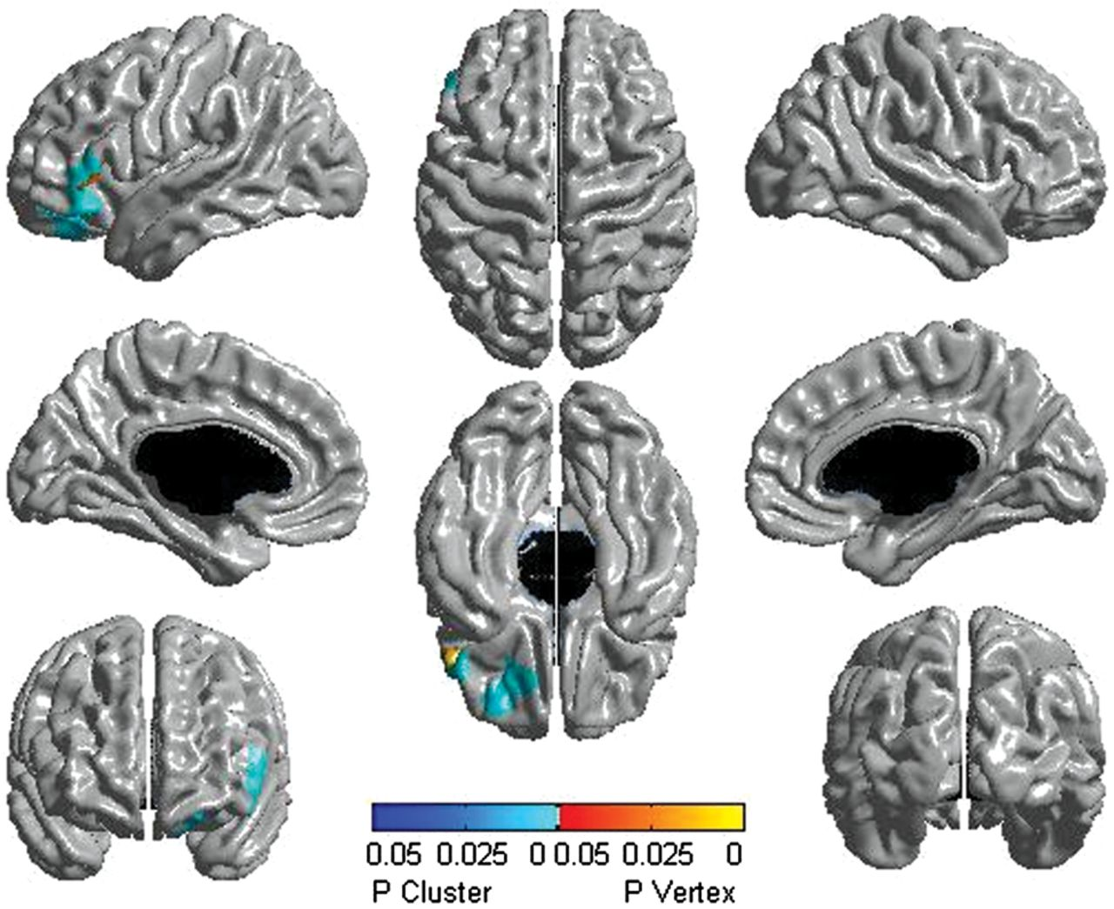
Figure 5. Males: testosterone-related lateralization effects (127 subjects and 199 scans). Significant differences ...
Notes:
Figure 5. Males: testosterone-related lateralization effects (127 subjects and 199 scans). Significant differences between the left and right hemispheres are displayed. Throughout the age span, males showed significant testosterone-related thinning of the left dorsolateral and ventral prefrontal cortices when compared with the same regions of the right hemisphere. The scale pictures significant interactions in yellow, red, and blue, with regions in yellow–red being significant at the peak level, whereas those in blue were significant at the cluster level. All associations pictured were significant at P< 0.05, corrected for multiple comparisons, using RFT.
Unless provided in the caption above, the following copyright applies to the content of this slide: © The Author 2012. Published by Oxford University Press. All rights reserved. For Permissions, please e-mail: journals.permissions@oup.com

Slide 6
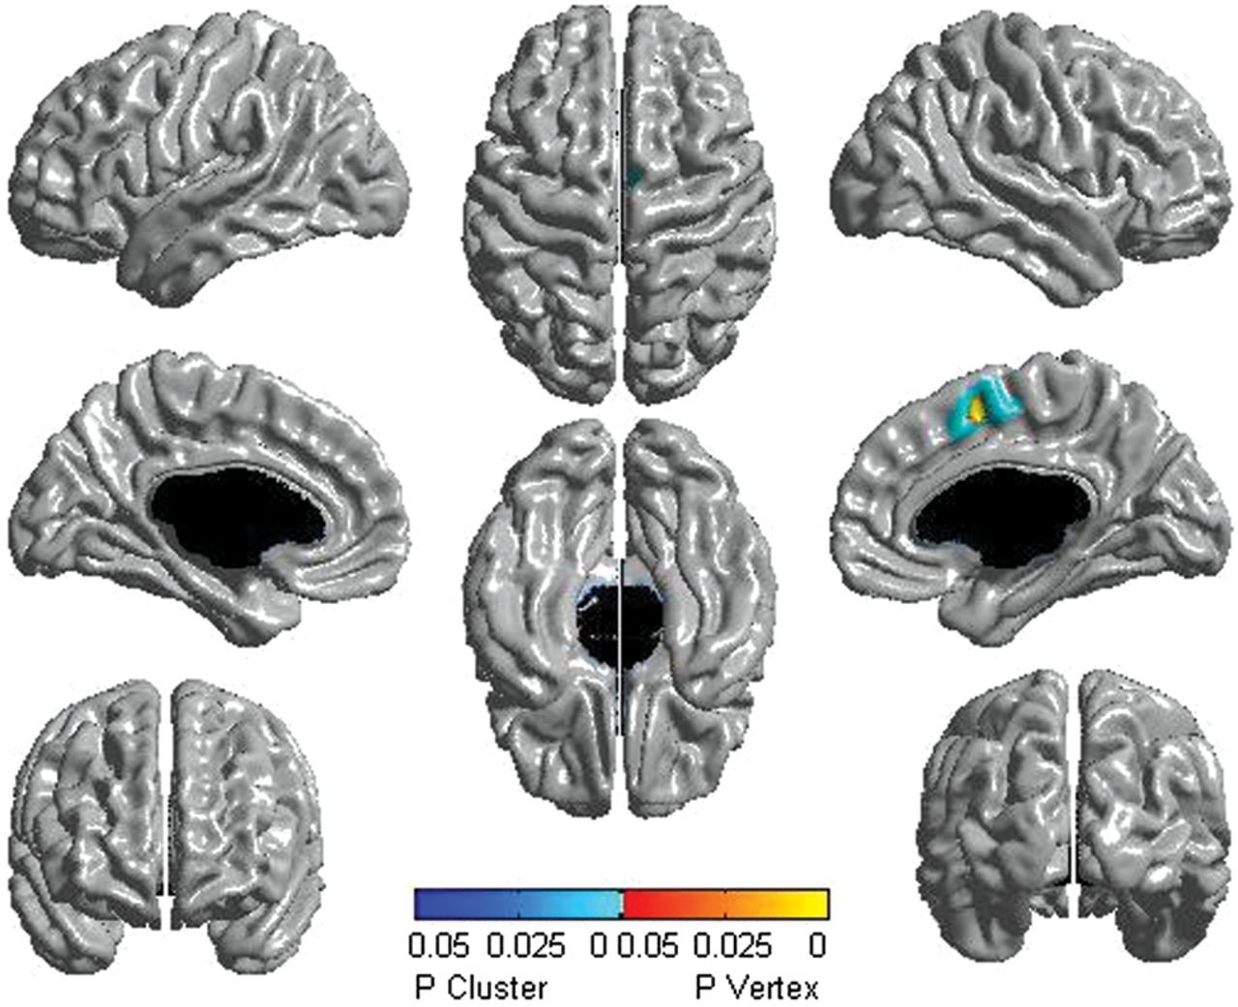
Figure 6. Females: testosterone-related lateralization effects (154 subjects and 270 scans). Significant differences ...
Notes:
Figure 6. Females: testosterone-related lateralization effects (154 subjects and 270 scans). Significant differences between the left and right hemispheres are displayed. Throughout the age span, females showed testosterone-related thickening of the right compared with the left somatosensory cortex. The scale pictures significant interactions in yellow, red, and blue, with regions in yellow–red being significant at the peak level, whereas those in blue were significant at the cluster level. All associations pictured were significant at P< 0.05, corrected for multiple comparisons, using RFT.
Unless provided in the caption above, the following copyright applies to the content of this slide: © The Author 2012. Published by Oxford University Press. All rights reserved. For Permissions, please e-mail: journals.permissions@oup.com

