Slide 1
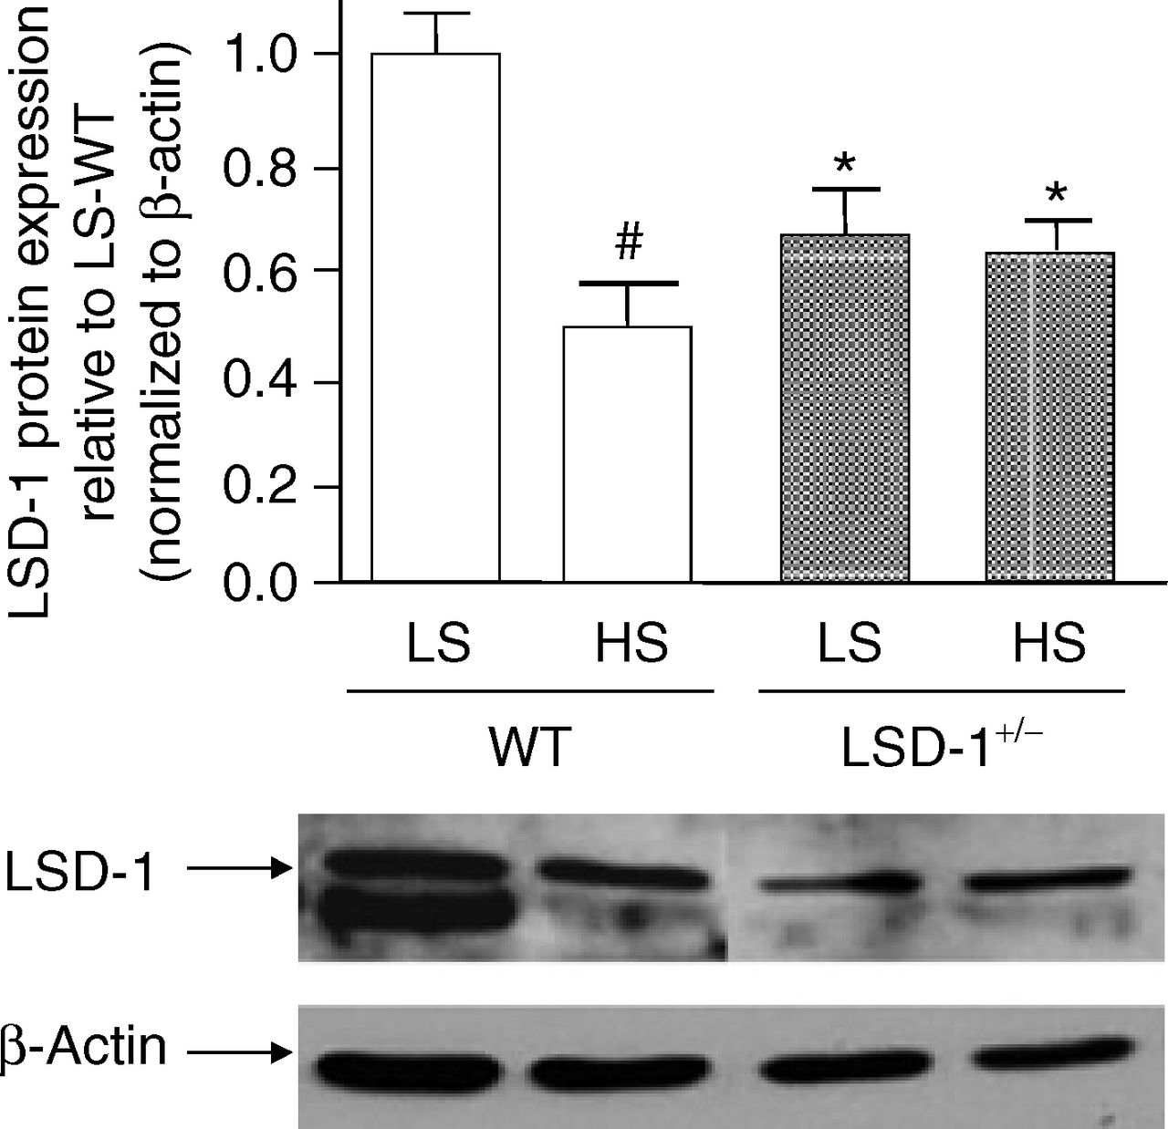
Figure 1. Effect of dietary sodium on lysine-specific demethylase 1 (LSD-1) protein levels in mouse kidney. ...
Notes:
Figure 1. Effect of dietary sodium on lysine-specific demethylase 1 (LSD-1) protein levels in mouse kidney. #LSD-1 protein levels were significantly higher on low salt (LS) compared to liberal salt (HS) diet in kidney tissue of wild-type (WT) mice (N = 3–4; P < 0.01). *In LSD-1 heterozygote knockout (LSD-1+/−) mice, LSD-1 protein levels in the kidney were significantly lower compared to WT mice on both diets (N = 3–4; P < 0.05). LSD-1 protein levels in the LSD-1+/− mice did not change significantly between diets. Error bars = SEM.
Unless provided in the caption above, the following copyright applies to the content of this slide: © American Journal of Hypertension, Ltd. 2012

Slide 2
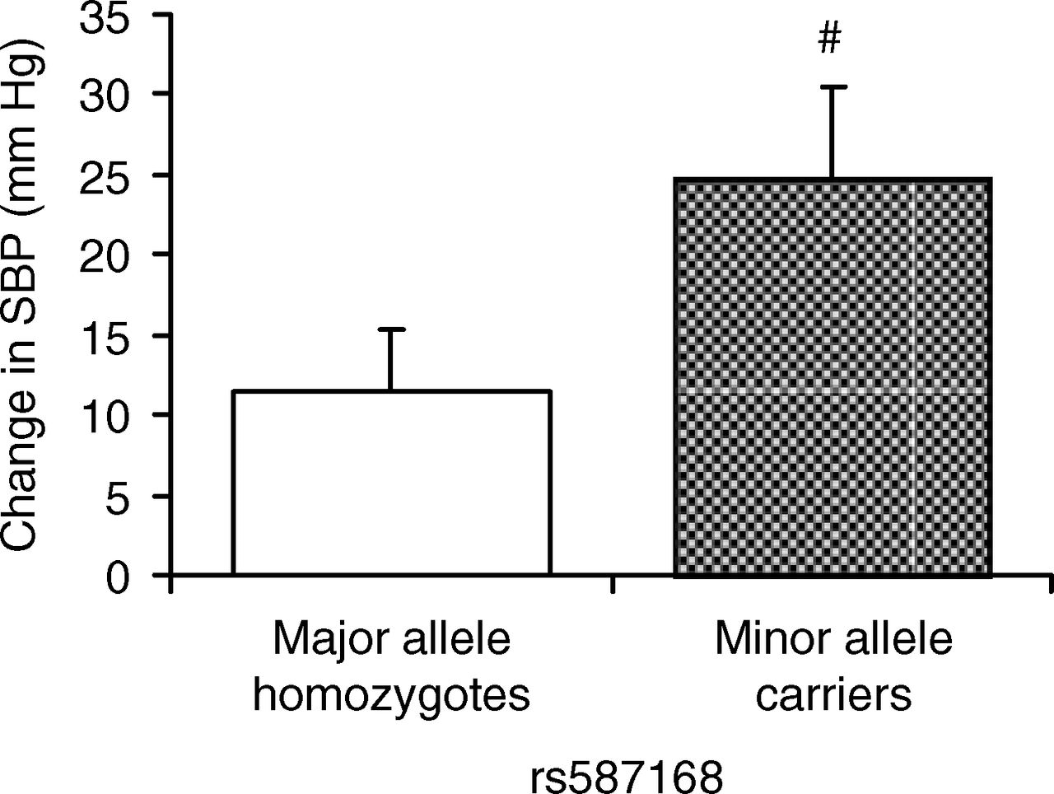
Figure 2. Effect of lysine-specific demethylase 1 (LSD-1) genetic variants on the systolic blood pressure (SBP) ...
Notes:
Figure 2. Effect of lysine-specific demethylase 1 (LSD-1) genetic variants on the systolic blood pressure (SBP) response to dietary salt in African-American hypertensive subjects. #African-American hypertensive minor allele carriers of LSD-1 rs587168 (N = 26) compared with major allele homozygotes (N = 28) had significantly greater increase in SBP in response to change from low to liberal salt diet (P < 0.01). Data shown are mean values adjusted for age, gender, and body mass index (BMI) differences. Error bars = SEM. A significant association of the minor allele with salt-sensitivity of BP was also seen for rs671357 (data not shown; P = 0.01) in the African Americans.
Unless provided in the caption above, the following copyright applies to the content of this slide: © American Journal of Hypertension, Ltd. 2012

Slide 3
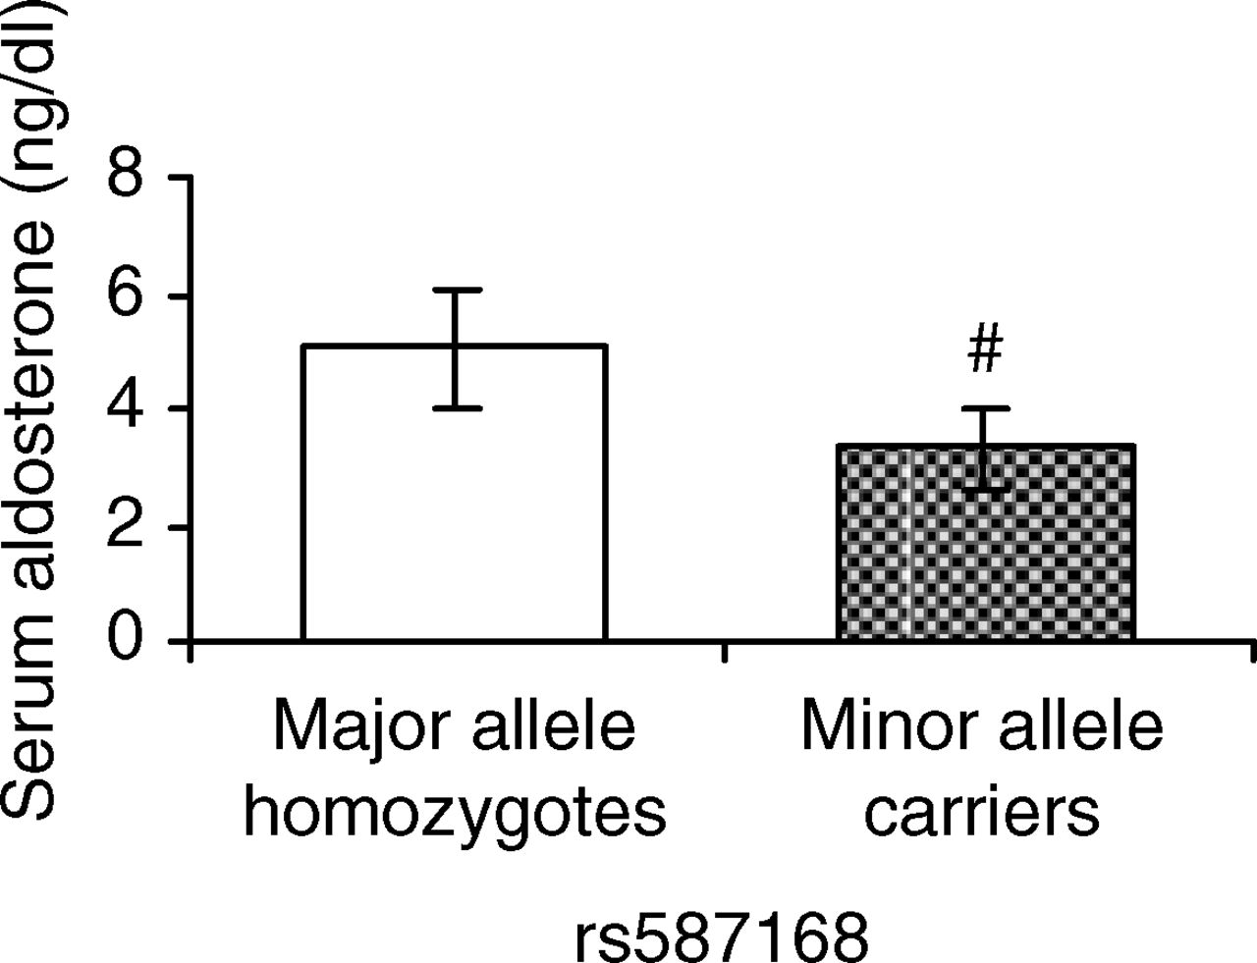
Figure 4. Aldosterone levels by lysine-specific demethylase 1 (LSD-1) genotype. #African-American ...
Notes:
Figure 4. Aldosterone levels by lysine-specific demethylase 1 (LSD-1) genotype. #African-American hypertensive minor allele carriers of rs587168 (N = 26) had significantly lower serum aldosterone levels compared with major allele homozygotes (N = 28) on liberal salt diet (P < 0.01). Error bars = 95% confidence interval.
Unless provided in the caption above, the following copyright applies to the content of this slide: © American Journal of Hypertension, Ltd. 2012

Slide 4
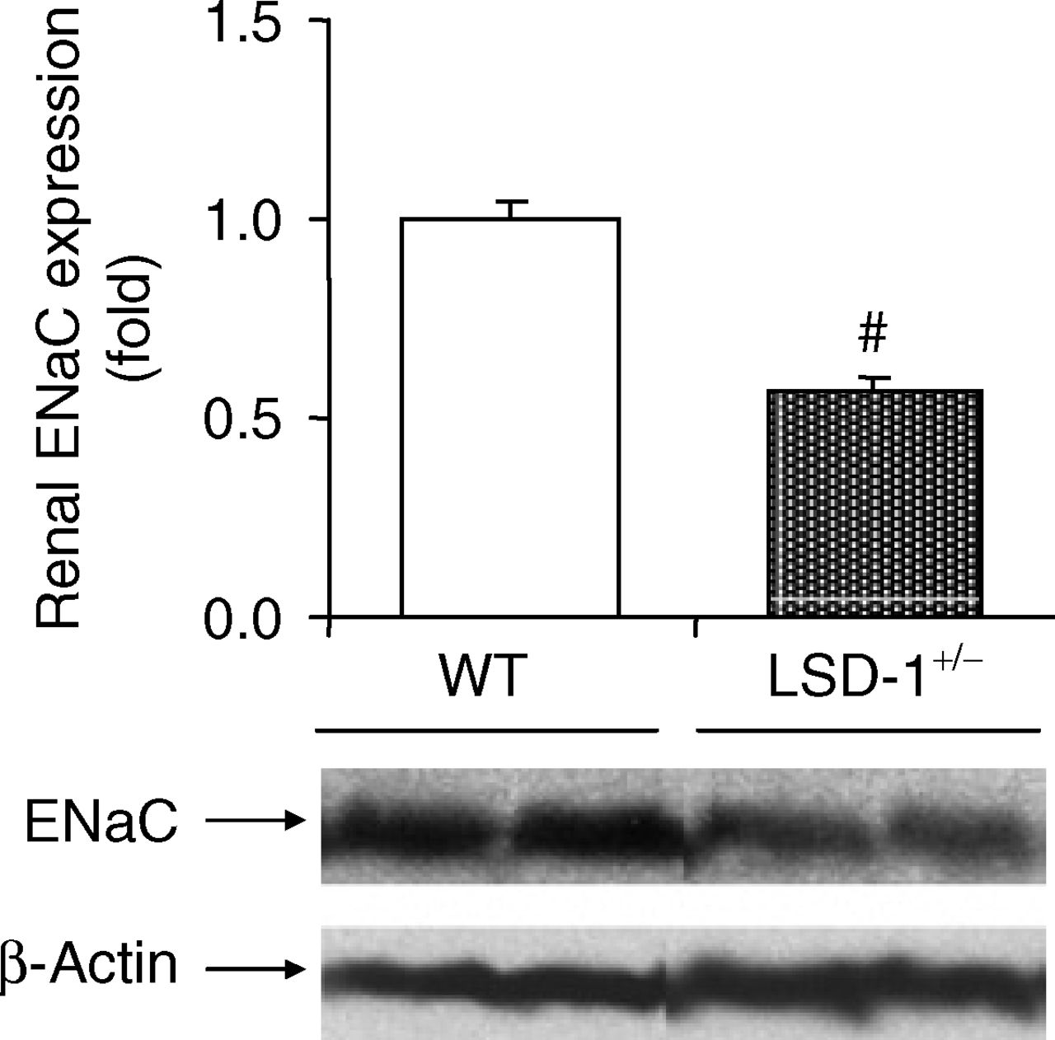
Figure 3. Renal epithelial sodium channel (ENaC) expression on liberal salt diet. #Lysine-specific ...
Notes:
Figure 3. Renal epithelial sodium channel (ENaC) expression on liberal salt diet. #Lysine-specific demethylase 1 (LSD-1) heterozygote knockout (LSD-1+/−) compared with wild-type (WT) mice, had significantly lower expression of the α-subunit of ENaC (N = 6–8 mice in each group; P < 0.01) on liberal salt diet. Error bars = SEM.
Unless provided in the caption above, the following copyright applies to the content of this slide: © American Journal of Hypertension, Ltd. 2012

