Slide 1
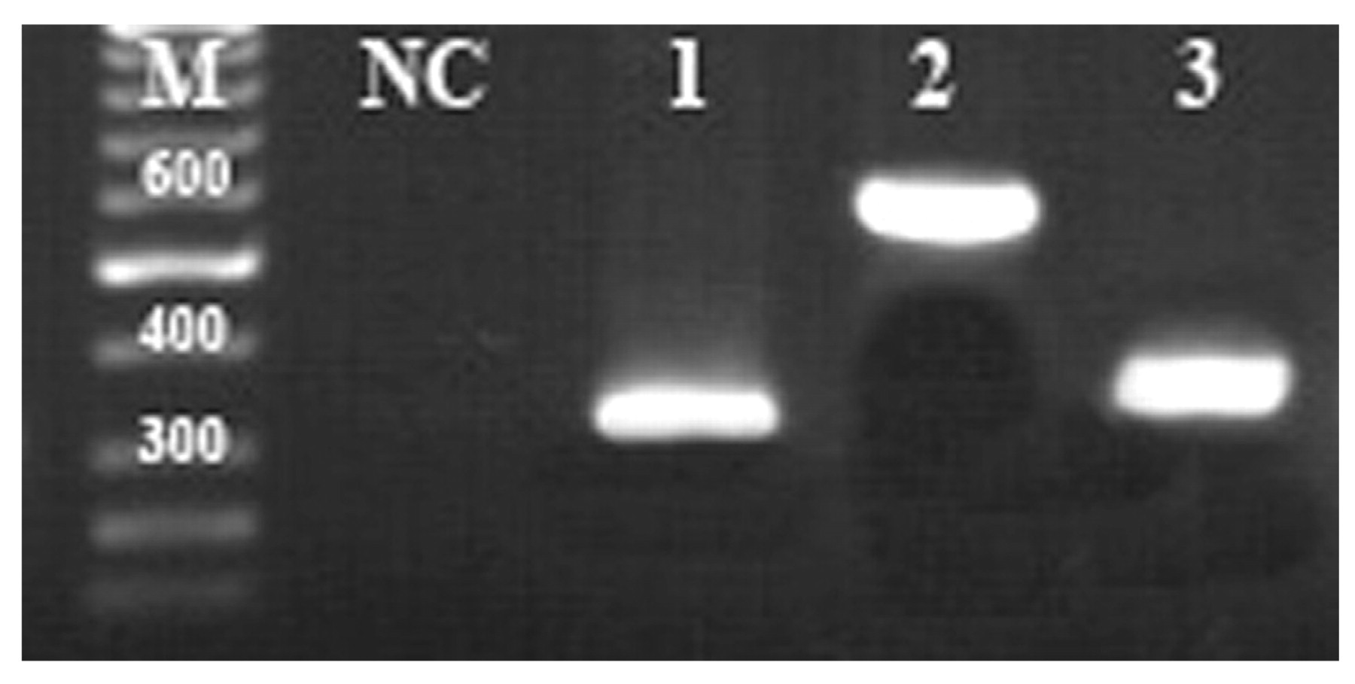
Image 1 Agarose gel electrophoresis of PCR products; M: size marker, NC: negative control, lane 1: VEGFR2-domain III, ...
Notes:
Image 1 Agarose gel electrophoresis of PCR products; M: size marker, NC: negative control, lane 1: VEGFR2-domain III, lane 2: VEGFR2-domains II–III, and lane 3: VEGFR1-domain II.
Unless provided in the caption above, the following copyright applies to the content of this slide: © American Society of Clinical Pathologists

Slide 2
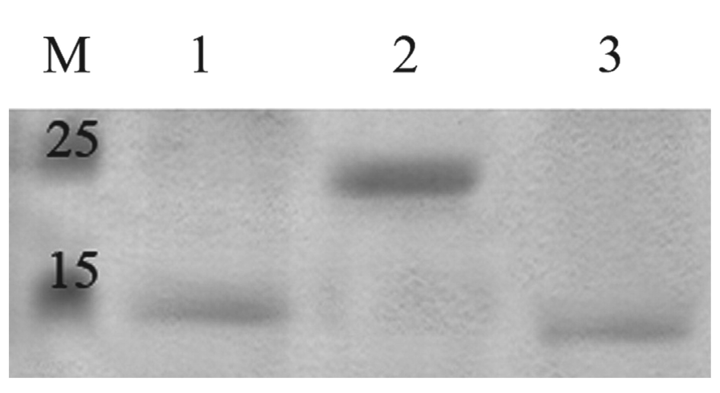
Image 2 Immunoblotting analysis; M: molecular weight marker, lane 1: VEGFR2-domain III, lane 2: VEGFR2-domains ...
Notes:
Image 2 Immunoblotting analysis; M: molecular weight marker, lane 1: VEGFR2-domain III, lane 2: VEGFR2-domains II–III, and lane 3: VEGFR1-domain II.
Unless provided in the caption above, the following copyright applies to the content of this slide: © American Society of Clinical Pathologists

Slide 3
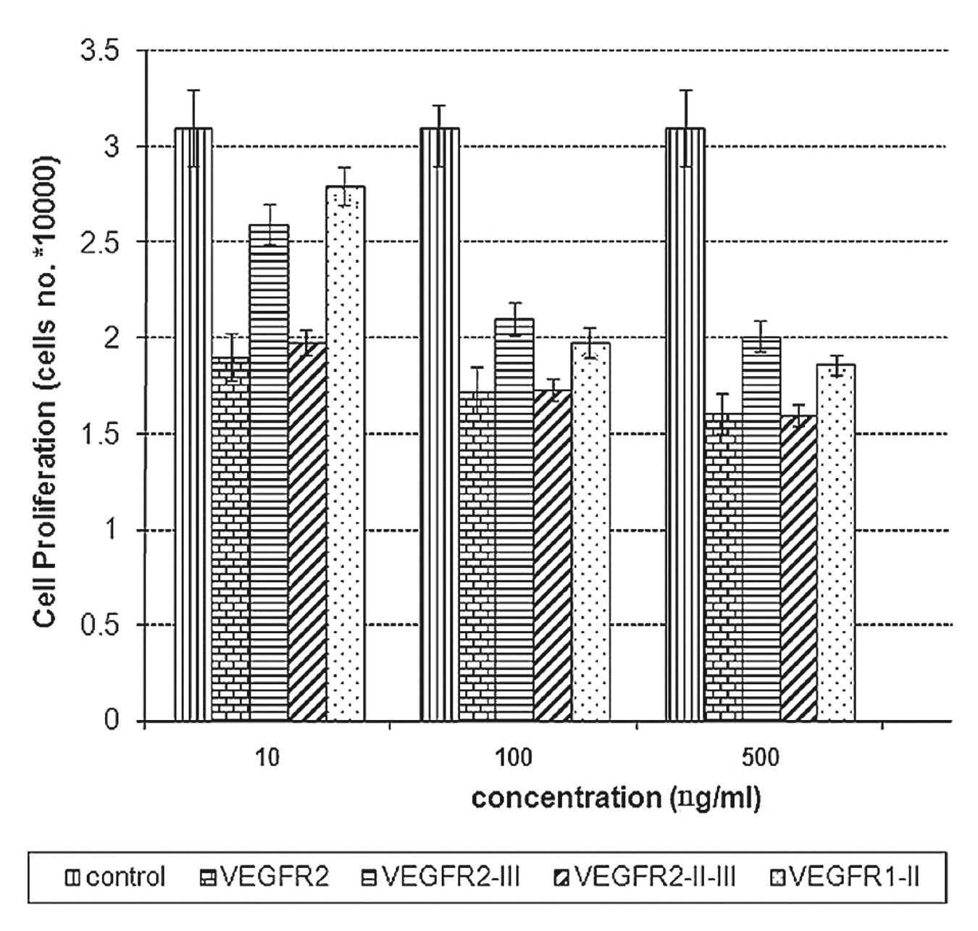
Figure 1 Human endothelial cells proliferation inhibition assay in various dilutions of control (cell culture medium ...
Notes:
Figure 1 Human endothelial cells proliferation inhibition assay in various dilutions of control (cell culture medium without VEGFR2 and VEGFR fragments), VEGFR2-domain III, VEGFR2-domains II–III, and VEGFR1-domain II. All assays were performed in triplicate.
Unless provided in the caption above, the following copyright applies to the content of this slide: © American Society of Clinical Pathologists

Slide 4
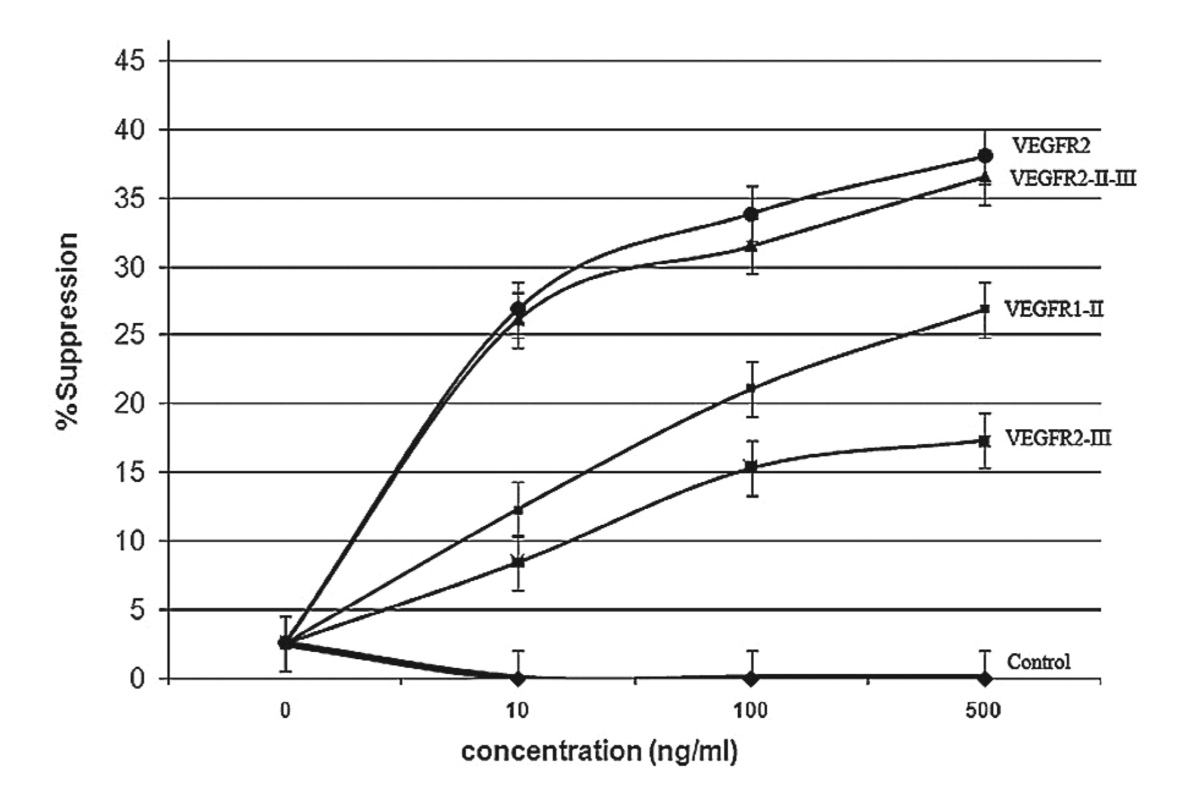
Figure 2 Dose-dependent suppression of endothelial cell growth in various dilutions of control (cell culture medium ...
Notes:
Figure 2 Dose-dependent suppression of endothelial cell growth in various dilutions of control (cell culture medium without VEGFR2 and VEGFR fragments), VEGFR2-domain III, VEGFR2-domains II–III, and VEGFR1-domain II. All assays were performed in triplicate.
Unless provided in the caption above, the following copyright applies to the content of this slide: © American Society of Clinical Pathologists

Slide 5
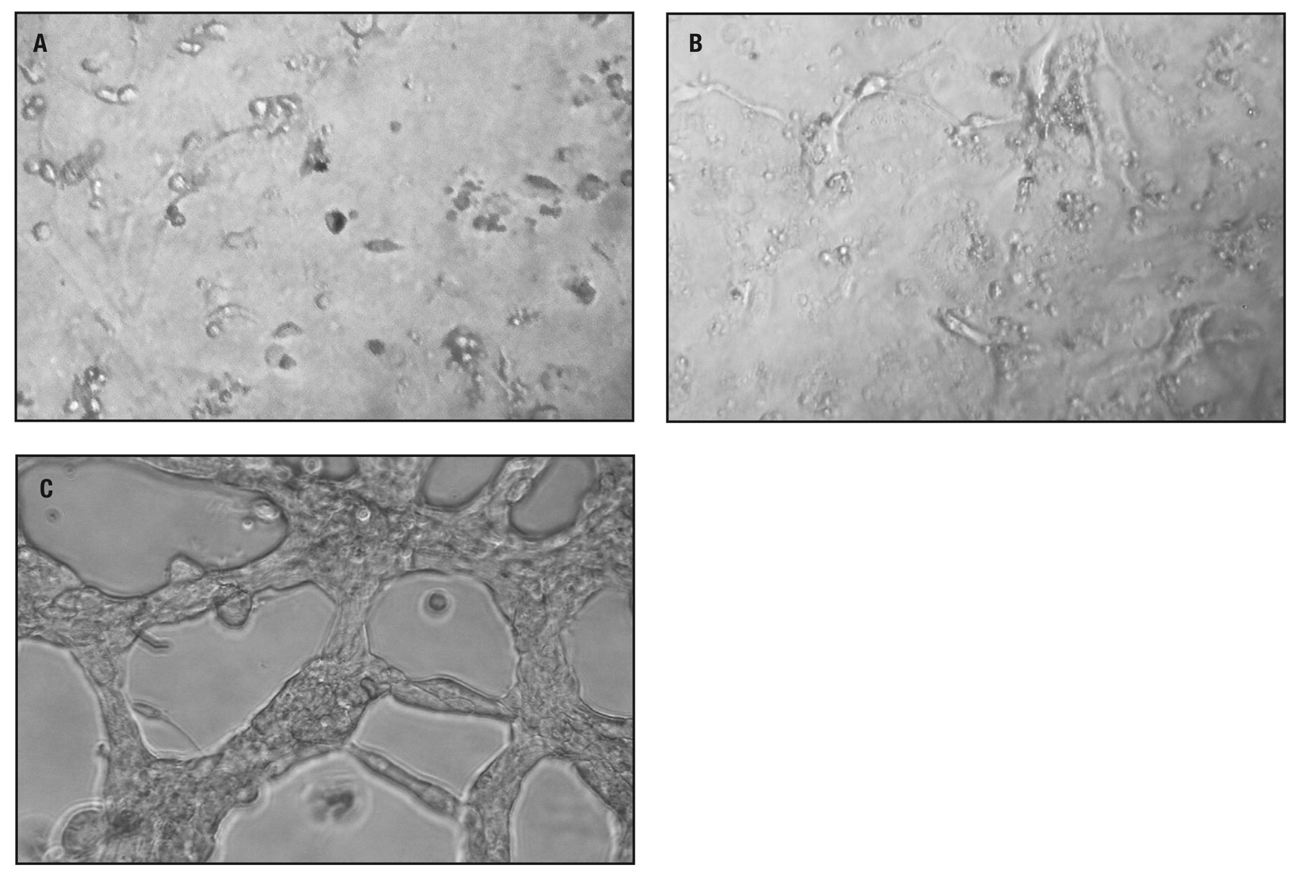
Image 3 Anti-angiogenic effect of VEGFR fragments in vitro. Endothelial tube formation is digitally photographed ...
Notes:
Image 3 Anti-angiogenic effect of VEGFR fragments in vitro. Endothelial tube formation is digitally photographed under an inverted light microscope at ×20 magnification. (A) in present of VEGFR2 or VEGFR2-domains II–III. (B) in the presence of VEGFR2-domain III and VEGFR1-domain II. (C) without VEGFR2 and VEGFR fragments. Representative of 3 experiments.
Unless provided in the caption above, the following copyright applies to the content of this slide: © American Society of Clinical Pathologists

