Slide 1
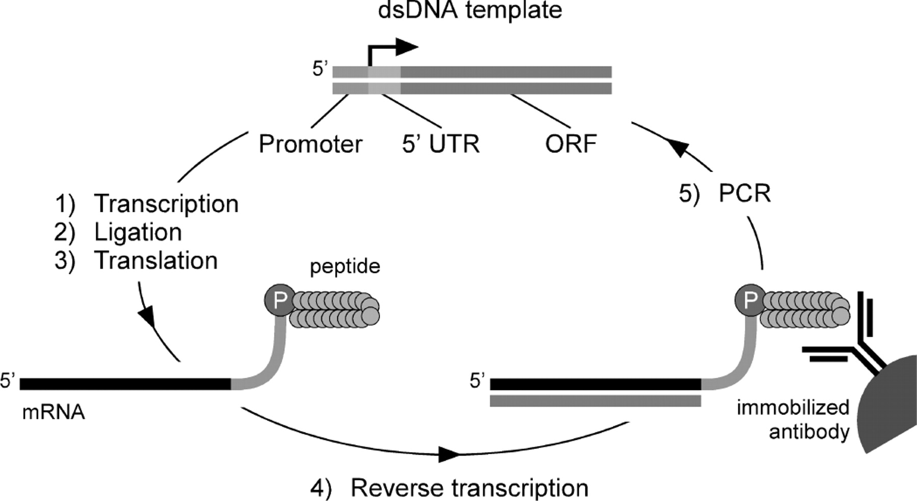
Fig. 1. In vitro selection scheme using mRNA display. The starting dsDNA pool (top, center) which encodes the peptide ...
Notes:
Fig. 1. In vitro selection scheme using mRNA display. The starting dsDNA pool (top, center) which encodes the peptide library is transcribed in vitro. Purified mRNA is enzymatically ligated to a puromycin–DNA oligo prior to RNA–peptide fusion formation via in vitro translation. Purified RNA–peptide fusions are reverse transcribed and affinity selected on to the immobilized antibody target. Eluted cDNA is used as the template for PCR for the next cycle of selection.
Unless provided in the caption above, the following copyright applies to the content of this slide: © The Author 2005. Published by Oxford University Press. All rights reserved. For Permissions, please e-mail: journals.permissions@oupjournals.org

Slide 2
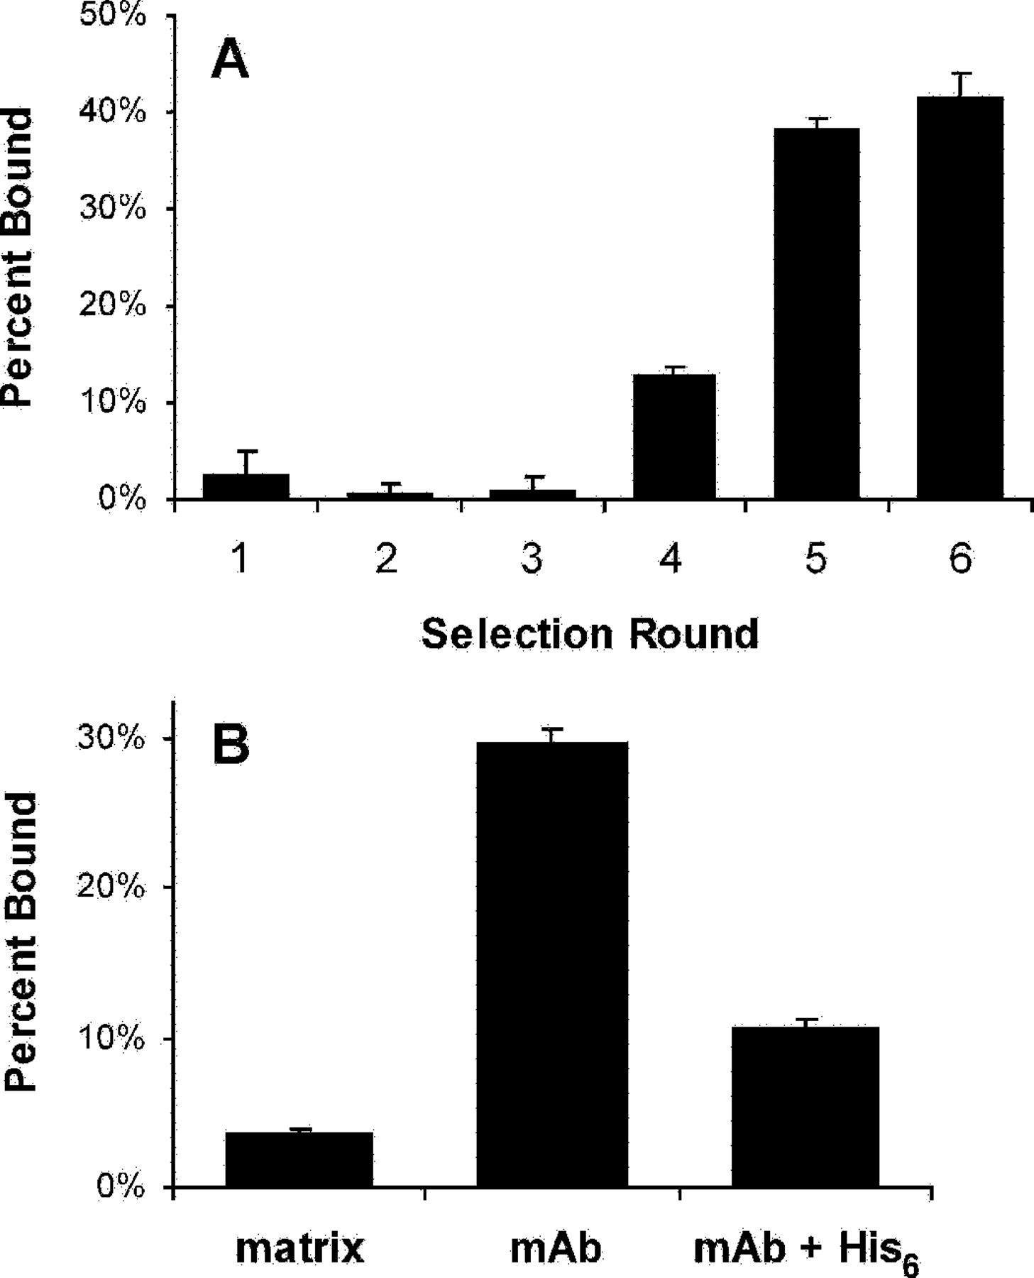
Fig. 2. Selection of peptides against the anti-polyhistidine mAb. (A) The percentage binding from each round of ...
Notes:
Fig. 2. Selection of peptides against the anti-polyhistidine mAb. (A) The percentage binding from each round of selection was determined by scintillation counting of an aliquot of the 35S-Met-labeled RNA–peptide fusions before and after affinity selection on the immobilized antibody. (B) Binding assay of the fifth round mRNA display library. Purified, 35S-labeled fusions from the fifth round pool were RNase treated (resulting in peptides covalently coupled to the puromycin–DNA linker) and assayed on the protein G–Sepharose matrix with and without immobilized anti-polyhistidine mAb. The addition of 10 mM hexahistidine peptide competitor resulted in reduced binding to the mAb, suggesting that the selected peptides interact specifically with the antigen-binding site.
Unless provided in the caption above, the following copyright applies to the content of this slide: © The Author 2005. Published by Oxford University Press. All rights reserved. For Permissions, please e-mail: journals.permissions@oupjournals.org

Slide 3
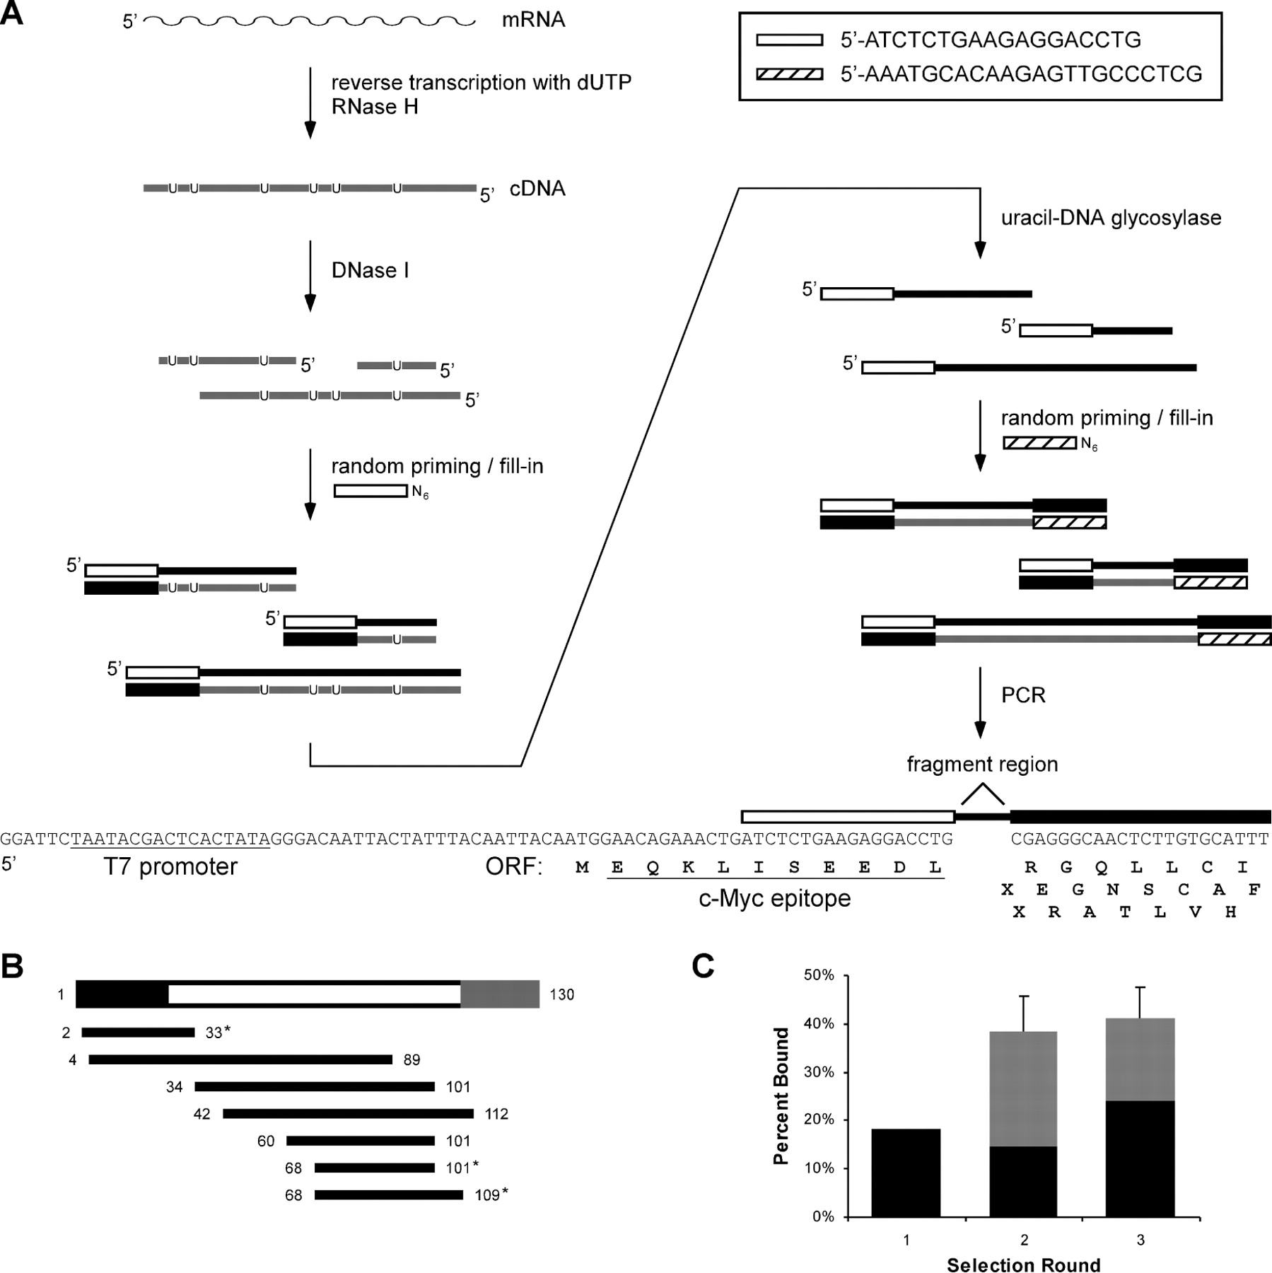
Fig. 3. Construction of a unidirectional nested deletion library. (A) Single-stranded cDNA is obtained by reverse ...
Notes:
Fig. 3. Construction of a unidirectional nested deletion library. (A) Single-stranded cDNA is obtained by reverse transcription of mRNA templates with dUTP. After fragments are produced by a partial DNase I digest, a randomly-primed fill-in reaction is performed with degenerate DNA hexamers containing a constant 5′ sequence, resulting in complete second-strand cDNA for each fragment. Uracil–DNA glycosylase (UDG) is used to remove first-strand cDNA and the anti-sense strand is filled-in again by random priming. The constant region of the second primer encodes a suitable peptide sequence in all three frames (lacking stop codons) and serves as the reverse primer site for subsequent PCR. PCR of the resulting dsDNA produces the initial library suitable for in vitro selection. (B) Representation of the peptide C parent DNA sequence in the initial fragment library. The 5′-UTR, peptide coding region and 3′-constant region are in black, white and gray, respectively. The bases spanned by each library member are shown. Sequences marked with an asterisk are in-frame with the 5′-constant region added during the generation of the library. The sequence spanning bases 4–89 is also viable assuming translation occurs at the first Met codon. (C) Selection of the peptide fragment library on anti-polyhistidine mAb. The percentage of recovered fusions (black) was determined as in Figure 2. In the second and third rounds, the competitive washes (gray) removed a portion of the initially bound counts.
Unless provided in the caption above, the following copyright applies to the content of this slide: © The Author 2005. Published by Oxford University Press. All rights reserved. For Permissions, please e-mail: journals.permissions@oupjournals.org

Slide 4
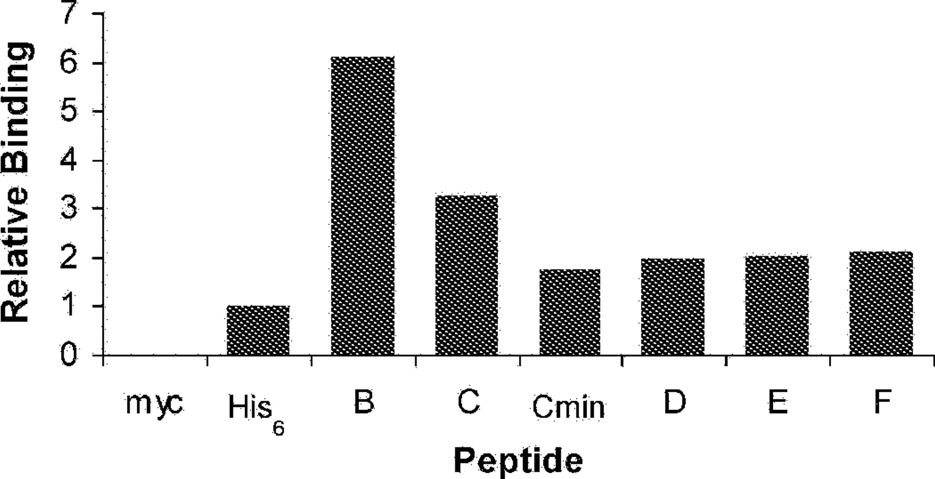
Fig. 4. Binding of in vitro translated peptides to anti-polyhistidine mAb. Free, ³⁵S-labeled peptides were ...
Notes:
Fig. 4. Binding of in vitro translated peptides to anti-polyhistidine mAb. Free, 35S-labeled peptides were assayed for binding directly from the translation reactions. Relative binding is shown as a fold-change versus the His6 sequence. Peptide sequences are given in Tables I and II. Myc is a peptide encoded by the constant regions of the fragment library primers with only an arginine residue in between. The His6 control sequence encoded a 31-mer peptide with a C-terminal His6 tag.
Unless provided in the caption above, the following copyright applies to the content of this slide: © The Author 2005. Published by Oxford University Press. All rights reserved. For Permissions, please e-mail: journals.permissions@oupjournals.org

Slide 5
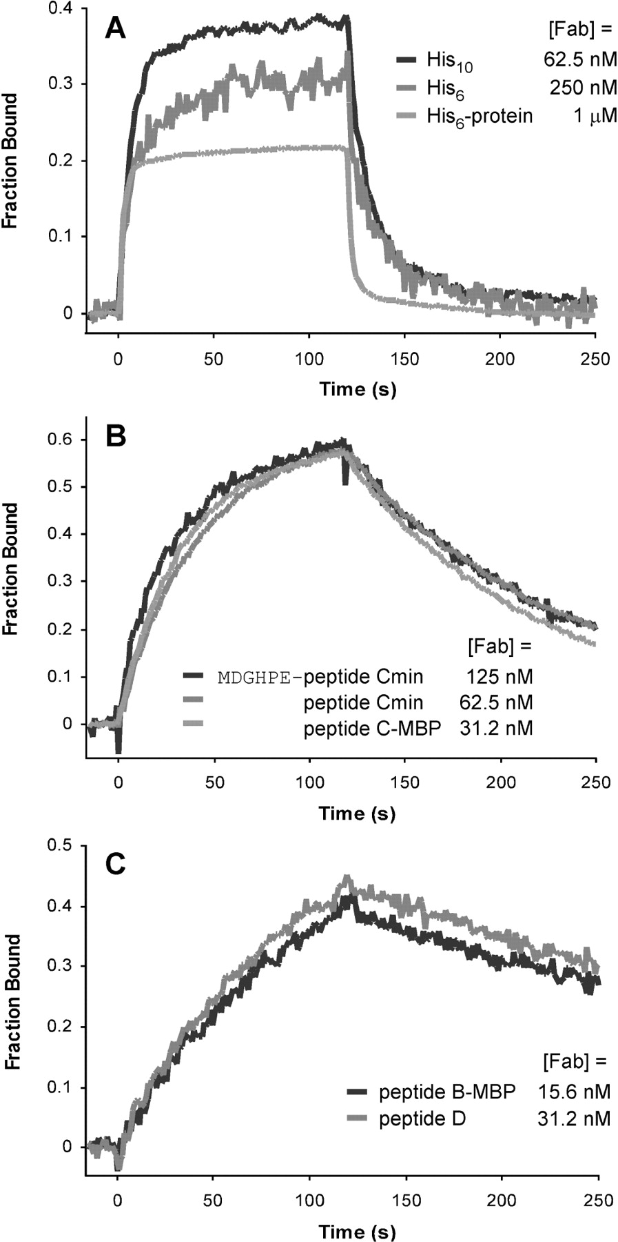
Fig. 5. Representative sensorgrams from SPR experiments. Purified anti-polyhistidine Fab at concentrations ...
Notes:
Fig. 5. Representative sensorgrams from SPR experiments. Purified anti-polyhistidine Fab at concentrations corresponding to ∼0.5 KD was injected over immobilized peptides or peptide-MBP fusions. Peptides fell into three categories describing (A) weak (His6, His10 and His6-tagged blocking protein), (B) intermediate (peptide C-derived sequences) and (C) strong (sequences containing the ARRXA motif) binding for the Fab. For comparison, sensorgrams were divided by the computed maximum signal. The Fab concentration for each injection is indicated.
Unless provided in the caption above, the following copyright applies to the content of this slide: © The Author 2005. Published by Oxford University Press. All rights reserved. For Permissions, please e-mail: journals.permissions@oupjournals.org

