Slide 1
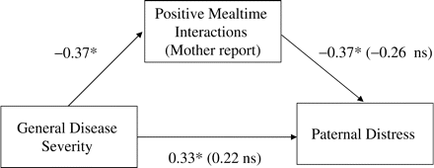
Figure 2 Mediational model in which mother-reported Positive Mealtime Interactions mediate the association between ...
Notes:
Figure 2 Mediational model in which mother-reported Positive Mealtime Interactions mediate the association between general disease severity ratings of children with NF1 and paternal distress. Path values not in parentheses are zero-order correlations; those in parentheses are standardized β-coefficients from the regression equation with the other predictors included. *p < .05, two-tailed tests.
Unless provided in the caption above, the following copyright applies to the content of this slide: © The Author 2007. Published by Oxford University Press on behalf of the Society of Pediatric Psychology. All rights reserved. For permissions, please e-mail: journals.permissions@oxfordjournals.org

Slide 2
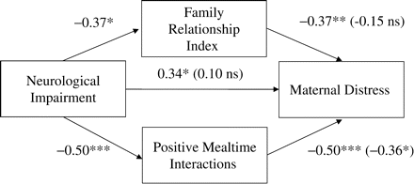
Figure 1 Mediational model in which mother-reported family functioning variables mediate the association between ...
Notes:
Figure 1 Mediational model in which mother-reported family functioning variables mediate the association between neurological impairment ratings of children with NF1 and maternal distress. Path values not in parentheses are zero-order correlations; those in parentheses are standardized β-coefficients from the regression equation with the other predictors included. *p < .05; **p < .01; ***p < .001, two-tailed tests.
Unless provided in the caption above, the following copyright applies to the content of this slide: © The Author 2007. Published by Oxford University Press on behalf of the Society of Pediatric Psychology. All rights reserved. For permissions, please e-mail: journals.permissions@oxfordjournals.org

