Slide 1
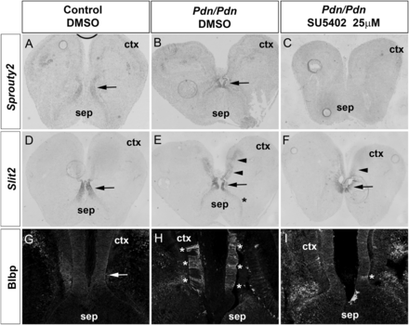
Figure 7. Effects of blocking Fgf signaling on midline development. (A–C) Sprouty2 expression is detected in the septum ...
Notes:
Figure 7. Effects of blocking Fgf signaling on midline development. (A–C) Sprouty2 expression is detected in the septum of DMSO treated control and Pdn/Pdn sections (arrows in A and B) but completely abolished after treatment with 25 μM SU5402. (D–E) Under control conditions, Slit2 expression is confined to the septum (arrows in D), but expands into the cortex (arrowheads in E) and into the ventralmost septum (asterisks in E) of Pdn/Pdn mutant sections. (F) Treatment of Pdn/Pdn sections with 25 μM SU5402 resulted in reduced Slit2 expression in the cortex (arrowhead) and to a loss of expression in the ventralmost septum. (G–I) Up-regulation of Fgf signaling is required for RGC cluster formation. (G) Blbp marks RGCs in the cortex dorsal to the CSB (arrow). (H and I) In Pdn/Pdn, sections treated with DMSO, Blbp+ cells form widespread cluster (asterisks in H), while their formation is nearly completely abolished after treatment with 25 μM SU5402 (I).
Unless provided in the caption above, the following copyright applies to the content of this slide: © The Author 2012. Published by Oxford University Press. All rights reserved. For Permissions, please e-mail: journals.permissions@oup.com

Slide 2
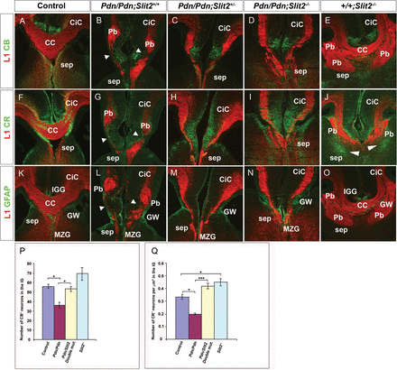
Figure 6. CC development in E18.5 Pdn/Slit2 double mutants. (A, F, and K) Immunostaining on control brain sections ...
Notes:
Figure 6. CC development in E18.5 Pdn/Slit2 double mutants. (A, F, and K) Immunostaining on control brain sections revealing L1+ callosal axons, CR+ and CB+ guidepost neurons and GFAP+ midline glia cells. (B, G, and L) In the Pdn cingulate cortex, the path of L1+ axons is interrupted at several positions (arrowheads), large L1+ Probst bundles are formed and midline glia and neuronal populations are disorganized. (C, D, H, I, M, and N) In Pdn/Pdn;Slit2+/− and in Pdn/Pdn;Slit2−/− embryos, callosal axons reach the CSB without forming Probst bundles, but do not cross the midline. Also, organization and positioning of midline guideposts is partially rescued in the Pdn/Slit2 double mutants. (C and D) In Pdn/Pdn;Slit2+/− and in Pdn/Pdn;Slit2−/− embryos, CB+ neurons are normally located in the IG region similar to control embryos. (H and I) Pdn/Pdn;Slit2+/− and in Pdn/Pdn;Slit2−/− CR+, sling neurons are normally localized in the cingulate cortex. (M and N) In Pdn/Slit2 double mutants, the IGG is absent and ectopic glial fascicles are formed at the CSB. (E, J, and O) Formation of guidepost neurons in Slit2−/− mutants. CR+ neurons form large ectopic clusters adjacent to large Probst bundles (arrowhead), but are largely missing from their normal position in the IG (J). Note the presence of glial fibers intermingling with the callosal axons crossing the midline (O). (P and Q) Quantification of CB+ (P) and CR+ (Q) neurons in the IG region. *P < 0.05, **P < 0.01, and ***P < 0.001 (Bonferroni's multiple comparison test).
Unless provided in the caption above, the following copyright applies to the content of this slide: © The Author 2012. Published by Oxford University Press. All rights reserved. For Permissions, please e-mail: journals.permissions@oup.com

Slide 3
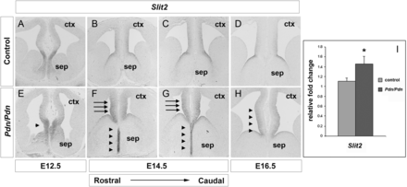
Figure 5. Slit2 expression expands into the rostromedial cortex of Pdn/Pdn embryos. (A and E) In E12.5 control embryos, ...
Notes:
Figure 5. Slit2 expression expands into the rostromedial cortex of Pdn/Pdn embryos. (A and E) In E12.5 control embryos, Slit2 expression is confined to the septum, but expands into cortical regions of Pdn mutants (arrowhead in E). Note the decreased size of the LGE in Pdn mutants as described previously (Magnani et al. 2010). (B–D) In E14.5 and E16.5 control embryos, Slit2 transcripts are detected in the septum and in the prospective cingulate cortex in a graded fashion. (F–H) In Pdn/Pdn embryos, Slit2 expression is increased in the future cingulate cortex (arrows). There is also ectopic Slit2 expression in the midlineof the septum, which is enlarged in E14.5 Pdn/Pdn embryos (arrowheads in F and G). (I) Quantification of Slit2 expression levels in the rostromedial telencephalon of E14.5 wild-type and control embryos. Asterisk (*) denotes statistically significant changes with P ≤ 0.05 (Mann–Whitney test).
Unless provided in the caption above, the following copyright applies to the content of this slide: © The Author 2012. Published by Oxford University Press. All rights reserved. For Permissions, please e-mail: journals.permissions@oup.com

Slide 4
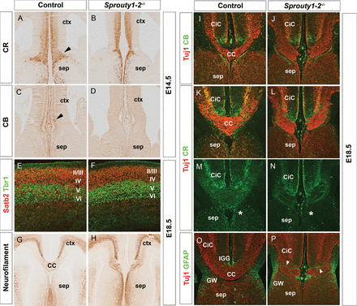
Figure 4. Sprouty1–2 double mutants lack the CC. (A and B) In E14.5 control embryos, CR⁺ guidepost neurons ...
Notes:
Figure 4. Sprouty1–2 double mutants lack the CC. (A and B) In E14.5 control embryos, CR+ guidepost neurons form a well organized band of neurons at the CSB, which is largely missing in Sprouty1/2 double mutants. (C and D) Unlike control embryos, CB+ guidepost neurons were not detected at the CSB of Sprouty1/2 double mutants at E14.5. (E and F) At E18.5, Satb2+ callosal neurons are normally positioned in the upper cortical layers II/III and IV above the Tbr1+ neurons in layer V and VI. (G–L, O, and P) Neurofilament and Tuj1 staining reveal agenesis of the CC in E18.5 sprouty1-2 mutants. Callosal fibers fail to cross the midline and form ectopic axon bundles. (I–J) No obvious differences in the distribution of CB+ guidepost neurons are detected in the dorsomedial cortex of Sprouty1-2 double mutants. (K–N) CR+ guidepost neurons form abnormal fiber bundles within the Probst bundles (O and P) GFAP immunofluorescence reveals abnormally formed midline glia populations. Several GFAP+ glia fibers abnormally cluster at the CSB (arrowheads in J), while the IGG cannot be identified.
Unless provided in the caption above, the following copyright applies to the content of this slide: © The Author 2012. Published by Oxford University Press. All rights reserved. For Permissions, please e-mail: journals.permissions@oup.com

Slide 5
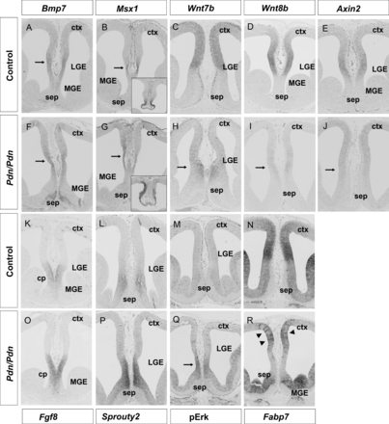
Figure 3. Altered Wnt/β-catenin and Fgf signaling in the E12.5 Pdn rostromedial telencephalon. (A, B, F, and G) Bmp7 ...
Notes:
Figure 3. Altered Wnt/β-catenin and Fgf signaling in the E12.5 Pdn rostromedial telencephalon. (A, B, F, and G) Bmp7 expression and that of its target gene Msx1 are detected on the cortical side of the CSB at caudal levels in both control and Pdn/Pdn mutants. Arrows in (A) and (F) demarcate the Bmp7 expression domain. The arrows in (B) and (G) point at the Msx1 expression domain and the insets show Msx1 expression in the telencephalic roofplate. (C, D, H, and I) Wnt7b and Wnt8b are expressed in the dorsomedial telencephalon with a sharp expression boundary at the CSB. In Pdn mutants, cortical Wnt7b and Wnt8b expression are strongly reduced (arrows in H and I), and Wnt7b expression is shifted ventrally into the septum. (E and J) Axin2 expression is severely reduced in the Pdn dorsomedial cortex (arrow in J). (K–M and O–Q) Fgf8, Sprouty2, and pErk expression are normally confined to the commissural plate (cp) and septum, respectively, but are shifted dorsally and expressed at higher levels at the Pdn/Pdn corticoseptal boundary. (N and R) Fabp7 is expressed at high levels in the dorsomedial cortex of control embryos with a sharp expression boundary at the CSB. The Pdn dorsomedial cortex lacks this Fabp7 high-level expression domain, but shows clusters of cells expressing high levels of Fabp7 (arrowheads in R).
Unless provided in the caption above, the following copyright applies to the content of this slide: © The Author 2012. Published by Oxford University Press. All rights reserved. For Permissions, please e-mail: journals.permissions@oup.com

Slide 6
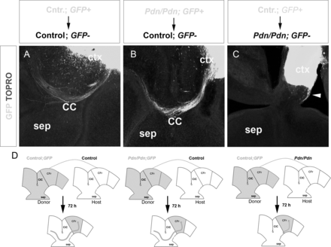
Figure 2. Pdn/Pdn callosal axons are able to cross the cortical midline in a control environment. (A) Transplantation ...
Notes:
Figure 2. Pdn/Pdn callosal axons are able to cross the cortical midline in a control environment. (A) Transplantation of E17.5 control GFP+ frontal cortex leads to the migration of GFP+ callosal axons across the midline (n = 8 of 9). (B) Pdn/Pdn;GFP+ cortex transplantation into control cortex also shows crossing callosal axons (n = 7 of 8). (C) After transplantation of control; GFP+ cortical tissue into Pdn/Pdn; GFP-frontal cortex callosal axons do not project into the intermediate zone (n = 0 of 7), only few axons project along the surface of the mutant tissue (arrowhead; n = 4 of 7). (D) Experimental procedure illustrating transplant experiments: Tissue from the frontal cortex of E17.5 GFP+ embryos was homotopically transplanted into cortical sections of age-matched GFP− embryos and the migration pattern of callosal axons was monitored using GFP immunofluorescence after 72 h of culture.
Unless provided in the caption above, the following copyright applies to the content of this slide: © The Author 2012. Published by Oxford University Press. All rights reserved. For Permissions, please e-mail: journals.permissions@oup.com

Slide 7
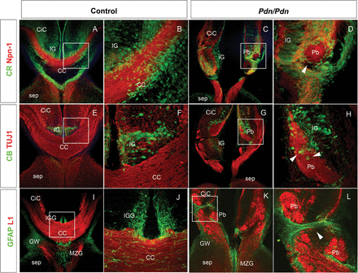
Figure 1. Disorganization of midline structures in P0 Pdn/Pdn brains. (A–D) Npn-1 stains the pioneer axons of the ...
Notes:
Figure 1. Disorganization of midline structures in P0 Pdn/Pdn brains. (A–D) Npn-1 stains the pioneer axons of the cingulate cortex (CiC) in control and Pdn/Pdn mutants. Pdn/Pdn Npn-1+ axons fail to reach the contralateral hemisphere, instead forming Probst bundles (C and D). (A and B) CR labels glutamatergic guidepost neurons. (C and D) In Pdn/Pdn brains, CR+ neurons are disorganized and clusters of CR+ neurons are associated with Probst bundles (arrowhead in D). (E and F) CB labels guidepost neurons located in the IG. (G and H) CB+ neurons abnormally cluster with Tuj1+ callosal axons in the Pdn/Pdn cortex (arrowheads in H). (I–J) GFAP immunofluorescence labels the GW, the IGG, and the MZG in control brains. (K and L) In Pdn/Pdn brains, GFAP+ fascicles are ectopically formed within the CiC (arrowhead in L) and transect the path of callosal axons. The MZG expands into more ventral regions of the septum.
Unless provided in the caption above, the following copyright applies to the content of this slide: © The Author 2012. Published by Oxford University Press. All rights reserved. For Permissions, please e-mail: journals.permissions@oup.com

Slide 8
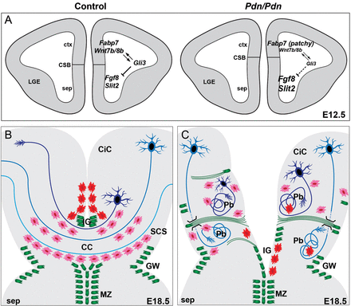
Figure 8. Schematic representation of the major changes during CSB formation and midline crossing of callosal axons in ...
Notes:
Figure 8. Schematic representation of the major changes during CSB formation and midline crossing of callosal axons in Pdn/Pdn mutants. (A) During patterning stages, Gli3 restricts the expression of Fgf8 and Slit2 to the commissural plate and is required for Wnt7b/8b expression in the rostromedial cortex of control embryos thereby establishing the CSB and controlling a balance between Fgf and Wnt/β-catenin signaling. Arrows and lines indicate genetic interactions except for the direct regulation of Gli3 expression by Wnt/β-catenin signaling (Hasenpusch-Theil et al. forthcoming 2012). Reducing Gli3 expression levels in Pdn/Pdn mutants leads to a down-regulation of Wnt7b/8b expression and a concomitant up-regulation of Slit2 expression and Fgf signaling, which in turns results in RGC clustering. (B) Schematic drawing representing the organization of glial cell populations (green) CR+ (pink) and CB+ (red) guidepost neurons in control embryos to channel callosal axons (blue) across the midline. (C) Disorganization of guideposts results in the formation of Probst bundles (Pb) in Pdn/Pdn embryos. Ectopic glial fascicles span the width of the cortex and provide a barrier to the migration of callosal axons. Callosal axons may migrate in and out of the image plane to circumvent the ectopic glial fascicles as indicated by the dotted lines. Guidepost neurons associate with the Probst bundles.
Unless provided in the caption above, the following copyright applies to the content of this slide: © The Author 2012. Published by Oxford University Press. All rights reserved. For Permissions, please e-mail: journals.permissions@oup.com

