Slide 1
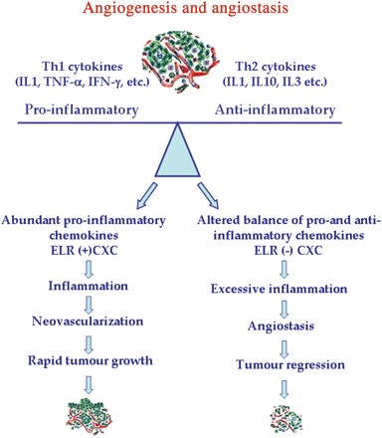
Figure 1 Opposing states of angiogenesis and angiostasis. The balance of cytokines in tumours is critical for ...
Notes:
Figure 1 Opposing states of angiogenesis and angiostasis. The balance of cytokines in tumours is critical for regulating the type and the extent of inflammatory infiltration. Cytokines produced by tumours and chemokines regulate neoplastic outcome by directing angiostasis or angiogenesis. Angiogenesis is the result of an imbalance in the over-abundance of angiogenic factors compared with relative under-expression of angiostatic factors that determines rapid tumour growth. Angiostasis is associated with high levels of monocyte and/or neutrophil infiltration in response to an altered balance of pro-inflammatory vs. anti-inflammatory cytokines.13
Unless provided in the caption above, the following copyright applies to the content of this slide: Published on behalf of the European Society of Cardiology. All rights reserved. © The Author 2008. For permissions please email: journals.permissions@oxfordjournals.org

Slide 2
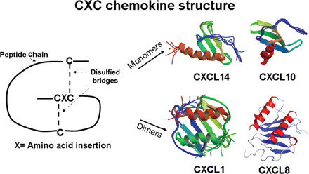
Figure 2 CXC chemokine structure. Examples of ribbon diagram structures of chemokines solved by X-ray crystallography ...
Notes:
Figure 2 CXC chemokine structure. Examples of ribbon diagram structures of chemokines solved by X-ray crystallography as monomers (CXCL10, 14) and dimers (CXCL1, 8). The general structure of CXC chemokine monomers (CXCL10, 14) consists of a three-stranded anti-parallel β-sheet that ends in a C-terminal helix (red). Many CXC chemokines also form dimers, higher-order homo-oligomers, and hetero-oligomers. Dimer structures (CXCL1, 8) consist of a six-stranded antiparallel β-sheet packed against two C-terminal antiparallel α-helices.
Unless provided in the caption above, the following copyright applies to the content of this slide: Published on behalf of the European Society of Cardiology. All rights reserved. © The Author 2008. For permissions please email: journals.permissions@oxfordjournals.org

Slide 3
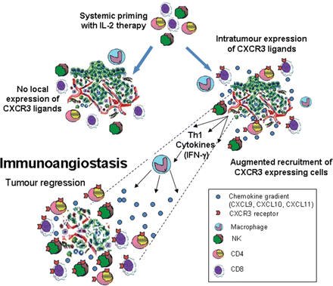
Figure 3 Priming and induction steps are necessary for the full induction of immunoangiostasis. Systemic IL-2 promotes ...
Notes:
Figure 3 Priming and induction steps are necessary for the full induction of immunoangiostasis. Systemic IL-2 promotes the expression of CXCR3 on mononuclear cells, and the induction of the local expression of CXCR3 ligands within the tumour leads to the establishment of a chemotactic gradient for mononuclear cells expressing CXCR3, which concomitantly promotes angiostasis. The combined two steps of systemic priming for mononuclear cell expression of CXCR3 and local induction of CXCR3 ligand expression fully establishes immunoangiostasis.
Unless provided in the caption above, the following copyright applies to the content of this slide: Published on behalf of the European Society of Cardiology. All rights reserved. © The Author 2008. For permissions please email: journals.permissions@oxfordjournals.org

