Slide 1
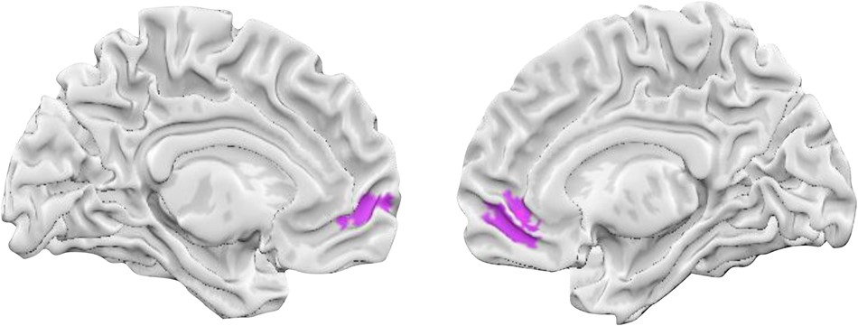
Figure 1. Neural activity in ventromedial prefrontal cortex. The figure illustrates portions of the ventromedial ...
Notes:
Figure 1. Neural activity in ventromedial prefrontal cortex. The figure illustrates portions of the ventromedial prefrontal cortex that responded as predicted by a bipolar model of affect. The bipolar model predicts the presence of neural regions that respond more frequently during positive versus negative contrasts than during positive versus neutral contrasts. No regions were observed that responded more during negative versus positive contrasts than during negative versus neutral. The activations shown are FWER corrected for clusters observed across the whole brain. The maximum voxel was also observed at voxel-wise FDR correction across the whole brain (MNI = [9, 39, −9]).
Unless provided in the caption above, the following copyright applies to the content of this slide: © The Author 2015. Published by Oxford University Press. All rights reserved. For Permissions, please e-mail: journals.permissions@oup.com

Slide 2
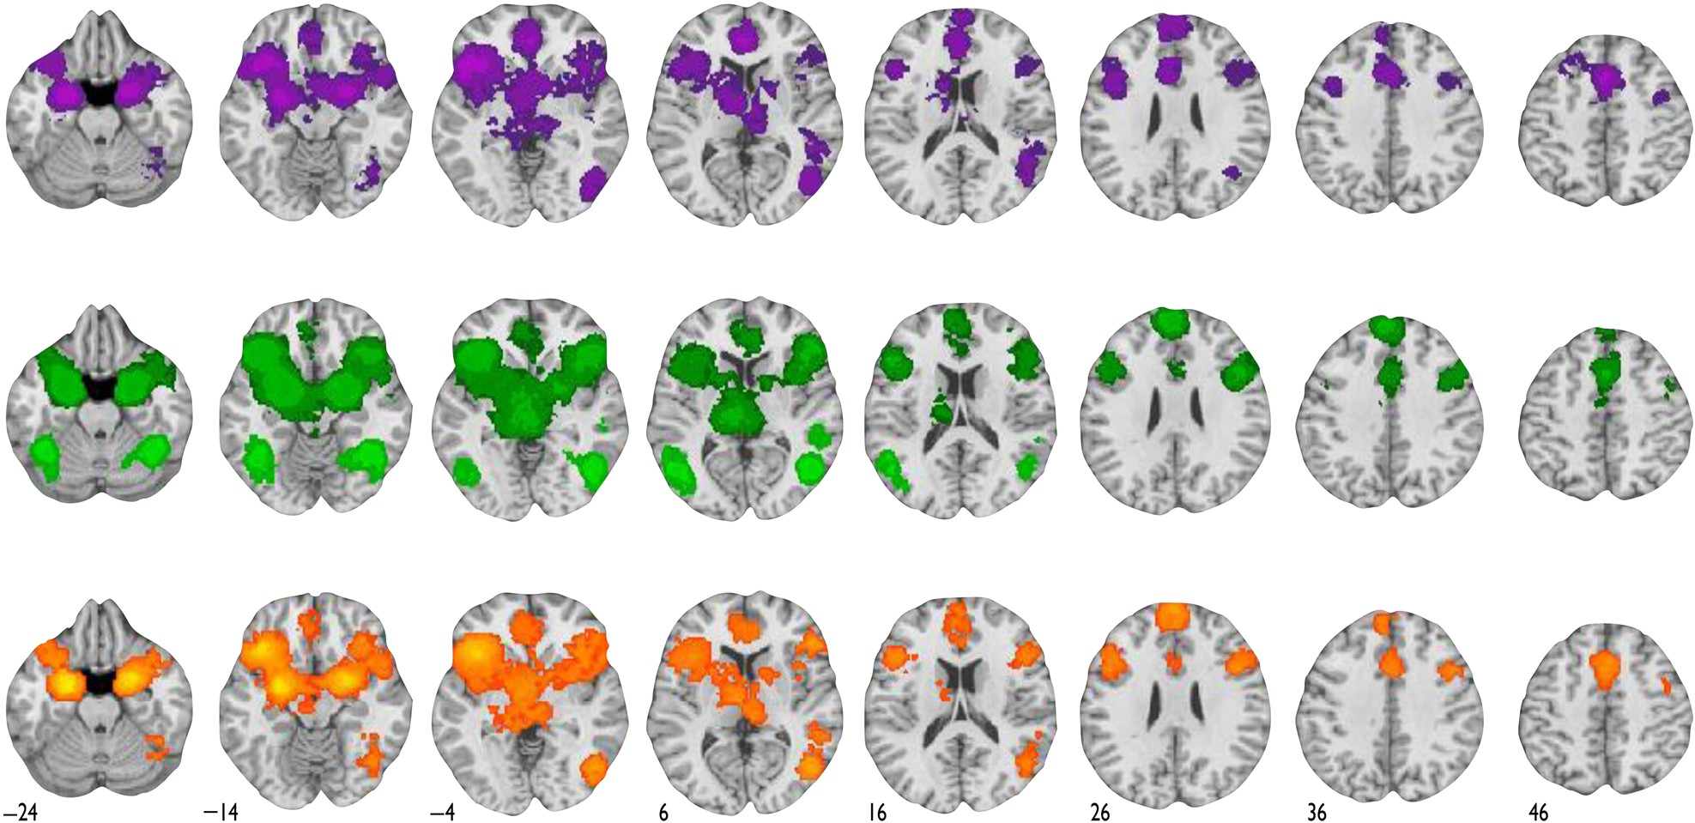
Figure 2. Neural regions consistently associated with valence-general activations. The top and middle rows of the ...
Notes:
Figure 2. Neural regions consistently associated with valence-general activations. The top and middle rows of the figure illustrate regions that were frequently correlated with positive versus neutral study contrasts (illustrated in purple) and negative versus neutral study contrasts (illustrated in green), respectively. For these maps, the color codes reflect whole-brain statistical correction at the voxel level (bright purple and bright green) using FDR procedures, or at 2 different cluster-level thresholds (given voxel-level P-values of 0.05 and 0.01; see Materials and Methods) using FWER procedures. The bottom row of the figure illustrates valence-general neural regions. These regions were frequently engaged by both positive versus neutral study contrasts and by negative versus neutral study contrasts, as revealed by a conjunction analysis. In common, contrasts that compare positive or negative valence with neutral baselines engage several regions including the dorsomedial prefrontal cortex, supplementary motor area, ventrolateral prefrontal cortex, anterior insula, amygdala, ventral striatum, and thalamus. See Supplementary Figure 1 for additional views of the valence-general regions.
Unless provided in the caption above, the following copyright applies to the content of this slide: © The Author 2015. Published by Oxford University Press. All rights reserved. For Permissions, please e-mail: journals.permissions@oup.com

Slide 3
Figure 3. Neural regions exhibiting a preference for negative affect. The figure shows that portions of the left ...
Notes:
Figure 3. Neural regions exhibiting a preference for negative affect. The figure shows that portions of the left anterior insula and amygdala extending into the anterior hippocampus exhibited more frequent preference to negative affect among regions already shown to respond in a valence-general fashion. The analysis examined negative versus positive study contrasts while masking in regions that were already active in the intersection between negative versus neutral contrasts and positive versus neutral contrasts. The activations shown are FWER corrected for clusters observed across the whole brain. A voxel in the left amygdala was also observed at voxel-wise FDR correction across the whole brain (MNI = [−18, −3, −24]).
Unless provided in the caption above, the following copyright applies to the content of this slide: © The Author 2015. Published by Oxford University Press. All rights reserved. For Permissions, please e-mail: journals.permissions@oup.com

