Slide 1
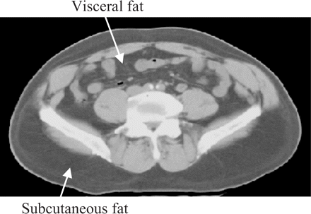
Figure 1 Cross-section of the abdomen in which subcutaneous and visceral fat can be distinguished. Lighter-coloured ...
Notes:
Figure 1 Cross-section of the abdomen in which subcutaneous and visceral fat can be distinguished. Lighter-coloured areas are muscles, bones, and organs
Unless provided in the caption above, the following copyright applies to the content of this slide: Published by Oxford University Press on behalf of the International Epidemiological Association © The Author 2005; all rights reserved.

