Slide 1
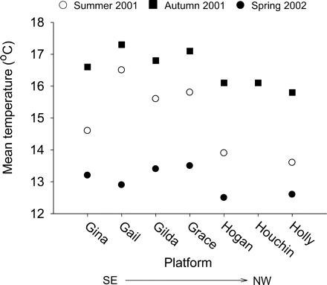
Figure 3. Water temperature at the study platforms during summer and autumn 2001, and spring 2002. Platforms are listed ...
Notes:
Figure 3. Water temperature at the study platforms during summer and autumn 2001, and spring 2002. Platforms are listed along the x-axis from the most southeast (Gina) to the most northwest (Holly) in the SBC.
Unless provided in the caption above, the following copyright applies to the content of this slide: © 2008 International Council for the Exploration of the Sea. Published by Oxford Journals. All rights reserved. For Permissions, please email: journals.permissions@oxfordjournals.org

Slide 2
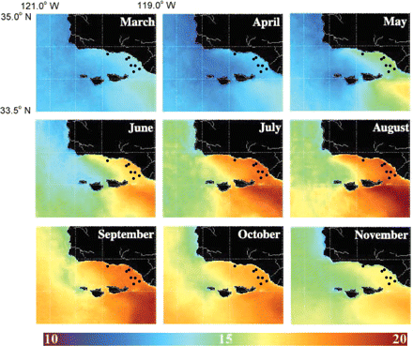
Figure 2. Monthly mean sea surface temperature (SST) derived from satellite images, October 1997 to June 2001, showing ...
Notes:
Figure 2. Monthly mean sea surface temperature (SST) derived from satellite images, October 1997 to June 2001, showing the intrusion of warm water from the Southern California Bight into the SBC starting in spring. Figure modified from Otero and Siegel (2004). Black dots show approximate locations of sampled offshore oil platforms.
Unless provided in the caption above, the following copyright applies to the content of this slide: © 2008 International Council for the Exploration of the Sea. Published by Oxford Journals. All rights reserved. For Permissions, please email: journals.permissions@oxfordjournals.org

Slide 3
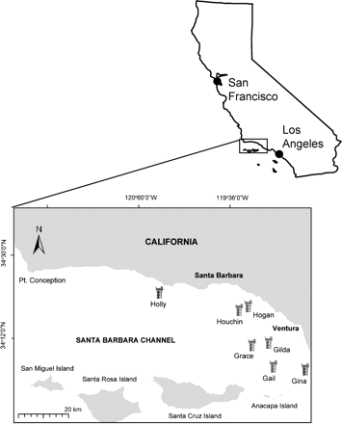
Figure 1. The Santa Barbara Channel and locations of the seven offshore oil and gas platforms sampled in this study.
Notes:
Figure 1. The Santa Barbara Channel and locations of the seven offshore oil and gas platforms sampled in this study.
Unless provided in the caption above, the following copyright applies to the content of this slide: © 2008 International Council for the Exploration of the Sea. Published by Oxford Journals. All rights reserved. For Permissions, please email: journals.permissions@oxfordjournals.org

Slide 4
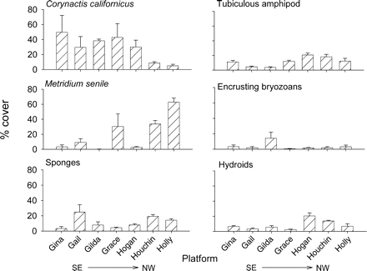
Figure 4. Percentage cover of the anemones, Corynactis californicus and Metridium senile, sponges, tubiculous ...
Notes:
Figure 4. Percentage cover of the anemones, Corynactis californicus and Metridium senile, sponges, tubiculous amphipods, encrusting bryozoans, and hydroids among study platforms. Data were derived for each leg or conductor pipe from photoplots taken inside and outside, and across depths of 12, 18, and 24 m. Data for encrusting bryozoans include the exotic species Watersipora subtorquata recorded only from platform Gilda. Mean values ± 1 s.e.
Unless provided in the caption above, the following copyright applies to the content of this slide: © 2008 International Council for the Exploration of the Sea. Published by Oxford Journals. All rights reserved. For Permissions, please email: journals.permissions@oxfordjournals.org

Slide 5
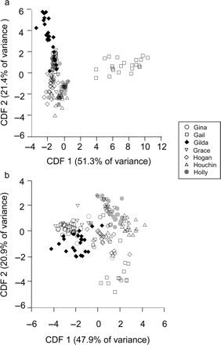
Figure 5. Results of canonical DFA of invertebrate assemblages on the seven study platforms: (a) all species, (b) ...
Notes:
Figure 5. Results of canonical DFA of invertebrate assemblages on the seven study platforms: (a) all species, (b) exotic species excluded. Each data point represents one leg or conductor pipe.
Unless provided in the caption above, the following copyright applies to the content of this slide: © 2008 International Council for the Exploration of the Sea. Published by Oxford Journals. All rights reserved. For Permissions, please email: journals.permissions@oxfordjournals.org

Slide 6
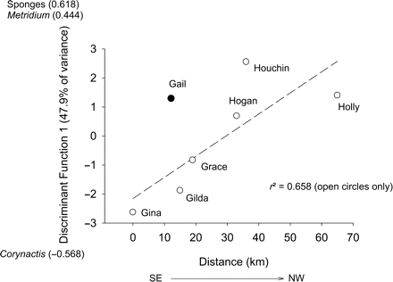
Figure 6. Relationship between CDF1 and location of platforms along the SBC. The r² value was calculated ...
Notes:
Figure 6. Relationship between CDF1 and location of platforms along the SBC. The r2 value was calculated excluding data from platform Gail. Taxa most positively or negatively correlated with CDF1 are also shown on the y-axis.
Unless provided in the caption above, the following copyright applies to the content of this slide: © 2008 International Council for the Exploration of the Sea. Published by Oxford Journals. All rights reserved. For Permissions, please email: journals.permissions@oxfordjournals.org

Slide 7
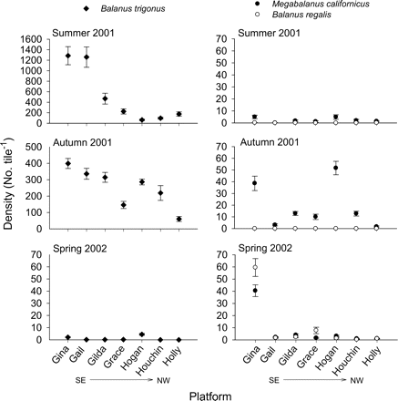
Figure 7. Recruitment of barnacles, Balanus trigonus, Megabalanus californicus, and B. regalis onto ceramic tiles ...
Notes:
Figure 7. Recruitment of barnacles, Balanus trigonus, Megabalanus californicus, and B. regalis onto ceramic tiles deployed at a depth of 15 m for ∼3 months at each platform. n = 4 per platform. Mean values ± 1 s.e.
Unless provided in the caption above, the following copyright applies to the content of this slide: © 2008 International Council for the Exploration of the Sea. Published by Oxford Journals. All rights reserved. For Permissions, please email: journals.permissions@oxfordjournals.org

Slide 8
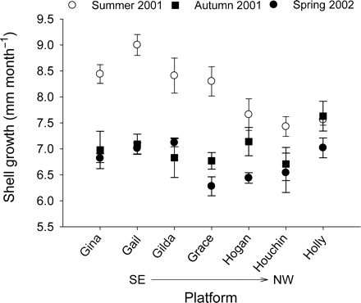
Figure 8. Growth rate of mussels, Mytilus galloprovincialis, in cages deployed at a depth of 15 m for ∼3 months at each ...
Notes:
Figure 8. Growth rate of mussels, Mytilus galloprovincialis, in cages deployed at a depth of 15 m for ∼3 months at each platform. Mean initial shell length of mussels was ∼30 mm. n = 4 cages of ten mussels at each platform.
Unless provided in the caption above, the following copyright applies to the content of this slide: © 2008 International Council for the Exploration of the Sea. Published by Oxford Journals. All rights reserved. For Permissions, please email: journals.permissions@oxfordjournals.org

